Slide 1
3D Visualization
Desi Dwi Kristanto, M.Ds.

Slide 2
Shape Based Modeling

Slide 3
Modify
Create → Shapes

Slide 4
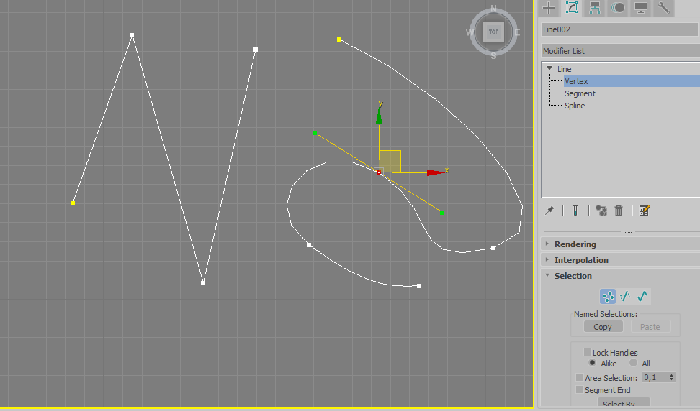

Slide 6
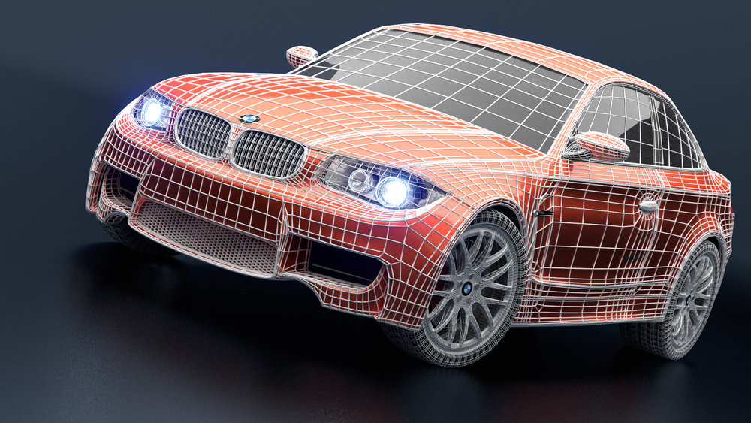

Slide 7
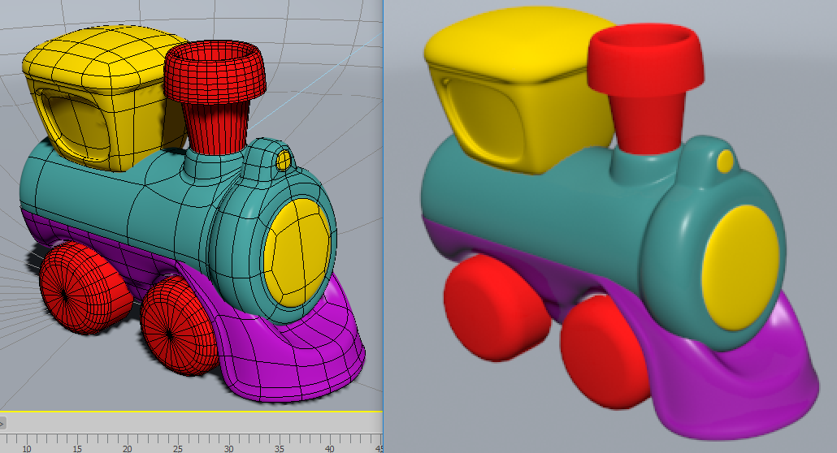

Slide 8
Polygon Modeling
Converting object to editable poly

Slide 9
Polygon Modeling
Transform sub-object (vertex/edge/polygon) using move-rotate-scale

