Slide 1

VCD102 - Gambar Desain
Desain Komunikasi VIsual
Desi Dwi Kristanto, M.Ds.

Slide 2
Gambar Proyeksi
Proyeksi Isometri
Proyeksi Dimetri
Proyeksi Trimetri
Proyeksi Ortogonal

Slide 3
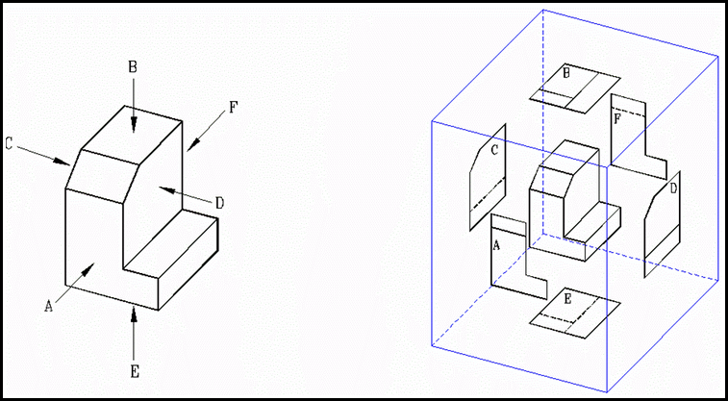
Proyeksi Ortogonal
Proyeksi Amerika
  A : Pandangan depan.
  B : Pandangan atas.
  C : Pandangan kiri.
  D : Pandangan kanan.
  E : Pandangan bawah.
  F : Pandangan belakang.

Slide 4
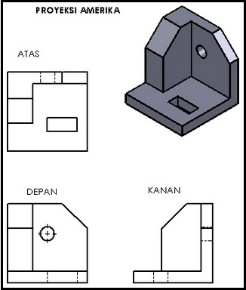
Proyeksi Ortogonal
Proyeksi Amerika

Slide 5
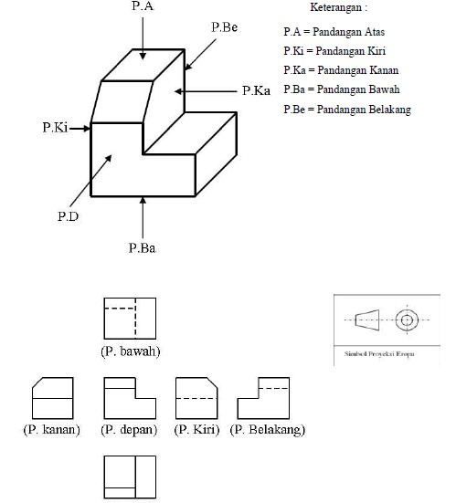
Proyeksi Ortogonal
Proyeksi Eropa

Slide 6
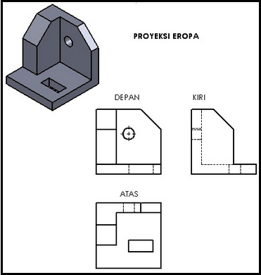
Proyeksi Ortogonal
Proyeksi Amerika

Slide 7
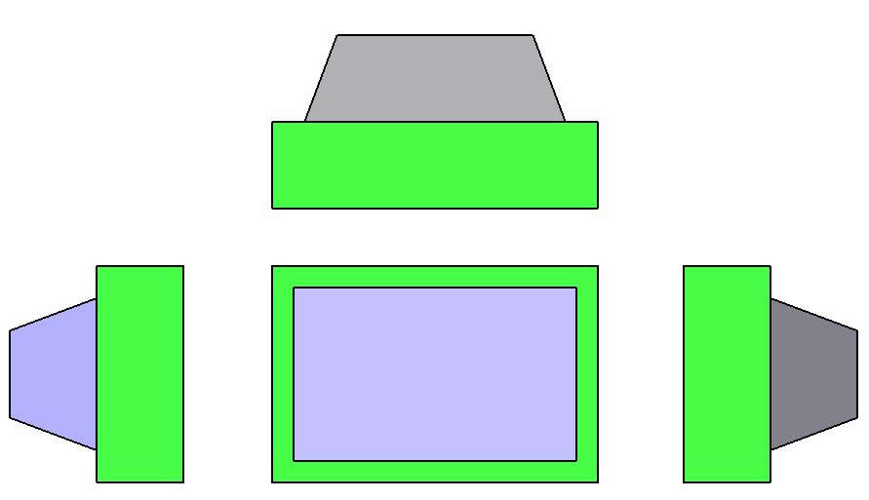

Slide 8
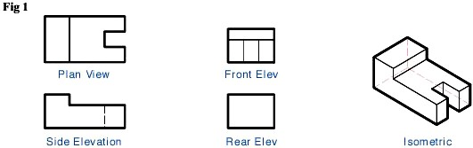

Slide 9
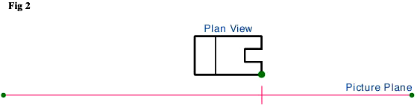

Slide 10
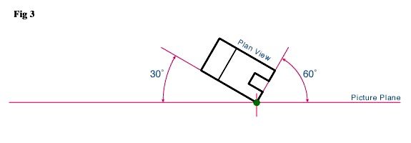
Place the lower right corner of Plan View on the PP and rotate it clockwise.The choice of 30° is arbitrary, but should provide a good view

Slide 11
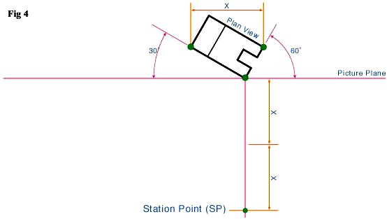
STEP 4
In Fig. 4 we will locate the Station Point. Measure the horizontal width of our Plan View (X) and double it. Extend a vertical line from the corner that touches the Picture Plane downward.At two times X we will locate the Station Point.

Slide 12
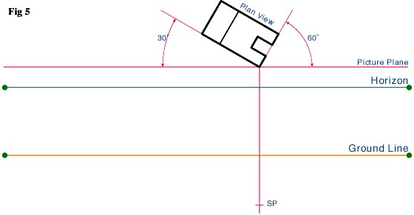
STEP 5
Draw lines for the Horizon and Ground Line Fig. 5.The
location of these lines are infinitely variable.

Slide 13
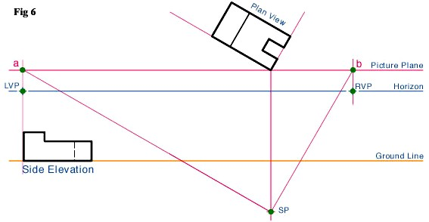
STEP 6
Draw 2 lines from the SP that are parallel to the bottom edges of the Plan View Fig 6.The lines should intersect with the PP (points a & b). Next draw vertical lines from points a & b to the HL.The point where these vertical lines intersect the HL is where the left and right vanishing points (VPL & VPR) will be located.

Slide 14
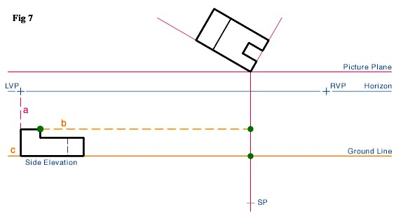
STEP 7
The last part of preliminary layout will be to place the Side Elevation view from Fig. 1 onto the GL. Project a line (orange dashed line b) from the top of the Elevation View to the vertical Line Of Sight (LS) Fig. 7.

Slide 15
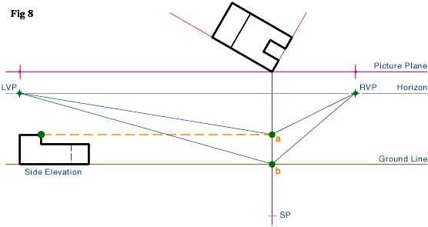
STEP 8
We are now ready to start projecting lines to the vanishing points. Referring to Fig. 8, draw lines from both vanishing points (VPL & VPR) to the top and bottom reference points of our subject (points a & b).

Slide 16
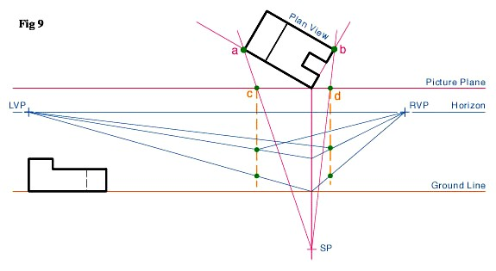
STEP 9
To locate the vertical lines on our subject, draw lines from the SP to corners a & b on the Plan View Fig. 9.At the point where these lines intersect the PP, draw vertical lines (orange dashed lines) downward to intersect the vanishing point projection lines.

Slide 17
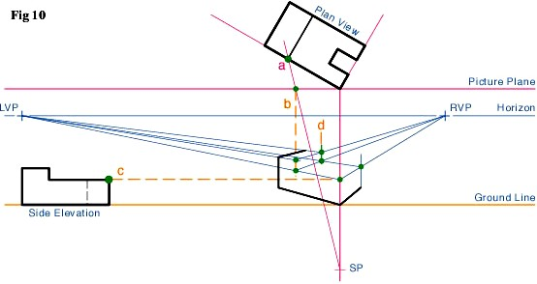
2-Point perspective drawing
STEP 10
Using the same procedure as shown in Fig. 9, find the smaller features on the subject in both the Plan View and the Elevation View (a & c) in Fig. 10.

Slide 18
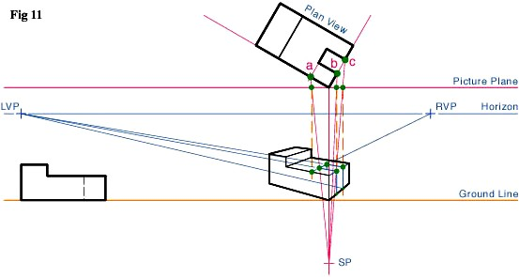
2-Point perspective drawing
STEP 11
Project the smaller features on the subject in both the Plan
View towards the vanishing point projection lines Fig. 11.

Slide 19
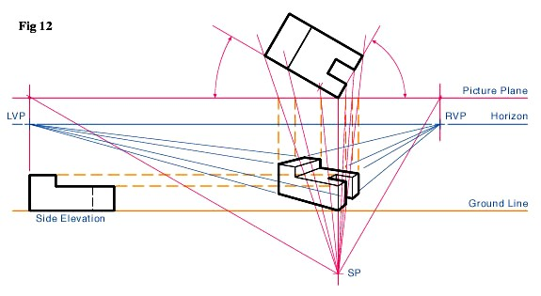
2-Point perspective drawing
STEP 12
The last step is to darken the object's construction lines, and heavy in the visible final edge lines, to increase readability Fig. 12.

