Slide 1



Slide 2
What opportunities have arisen for women since the passing of Title IX?

Slide 3

In 1950s and ’60s women were usually cheerleaders.
Women were taught to be housewives.
If women played sports it was seen as proof of
lesbianism.
Cheerleaders were given more attention than other women atheletes.

Slide 4
In 1971, fewer than 295,000 girls participated in high school varsity sports.
Only 16,000 female athletes participated in intercollegiate sports in 1971.

Slide 5
“No person in the United States shall, on the basis of sex, be excluded from participation in, be denied benefits of, or be subjected to discrimination under any education program or activity receiving Federal financial
assistance.”

Slide 6
Part of the Education Amendments of 1972
A Law passed on June 23, 1972
Covers 10 aspect of education

Slide 7
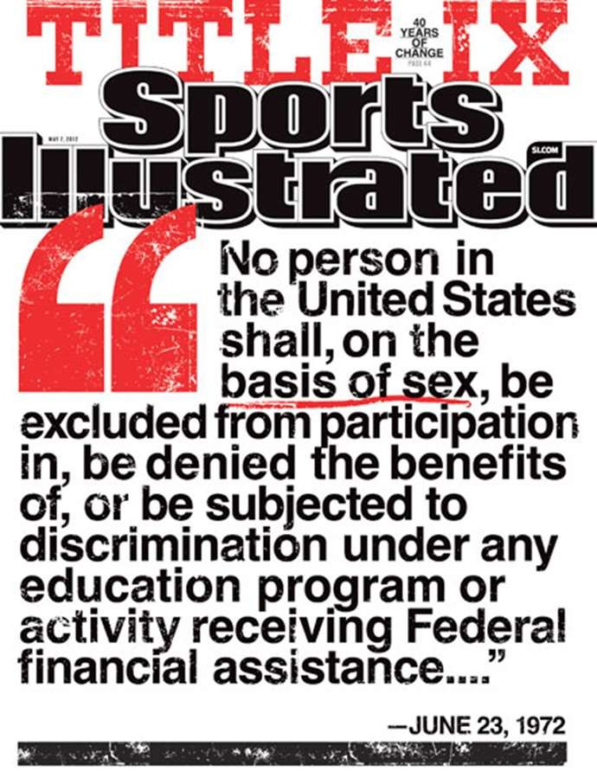
Cover of Sports Illustrated Magazine on May 7, 2012, in honor of the 40- year anniversary.

Slide 8



The Women’s National Basketball Association was started with the help of former NBA commissioner David Stern.
  12 teams
  Get television coverage
National Pro Fastpitch
  Started in 1997
  4 teams

Slide 9
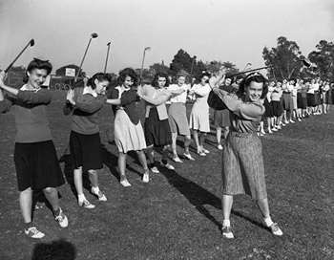

Ladies Professional Golf Association
  1950
  Started by 13 women who wanted to play golf
Women’s Tennis Association
  1970 with 9 women
  1973 by Billie Jean King

Slide 10

Today young girls have so many women athletes they can look up and hope to be like one day because of Title IX
Tennis – Venus and Serena Williams
Basketball- Sheryl Swoopes
Golf- Stacy Lewis
Soccer- Hope Solo
Softball- Jennie Finch

Slide 11



Born June 17, 1980
Turned Pro on October 31, 1994
Won both U.S. Open and Wimbledon in 2000 and 2001.

Slide 12
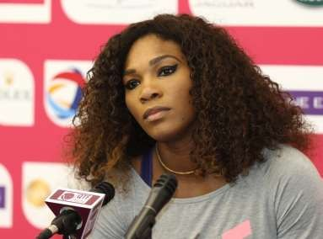

Born September 20, 1981
Turned Pro in 1995
Has won 23 Grand Slam titles

Slide 13


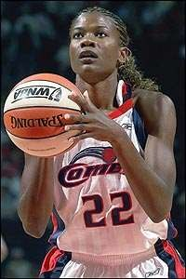
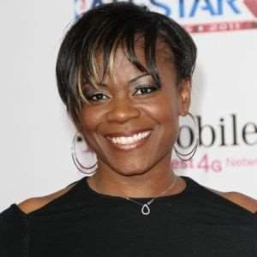
Born on March 25, 1971
Won gold medal in 1996 Olympics
Signed with WNBA in 1997 with Houston Comets
Head coach at Loyola University in Chicago

Slide 14

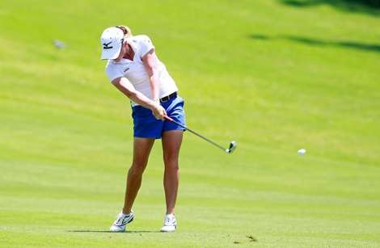
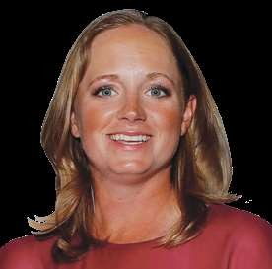
Stacy started playing golf at age eight.
Graduated from University of Arkansas in 2008.
Turned Pro that same year.
Rolex Player of the Year in 2012.

Slide 15

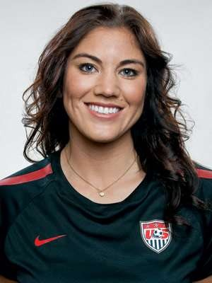
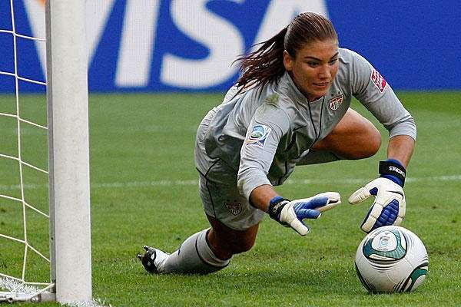
Born on July 30, 1981
Started out as a forward on high school team
In 2005 became Team U.S.A.’s top goalkeeper
Helped U.S. Women’s soccer team win gold in the Olympics in 2008 and 2012.

Slide 16



Born on September 30, 1980
Started pitching at the age of 8.
Attended University of Arizona
Played for the NPF team Chicago Bandits
Co-Pitcher of the Year in 2005.

Slide 17
Title IX has still not created equal status for women in athletics today.
Title IX still needs to help women get equal pay in professional leagues, get more air time, and equal scholarship money for colleges.

Slide 18

http://cnnsi.com/vault/cover/toc/11734/index.htm
http://www.lpga.com/tcp/historytcp.aspx
http://www.wtatennis.com/scontent/article/2951989/title/a bout-the-wta
http://www.peoplequiz.com/trivia-quizzes-3666- WNBA_Team_Names.html
http://www.nationalsportsclinics.com/New%20Pages/link. html
http://www.biography.com/people/venus-williams- 9533011#awesm=~oFXbJTfwLnKX3k
http://jenniefinch.com/career-highlights

Slide 19
http://uptownmagazine.com/2011/11/venus-williams-to-make-
return-against-serena/
http://en.wikipedia.org/wiki/2013_Serena_Williams_tennis_sea son
http://www.biography.com/people/sheryl-swoopes- 9542142#awesm=~oFXeINQiOo6KqS
http://www.wnba.com/features/swoopes_texas_tech.html
http://www.lpga.com/golf/players/l/stacy-lewis.aspx
http://www.kpmg.com/us/en/about/sponsorships/pages/stacyle wis.aspx
http://www.flatheadbeacon.com/articles/article/hope_arrives/32
449
http://iameviltebow.com/manliest-female-athletes-2/1hopesolo/

