Slide 1
How to Survive KP

Slide 2
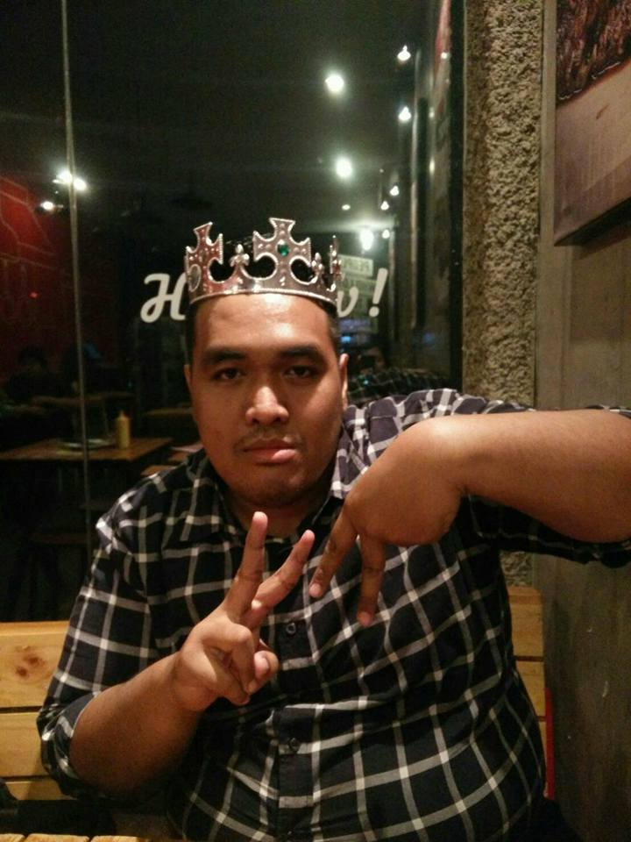
Hello!
I am Dimas Wahyu Bagasworo
I am here because I want to share my time I spent interning.
You can find me at:
@roflpaladin on Twitter or IG

Slide 3
Rules of thumb on creating a CV
Keep it ONE PAGE, two page max.
Professional picture or no picture. Don’t use selfies or etc
Never ever EVER use a plain bulleting format. Browse the web for an attractive but professional template.
Be REALISTIC about your skills.
Be HONEST about your past experience.
Anything achieve before high school means NOTHING

Slide 4
Rules of thumb on interviewing
Show up 15 minutes before scheduled appointment
Dress professionally while being attractive
Chew peppermint gum
PERFUME AND DEODORANT
Profesionally styled hair
Keep eye contact with the interviewer, be HONEST when answering
Ask questions (take notes on what to ask)

Slide 5
How did I get here?
1st
I wanted to work in a leisez-faire environment with an autonomous working environment or a psychological clinic.
2nd
Initially, I applied to many companies:
Tokopedia
Google
PwC
Bain & Company
Ernst&Young
Experd
Traveloka
Etc (20+ more)
3rd
Of course I failed to get into those companies (to be fair, Bain & Company did want me).

Slide 6
Expectations
No pay
Leisez-faire envinronment
Work what you wanna work on
No hierarchy
Surrounded by brilliant minds in psychology
Intellectual conversations
Cool discussions

Slide 7
What kind of work you do there?

Slide 8
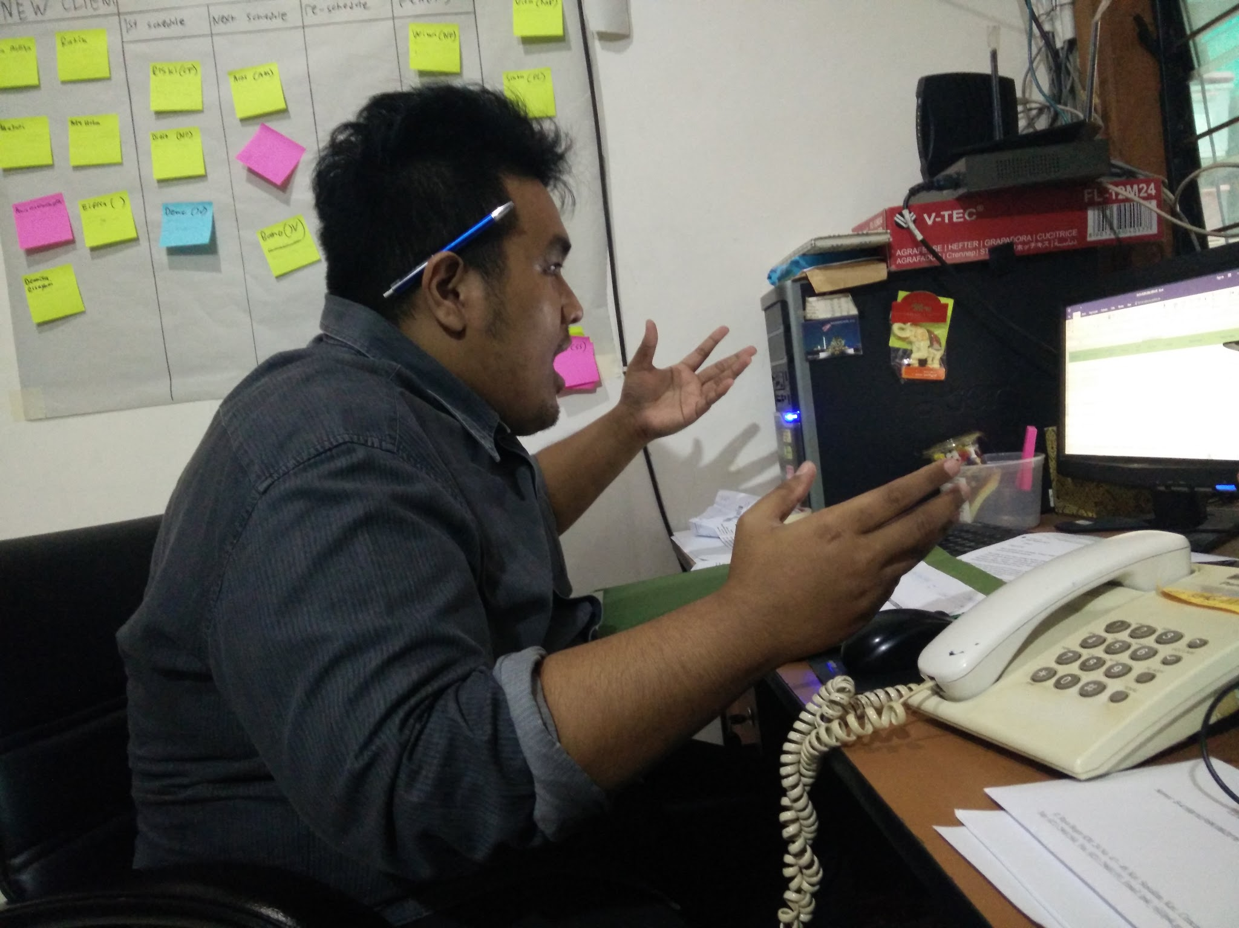
Pendataan klien (dan panik)

Slide 9
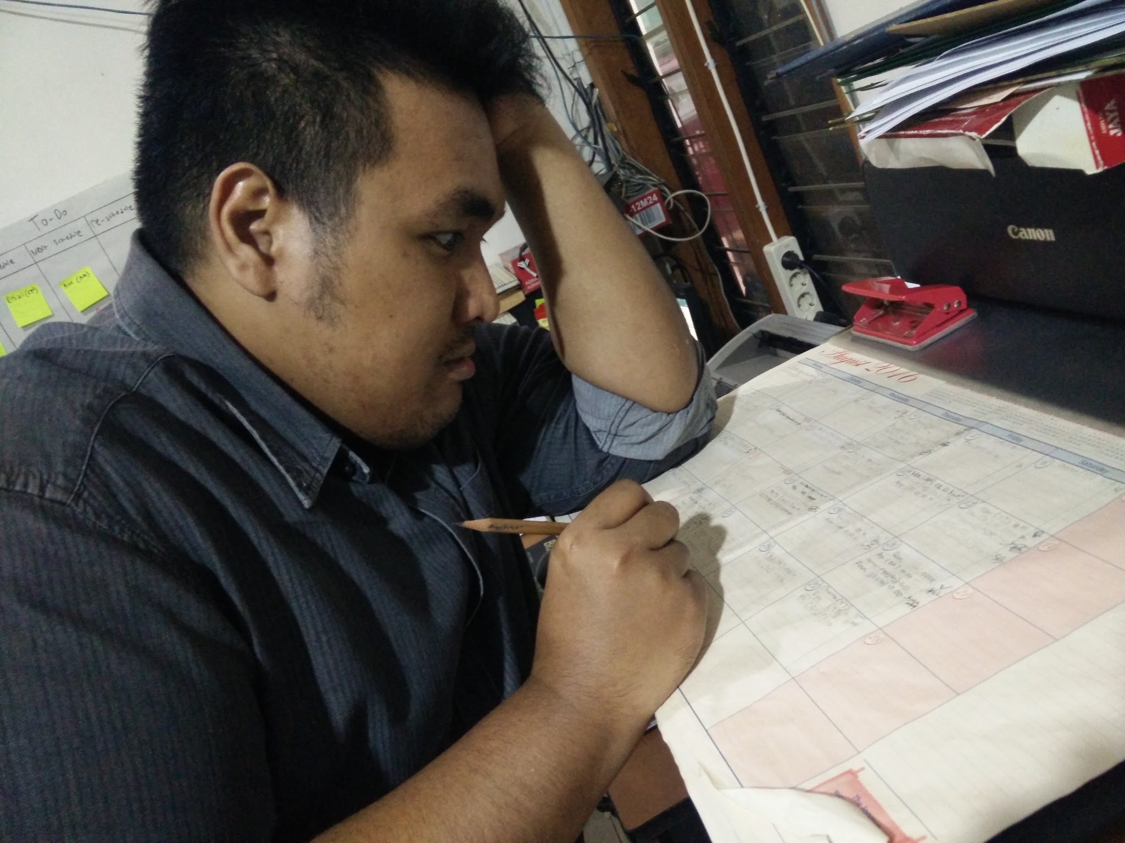
Pendaftaran jadwal konseling (dan panik)

Slide 10
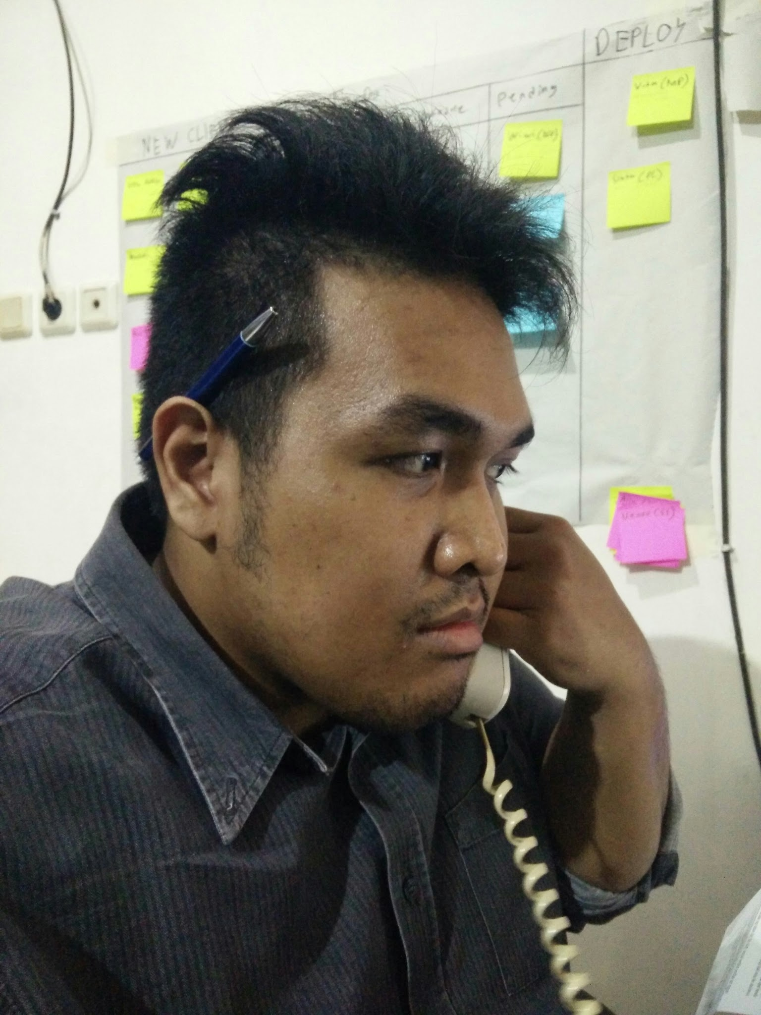
Telfon klien dan psikolog

Slide 11
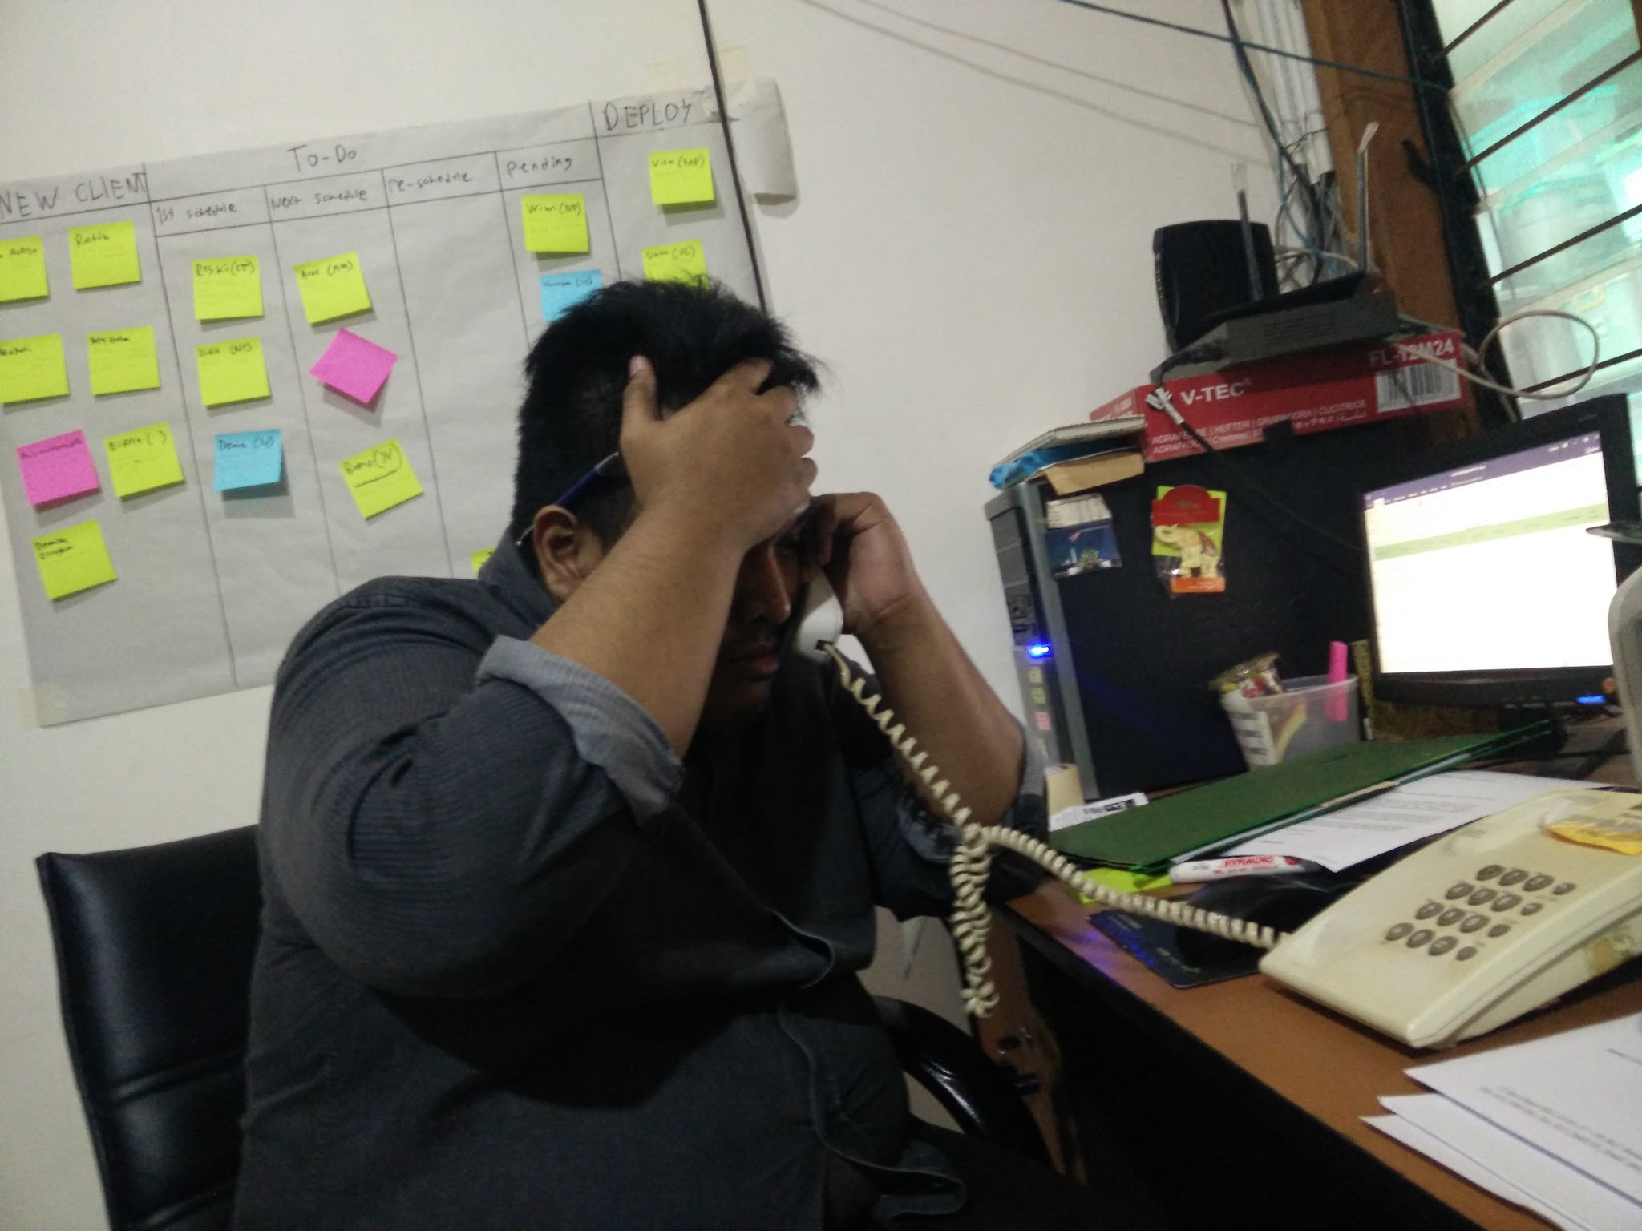
Salah penjadwalan

Slide 12
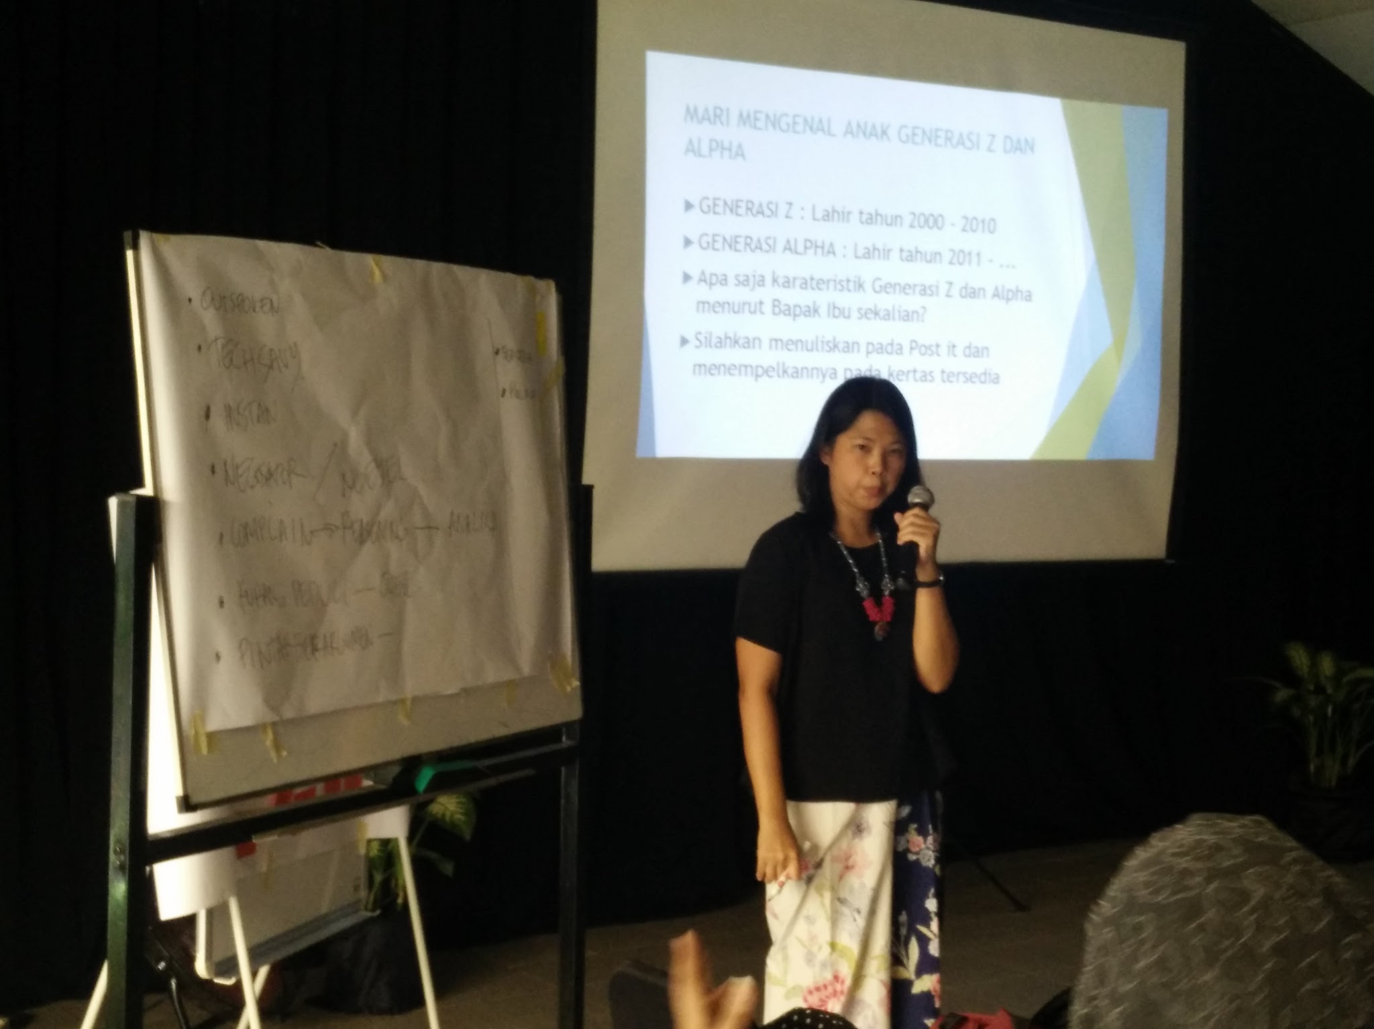
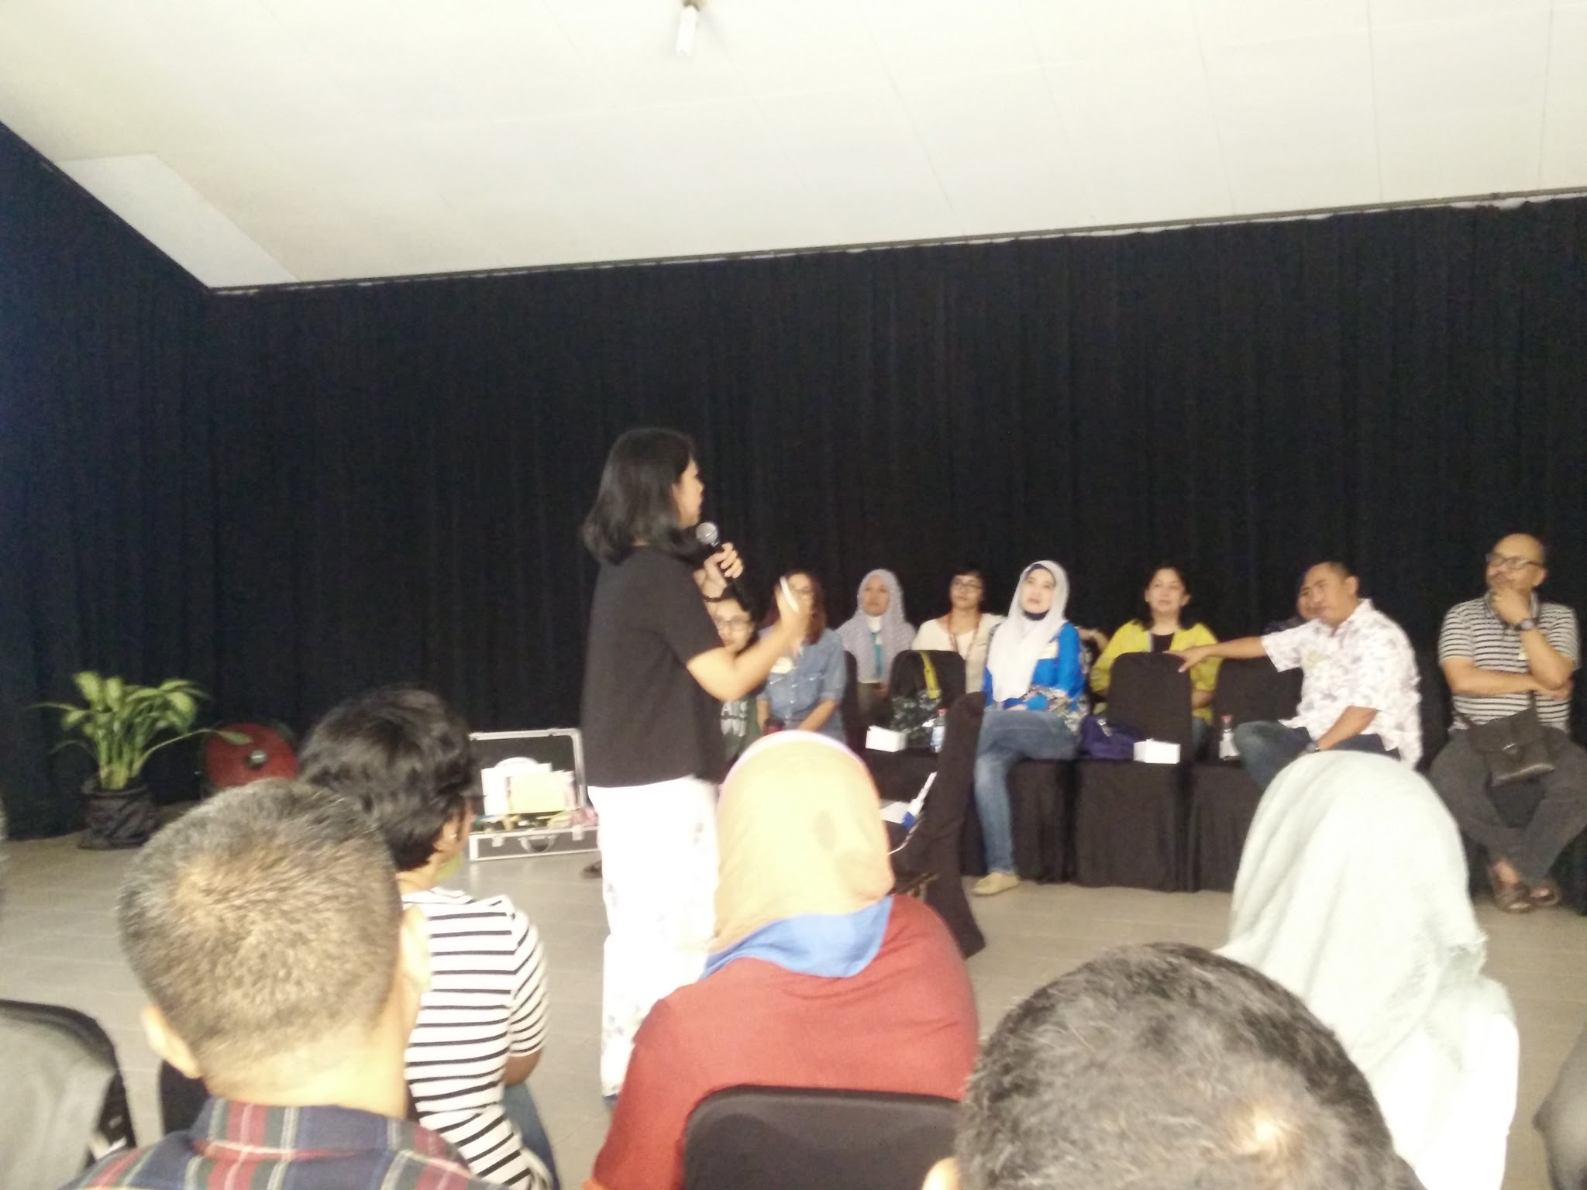
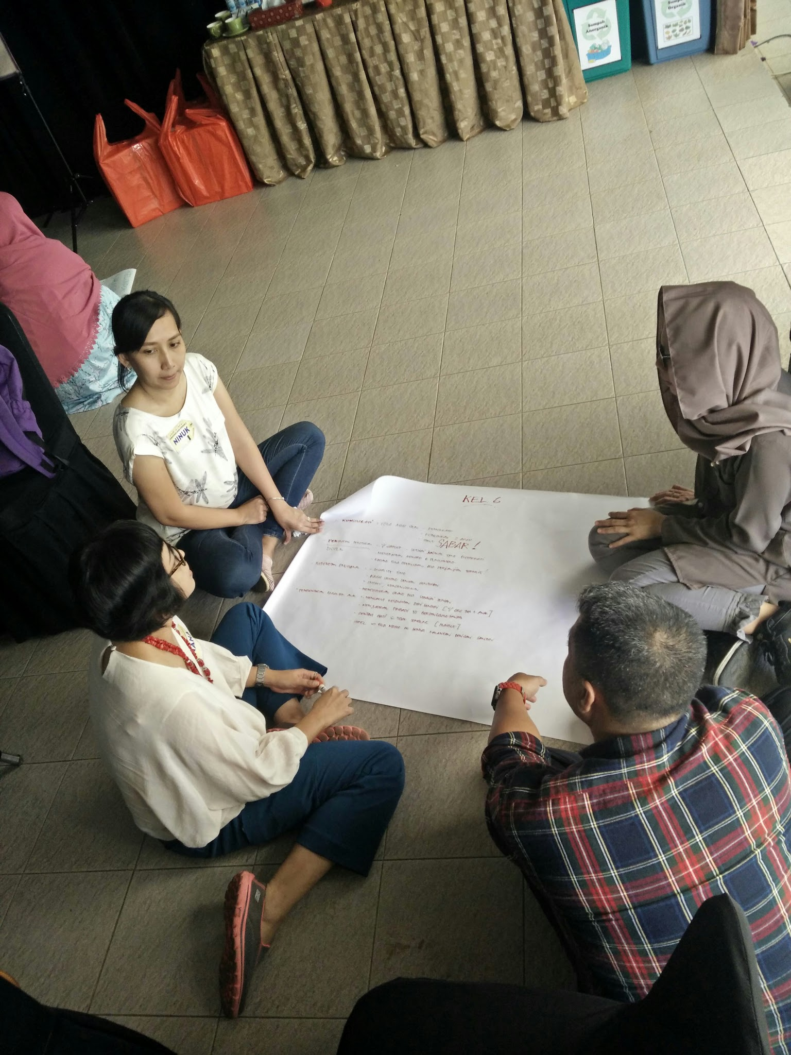
Workshop Generasi Z

Slide 13
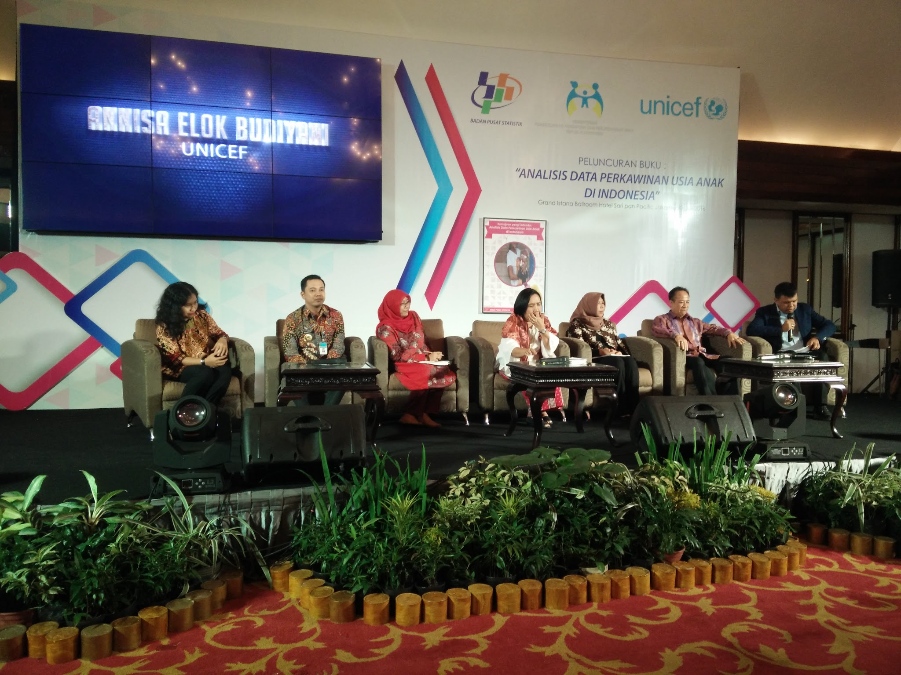
Launching Buku dari BPS

Slide 14
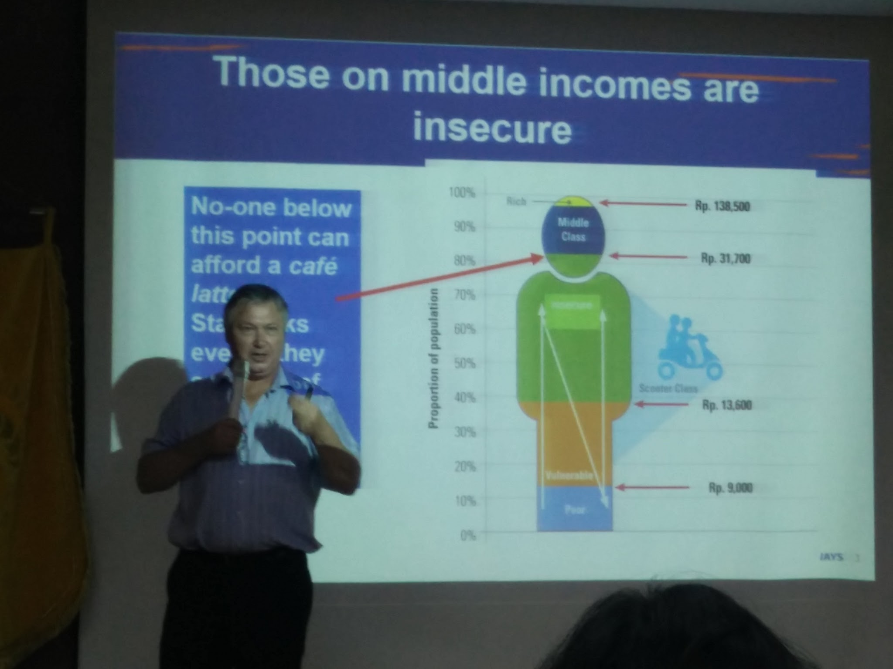
Acara Puskapa

Slide 15
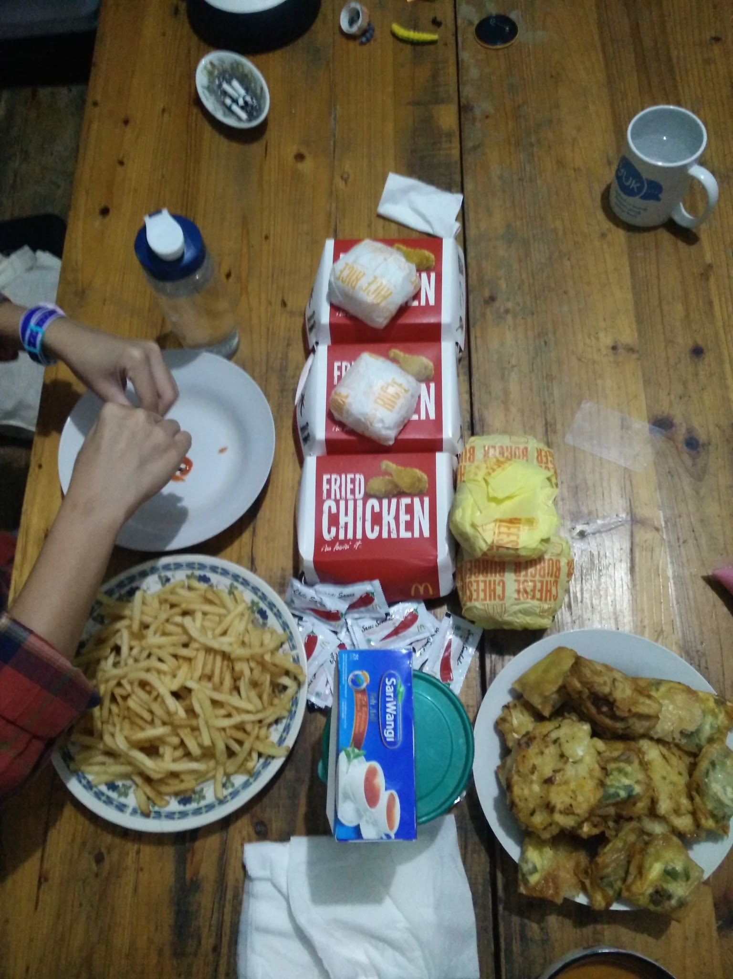
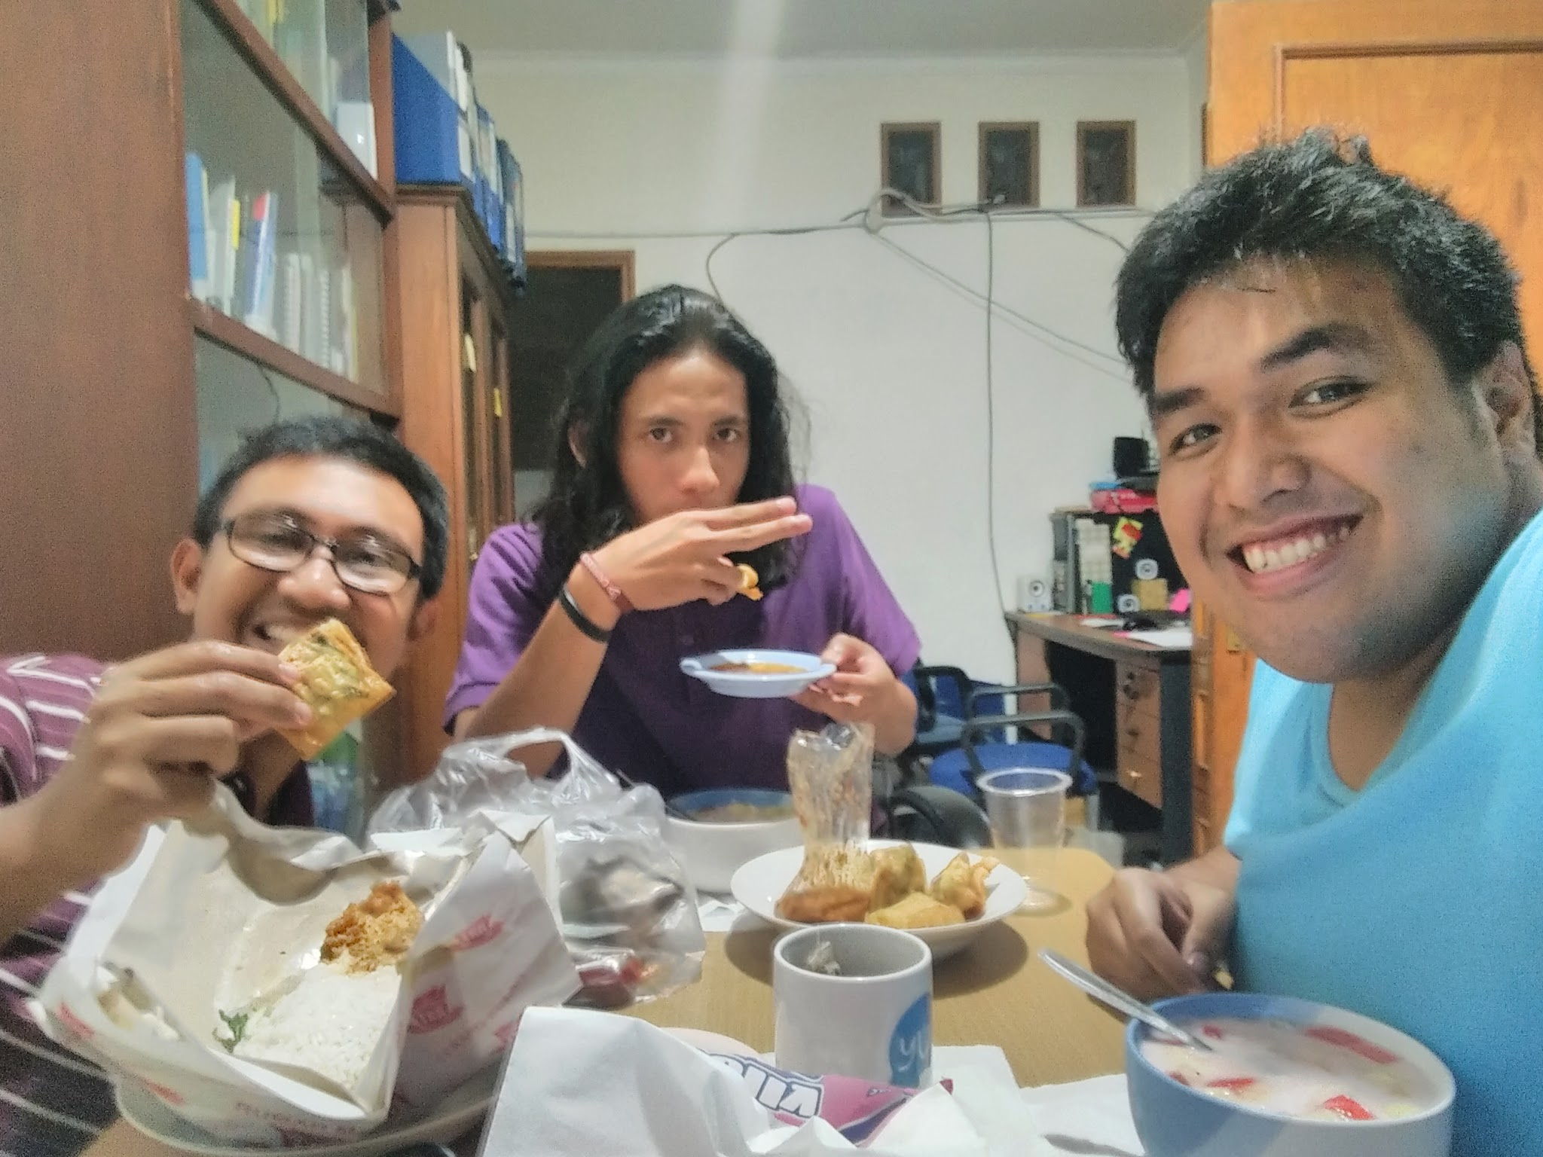
Makan

Slide 16
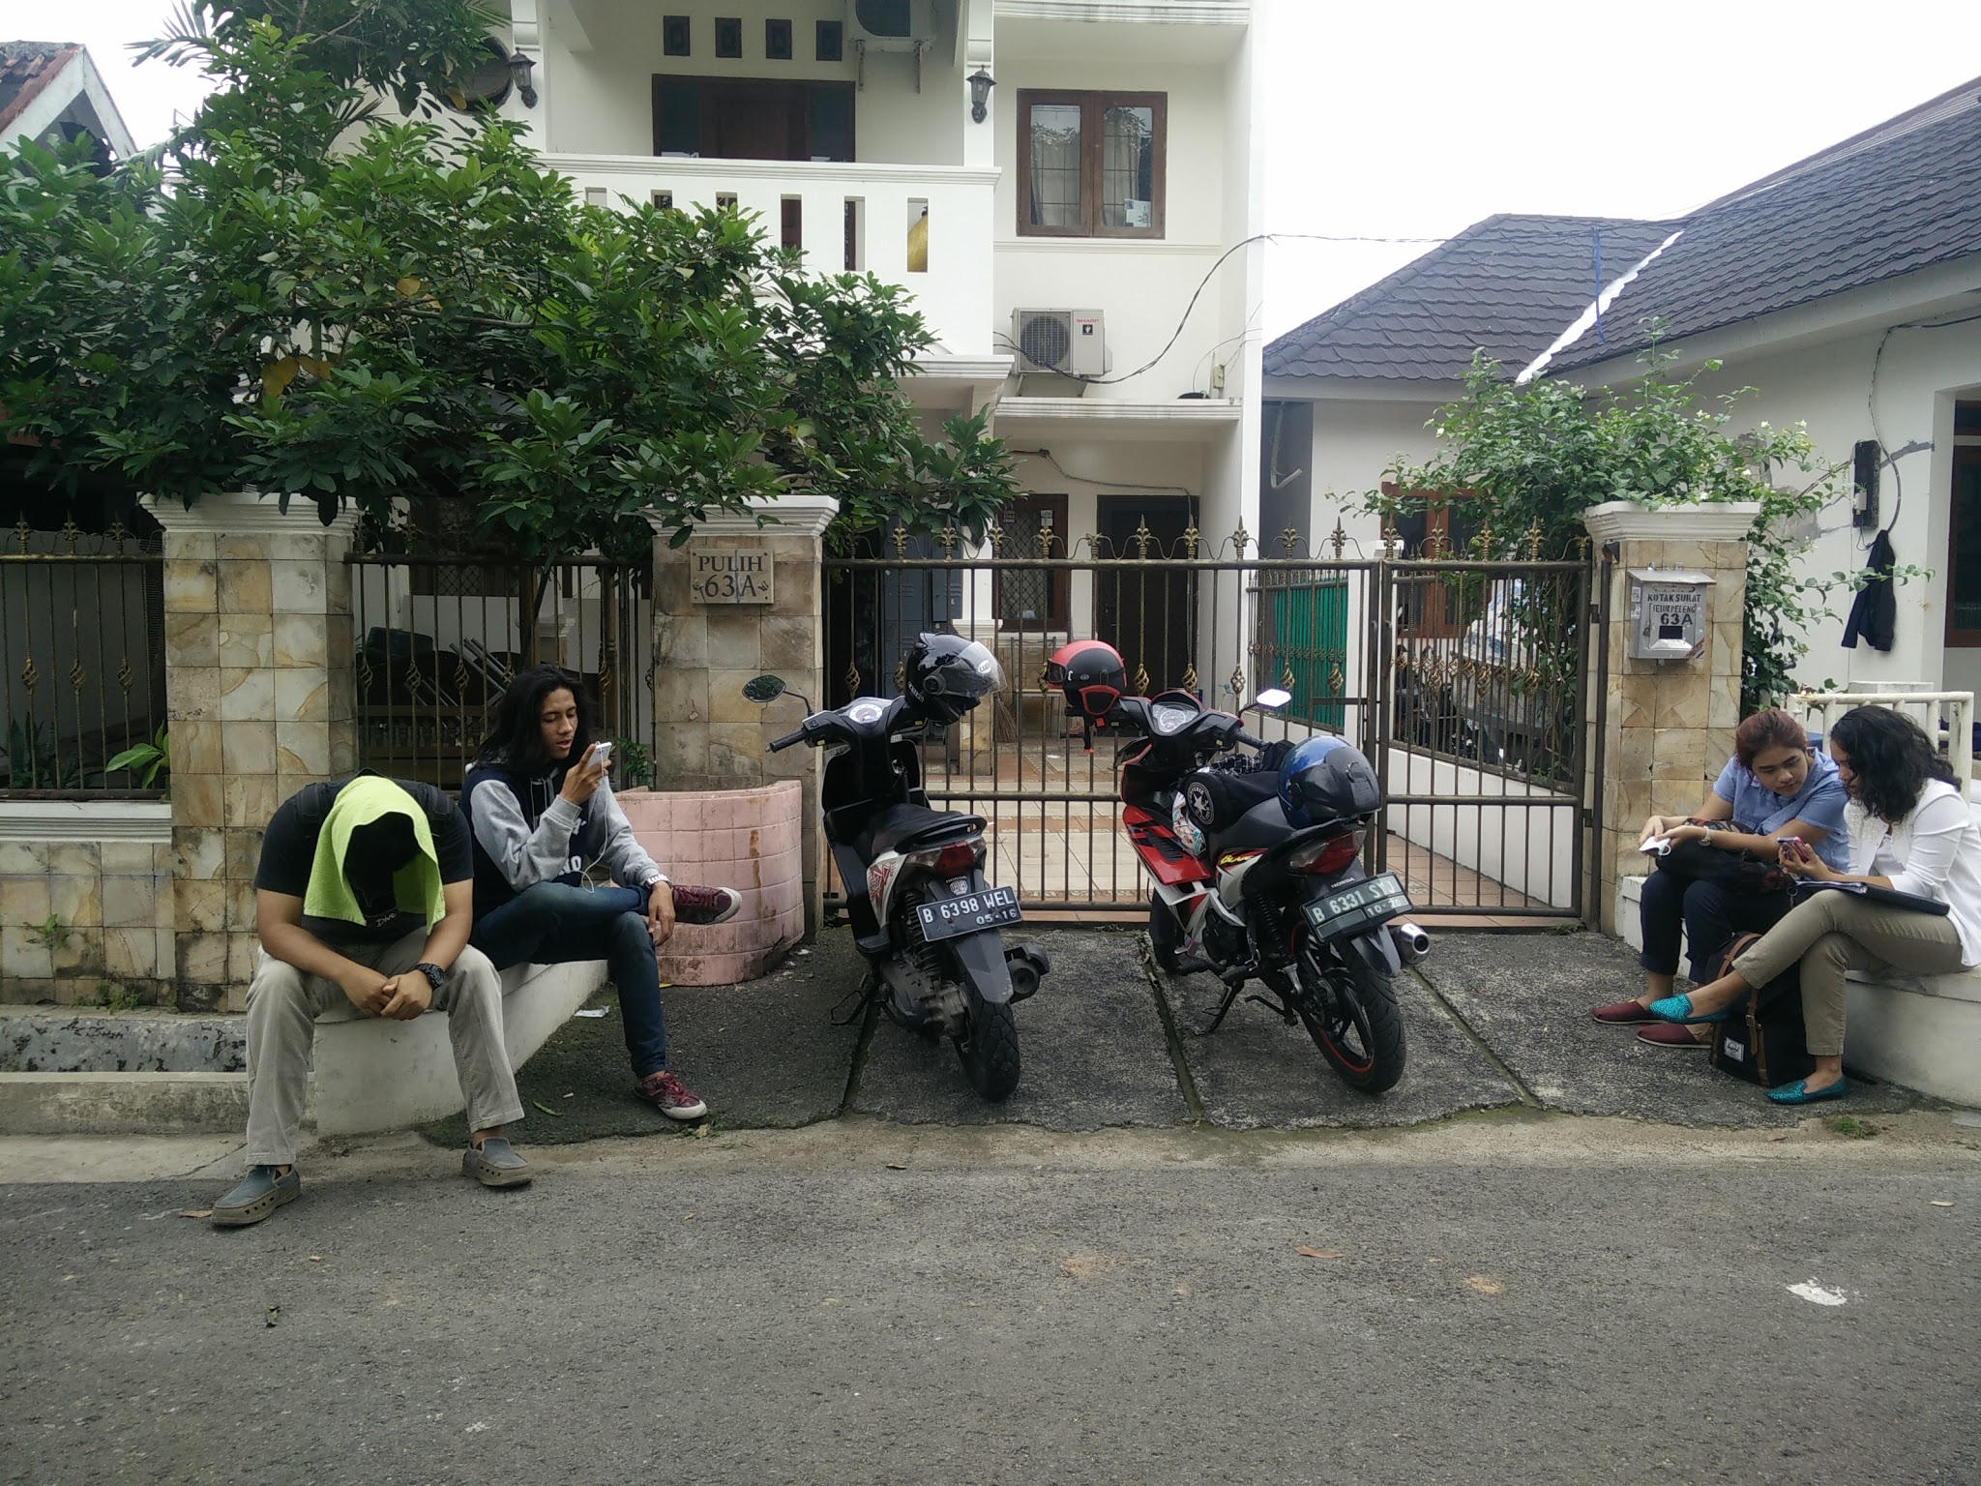
Kekunci

Slide 17
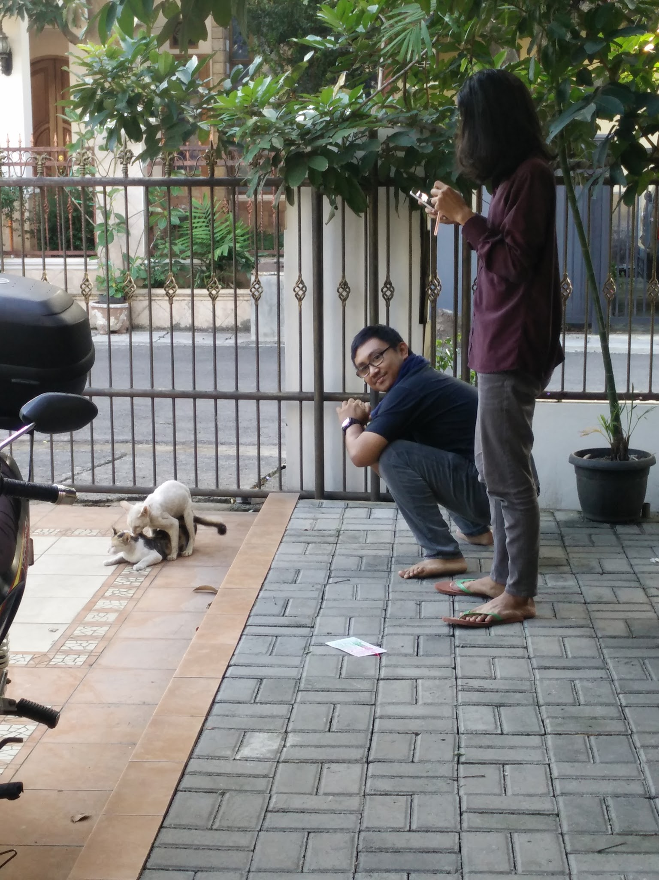
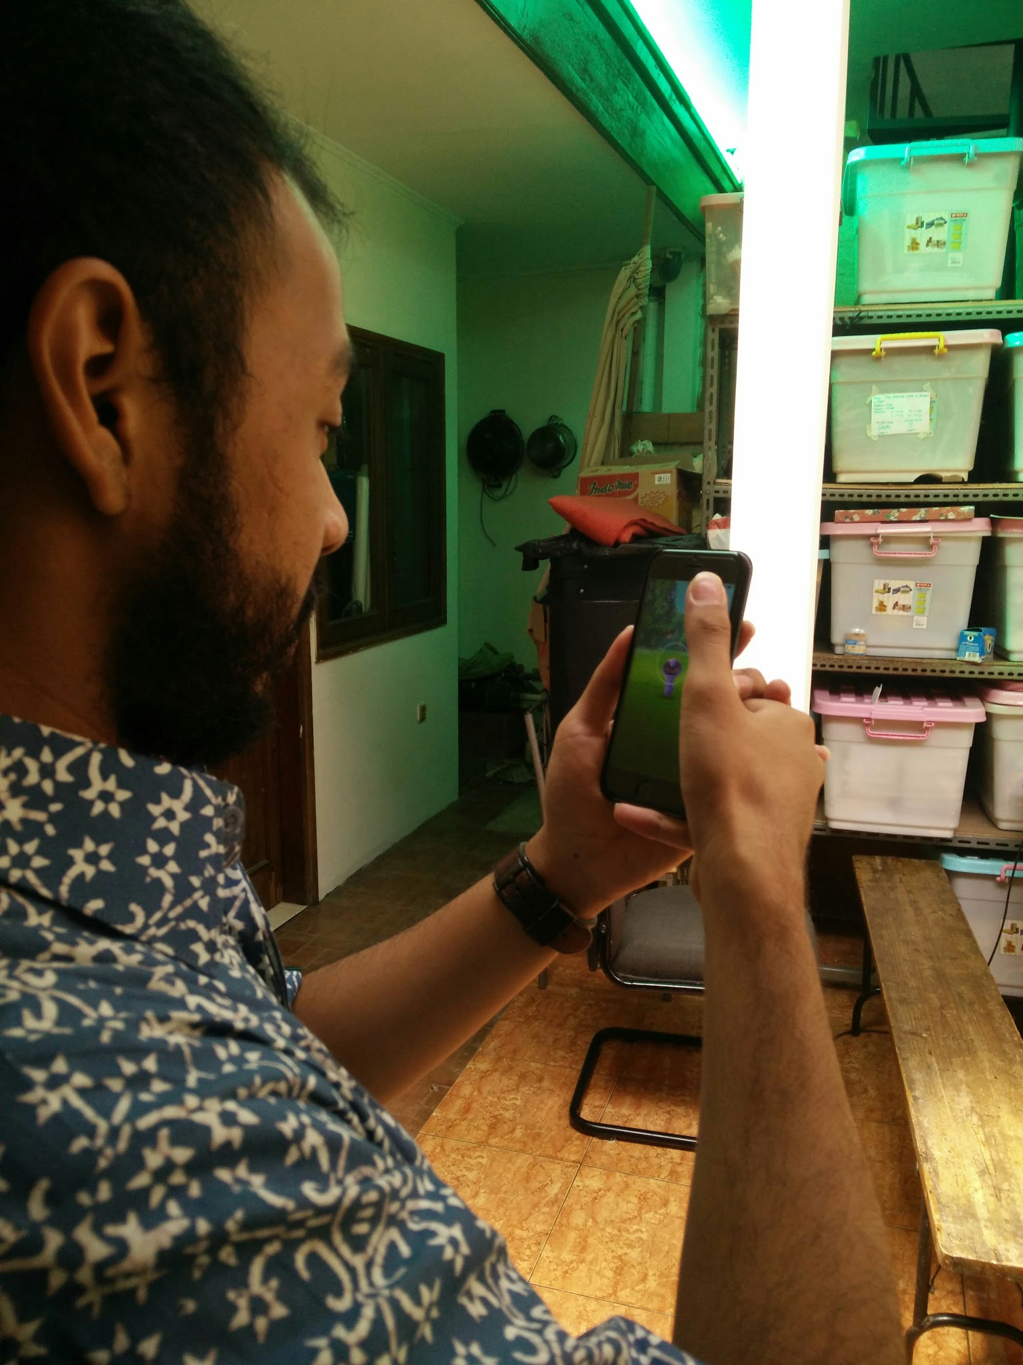
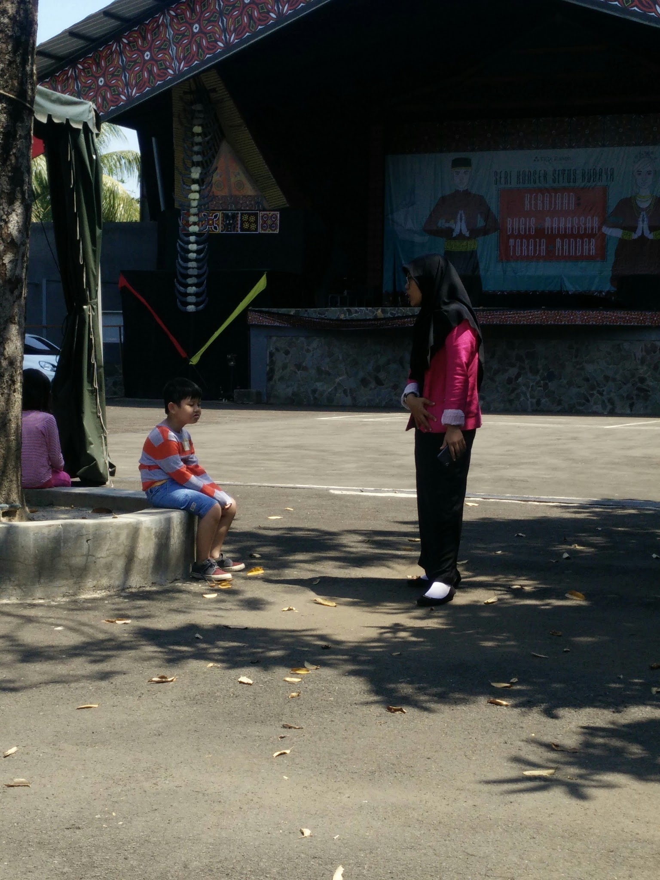
Hal-hal lain

Slide 18
Is it worth it?

Slide 19
HELL YES

Slide 20
What did I get?
No pay
All the expectations are fulfilled
Framework of the law concerning abusive relationships and sexual abuse
A mental picture of a psychologist day job
Networking
Friendship
Fun

Slide 21
That’s it?

Slide 22
Rules of thumb on composing laporan KP
Do it on your spare time
Keep track of your work
Sharpen your MS Word skills
Don’t cram it on the last hour
Communicate with your advisor regularly
Revise at least one time every week
BE SMART WHEN SPENDING MONEY ON PRINT SHOPS
ALWAYS MAKE A BACKUP (Physical and Cloud)

Slide 23
Rules of thumb on sidang KP
Simulate 1 – 2 month before
Practice on funneling your main idea
Focus on the big picture
Dress properly or professionally
Pray to God

Slide 24
Rules of thumb laporan KP revision
Schedule your work
Schedule revision sessions with your examiner with proper etiquette
ALWAYS KEEP A BACKUP
Be wise when printing
Don’t cram it on the last hours

Slide 25
THANKS!
Any questions?
You can find me at:
@roflpaladin
dimas.wahyu@student.upj.ac.id

