Slide 1


Chapter 8
269
Training and Developing Employees
Boma Wikanthyasa Irawan
2014021024
Dyah Ayu Karyanti
2014021006
Fandi Nofaldiansyah
2014021027

Slide 2


Summarize the purpose and process of employes orientation.
List and briefly explain each of the five steps in the training process.
Describe and ilustrate how you would identify training requirements.
Explain how to distinguish between problems you can fix wtih training and those you can’t.
Discuss how you would motivate trainees.
Explain how to use five training techniques.
List and briefly discuss four management development programs.
List and briefly discuss the importance of the eight steps in leading organizational change.
Answer the question, “what is organizational development and how does it differ from traditional approaches to organizational change ?”

Slide 3

Orienting And Onboarding New Employee
270
Memastikan bahwa karyawan baru yang kita pilih dapat mengetahui apa yang mereka lakukan dan bagaimana melakukannya merupakan orientasi dan pelatihan.

Slide 4

The purpose of employee orientation/onboarding
Orientasi pekerja menyediakan karyawan baru dengan info yang mereka butuhkan dan hal ini seharusnya dapat membuat karyawan baru merasa terikat dalam perusahaan tersebut.

Slide 5

The orientation process
Spesialis sdm biasanya menerangkan tentang jam kerja, insentif dan liburan pada awal orientasi. Kemudian memperkenalkan ke supervisor baru mereka. Kemudian supervisor melajutkan orientasi dengan menjelaskan tentang departemen organisasi dan memperkenalkan ke rekan kerja di tempat kerjanya.

Slide 6

The employee handbook
Pedoman karyawan terikat secara hukum hukum komitmen kerja. Maka dari itu pengusaha sering melakukan penolakan. Semakin jelas bahwa kebijakan perusahaan dan peraturannya bukan syarat dan ketentuan dari kontrak kerja.

Slide 7

Orientation Technology
Bos memakai teknologi untuk mendukung kegiatan orientasinya. Hampir semua bos menaruh beberapa/semua orientasinya di web.

Slide 8

Overview of the Training Process
272
Setelah orientasi, pelatihan harus dimulai. Pelatihan berarti memberikan keterampilan yang mereka butuhkan untuk melakukan pekerjaan mereka.

Slide 9
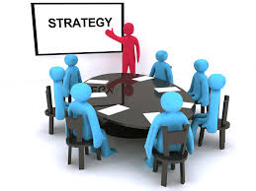
Aligning strategy and training
Rencana strategi pemilik perusahaan harus diatur dalam tujuan pelatihan. Hal ini bertujuan untuk mengidentifikasi perilaku karyawan dan untuk mengambil kesimpulan apakah kompetensi karyawan di butuhkan.

Slide 10

Training and Performance
Pelatihan yang ekspert sering menggunakan frasa “pembelajaran tempat kerja dan performa”
Sebagai pengganti tujuan ganda pelatihan untuk pembelajaran karyawan kinerja organisasi

Slide 11
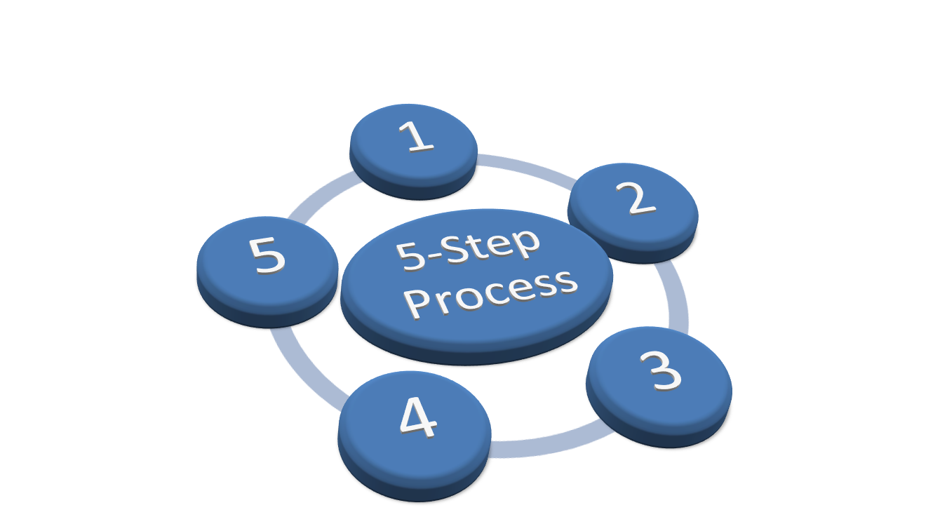
The ADDIE five-step Training Process
273
Menggunakan kebutuhan pelatihan
Mendesign kesulurahan program pelatihan
Mengembangkan kursus
Mengidentifikasi pelatihan dengan pelatihan yang sesungguhnya yang di targetkan grup karyawan dengan menggunakan metode on-the-job/ pelatihan online
Mengevaluasi keefektifan kursus tersebut

Slide 12
Conducting the training needs analysis strategic training needs analysis current training needs analysis

Slide 13
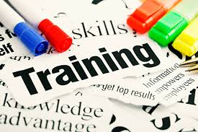
Analyzing new employees’ training models
274
Karyawan di tingkat yang lebih rendah adalah umumnya menyewa tenaga berpengalaman dan melatih mereka

Slide 14

Using Profiles And Competency Models
Strategi – employee behaviors – employe competencies – training and developments needs – training implementation and evaluation

Slide 15

Designing the Training Program
276
Setting Learning Objective
Creating a Motivational Environment
Making the Learning Maningful
Making Skill Transfer Obvious and Easy
Reinforcing the Learning
Ensuring Transfer of Learning to the Job
Other Training Design Issues

Slide 16



Developing the Program

Slide 17
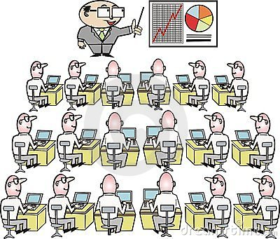
Implementing Training Programs
279
ON-THE-JOB TRAINING
APPRENTICESHIP TRAINING
INFORMAL LEARNING
JOB INSTRUCTION TRAINING
LECTURES
PROGRAMMED LEARNING
AUDIOVISUAL-BASED TRAINING
VESTIBULE TRAINING
ELECTRONIC PERFORMANCES SUPPORT SYSTEM (EPSS)

Slide 18
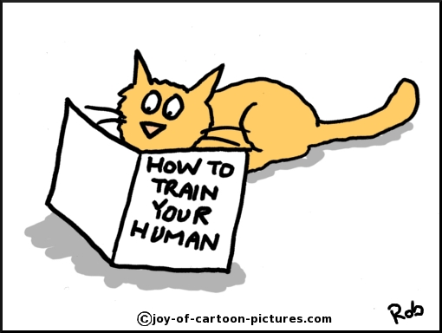
CONTINUE…
10. COMPUTER-BASED TRAINING (CBT)
11. SIMULATED LEARNING
12. INTERACTIVE LEARNING
13. INTERNET-BASED TRAINING
14. IMPROVING PRODUCTIVITY THROUGH HRIS
15. MOBILE LEARNING
16. THE VIRTUAL CLASSROOM
17. LIFELONG AND LITERACY TRAINING
18. TEAM TRAINING

Slide 19

ON-THE-JOB TRAINING (OJT)
The OJT Process
Prepare the Learner
Present The Operation
Do a Tryout
Follow-Up

Slide 20


Continue…
Apprenticeship Training
Simulated Learning
Lifelong and Literacy Training Techniques
Team Training
U.S ARMY EXAMPLE
OTHER EXAMPLE
ADVANTAGES
LITERACY TRAINING

Slide 21


List and briefly discuss four management development programs.
289
Strategy and Development
1. Managerial On-the-Job Training
Coaching/Understudy Approach
Action Learning

Slide 22


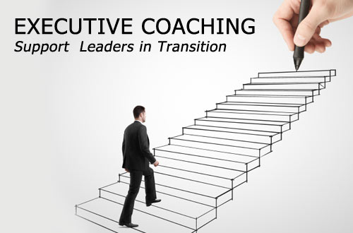
290
2. The Case Study Method
3. Role Playing
4. Executive Coaches

Slide 23
List and briefly discus the importance of the
Eight steps in leading orgnizational change.
Strategic Change
Other Changes
Lewin’s Change Process
1. Unfreezing
2. Moving
3. Refreezing
294

Slide 24
Leading Organizational Change
295
Unfreezing Stage
Moving Stage
5. Help employees make the change
1.Establish a sense of urgency
3. Create a guilding coalition
6.Consolidate gains
2. Mobilize Commitment
4. Develop and communicate
Refreezing Stage
7. Reinforce the new ways of doing things
8. Finally

Slide 25
Answer the question, “what is organizational
Development and how does it differ from traditional
Approaches to organizational change ?”
296
Using Organizational Development
Human Process Applications
Strategic OD Application
Technostructural Interventions
Human Resource Management Applications

Slide 26

Evaluating The Training Effort
298
Designing the Study
Trainng Effects to Measure
Reaction
Learning
Behavior
Results

Slide 27

Terima Kasih

