Slide 1
Job analysis and the Talent Management Process
Bias Sukma Putra (2014021010)
Gloria Audrey F (2014021004)
Manuel Bias (2014021015)

Slide 2
LEARNING OBJECTIVES
129
Explain why Talent Management is important?
Discuss the nature of Job Analysis, including what it is and how it used.
Use at least three methods of collecting Job analysis information, including interviews, questionnaires, and observation.
Write Job descriptions, including summaries and Job functions, using the internet and traditional methods.
Write a job specification.
Explain competency-based job analysis, including what it means and how it’s done in practice

Slide 3
“Why Talent Management is important”
130
Talent Management
Planning
Developing
Recruiting
Managing
Compensating Employee

Slide 4
The Talent Management Process
130
Decide what position to fill
Build a pool of job
candidates
Application forms
Use selection tools
Make an offer
Orient, train and develop
Appraise employees
Reward and compensate

Slide 5
When a manager takes a TM perspective, he or she:
130
1. Memahami tugas sebagai talent
management
2. Memastikan keputusan talent
management seperti staffing, training
dan pembayaran dengan tujuan yang
terarah.
3. Secara konsisten menggunakan “pr ofile”
yang sama dari kompetensi , sifat,
pengetahuan, dsb.
4. Segmen aktif & mengelola karyawan
dengan proaktif
5. Menyatukan seluruh fungsi Talent
Management

Slide 6
The Basic of Job Analysis
131
Job Analysis
Job Description
Job Specification

Slide 7
The basic job analysis
131-132
Work activities
Human behaviors
Machines, tools,
Equipment and work aids
Perfomance standards
Job context
Human requirements

Slide 8
132
Uses of Job Analysis
Recruiting &
Selection
EEO Compliance
Performance
Appraisal
Compensation
Training

Slide 9
Methods For Collecting Job Analysis Information
Diary/Logs
Internet-Based
Quantitative Techniques
Questionnares
Observation
The Interview

Slide 10
The interview
Structured Interviews
Pros and Cons
Typical Questions
Interviewing Guidelines

Slide 11
Questionnaires
Observation
Participant Diary/Logs
Internet-Based Job Analysis
Quantitative Techniques

Slide 12
Writing Job Description
Relationships
Duty: Accurately Posting Accounts Payable
Responbilities and Duties
Job Summary
Job Identification
Standards of Performance and Working Conditions
Using The Internet for Writing Job Descriptions

Slide 13
Menuliskan spesifikasi pekerjaan
“Apa yang dibutuhkan seseorang untuk melakukan pekerjaan ini dengan baik?”
Spesifikasi untuk Personel Terlatih VS Tidak Terlatih
Menggunakan laporan kerja
Spesifikasi Pekerjaan Berdasarkan Penilaian
Spesifikasi Berdasarkan pada analisis Statistik

Slide 14
Jelaskan kompetensi berdasarkan analisis pekerjaan, termasuk apa pengertiannya dan bagaimana itu dilakukan dalam praktek
Apa yang dimaksud dengan talent majajemen ?
Apa itu kopetensi ?

Slide 15
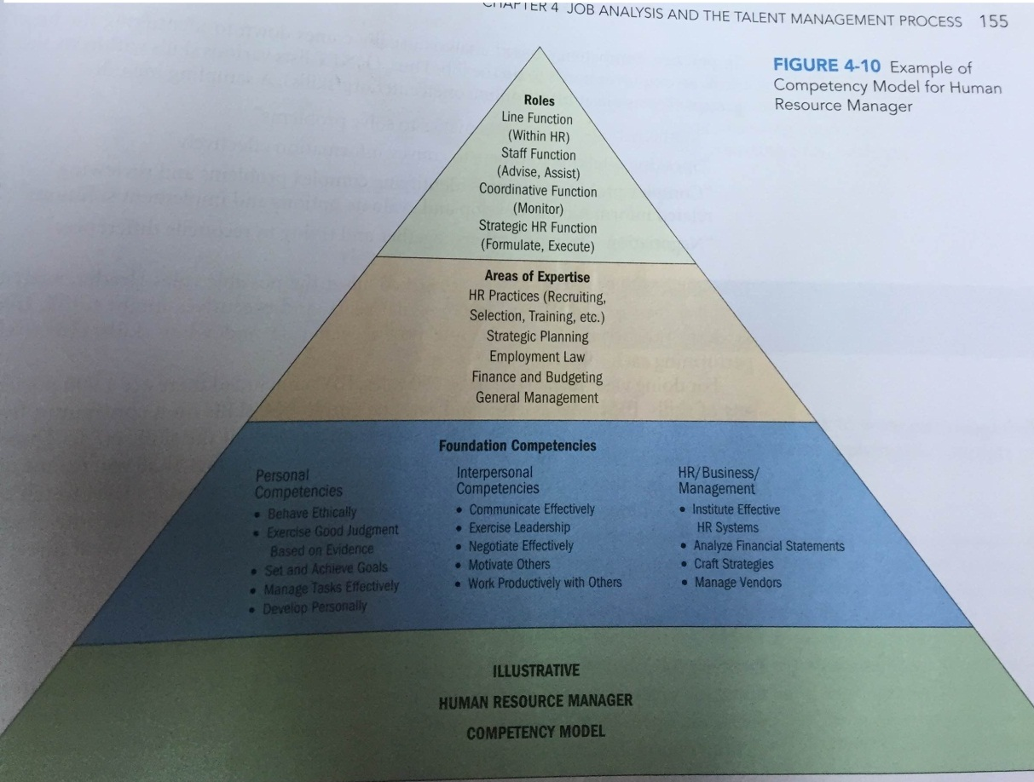

Slide 16
Contoh contoh kopetensi teknis yang umum
Systems Enginer
bendarahara

Slide 18
Bagaimana Menulis Kompetensi pekerjaan?
Melakukan wawancara
Matriks British Petroleum

Slide 20
Terima Kasih

