Slide 1
PAY FOR PERFOMANCE AND FINANCIAL INCENTIVES
Nama Kelompok :
Erwin Winarjo (2014021002)
Anggita Kusuma Dewi (2014021018)
Arif Agus Setiawan (2014021019)

Slide 2
MONEY AND MOTIVATION
418
Financial Insentives
Boost Employee
Perfomance
Productivity
Gains

Slide 3
Linking Strategy, Perfomance, and Incentive Pay
418

Slide 4
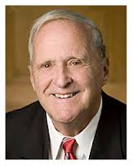
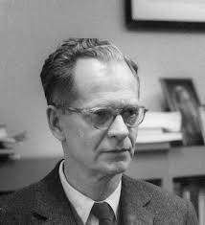
Motivation and Incentives
The Hierarchy of Needs and Abraham Maslow
Motivators and Frederick Herzberg
Demotivators and Edward Deci
Expectancy Theory and Victor Vroom
Behavior Modification/Reinforcement and B.F Skinner
419 - 420

Slide 5
421
Incentive Pay Terminology
Employee Incentives and the law

Slide 6
Individual Employee Incentive and Recognition Progams
Merit Pay as an Incentive
Piecework Plans
Straight Piecework
Differential Pay Increases
Standard Hour Plans
Merit pay options
Pros and Cons
422 - 423

Slide 7
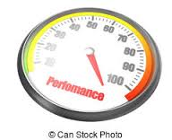
Incentives for Professional Employees
Nonfinancial and Recognition Based Awards
424

Slide 8
Online and IT Supported Awards
Job Design
426

Slide 9
INCENTIVES FOR SALES PEOPLE
426 - 428
1
2
3
SALARY PLAN
COMMISSION PLAN
COMBINATION PLAN
4
5
MAXIMIZING SALES FORCE RESULTS
HOW EFFECTIVE ARE YOU INCENTIVES ?

Slide 10
INCENTIVES FOR MANAGERS AND EXECUTIVES
429 - 430
1
2
STRATEGY AND THE EXECUTIVE’S LONG-TERM AND TOTAL REWARDS PACKAGE
SARBANES - OXLEY

Slide 11
430 - 431
ELIGIBILITY
3
FUND SIZE
SHORT – TERM INCENTIVES AND THE ANNUAL BONUS
INDIVIDUAL PERFORMANCE
FORMULA

Slide 12
CONTINUED…
432 - 433
STOCK OPTION
4
STOCK OPTION PROBLEMS
STRATEGIC LONG-TERM INCENTIVES
OTHER STOCK PLANS
ETHICS AND INCENTIVIES
5
OTHER EXECUTIVE INCENTIVIES

Slide 13
TEAM AND ORGANIZATIONWIDE INCENTIVE PLANS
433 - 434
How to Design Team Incentives

Slide 14
engineered
434
TEAM

Slide 15
434 - 435
Evidence-Based HR: Inequities That Undercut Team Incentives
Profit-Sharing Plans

Slide 16
Scanlon Plans
435 - 436
of
sharing of benefits formula
system

Slide 17
Other Gainsharing Plans
At-Risk Pay Plans
Establish
Specific
Portion
Method
Form
Bonuses
Involvement
Implement
Employee Stock Ownership Plans
BROAD-BASED STOCK OPTIONS
436 - 437

Slide 18
437 - 439
DESIGNING EFFECTIVE INCENTIVE PROGRAMS
Incentives Plans in Practice
The Five Building Blocks of Effective Incentive Plans
Link the incentives with your strategy
Set complete standards
Does it make sense to use incentives?
Make sure the program is motivational
Be scientific

