Slide 1
Chapter 10
346
Employee Retention, Engagement, and Careers
Dini Arifiani 2014021021
Gloria Audrey

Slide 2
347
LEARNING OBJECTIVE
Describe a comprehensive approach to retaining employees.
Explain why employee engagement is important, and how to foster such engagement.
Discuss what employers and supervisors can do to support employees’ career development needs.
List and discuss the four steps in effectively coaching an employee.
List the main decision employers should address in reaching promotion decisions.

Slide 3
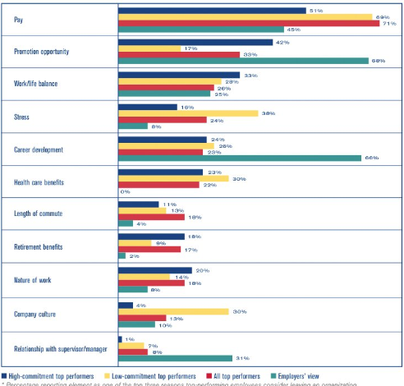
348-349
MANAGING EMPLOYEE TURNOVER AND RETENTION
COST OF TURNOVER
MANAGING VOLUNTARY TURNOVER
RETENTION STRATEGIES FOR REDUCING VOLUNTARY TURNOVER

Slide 4
Describe a comprehensive approach to retaining employees.
350-351
Selection,
Professional growth,
Provide career direction,
Meaningful work and ownership of goals,
Recognition and rewards,
Culture and environment,
Promote work-life balance,
Acknowledge achievements.
A Comprehensive Approach to Training Employees
Managing Involuntary Turnover
Talent Management and Employee Retention
Job Withdrawal
DEALING WITH JOB WITHDRAWAL

Slide 5
2. Explain why employee engagement is important, and how to foster such engagement.
352-354
Why Engagement is important
EMPLOYEE ENGGAGEMENT
Actions That Foster Engagement
Monitoring Employee Engagement
Careers Terminology
CAREER MANAGEMENT
Careers Today
Psychological Contract
The Employee’s Role in Career Management

Slide 6
355
EXERCISE 1
EXERCISE 2

Slide 7
The employer’s role in career management
356-357
Career Management System
CAREER CENTER
OFFER ONLINE PROGRAMS
CAREER-ORIENTED APPRAISAL
CAREER PLANNING WORKSHOP
LIFELONG LEARNING BUDGETS
PROVIDE CAREER COACHES

Slide 8
358-359
GENDER ISSUES IN CAREER DEVELOPMENT
THE MANAGER’S ROLE

Slide 9
IMPROVING COACHING SKILL
359-360
Build your coaching skill
Build your mentoring skill
MENTORING CAVEATS
THE EFFECTIVE MENTOR

Slide 10
THE PORTEGE’S RESPONSIBILITIES
362
Choose an approptiate potential mentor
Make it easier for a potential mentor to agree to your request
Don’t be surprised if you’re turned down
Respect the mentor’s time

Slide 11
Improving productivity through HRIS: Integrating Talent Management and Career and Succession Planning
362
360 feedback
Compensation Management
Career Development
Career Progression
Learning Management
Perfomance Management
Recruiting and Hiring

Slide 12
Making Promotion Desicion
363-366
Decision 1 : is seniority or competence the rule?
Decision 2 : how should we measure competence?
The 9-Box Assessment
Decision 3 : is the process formal/informal?
Decision 4 : Vertical, Horizontal or other?
Practical Consideration
Sources of bias in promotion decision
Promotion and the law
Managing Transfers
Managing Retirements

