Slide 1
Chapter 2 Perception
Perception is a three-stage process that translates raw stimuli into meaning
Product and commercial message often appeal to our senses, but we won’t be influenced by most of them
The design of a product today is a key driver of its success or failure
Subliminal advertising is a controversial-but largely ineffective-way to talk to consumers
We interpret the stimuli to which we do pay attention according to learned patterns and expectations
The science of semiotics helps us to understand how marketers use symbols to create meaning.

Slide 2
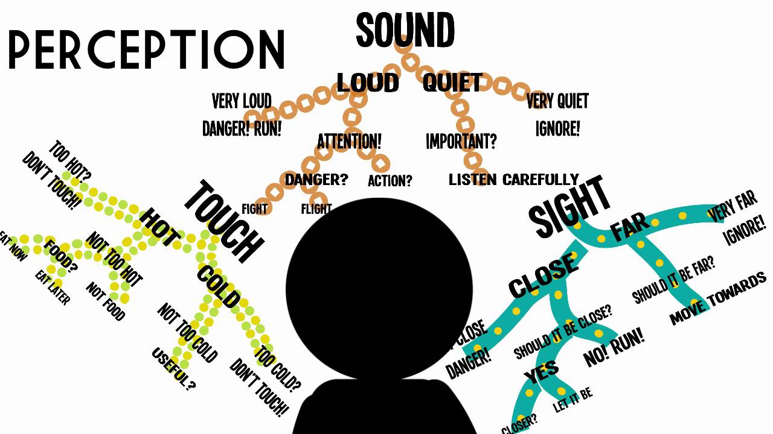
Sensation refers to the immediate response of our sensory receptors ( eyes, ears, nose, mouth, skin ) to basic stimuli such as light, colour, sound, odour, and texture.
Perception is the process by which these sensations are selected, organised, and interpreted.

Slide 3
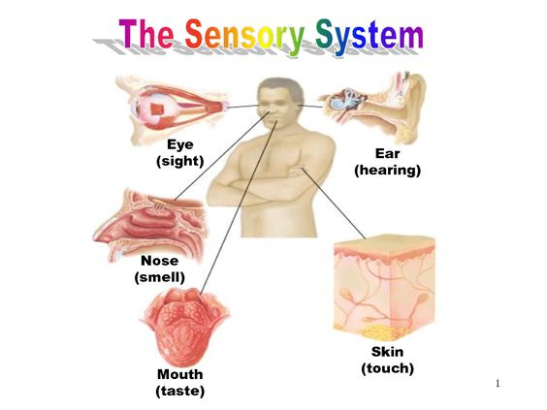
Sensory system
The inputs picked up by our five senses are the raw data that begin the perceptual process

Slide 4
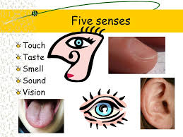
Vision
Colours may even influence our emotions more directly. Evidence suggest that some colour (particulary red) create feelings of arousal and stimulate appetite, and others (such as blue) are more relaxing.
Smell
Odours can stir emotions or create a calming feeling. They can invoke memories or relieve stress

Slide 5
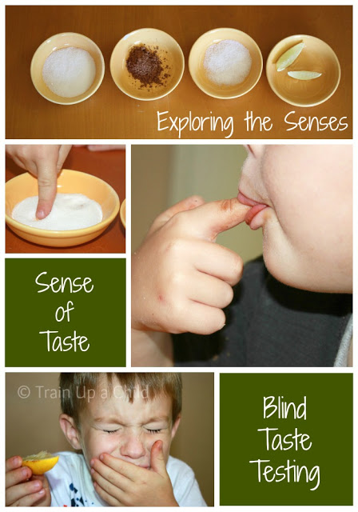
Sound
Many aspect of sound affect people’s feelings and behaviour.
Touch
Moods are stimulated or relaxed on the basis of sensations reaching the skin, whether from a luxurious massage or the bite of a winter wind
Taste
Our taste obviously contribute to our experience of many product

Slide 6
Sensory thresholds
The absolute threshold
Refers to the minimum amount of stimulation that can be detected on a given sensory channel
The differential threshold
Refers to the ability of a sensory system to detect changes or differences between two stimuli. The minimum difference that can be detected between two stimuli is known as j.n.d (just noticeable difference)

Slide 8
Subliminal perception
Subliminal perception
Occours when the stimulus is below the level of the consumer’s awareness
Subliminal techniques
Subliminal messages supposedly can be sent on both visual and aural channels

