Slide 1
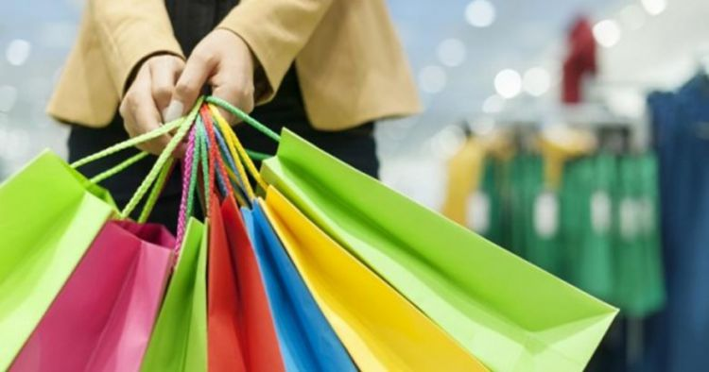
Group Influence
and Opinion Leadership
Dimas Dear Pratama (PSI)
Syifa Eramithya (DKV)

Slide 2
Outline
Reference Group
Consumers do it in Group
Word of mouth Communication
Opinion Leadership

Slide 3
Reference Group
Reference group is an actual or imaginary individual or group conceived of having siginificant relevance upon an individual’s evaluation, aspirations or behavior.
Reference group mempengaruhi konsumer melalui 3 cara yaitu :
Information influence
Utilitarian influence
Value expressive Influence

Slide 4
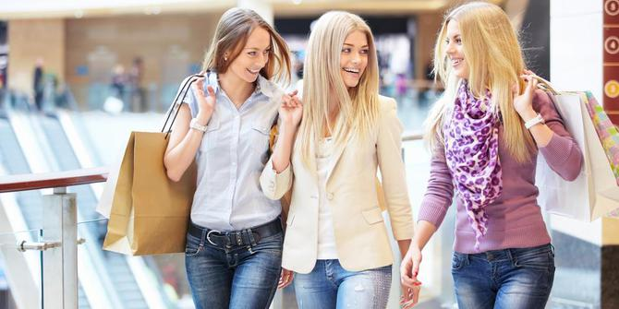
Apakah Reference Group itu penting ?

Slide 5
2 dimensi yang mempengaruhi groups reference itu menjadi penting yaitu :
Luxuries rather than necessities
Socially conspicuous or visible to other

Slide 6
Product
Weak reference
Group influence (-)
On product Purchase
strong reference
Group influence (+)
On product Purchase
Strong reference
Group influence (+)
On brand selected
Public Necessities
Influence : weak for product and strong for brand
Examples : wristwatch, man’s suit
Public Luxuries
Influence : strong for product and for brand
Examples : Golf clubs, sailbot
Brand
Weak reference
Group influence (-)
On brand selected
Private Necessities
Influence : weak for product and weak for brand
Examples: floor, lamp
Private luxuries
Influence : strong for product and weak for brand
Examples: TV game, icemaker

Slide 7
Setiap reference group memliki social power untuk mempengaruhi individu
Social power → mengacu pada seberapa kuat kapasitas untuk mengubah tindakan orang lain
Jenis-jenis social power meliputi
Information Power
Referent power
Legitimate power
Expert power
Reward power
Coercive power

Slide 8
Types of Reference Groups
Normative Influence → berdasarkan pada norma
Comperative influences → membandingkan dengan individu/kelompok lain

Slide 9
Brand Comunities and Tribes
Brand community → kumpulan grup yang tertarik pada suatu produk
Consumer Tribe → Grup yang memiliki lifestyle yang sama
Tribal Marketing → memantau consumer tribe

Slide 10
Membership vs Aspirational Reference Groups
Aspirational Reference Groups →figures
Membership Reference Groups → orang-orang terdekat seperti keluarga, teman
Membership Reference Groups dipengaruhi oleh beberapa faktor yaitu :
Propinquity
Mere exposure
Group cohesiveness

Slide 11
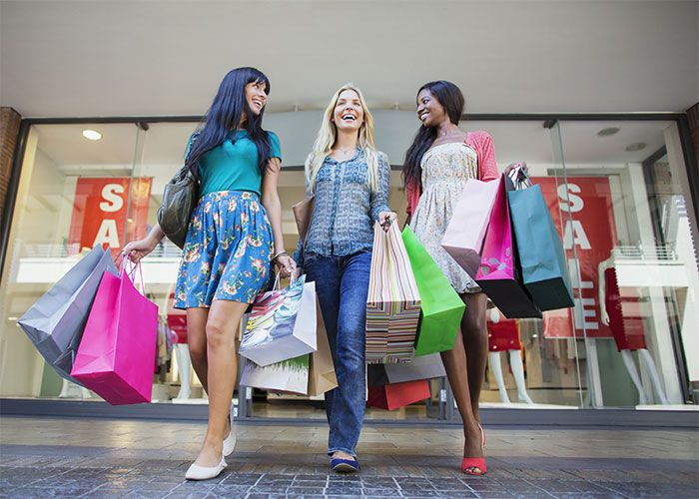
Consumers Do it in Groups
Deindividuation
Decision Polarisation
Risky Shift
Home Shopping Parties

Slide 12
Conformity
Conformity merujuk pada perubahan keyakinan atau tindakan karena adanya tekanan dalam grup.
Conformity → Norma
Faktor yang mempengaruhi conformity yaitu:
Cultural pressures
Fear of deviance
Commitment
Group unanimity
Susceptibility to interpersonal influence

Slide 13
Social Comparison Theory → Self evaluation
Resisting Conformity → Reactance

Slide 14
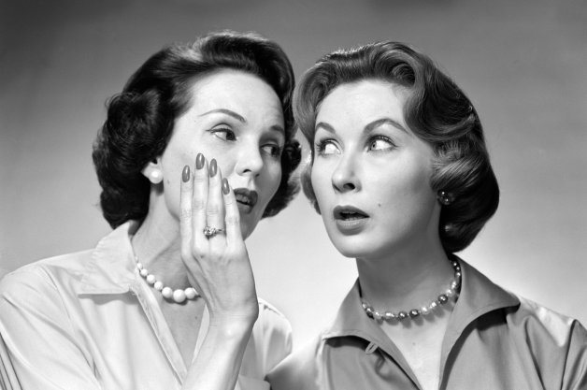
Word-of-Mouth Communication
Product Information that individuals transmits to other individuals.
Tends to be more reliable and trustworthy than the actual formal ads.
Often comes with social pressure to conform to these recommendation.

Slide 15
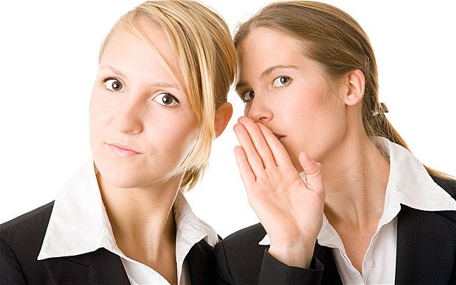
Negative WOM and the Power of Rumours
Consumers weight negative word-of-mouth more heavily than they do positive comments.
There are three themes that cause negative WOM:
Injustice
Identity
Agency
As we transmit information to one another, it tends to change and resulting the message didn’t resemble the original message.

Slide 16
Virtual Communities
Virtual Communities is a collection of people whose online interactions are based upon enthusiasm for and knowledge of a specific consumption activity
Virtual Communities come in many different forms
Massive multi player online
Rooms, rings and lists
Boards
Blogs

Slide 17
Guerrilla Marketing
Guerrilla Marketing → Promotional strategies that use unconventional locations and intensive word of mouth campigns to push products.

Slide 18
Opinion Leadership
A person whose frequently able to influence others’ attitude or behaviors.
Technically competent.
Prescreen, synthesize and evaluate in an unbiased ways.
Socially active and highly interconnected with their communities.
Tend to be similar with consumers in terms of value and beliefs.
Often among the first to buy new products

Slide 19
Types of Opinion leaders
The Market Maven
The surrogate Consumer

Slide 20
Perspective on the communication Process
Traditional Model
Mass Media
Opinion Leaders
Recipients
Updated Model
Gatekeepers
Mass Media
Recipients
Opinion Leaders

Slide 21
Identifying Opinion Leaders
Sociometric Method → used to trace referral patterns. This information can be used to identify opinion leaders and other influential consumers

Slide 22
