Slide 1





Achievement, Careers, and Work
Nindya Yasmin
Yohana Intan Kusuma Dewi

Slide 2




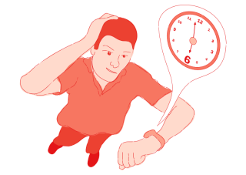

1. Achievement
Intrinsic and Extrinsic Motivation
Goal Setting, Planning, and Monitoring
Some Obstacles to Achievement
Time Management

Slide 3
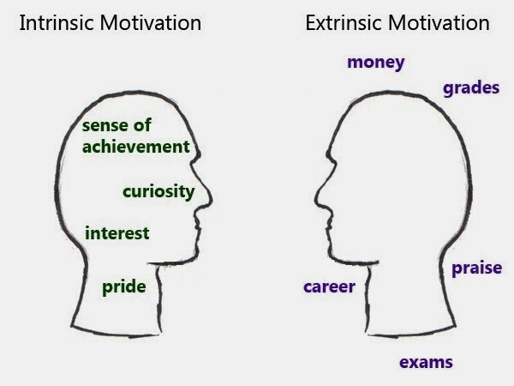
Intrinsic and Extrinsic Motivation
Motivasi Intrinsik → self-determination, rasa ingin tahu, tantangan, usaha.
Motivasi Ekstrinsik → penghargaan dan hukuman.

Slide 4


Goal Setting, Planning, and Monitoring
Notes:
Membuat goal/ target, perencanaan, dan evaluasi usaha untuk mencapai goal adalah aspek sentral dari prestasi.
Prestasi membaik saat seseorang mengatur goal yang spesifik, jangka pendek dan menantang.

Slide 5
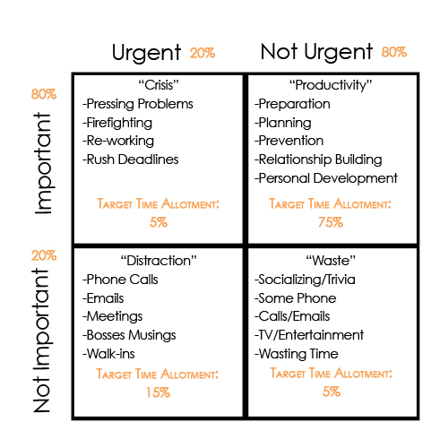
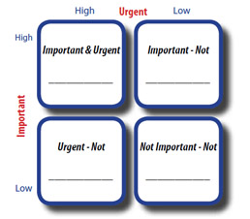
Time Management
Plan and Set Priorities

Slide 6
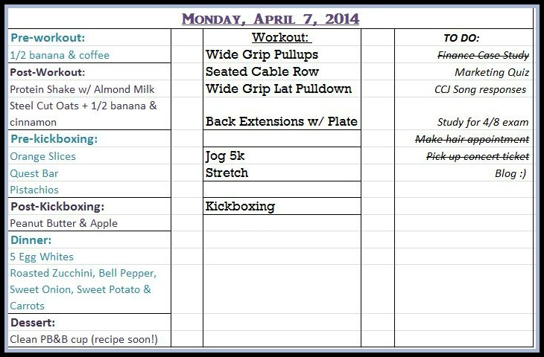
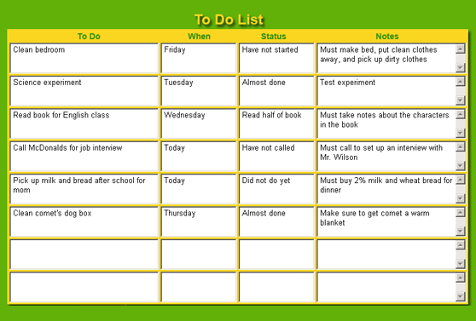
Time Management
Create a Daily Plans
Monitor Time Plans

Slide 7

Some Obstacles to Achievement
Procrastination (Penundaan)
Perfectionism
Protecting Self-Worth by Avoiding Failure
  Nonperformance
  Sham Effort
  Procrastination
  Setting Unreachable Goals

Slide 8
The Effort to Avoid Failure
Self-handicapping strategies: Usaha seseorang untuk menghindari kesalahan.
Beberapa strategi untuk mengurangi penghindaran kesalahan:
  Atur target yang menantang tapi realistik.
  Kuatkan hubungan antara usaha dan harga diri. Banggalah dengan usahamu dan kurangi perbandingan sosial.
  Mempunyai kepercayaan positif dalam kemampuan masing-masing.
Notes:
Self-handicapping is a cognitive strategy by which people avoid effort in the hopes of keeping potential failure from hurting self-esteem.^{[1]} It was first theorized by Edward E. Jones and Steven Berglas,^{[2]} according to whom self-handicaps are obstacles created, or claimed, by the individual in anticipation of failing performance.^{[3]}
Self-handicapping can be seen as a method of preserving(mempertahankan) self-esteem but it can also be used for self-enhancement and to manage the impressions of others.^{[4]} This conservation or augmentation of self-esteem is due to changes in causal attributions or the attributions for success and failure that self-handicapping affords. There are two methods that people use to self-handicap: behavioral and claimed self-handicaps. People withdraw effort or create obstacles to successes so they can maintain public and private self-images of competence.
Self-handicapping is a widespread behavior amongst humans that has been observed in a variety of cultures and geographic areas. For instance, students frequently participate in self-handicapping behavior to avoid feeling bad about themselves if they do not perform well in class. Self-handicapping behavior has also been observed in the business world. The effects of self-handicapping can be both large and small and found in virtually any environment wherein people are expected to perform.

Slide 9






2. Careers and Jobs
Career Development Across the Life Span
Getting a Job
Knowledge, Goals, and Careers
Skills and Personality Traits

Slide 10
Career Development Across the Life Span
Ginzberg
Super
Fantasy (lahir-11th)
Tentative (11th-17th)
Realistic (18th-25th)
Growth (lahir-14th)
Exploration (15th-24th)
Establishment (25th-44th)
Maintenance (45th-64th)
Decline (≥ 65th)

Slide 11





Childhood (Masa kanak-kanak)
Fantasy Stage [lahir-11th]
(Ginzberg)

Slide 12
Chilhood (Masa kanak-kanak)
Growth Stage [lahir-14th] (Super)
  Lahir-3th: Tidak ada ketertarikan u/ memiliki pekerjaan
  4th-10th: Fantasi yang luas dalam karir.
  10th-12th: Ketertarikan pada karir didasarkan rasa suka dan tidak suka.

Slide 13


Childhood (Masa kanak-kanak)
Apa peran orang tua yang dimainkan di dalam proses ini?

Slide 14



Adolescene (Masa Remaja)
Tentative Stage [11th-17th] → Ginzberg
Realistic Stage [18th-25th] → Ginzberg
Exploration Stage [15th-24th] → Super

Slide 15


Early Adulthood (Masa Dewasa Awal)
Establishment Stage [25th-45th] → Super

Slide 16


Middle Adulthood (Masa Dewasa Menengah)
Maintenance Stage [45th-64th] → Super

Slide 17


Late Adulthood (Dewasa Akhir)
Decline Stage [≥65th] → Super

Slide 18
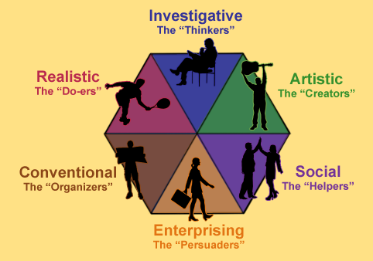
Skills and Personality Traits
Holland’s personality type theory:
  Realistic
  Investigative
  Artistic
  Social
  Enterprising
  Conventional

Slide 19
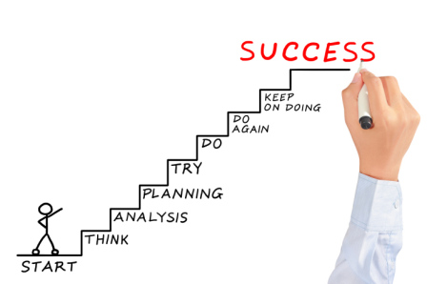
Knowledge, Goals and Careers
Set Careers Goals
Become Knowledgeable About Careers

Slide 20


Become Knowledgeable About Careers

Slide 21


Set Careers Goals

Slide 22
Getting a Job
Be Aware of What Employers Want
Learn How to Have a Great Job Interview
Do Thorough Job Search
Create a Resume
Chronological
Functional
Achievement

Slide 23
Strategies for Having a
Good Job Interview
Create an excellent resume
Don’t wing an interview
Be prepared to give positive example of your past work experience
Anticipate the question that you will be asked in the interview
Ask appropriate job-related question yourself
Keep your cool
As the interview closes, decide whether you want the job
Immediately after the interview, type a follow-up letter

Slide 24

3. Work
The Role of Work in People’s Lives
Working During College
Work and Retirement
Leisure

Slide 25
The Role of Work in People’s Lives
Pengaruh yang penting dalam kedudukan finansial seseorang, housing, cara mereka menghabiskan waktu mereka, dimana mereka tinggal, pertemanan, dan kesehatan mereka.
Workaholics
Dual – Career Couples
Diversity in the Workplace
Unemployment

Slide 26
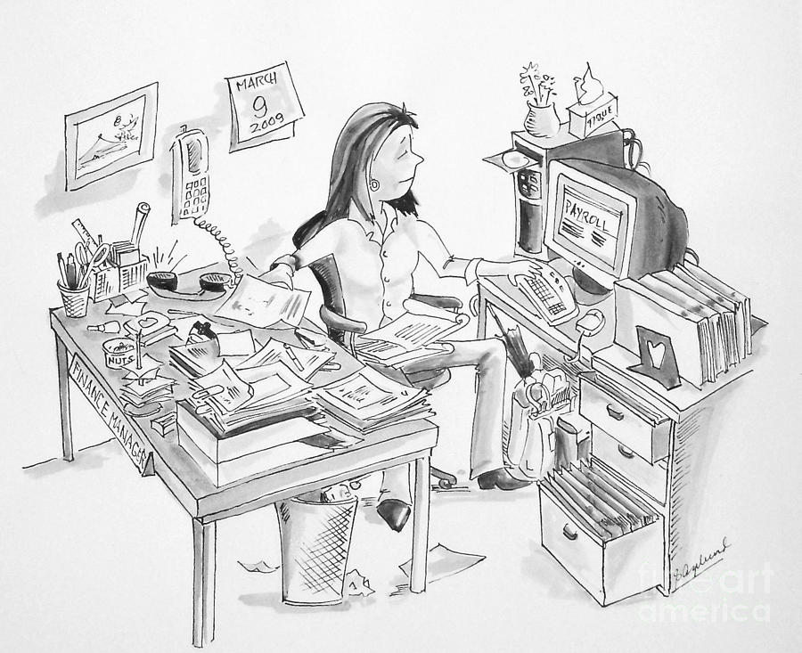

Workaholics
Individuals who are seemingly addicted/ obsession to work.

Slide 27

Dual – Career Couples
Semakin banyaknya wanita di U.S yang bekerja di luar rumah, pembagian tugas mengenai pekerjaan dan keluarga berubah.
1/3 dari pasangan yang bekerja, istri/wanita menghasilkan penghasilan yang sama atau lebih banyak dari suami
Positive
Negative
Meningkatnya peran suami di U.S yang melakukan pekerjaan rumah tangga.

Slide 28


Diversity in Workplace
Meningkatnya keberagaman di tempat kerja membutuhkan kepekaan terhadap perbedaan budaya, dan nilai-nilai budaya yang dibawa oleh pekerja harus diakui dan dihargai.

Slide 29
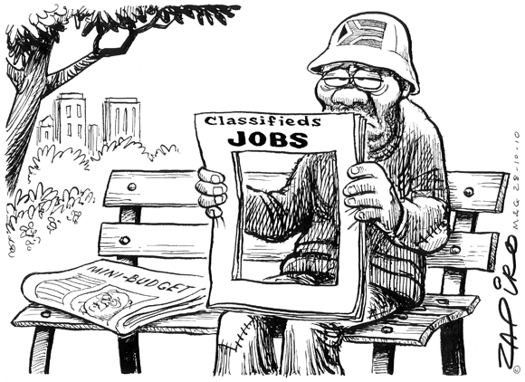
Unemployment
Stress
Mental
Karena Masalah Fisik
Kejahatan
Pernikahan dan Keluarga

Slide 30


Working During College
POSITIVE
Ketika mahasiswa ikut dalam magang atau part-time di bidang yang bersangkutan dengan bidang studi mereka.
NEGATIVE
Ketika jam kerjanya panjang/berjam-jam.

Slide 31
Work and Retirement
Pensiun adalah di mana seseorang berhenti kerja sepenuhnya.
Retiring Part - Time
Adjusting to Retirement

Slide 32


Leisure (Waktu Luang)
Waktu yang dihabiskan jauh
dari bisnis, pekerjaan,
pekerjaan rumah tangga dan
pendidikan.

Slide 33

THANK YOU!

