Slide 1
health
Disusun oleh :
Hanna indah solifatun(2016031015)
Ines patricia(2016031017)
Michele fredika(2015041018)

Slide 2
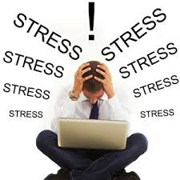
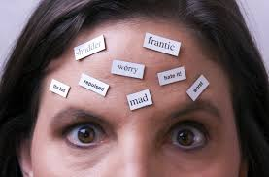
Explaining health and illness
THE BIO-PSYCHO-SOCIAL MODEL
Teori ini tentang bagaimana pola gaya hidup mempengaruhi kesehatan. Dalam pendekatan secara biologis, masalah kesehatan disebabkan oleh fungsi tubuh pada setiap individu.
PSYCHOLOGICAL FACTORS IN HEALTH AND ILLNESS

Slide 3
SOCIAL FACTORS IN HEALTH AND ILLNESS
SOCIOECONOMIC STATUS
KEMISKINAN

Slide 4
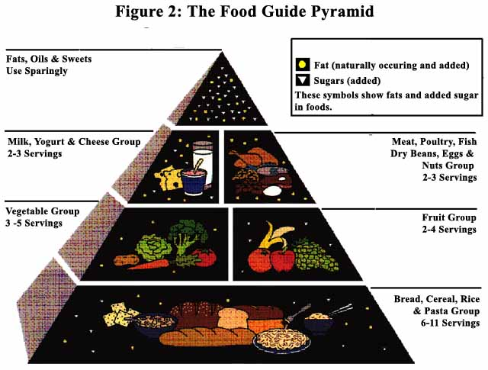
Nutrition and eating
NUTRITION AND EATING BEHAVIOR
THE FOOD GUIDE PYRAMID
Adjusment Strategies For Eating Right
Study the Food Guide Pyramid and Monitor Proposed Changes in it.
Follow a diet low in fat, saturated fat, and cholesterol.
Substitute plenty oof vegetables, fruits, and grain products for unhealthy foods
Use sugar only in moderation
Use Sodium in moderation
Drink plenty of water
Eat breakfast every day

Slide 5
CULTURAL VARIATIONS
EATING ANG LONGEVITY
Makanan mempengaruhi seberapa lama seseorang hidup. Terdapat 2 cara memperpanjang hidup :
A. CALORIC RESTRICTION
B. THE VITAMIN-AND-AGING CONTROVERSY

Slide 6
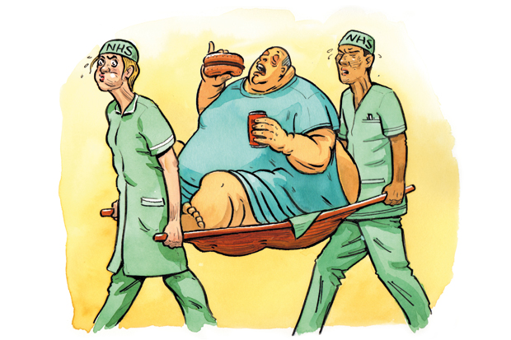
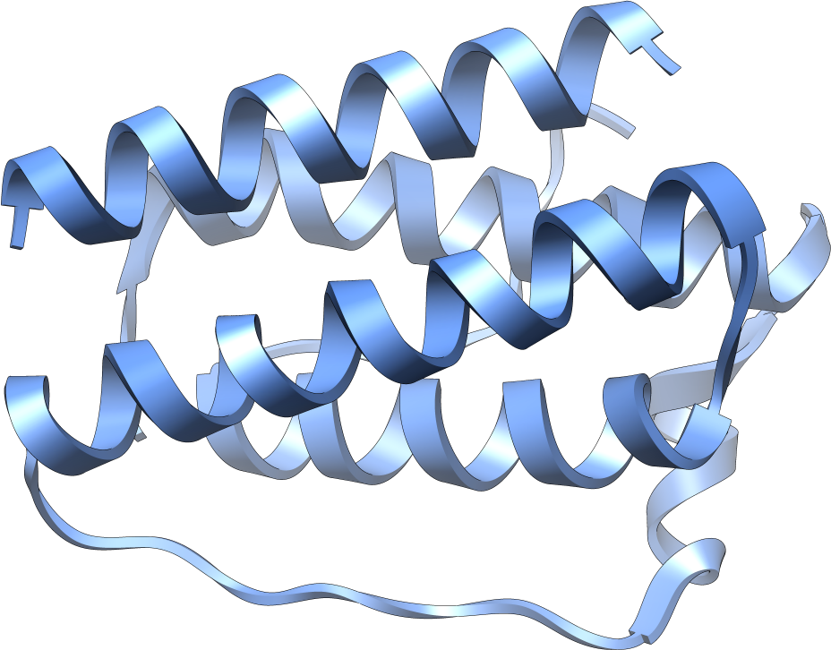
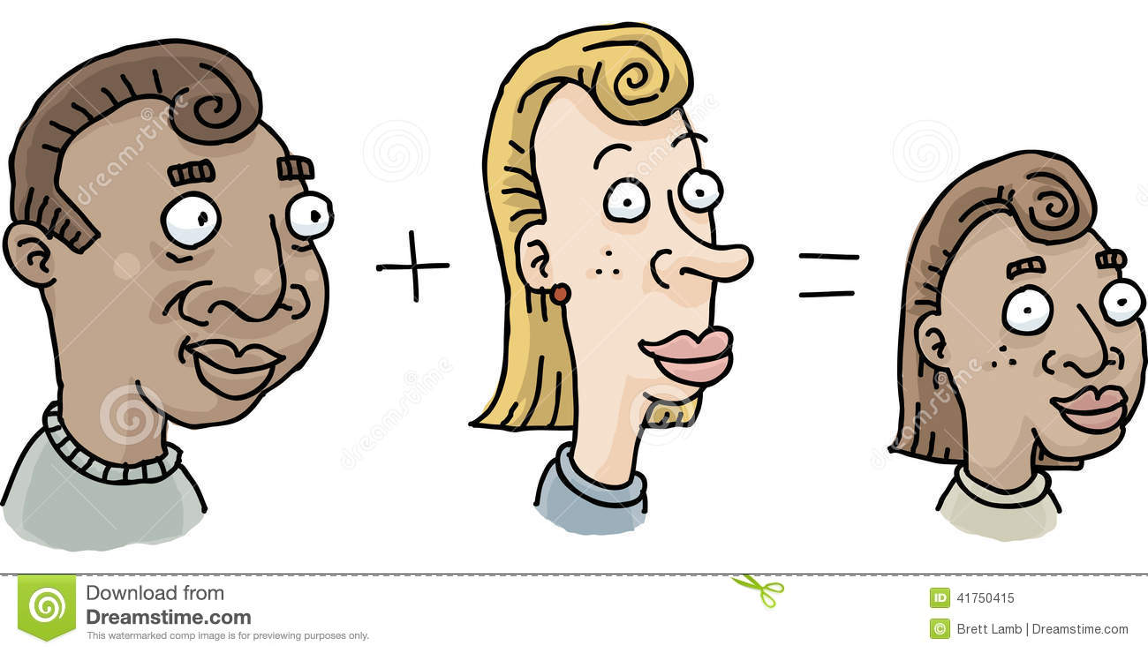
EATING PROBLEMS
OBESITY LEPTIN
HEREDITY ETHNICITY and GENDER
DIETING

Slide 7
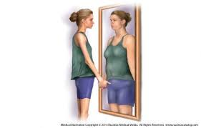
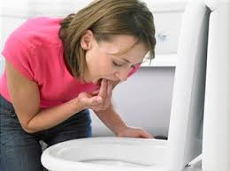
Gangguan pola makan
ANOREXIA NERVOSA
Membuat dirinya kelaparan untuk menjadi kurus.
BULIMIA NERVOSA
Setelah makan lalu dimuntahkan kembali.

Slide 8
The benefits of exercise
Eerobic Exercise :

Slide 9
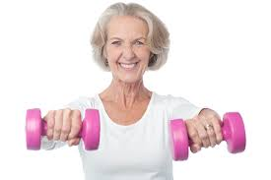
Exercise and longevity
Exercise can lead to a healthier life as a middle-aged and older adult, and increase longevity.

Slide 10
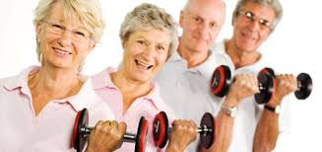
Consult with your doctor and get physical examination
Make exercise a high priority in your life

Slide 11
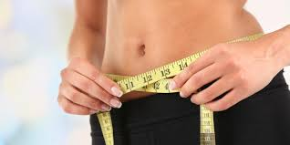
Reduce TV time
Chart your progress

Slide 12
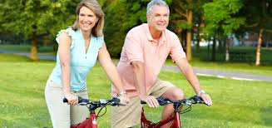
Get rid excuses
Learn more about exercise

Slide 13
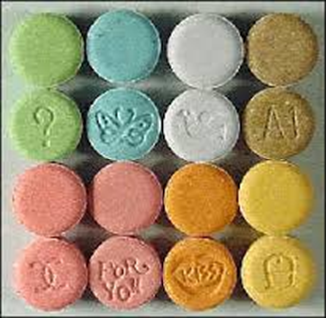
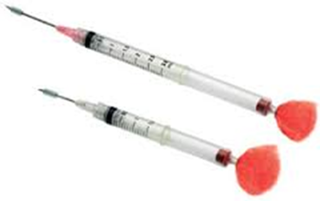
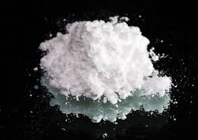
Psychoactive Drugs
Zat kimia yang bertindak terutama pada sistem saraf pusat di mana ia mengubah fungsi otak, yang mengakibatkan perubahan sementara dalam persepsi, suasana hati, kesadaran dan perilaku.
Depressants
Alcohol, barbiturates, and transquilizers.
Stimulants
Caffein, Nicotine, Amphetamines and Cocaine.
Hallucinogens
LSD, Marijuana, and ectasy.

Slide 14
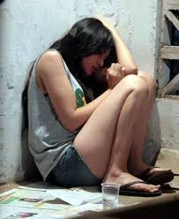
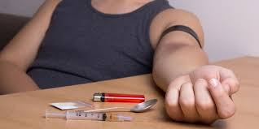
Addiction
The use of psychoactive drug for personal gratification and temporary adaptation can carry high price tag. Drug dependence ,personal disarray, and predisposition to serious, sometime fatal, disease.
Psychological dependence
Physical dependence
Disease model addiction
Life- process model of addiction

Slide 15
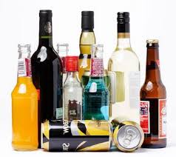
Alcoholism
Is a disorder that involves long-term, repeated, uncontrolled, compulsive, and excessive use of alcoholic beverage and that impairs the drinker’s health and social relationship.
Recovery from alcoholism is predicted by certain factors:
A strong negative experience related a drinking, such as a serious medical emergency condition.
Finding a substitute dependency to compete with alcohol abuse, such as meditation, exercise, or overeating. ( which of course has it own negative health consequence )
Having a new social supports.
Joining an inspirational group, such as a religious organization or AA.

Slide 16
Adjusment strategies for curbing alcohol use
Admit that you have a problem.
Write down your reasons for cutting down elimination your drinking.
Set a drinking goal and keep a drinking diary.
Don’t ignore what others are saying to you.
Don’t go out with people who make you feel uncomfortable if you are not drinking.
Don’t keep beer, wine or hard liquor at home.
Seek help for your problem.
Use the resources at the end of this chapter and on the book’s online.

Slide 17
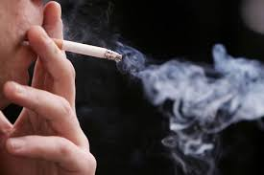
Smoking
Smoke is implicated in as many as 9,000 lung cancer deaths a year. Children of smokers are special risk for respiratory and middle-ear diseases.
Most adult smoker would like to quit, but their addiction to nicotine often make quitting a challenge. Nicotine, the active drug in cigarettes, is a stimulant that increases the smoker’s energy and alertness, a pleasureable and reinforcing experience.

Slide 18
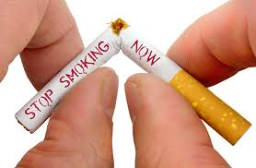
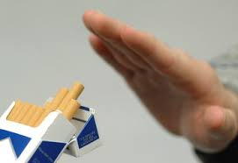
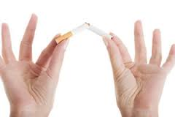
Adjustment strategies for quitting smoking
Develop a strong self-motivation to quit.
Use a substitute source of nicotine.
Take the antidepressant bupropion ST.
Control stimuli associated with smoking.
Undergo aversive conditioning.
Go “cold turkey”.
Stay smoke-free.

Slide 19
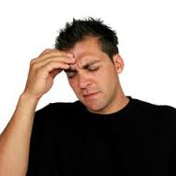
recognizing and interpreting symptoms
Mengenali Dan Menafsirkan Gejala
BAGAIMANA KITA TAHU JIKA KITA ITU SAKIT?

Slide 20
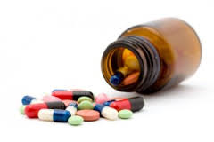
Seeking treatment (mencari pengobatan)

Slide 21
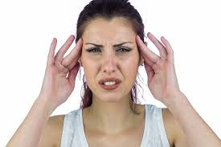
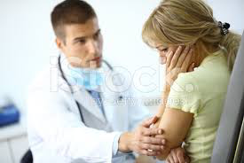
The patient role (peran pasien)
GOOD PATIENT
BAD PATIENT

Slide 22
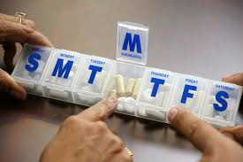
Adherence to medical&treatment (kepatuhan terhadap nasihat medis dan pengobatan)
15% pasien mengikuti intstruksi dokter dan 90% pasien yang tidak memperdulikan gaya hidupnya yg dianjurkan oleh dokter.

Slide 23
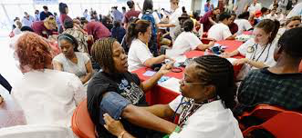
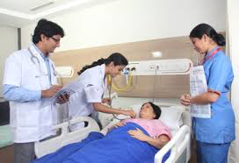
Socioeconomics status and ethnicity (status sosial ekonomi dan etnis)
Orang yang berstatus sosial ekonomi rendah, latar blkg pelayanan medisnya lebih kurang daripada orang2 yang di kelas menengah keatas & kelas atas.

Slide 24
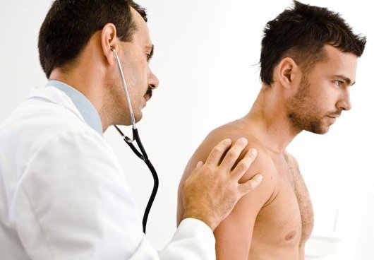
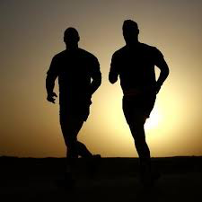
Gender

