Slide 1

Adjusting To Life
Amanda Widya Samputry 2015041021
Herlita 2016031016
Nyayu Sophia Olivia C. Henry 2013031012

Slide 2
Learning Goals
Identify some key concept that provide a foundation for understanding adjustment
Define subjective well-being and describe the factors related to it
Characterize the scientific foundation of the study of adjustment
Discuss some resources for improving adjustment and cautions in their use

Slide 3
Exploring Adjustment
What is adjustment?
Context, Diversity and Adjustment
Thinking Critically about Adjustment

Slide 4




What is Adjustment?

Slide 5
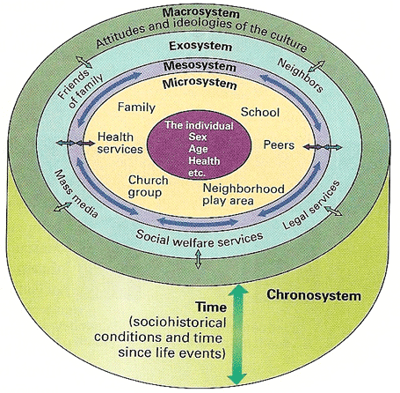


Context, Diversity and Adjustment

Slide 6


Thinking Critically

Slide 7



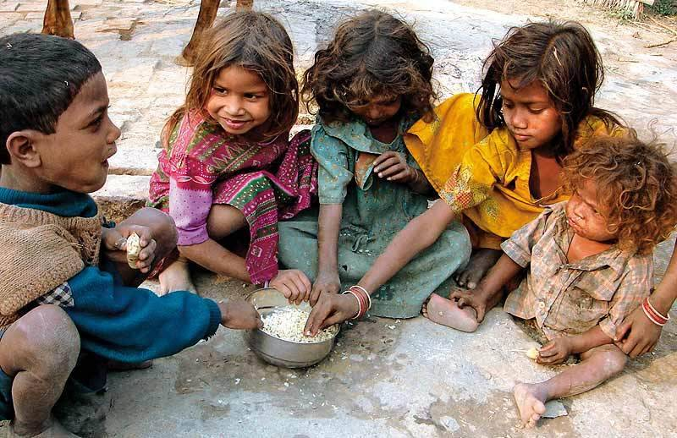
Subjective Well-Being and Adjusment
Are Rich People Happier?
Who Is Happy?

Slide 8
The Scientific Approach to Adjusment
Psychology and Adjustment
Adopting the scientific attitude
Using the scientific method
Experimental and Correlation Research
Being a wise consumer of research information

Slide 9
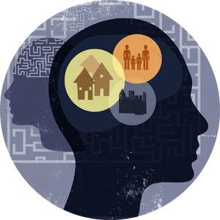


Psychology and Adjustment
Adopting a scientific attitude
Scientific method
Experimental
Wise consumer

Slide 10
Resources for Improving Adjusment
Mental health professional
National support groups
Self-help books
The Internet

Slide 11
Mental Health Professional
Resources For Improving Adjustment
National Support Groups
Self-Help Books
The Internet

Slide 12
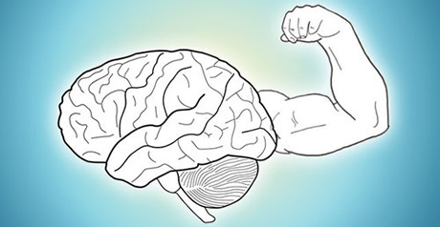

Mental health
National support groups

Slide 13
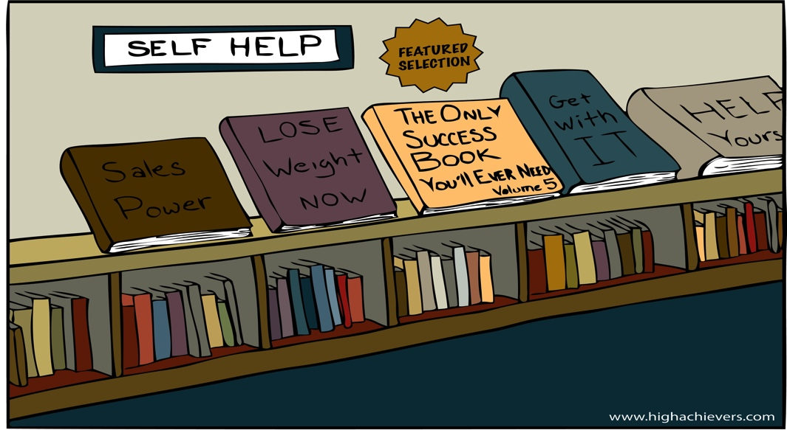
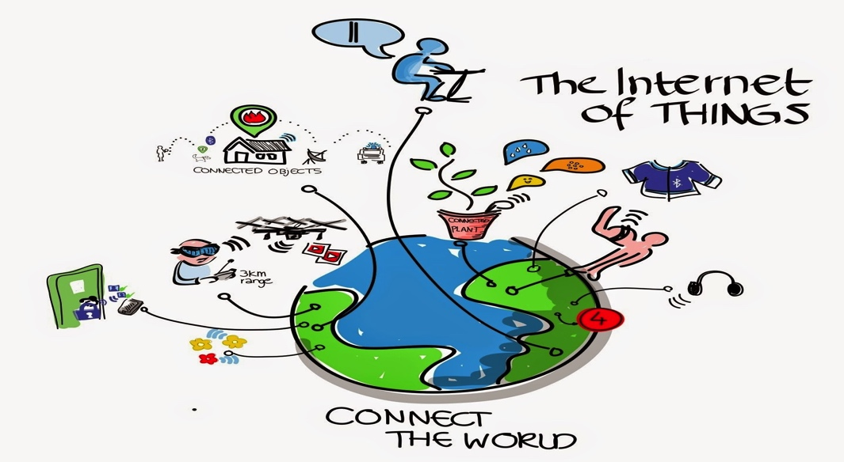
Self-help books
The internet

Slide 14


