Slide 1

STRESS & STRESS MANAGEMENT

Slide 2


Slide 3
HISTORY
A key to the understanding of the negative aspects of stress is the concept of milieu interieur (the internal environment of the body), which was first advanced by the French physiologist Claude Bernard.
He described it as external changes in the environment or external forces that change the internal balance must be reacted to and compensated for if the organism is to survive.

Slide 4
STRESS: WHAT IS IT?
Although we all talk about stress, it often isn’t clear what stress is really about.
Many people consider stress to be something that happens to them, as a negative event such as an injury or a job loss. Others think that stress is what happens to our body, mind, and behavior in response to an event (E.g. heart thumping, anxiety, or nail biting).

Slide 5


Slide 6
STRESS & STRESSOR
Stress : A person’s response to events that are threatening or challenging.
Stressor : A stimulus that causes stress

Slide 7

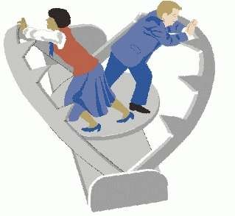
STRESS & STRESSOR
“Its not stress that kills us, it is our reaction to it.”
Hans Selye

Slide 8

SOURCES OF STRESS

Slide 9


EUSTRESS: GOOD STRESS
Getting into college.
Getting engaged.
Winning the lottery.

Slide 10


DISTRESS: STRESS FROM BAD SOURCES
Difficult work environment.
Threat of personal injury.
Diseases.

Slide 11
CATEGORIZING STRESSORS
There are three general types of stressors:
Cataclysmic events: Strong stressors that suddenly and typically affect many people at (e.g., natural disasters).
occur once
Personal stressors: Major life events, such as the death of a family member, that have immediate negative consequences that generally fade with time.
Background stressors: Everyday annoyances, such as being stuck in traffic, that cause minor irritations and may have long-term ill effects if they continue or are compounded by other stressful events.

Slide 12
THE GENERAL ADAPTATION SYNDROME
A theory developed by Selye that suggests that a person’s response to a stressor consists of three stages: alarm and mobilization, resistance, and exhaustion.
Stage I – Alarm & Mobilization:
The “fight or flight” response which causes you to be ready for physical activity.

Slide 13
THE GENERAL ADAPTATION SYNDROME
Stage II – Resistance:
If stress continues, the body adapts to the stressors it is being exposed to.
Stage III – Exhaustion:
Stress continues to exist for a long time.

Slide 14
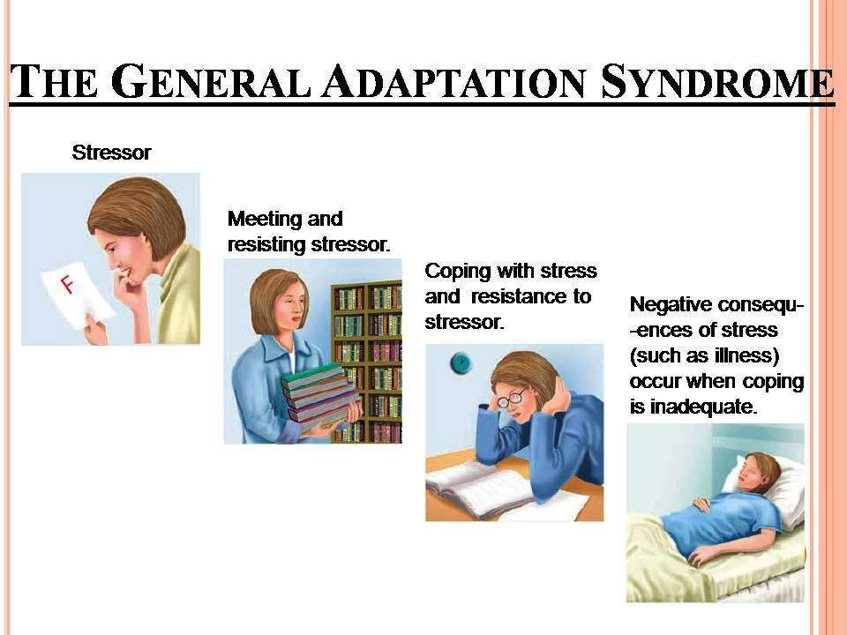


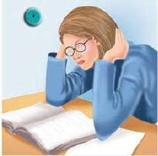
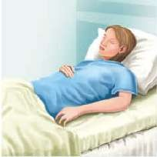
THE GENERAL ADAPTATION SYNDROME
Stressor
Meeting and resisting stressor.
Coping with stress and resistance to stressor.
Negative consequ-
-ences of stress (such as illness) occur when coping is inadequate.

Slide 15

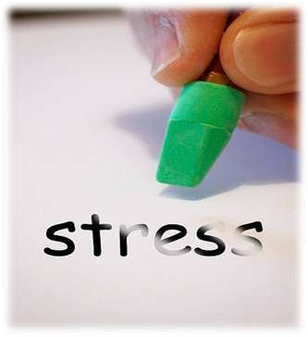


Slide 16
COPING WITH STRESS
Efforts to control, reduce, or learn to tolerate the
threats that lead to stress are known as coping.
We habitually use certain coping responses to deal with stress.

Slide 17

STEPS TO MANAGING STRESS
Step 1: Identify if you are stressed.

Slide 18

STEPS TO MANAGING STRESS
Step 2: Identify the stressor.

Slide 19

STEPS TO MANAGING STRESS
Step 3: Identify the reason for the stressor.

Slide 20

STEPS TO MANAGING STRESS
Step 4: Select an appropriate stress management strategy and apply it.

Slide 21

STEPS TO MANAGING STRESS
Step 5: Evaluate.

Slide 22
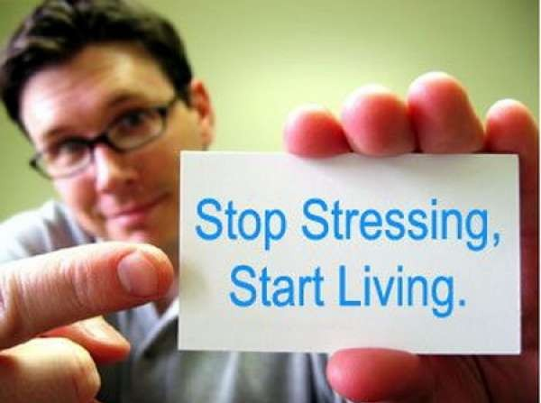

Slide 23


Slide 24


