Slide 1
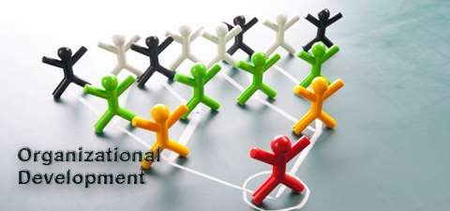

Slide 2
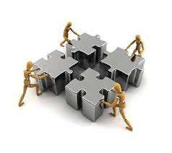
INTRODUCTION

Slide 3
An organization
No matter how well designed
Only as good as the people who live and work in it

Slide 4
OVERVIEW
What is Organizational Development (OD)
OD in Practice
Relationship between HRD and OD
OD Practitioner

Slide 5

1. WHAT IS ORGANIZATIONAL
DEVELOPMENT (OD)

Slide 6

HR PROFESSIONALS
Be HR Specialist And OD Practition
er

Slide 7

OVERVI EW
STRUCTURE
SYSTEMS
STRATEGY
STAFF
SKILLS
STYLE
HRD

Slide 8
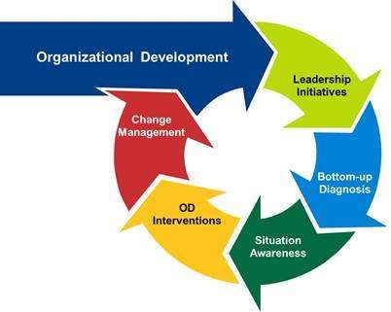
OD LOOP

Slide 9

OD
Effective diagnostic and development t Strategic and operational interventions Lead to change
Long-range effect
Problem solving and renewal processes
ool

Slide 10

How groups and organizations function
How people interact to accomplish work
OD

Slide 11
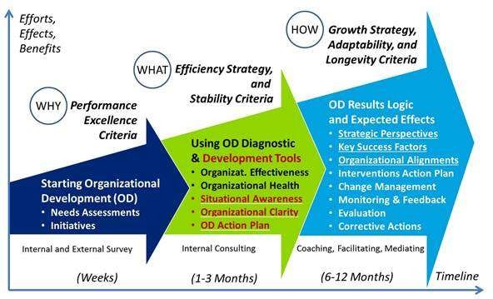
OD FRAMEWORK

Slide 12
ORGANIZATIONAL INTERVENTIONS
Implement strategic and operational changes Stem from diagnosed needs
Align organizational elements with strategy

Slide 13
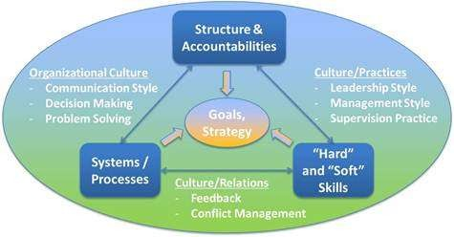
ORGANIZATIONAL ALIGNMENTS

Slide 14
OD PROCESS
Top management’s commitment, support, and involvement
Bottom-up approach - inputs from employees

Slide 15
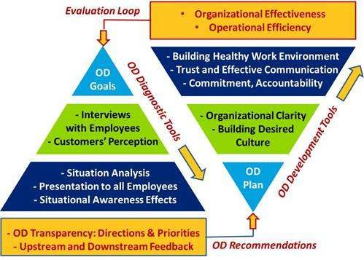
OD PRO
CESS

Slide 16
OD STRATEGY MAP
Relations between key strategic perspectives
People
Process
Customer
Stakeholders

Slide 17
OD DRIVING FORCES
Organizational clarity - strategic direction clear and aligned with defined goals
Efficiency strategy - maintaining productivity
Growth strategy - maintaining organizational adaptability and longevity

Slide 18
OD DRIVING FORCES
Values system based on optimistic view Supportive environment
Higher levels of development and accomplishment

Slide 19
OD
Planned Activity
Effects Entire Organization Requires Support from All Levels
Improve Organizational Effectiveness and Health
Deliberate Interventions

Slide 20
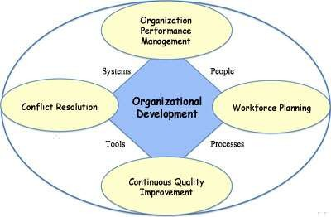

Slide 21
KEY CHARACTERISTICS OF OD
Response to Need/Problem - Turnover, Absenteeism, Low Job Satisfaction
Views Organization System - Interdependence
Involves Extensive Planning - Deal with Resistance, Systematic Diagnosis, Change Plan

Slide 22
CORE BUSINESS OF OD
Capability maintained, aligned and improved Health maintained or developed

Slide 23
Behaviora l
OD
Approaches
Technic al
Structur al

Slide 24
BEHAVIORAL APPROACH
Better utilization of Human Resources Improving Morale, Motivation & Commitment

Slide 25
STRUCTURAL APPROACH
Relate elements of Organization to one another Downsizing
Decentralization Centralization

Slide 26
TECHNICAL APPROACH
Changes in Machinery, Methods, Automation, Job Design
Change to be more Productive

Slide 27
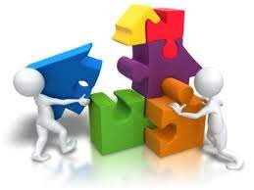
2. OD IN PRACTICE

Slide 28
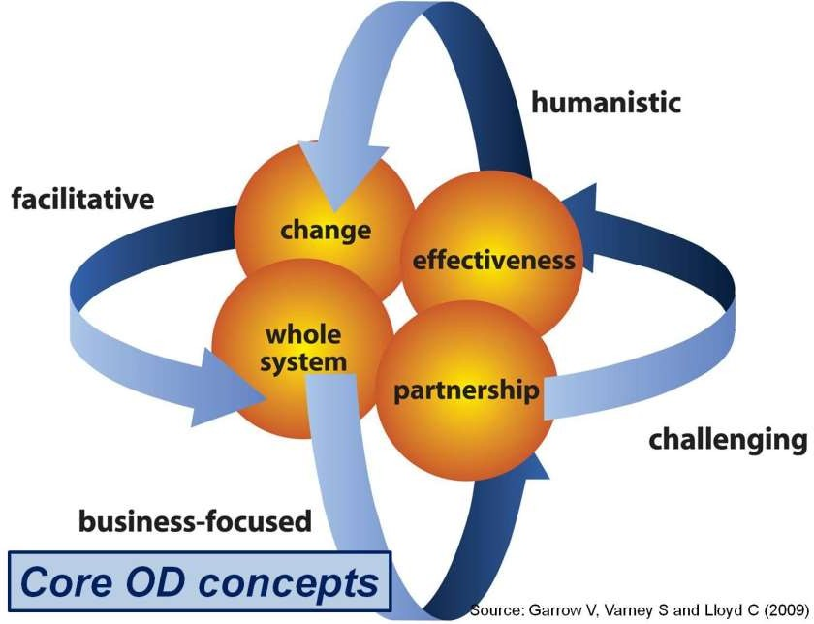

Slide 29
OD INTERVENTION
Not merely change in way things done Change in behaviour AND attitude

Slide 30
OD INTERVENTION
Reflect and Respond
Working across different departments

Slide 31
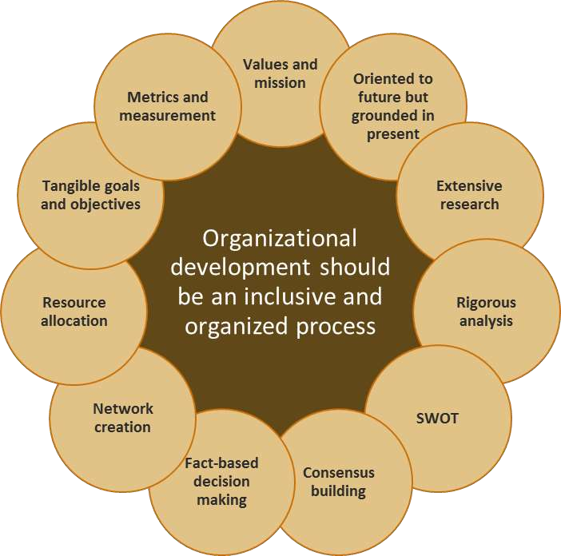

Slide 32
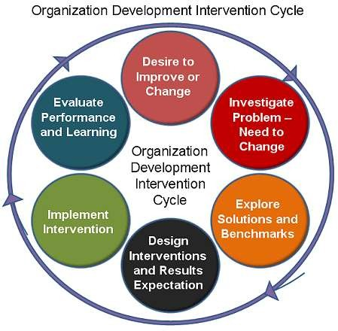

Slide 33
OD INTERVENTIONS
Mission and Vision Statement Analysis
Strategic Planning Reward and Recognition
Change Management
Leadership Team Building Facilitation

Slide 34

3. RELATIONSHIP BETWEEN OD AND
HRD

Slide 35
OD
Involve groups of people to maximise engagement, ownership and contribution
HR skill

Slide 36
HR SKILLS
Collecting, analysing data Acting on data and information Provide insight across business

Slide 37
OD
Managed from board level
Reach across all areas of business

Slide 38
DELIVERING OD
Many ways
HR take lead
Multi-disciplinary approach
HR and OD work together to develop long
term strategic view
OD activities supported and underpinned by people management practice

Slide 39
HR PROFESSIONALS
Business partner Guide behaviours Reinforce values

Slide 40
OD
Develop HR’s strategic role Organisational change Organisational culture Employee engagement

Slide 41
OD
Do not replace HR Draw on HR processes

Slide 42
OD
People and problem-centred activity People data to diagnose issues

Slide 43

4. OD PRACTITIONER

Slide 44
OD PRACTITIONER
Bringing whole self to task in hand Build reputation as trusted advisor Advocate of development
Continuously improving and developing own learning and understanding of practice

Slide 45
KEY COMPETENCIES
Theoretical and Technical expertise Influencing Skills
Energise engagement
Innovative, Creative and Critical thinking

Slide 46
KEY COMPETENCIES
Tackle difficulties and problems with positivity Self-Confident
Credible communicators Interpersonal and Facilitation skills

Slide 47
KEY COMPETENCIES
Emotionally Tuned in Ethical, value driven Acts with integrity

Slide 48
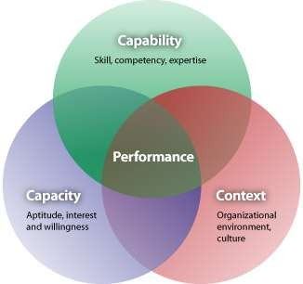
OD PRACTITION ER’S PERFORMAN CE:
3 CS

Slide 49
OD PRACTITIONER
Strong grasp of strategic planning
Estimation of human capital and social capital Align strategy within values of organization Challenge assumptions

Slide 50
CORE VALUES – HUMANISTIC
Function as human beings rather than resources
Develop to full potential
Increase effectiveness of organizational goals

Slide 51
CORE VALUES – HUMANISTIC
Exciting and challenging
Treating each human being as person with complex set of needs

Slide 52
OD PRACTITIONER
Role varied and dynamic
Helper, advisor, sounding board, navigator, coach, facilitator, designer, developer, leader, consultant, expert, partner, problem solver, diagnostician, process specialist and collaborator
Internal or external consultant

Slide 53
OD PRACTITIONER
Helping clients to improve effectiveness of organization
Develop both business and people processes

Slide 54
OD PRACTITIONER
Centre of change and development efforts Drive change
Help organisation develop
Each phase of OD cycle: Diagnostic, Intervention and Evaluation

Slide 55
OD PRACTITIONER
Help organisations define agenda Not reactive to needs
Working at process level

Slide 56
1. START WITH PROCESS
OD practitioner key to success or failure of OD intervention

Slide 57
2 GATHERING AND ASSESSING DATA
Decide how to intervene
Ensure intervention have impact on root cause Action research process
Diagnostics done with client

Slide 58
3. FEEDBACK AND DECISION
Communicate outcomes in comprehensible format
Non-threatening atmosphere
Ownership in process Process consultation

Slide 59
4. FORM PLAN
Considered approach
Distil recommendations from data
Focus on action with high impact with minimum costs
Implement

Slide 60
5 INTERVENE
Intervention pitched at right emotional depth
Clear on focus – individual, group or whole organisation
Choose right type of intervention Different interventions - restructuring,
coaching, transformational change, learning
and development

Slide 61
6 EVALUATE
Right evaluation method Action research approach
Continually assessing impact and results Cultural fit

Slide 62

CONCLUSION

Slide 63
REVIEW
What is Organizational Development (OD) OD in Practice
Relationship between HRD and OD OD Practitioner

Slide 64
Organization's ability to learn Translate learning into action rapidly The ultimate competitive advantage

Slide 65
First comes thought
Then organization of that thought, into ideas and plans
Then transformation of those plans into reality The beginning is in your imagination!

Slide 66

THANK YOU!

