Slide 1

Leadership
The Power Works

Slide 2

What is the Leadership?

Slide 3

Leadership?
Perform one or more acts of leading.
Affect human behavior so as to accomplish a mission.
Influencing a group of people to move towards its goal setting or goal achievement.
Stogdill 1950)

Slide 4
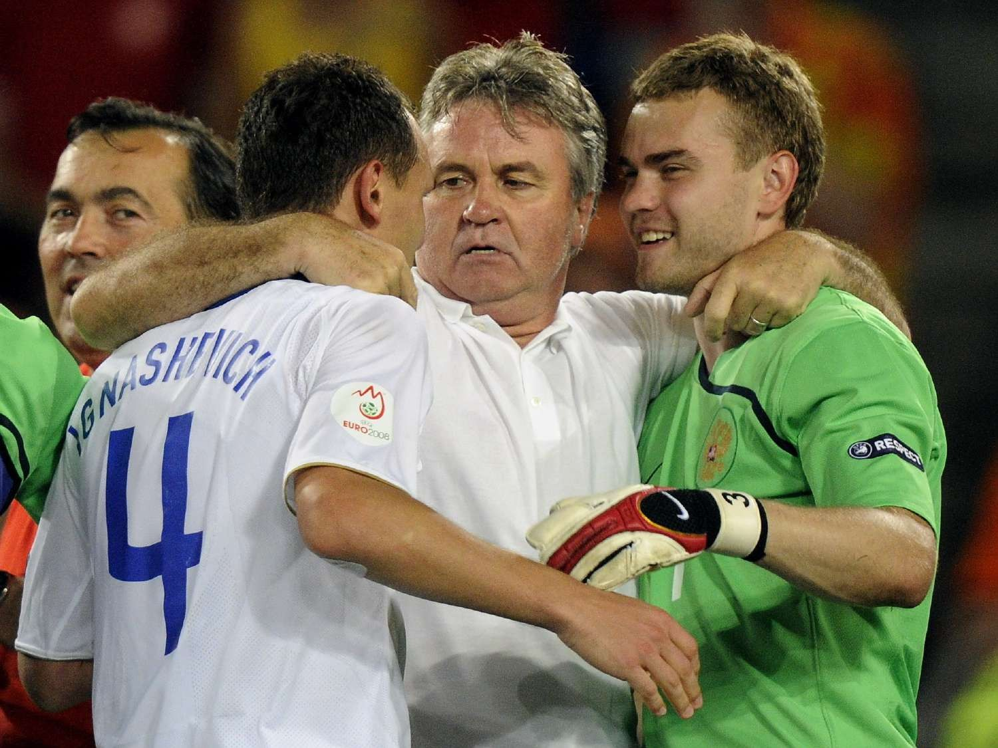
Leaders?
Strategic Thinkers
Look Forward and Create Visions Challenge
Motivate Inspire

Slide 5

Managers?
Maintain the status quo Monitor situation Allocate resources Communicate targets Measure the results Feedback on the trends

Slide 6
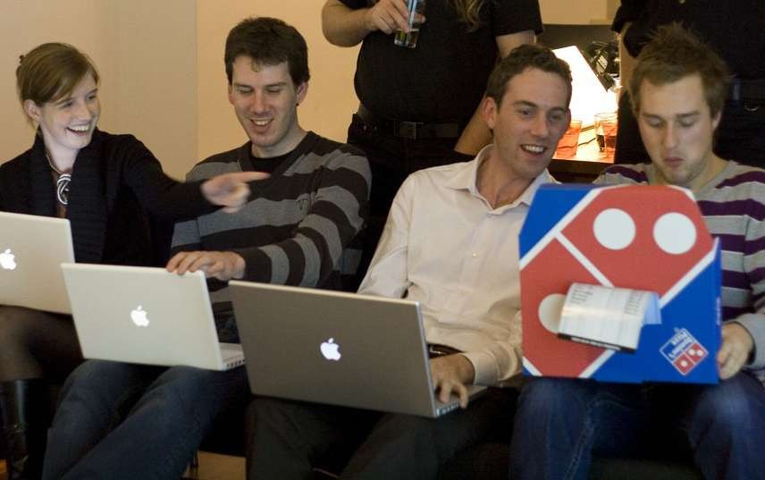
Formal vs. Informal

Slide 7

Leader vs. Follower

Slide 8
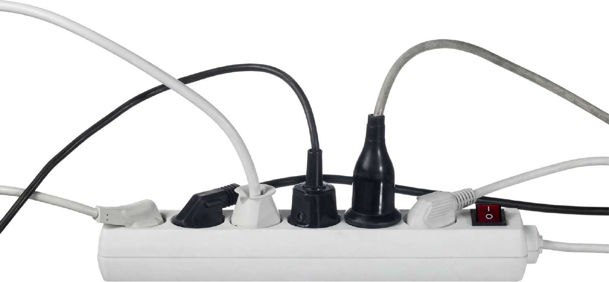
Where is the Power from?

Slide 9

Leader is an Innovator

Slide 10

Leader is a Coach

Slide 11
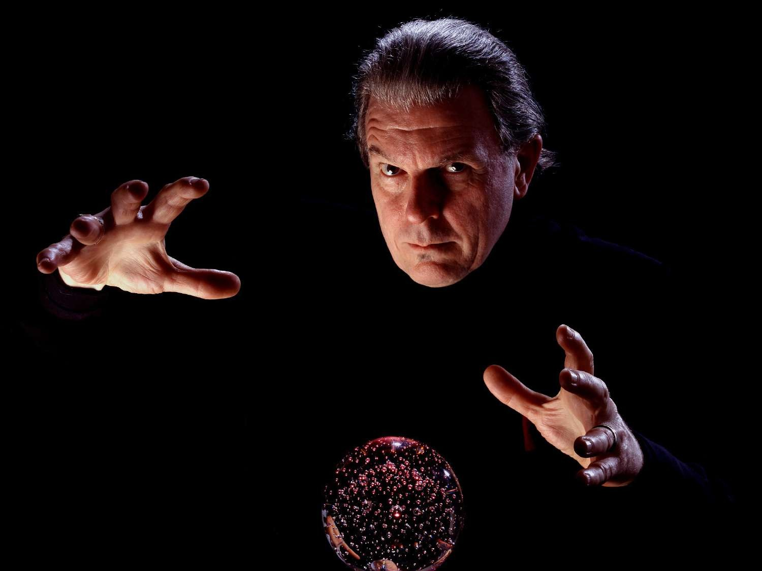
Leader is a Politician

Slide 12
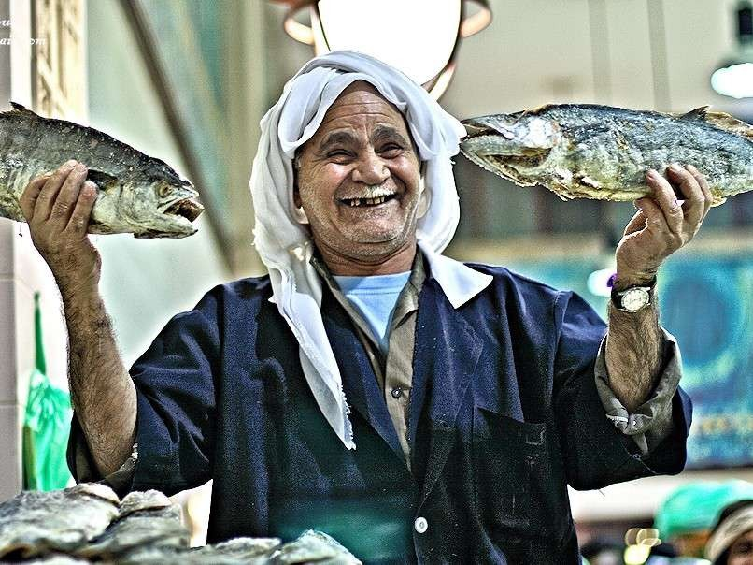
Leader is a Salesperson

Slide 13

Leader is a Communicator

Slide 14
Your difficult boss, customer, prospect, voter, student... probably not stupid, probably just uninformed.
There's a huge difference.
[Seth Godin]

Slide 15

Leader is a Problem Solver

Slide 16

Leader manages Time

Slide 17

Leader manages Quality

Slide 18

Leader manages Chemistry

Slide 19

Leader manages Goal

Slide 20
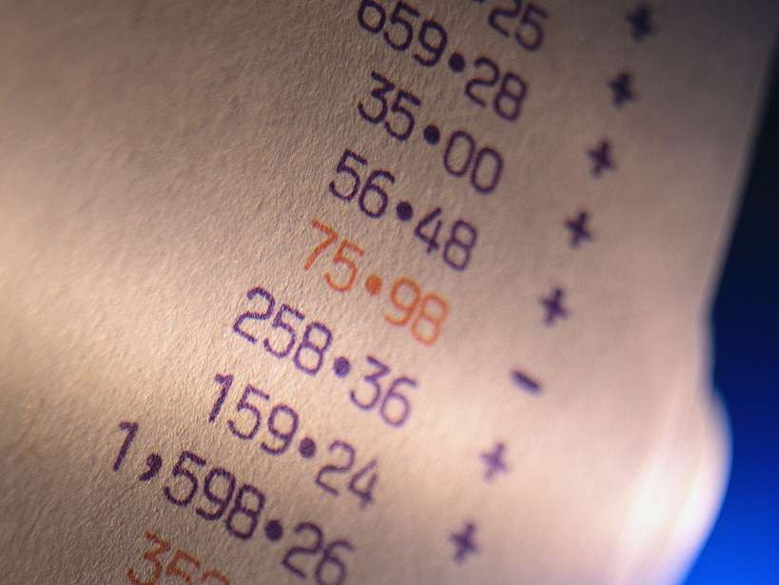
Leader manages Numbers

Slide 21

Leader speaks in Performance

Slide 22
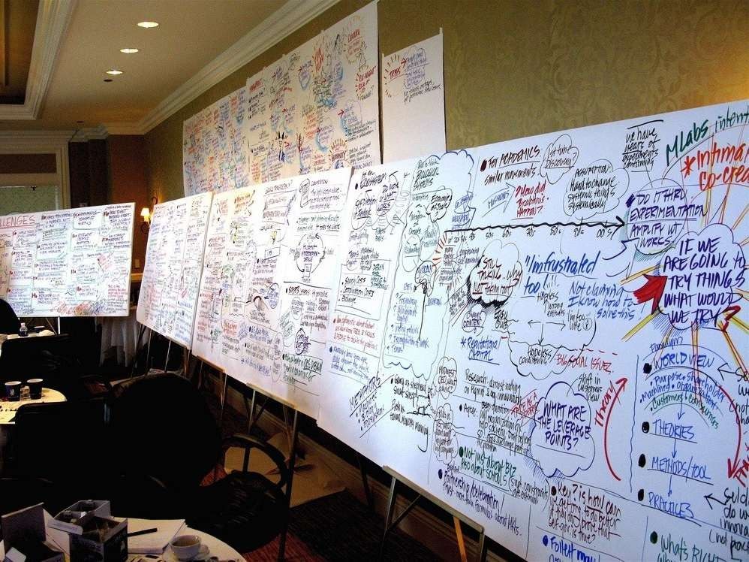
Leader Makes Decision

Slide 23

Leader takes Risks

Slide 24

Emotions are Contagious

Slide 25

Discipline Yourself

Slide 26

Be Better than All

Slide 27

Rent Autonomy

Slide 28

Communicate More, Faster, Clearer

Slide 29
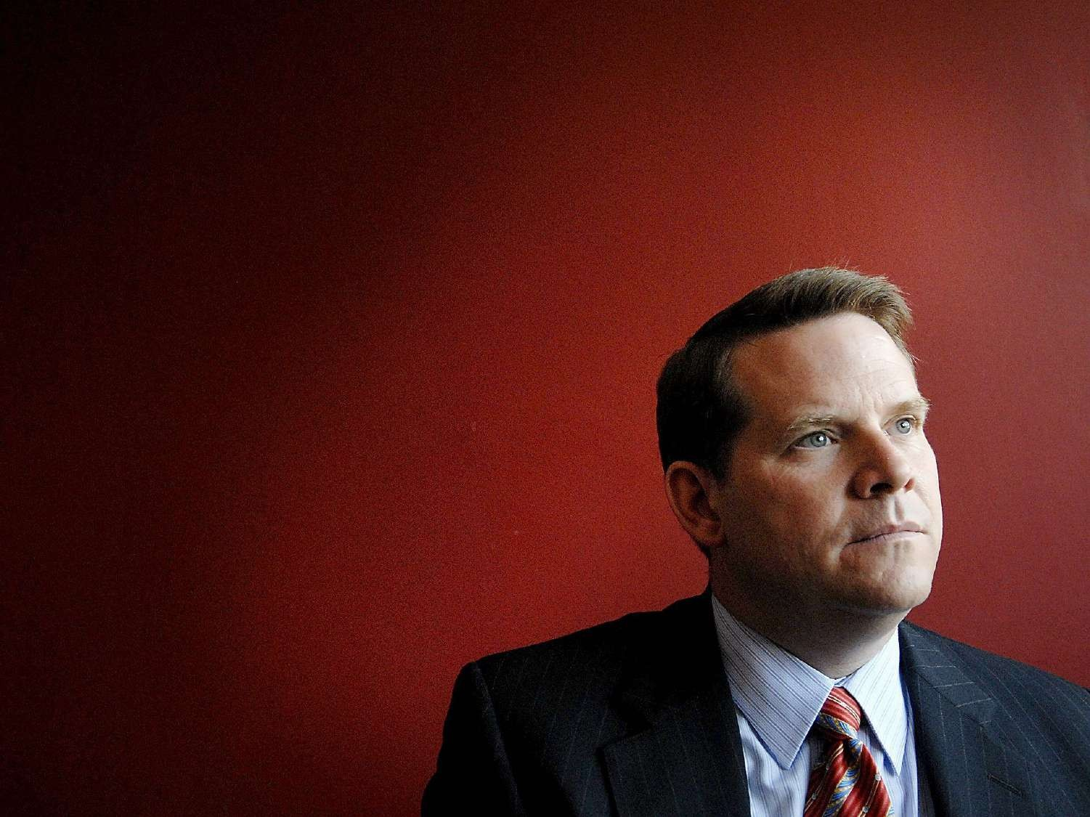
But,
Deal Information Strategically

Slide 30

Lead by Asking Questions Not By Issuing Instructions
Source: The 60 Second Leader

Slide 31

‘To Do or To Be?” THAT is the question
Source: The 60 Second Leader

Slide 32

Failure is
Not the Opposite of Success
Source: The 60 Second Leader

Slide 33

Only Make New Mistakes
Source: The 60 Second Leader

Slide 34

“Leadership, like swimming, cannot be learnt by reading about it”
Henry Mintzberg
Source: The 60 Second Leader

Slide 35


PR Manager in Agency

Slide 36

Ticket to Where?

Slide 37
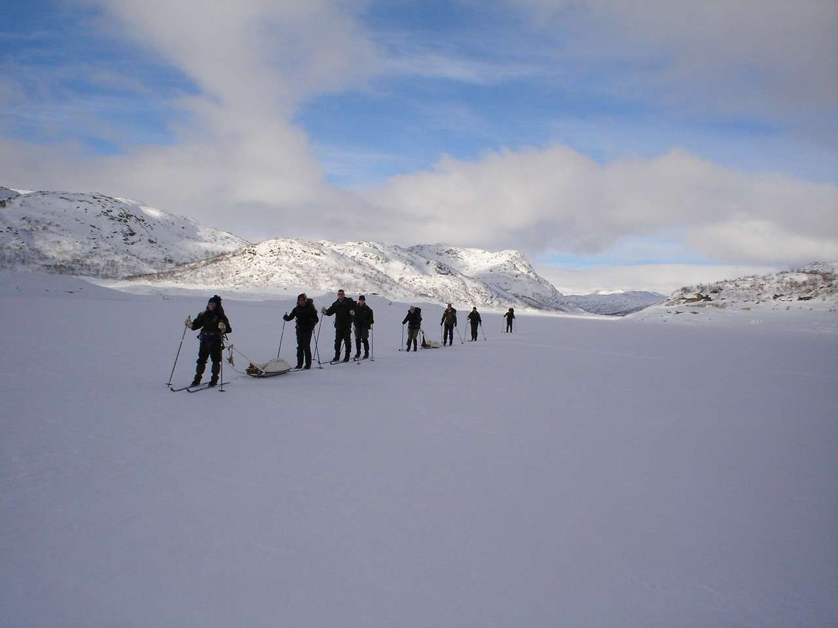
Where is Your Destination?

Slide 38

Check Reference on Yourself

Slide 39

Keep Your Own Specialty

Slide 40

If your product has no unique value, you will be
selling on price alone.

Slide 41

Build Reputation on You

Slide 42
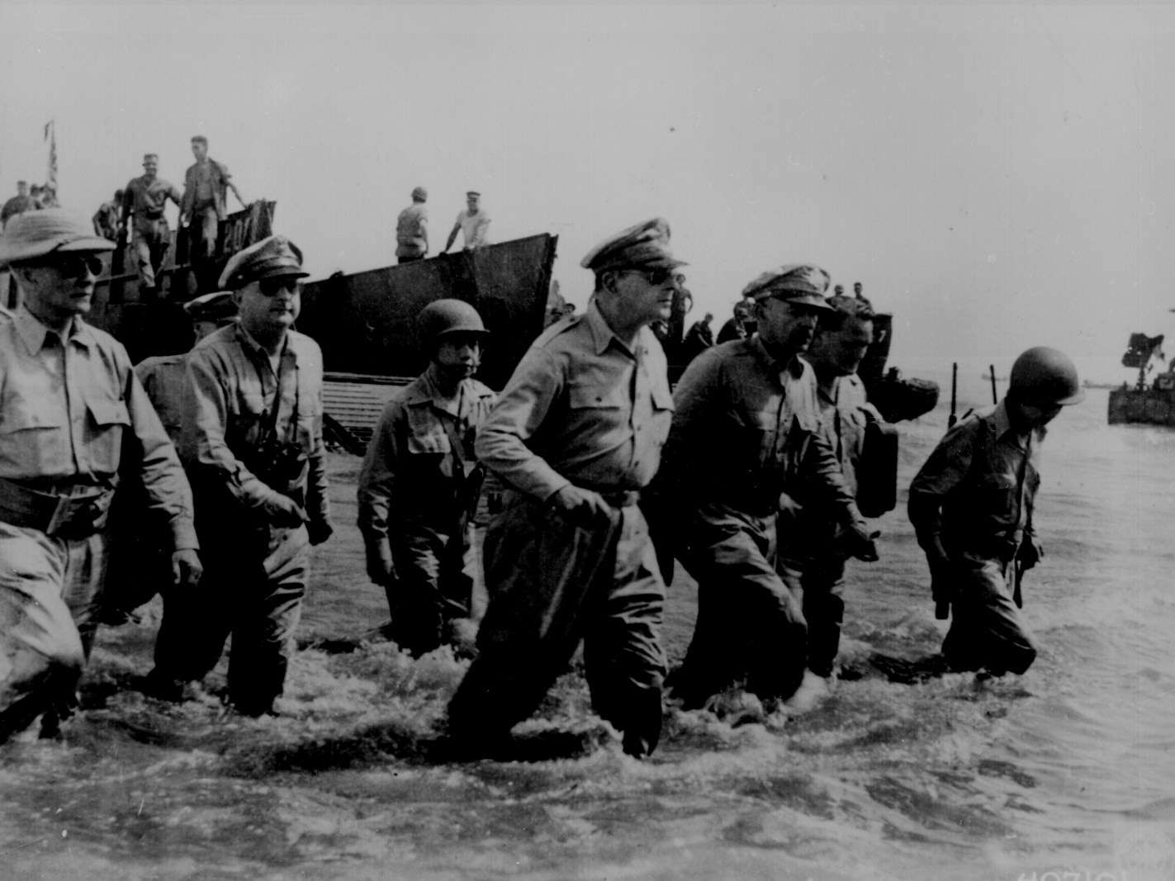
Excellent Managers Create Excellent Agency

Slide 43

What is Our Vision?

Slide 44




Limitless Organic Growth
Timeless Competition with Clients
Priceless Life Management
What is Our Vision?

