Slide 1






A Presentation on

Slide 2

WHAT IS MOTIVATION?
Motivation is generally defined as the force that compels us to action. It drives us to work hard and pushes us to succeed. Motivation influences our behaviour and our ability to accomplish goals.
Motivation is the driving force behind behavior. This is key to understanding why it is important for business.
As managers/owners we need to drive behavior of our employees. Understanding what their motivation is and how to tap into it.

Slide 3
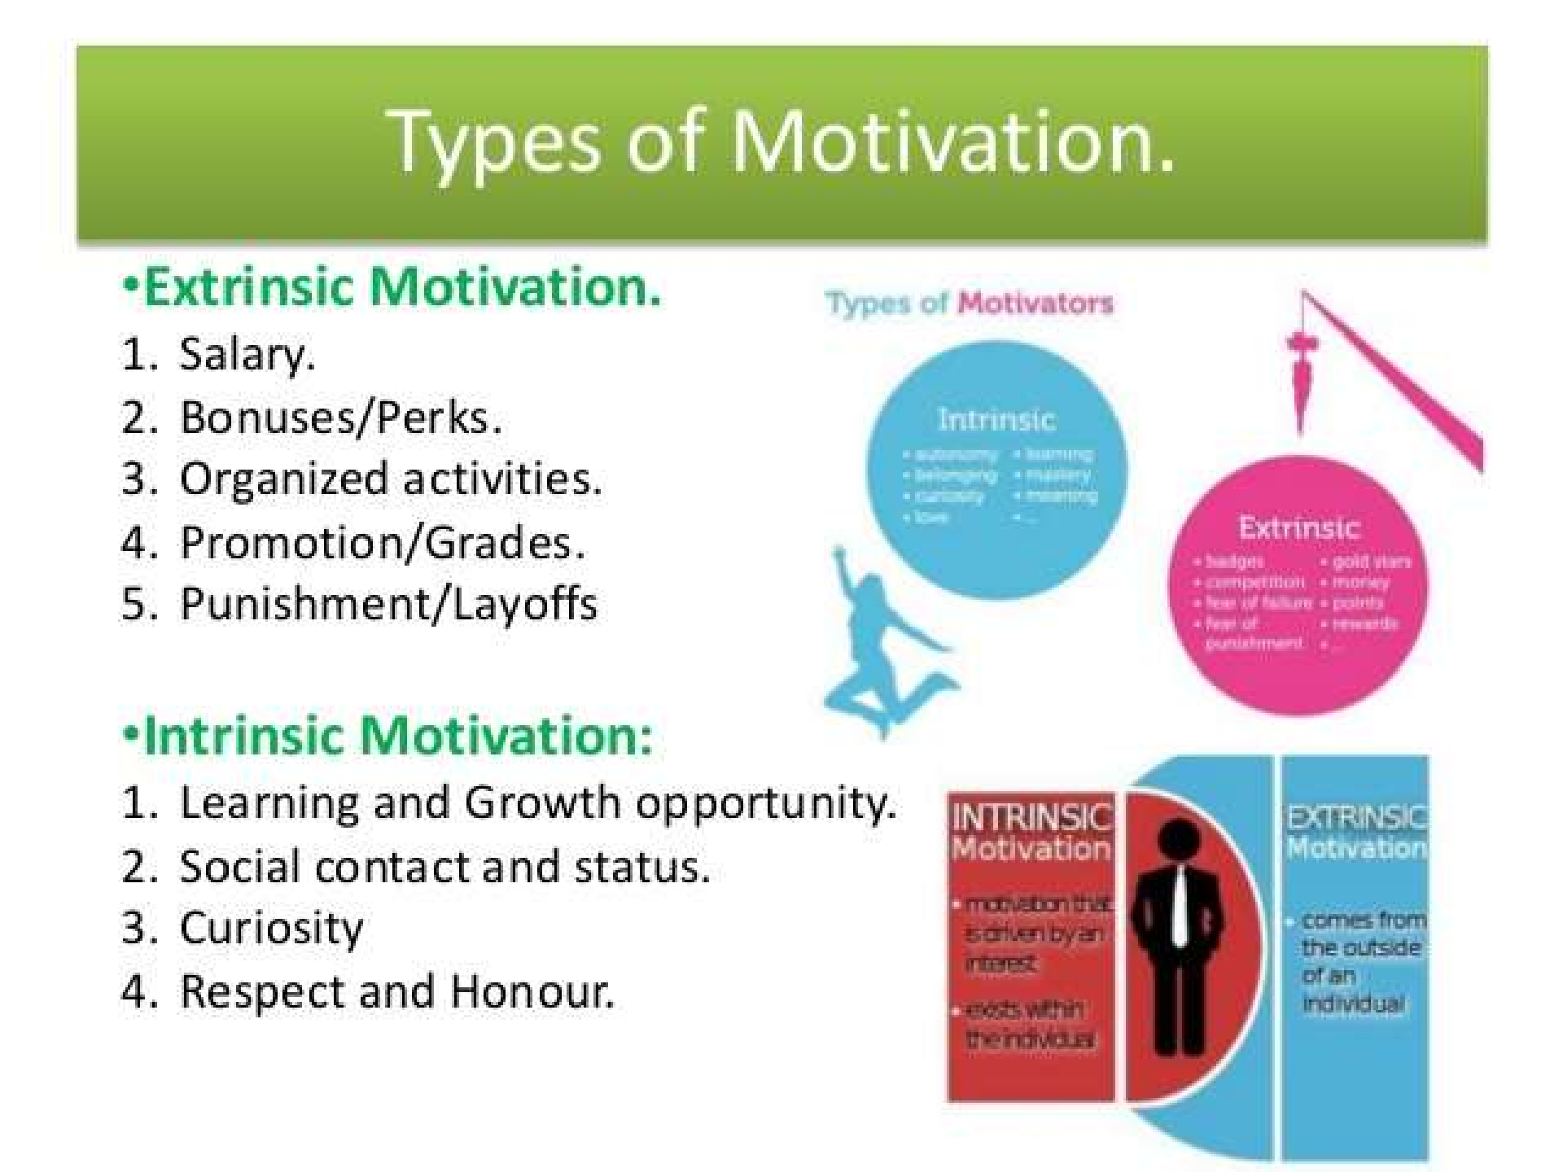

Slide 4
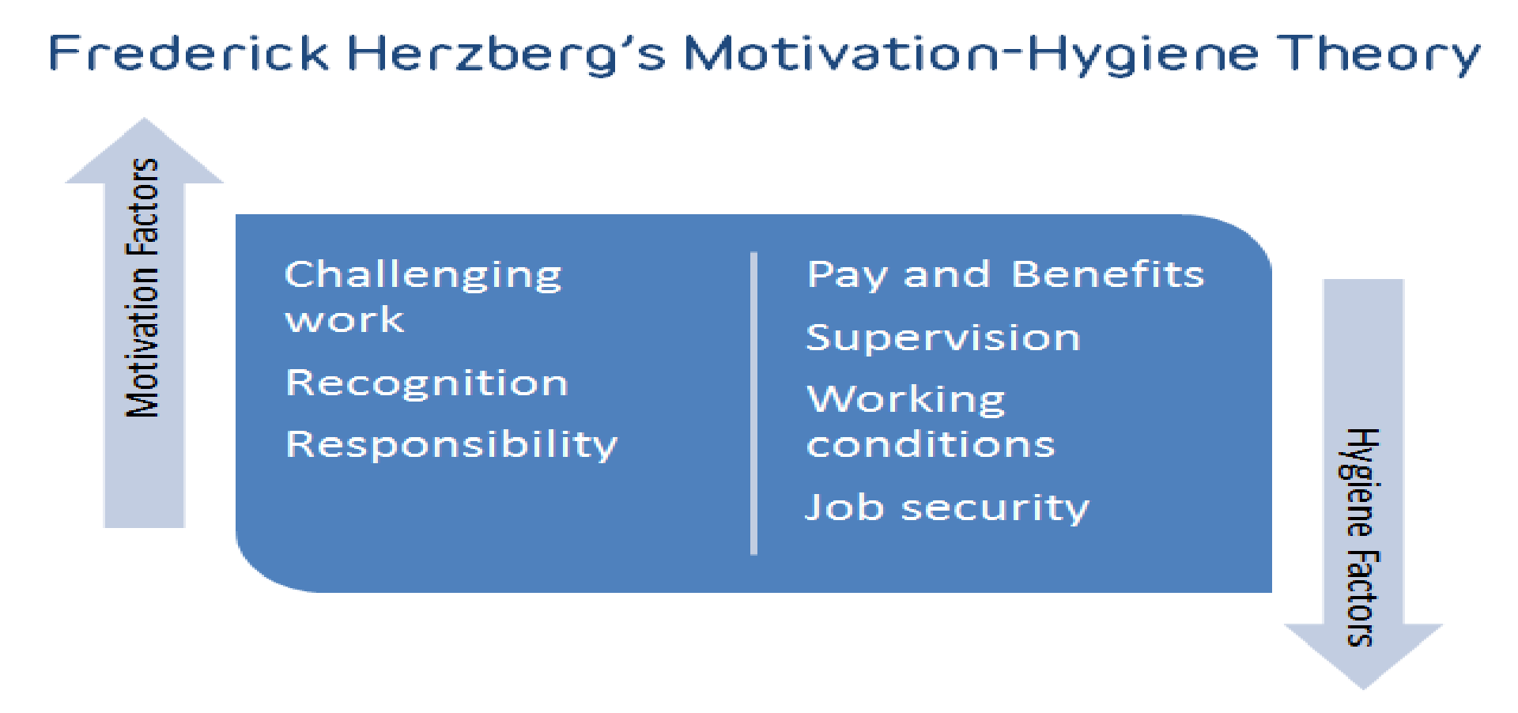
Psychological Theories of Motivation
1. Hertzberg’s Two-Factor Theory: was developed by psychologist Frederick Herzberg in the 1950s. Herzberg found 2 factors that influence employee motivation and satisfaction:

Slide 5

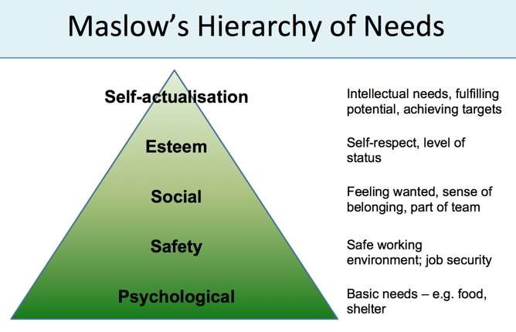
2. Maslow’s Hierarchy of Needs:
The hierarchy is made up of 5 levels:

Slide 6

3. Hawthorne Effect: a tendency for some people to work harder and perform better when they were being observed by researchers.
4. Expectancy Theory: Proposes that people will choose how to behave depending on the outcomes they expect as a result of their behaviour.
Expectancy Theory is based on three elements:
Expectancy – the belief that your effort will result in your desired goal.
Instrumentality – the belief that you will receive a reward if you meet performance expectations.
Valence – the value you place on the reward.

Slide 7


Challenges of Motivating Employees
Focus
Personalities
Communication
Expectations
Costs
Environment
Low Self-Confidence
Low Expectations for Success
Lack of Interest in Subject Matter
Achievement Anxiety
Fear of Failure

Slide 8
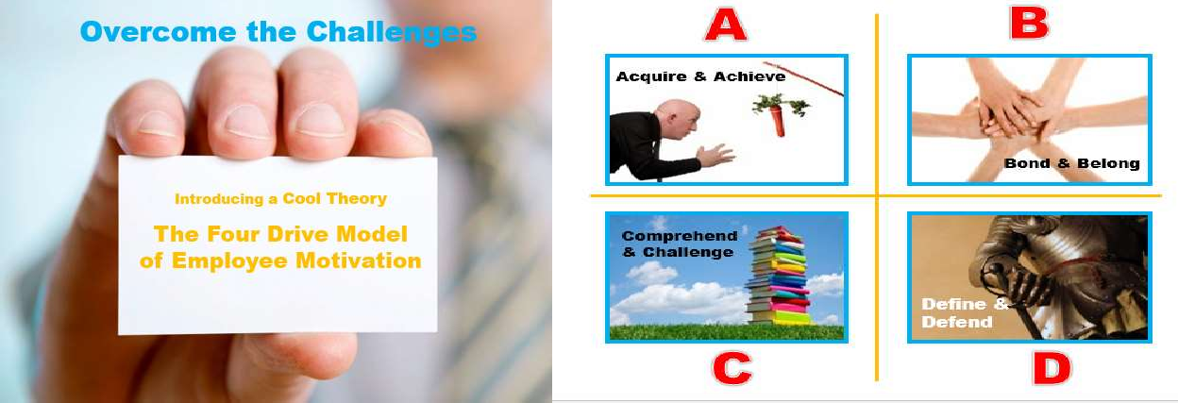
We all have a drive to Acquire & Achieve money, things, prestige, power etc.
We also want to Bond with others – and Belong
We strive to COMPREHEND our world and feel CHALLENGED
And we need to DEFINE and DEFEND those things and ideas we BELIEVE IN

Slide 9


Motivational Tips & Techniques
Top Ten Motivation Tips:
A positive attitude
The right tools and skills for the job
Training is always good, it keeps people up to date and focused on the
job
Offer a nice clean working environment
Listening to your team
Positive immediate Effects
Encourage staff to dress smartly
Remind staff how their work matters to customers and encourage.
Join in and help an employee who is under pressure. Ask what can be done and help complete the task side-by-side.
Create a change of pace by giving employees a chance to work on
exciting projects or learn new skills.

Slide 10
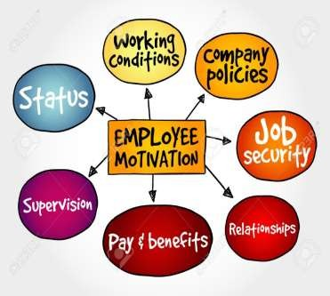


Effective Ways to Motivate Employees
Create a Positive Work Environment
Increase salary
Set Goals
Build Trust and Respect
Business Promotion
Understanding Employees
Improve productivity
Reduce workload
Improve your leadership
Provide Incentives
Building Employee Recognition Program

Slide 11




Recognize Achievements
Share Profits
Solicit Employee Input
Provide Professional Enrichment
Positive Reinforcement
Cross Training
Radiate Positivity
Be Transparent
Motivate Individuals Rather Than the Team
Rewards: intrinsic and extrinsic motivation

Slide 12
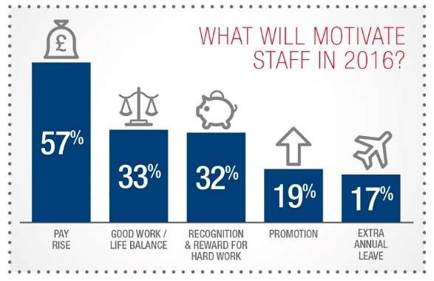

Slide 13
References
https://en.wikipedia.org/wiki/Employee_motivation
http://www.inc.com/ilya-pozin/14-highly-effective-ways-to-motivate- employees.html
http://www.employee-motivation-skills.com/employee-motivation- techniques.html
http://www.inc.com/encyclopedia/employee-motivation.html
http://www.accel-team.com/publications/atPDF_02_motivation.html
https://contactzilla.com/blog/5-psychological-theories-motivation-increase- productivity/
https://www.officevibe.com/blog/challenges-first-time-managers

Slide 14



