Slide 1




Industrial and Organizational Psychology Selecting Employees
©www.asia-masters.com

Slide 2
Selection Problem: Choose the Best Person For the Job
1. Best performer
•
•
Best social fit (team player)
Best person‑job fit (worker adjustment/well- being)
•
•
•
Empirical process: Data based and objective Legal process: Government regulation and law Utility: Benefit of using a selection procedure
©www.asia-masters.com

Slide 3
Hiring Process
©www.asia-masters.com

Slide 4
Planning and Recruitment
•
Planning: Anticipating needs for human resources
Expansion vs. replacements
Labor markets
Recruitment
Advertising
Employee referral
Employment agencies
School recruiters
Walk-ins
Web (Monster website)
•
©www.asia-masters.com

Slide 5
Preliminary Concepts
•
Reliability
Test‑retest
Internal consistency: Multiple items required
Validity
Criterion related
•
Concurrent vs. predictive
Content
Face
Convergent vs. Discriminant
Construct: Overall case necessary for legal defense
©www.asia-masters.com

Slide 6
Making Selection Decisions
•
•
Human judgment: Hire whoever seems best
I/O approach: Use empirically (research-based) proven assessment methods
Steps involved in I/O method
•
–
–
–
–
–
–
Analyze job
Define criteria
Define abilities needed
Choose potential predictors
Validate (determine equation)
Cross‑validate
•
•
Multiple cutoff option: Must meet each selection requirement
Multiple regression: Must achieve a certain total score regardless of performance on each requirement
Validity generalization: Effective selection devices work in all settings
•

Slide 7
Utility
•
•
•
Value of selection system to the organization Cost/benefit ratio
Utility is maximized by
–
–
–
–
–
Validity of selection device—should be high
Selection ratio (hired/applicants)—should be low
Baseline for success—should be 50%
Cost of selection program—should be low
Cost of bad selection (recruitment, training, low productivity)—should be high
•
Hunter‑Schmidt programmer aptitude test for federal government
–
–
–
–
Cost: $6000/year
Estimated gain: $5.6 million to 97.2 million
If universally adopted could save $1.5 billion in U.S.
However, this assumes unlimited supply of applicants and no constraints on performance in organizations
©www.asia-masters.com

Slide 8
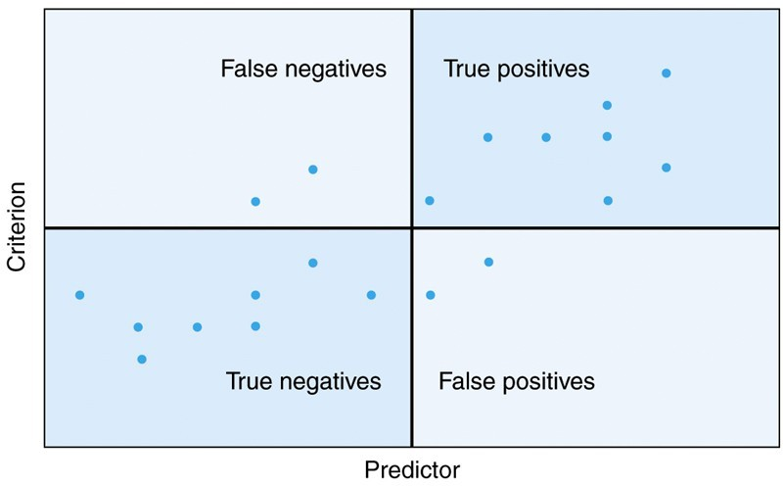
Utility Example

Slide 9
Legal Issues
•
•
Civil Rights Act (1964) prohibited discrimination
Equal Employment Opportunity Commission, EEOC charged with overseeing compliance
Uniform Guidelines for Employee Selection (1978). Adverse impact (80% rule based on selection ratios) Discrimination Case based on
Adverse impact
Invalid selection/placement procedures
Job irrelevance
Lack of business necessity
•
•
•
©www.asia-masters.com

Slide 10
Affirmative Action
•
Required of all organizations with > 50 employees or government contracts > $50,000
Includes universities with grants
Requires a plan to increase female and minority representation Hiring unqualified forbidden by Supreme Court
Preferential Treatment
•
•
•
•
–
–
–
–
–
Not required except under unusual circumstances E.g., organization unwilling to practice fair selection Can have negative effects
Beneficiaries--poor self-image
Nonbeneficiaries--negative attitudes and resistance
©www.asia-masters.com

Slide 11
Americans With Disabilities Act of 1990
•
Extends civil rights protection to disabled
•
Similar to Civil Rights Act in how it works
•
Reasonable accommodation
– What is reasonable?
•
Essential functions
©www.asia-masters.com

Slide 12
Solutions To Problems of Discrimination
•
Objectivity in selection procedures
•
Focus on job relevant characteristics
•
Panel interview with diverse membership (Prewett- Livingston et al., 1996)
•
Training of people who make selection decisions
©www.asia-masters.com

