Slide 1


EMPLOYMENT ISSUES

Slide 2



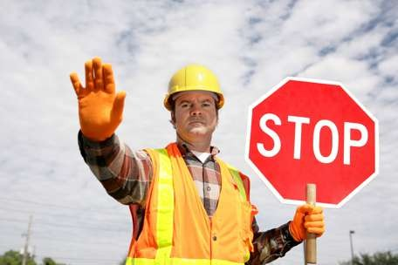
Legal Issues Relating to the Workplace
Work, Health and Safety
Close to 180 workers will die per year in the workplace. Most of them will be men under 34
Construction, Agriculture/ Forestry, and Transport Industries are the most dangerous
Most of these deaths could have be prevented with proper safety management

Slide 3

Work, Health and Safety in the Workplace

Slide 4
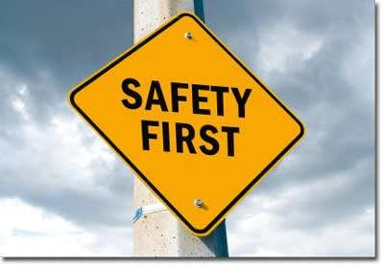
Work Health and Safety (WHS) Act 2010 (Cwlth)
safe workplace, regular maintenance of equipment and machines, have a written WHS policy, protective clothing used, established committees
Click here

Slide 5
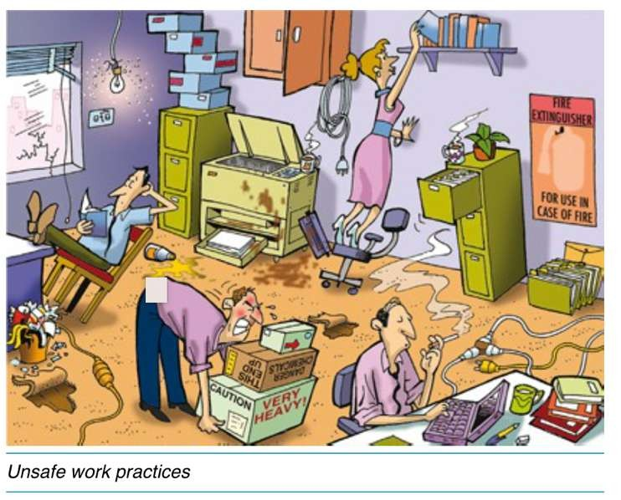
List the unsafe workplace practices in the picture

Slide 6



Anti - Discrimination
Forms of workplace bullying include intimidation, humiliation, verbal abuse, slamming doors, pushing, touching or fondling, and threatened or actual violence against an employee
The Anti-Discrimination Act 1997 (NSW) and the Sex Discrimination Act 1984 (Cwlth) make sexual harassment unlawful

Slide 7

Sexual Harassment and the Police NSW

Slide 8
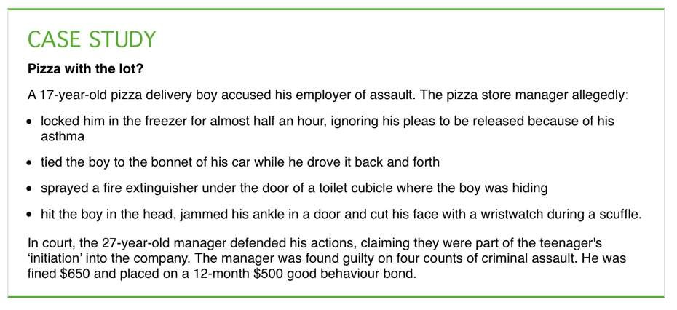
UNETHICAL
ILLEGAL

Slide 9


David Jones Sexual Harassment Case

Slide 10

Employees can make a complaint to the Australian Human Rights Commission
During 2009-10 21% of complaints to the commission were sexual harassment and 88% were in the workplace
New technologies have increased harassment however this can be evidence used to convict offenders

Slide 11


David Jones Sexual Harassment Case

Slide 12
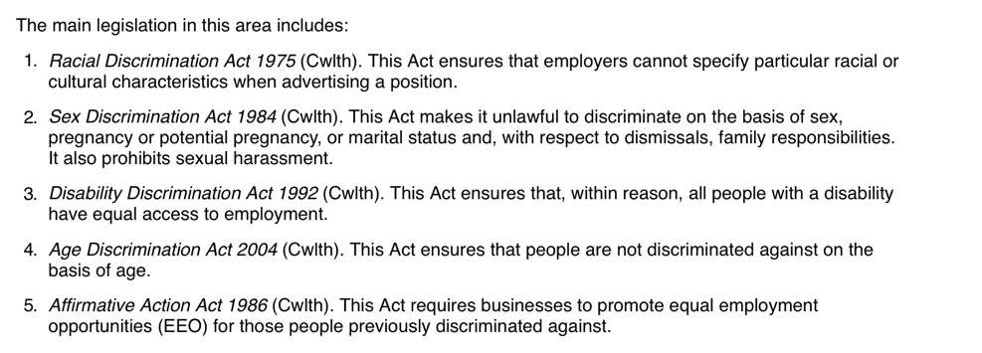

Slide 13
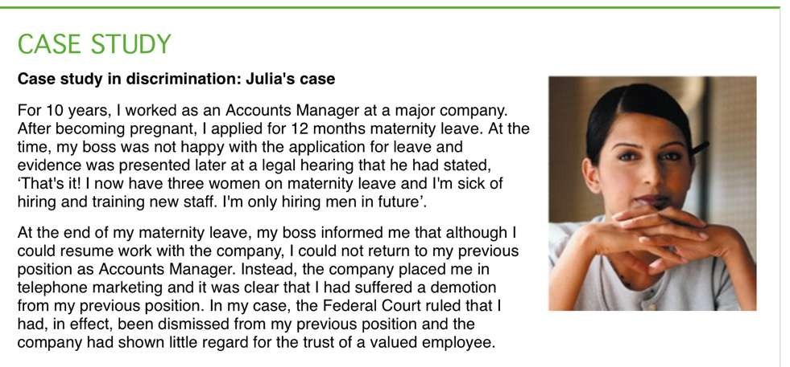

Slide 14

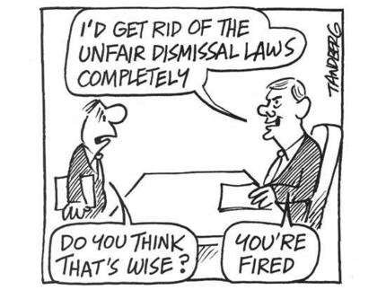
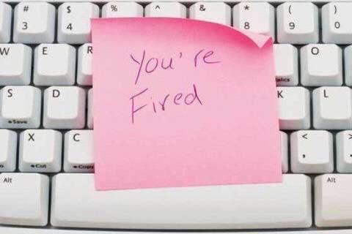
Unfair Dismissal
Any termination of employment that is considered harsh, unfair or unreasonable is illegal.
An employee can lodge an unfair dismissal claim to Fair Work Australia which operates under the Fair Work Act 2009 (Cwlth)

Slide 15

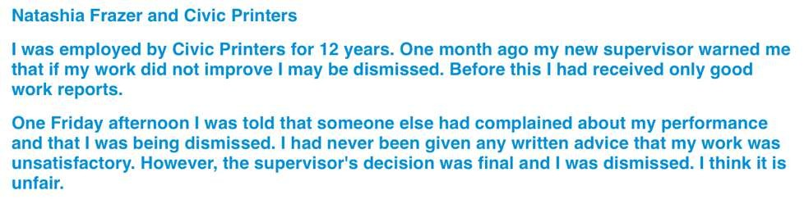
Voting Time - Is this case unfair?

Slide 16

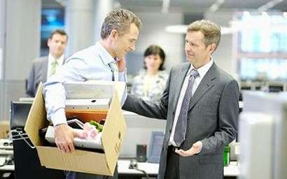

Redundancy
When a job is no longer required, usually due to technological changes in the workplace
Redundancy can either be voluntary or involuntary
Redundancy can sometimes occur due to a business restructuring the size and formation of their employment

Slide 17
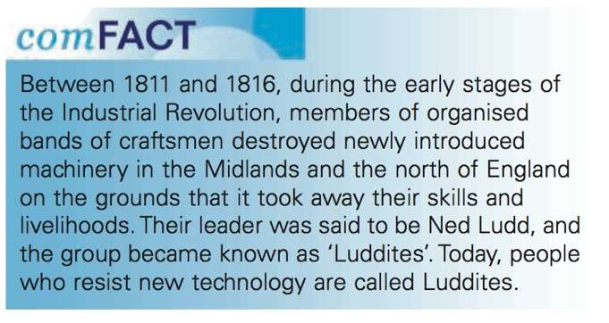
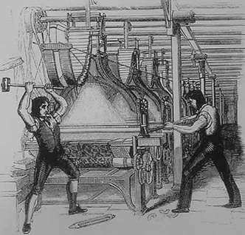
Click Here

Slide 18

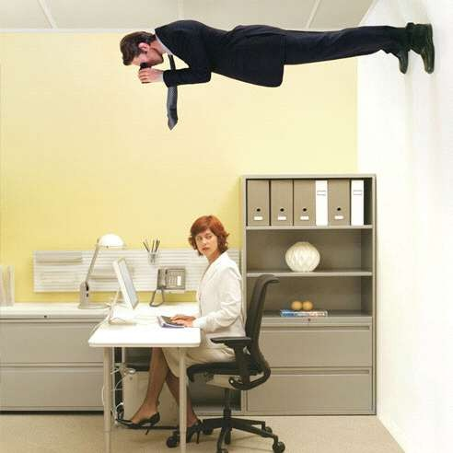
Privacy
In the digital age there has been an increase of worker surveillance and activity
Examples include telephone conversations, Web hits, keystrokes, completion time and emails

Slide 19
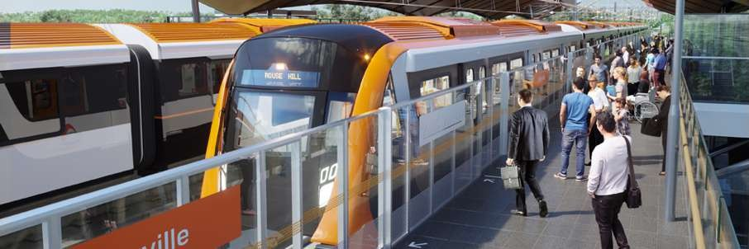
Case Study: NSW Transport Workers and Testing
NSW Transport workers are tested for drugs and alcohol
This policy has been brought into for public safety
Every year at least 25% or workers will be randomly tested
Click Here

Slide 20
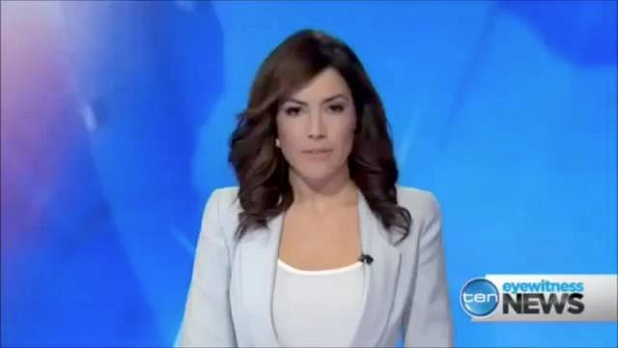

Drug Testing in NSW Transport

Slide 21
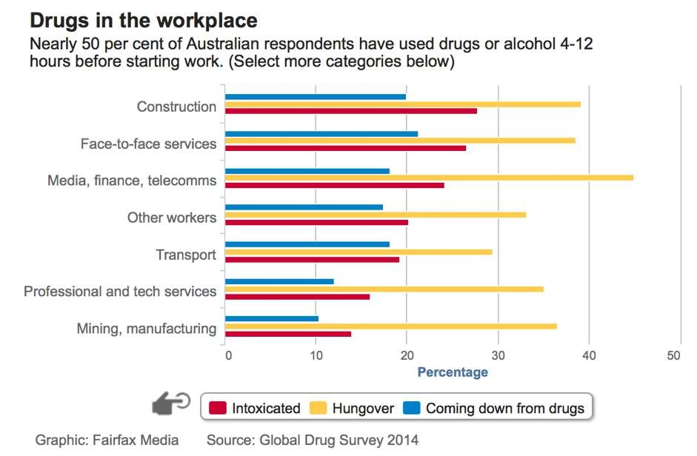

Slide 22


Why Privacy Matters

Slide 23

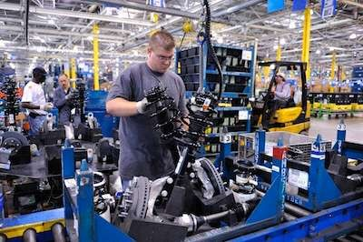
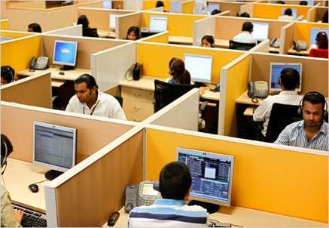
Outsourcing
The contracting of some organisational operations to outside suppliers. For example, school cleaning is outsourced to private companies.
Those in favour of outsourcing argue that resources are used more efficiently and it provides employment opportunities.
Opponents argue that it results in less job security and lack of employee entitlements.

Slide 24


Outsourcing Technology

Slide 25

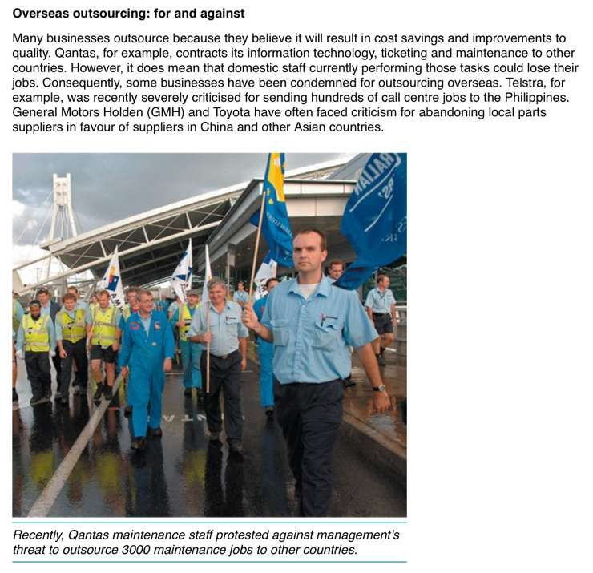

Slide 26

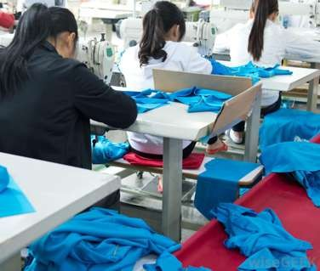
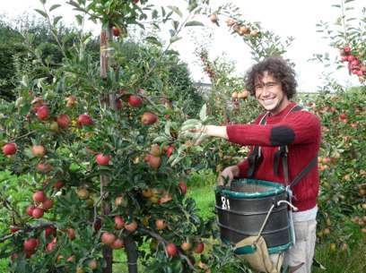
Piecework
people who are paid according to the number of items they make
  This rewards efficiency but may not be suitable for jobs that require care and time

Slide 27


Loss of Jobs Fairfax Media

Slide 28
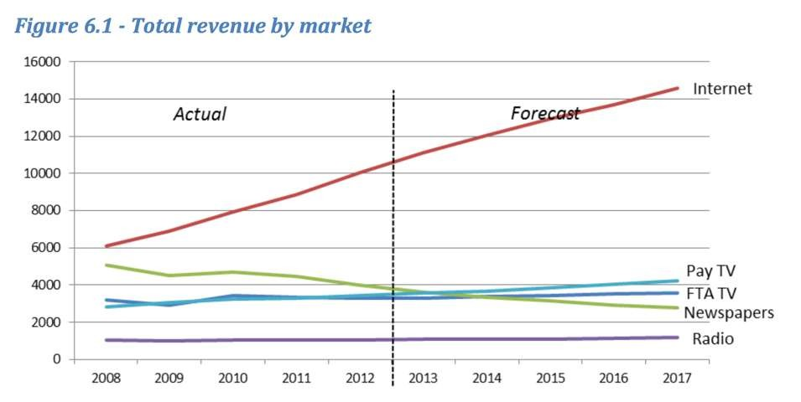
Case Time - Decline of Print Media

Slide 29
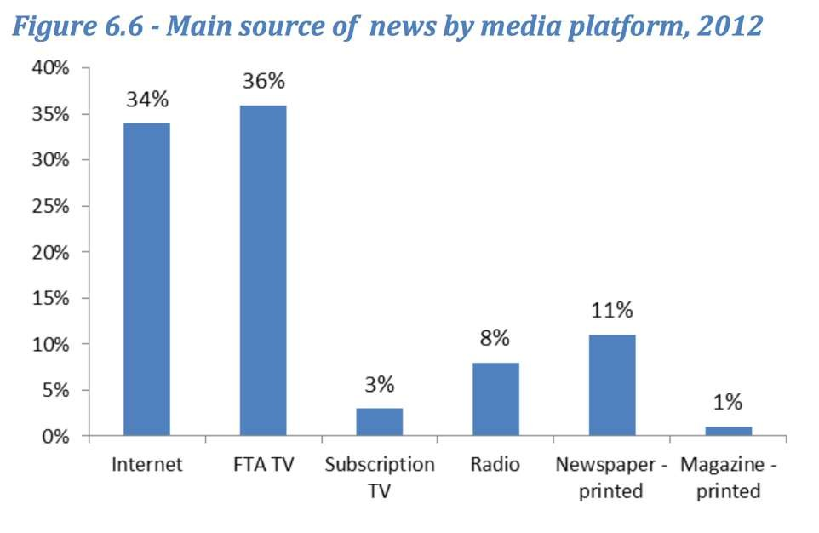

Slide 30
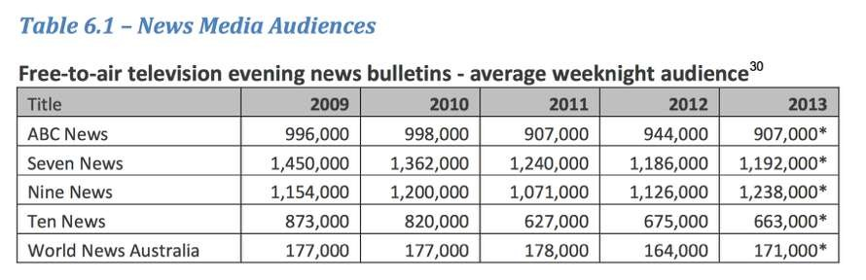
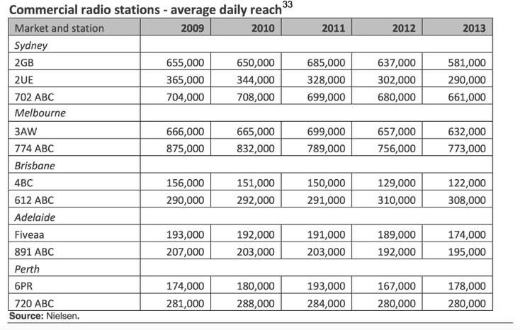

Slide 31
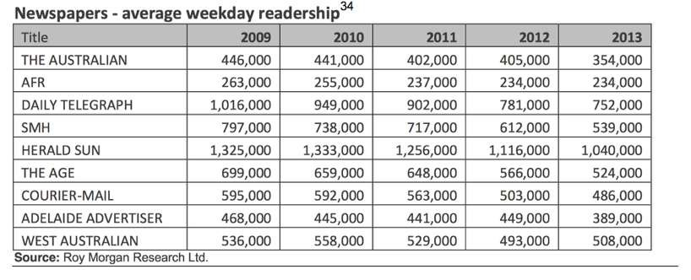
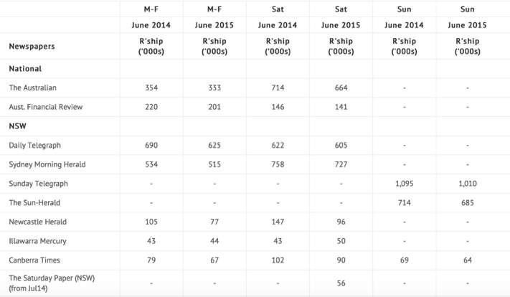

Slide 32
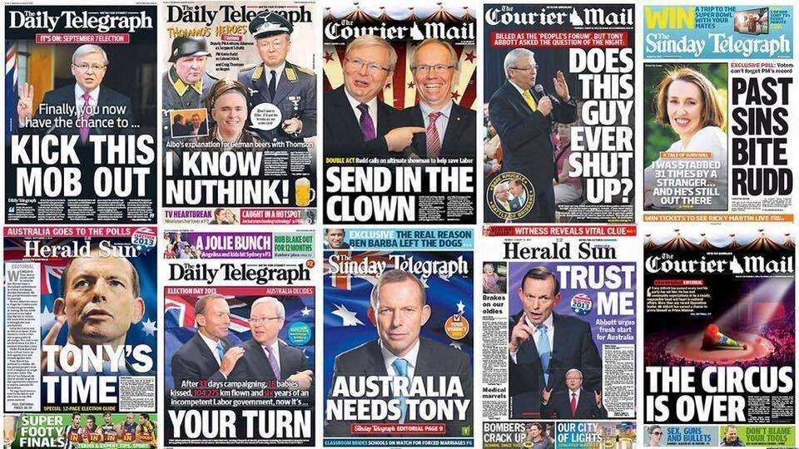
Click here

Slide 33
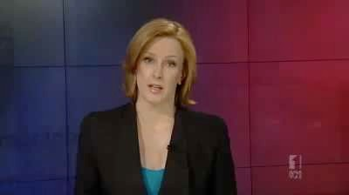

Outsourcing of Fairfax Media

Slide 34
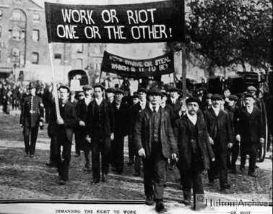

The Role of Unions and Employer Groups
In the initial phase of the industrial revolution, conditions were harsh, risky and workers had no forms of compensation if injured.
Trade unions improve rights for workers in a collective manner through membership. However, trade unions can be criticised for slowing job productivity
Click Here

Slide 35

Unions Protesting

Slide 36
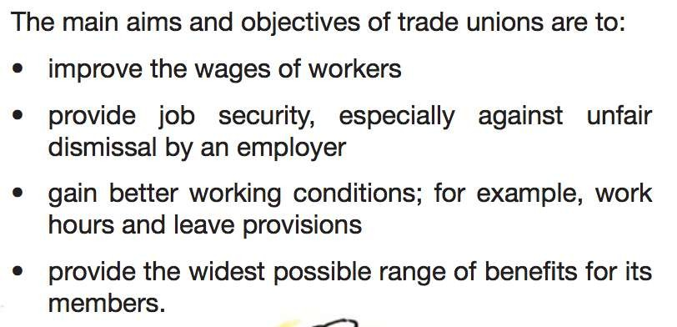
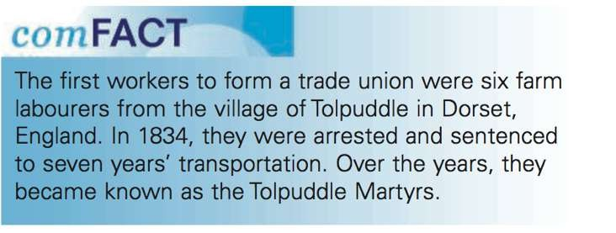

Slide 37
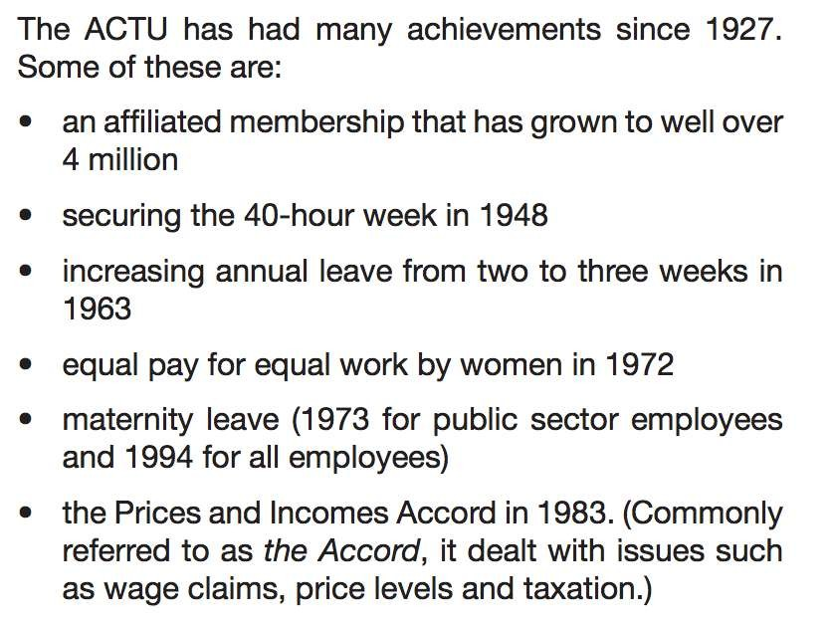

Slide 38
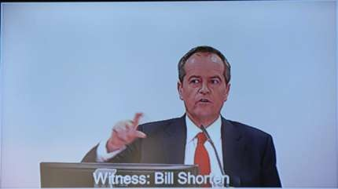
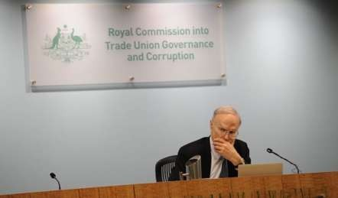
The Royal Commission into Trade Union Corruption
Established under the Abbott Govt to investigate union affairs (slush funds)
Over 50 criminal and civil law breaches have been uncovered.
The opposition leader, Bill Shorten has given evidence at the inquiry

Slide 39
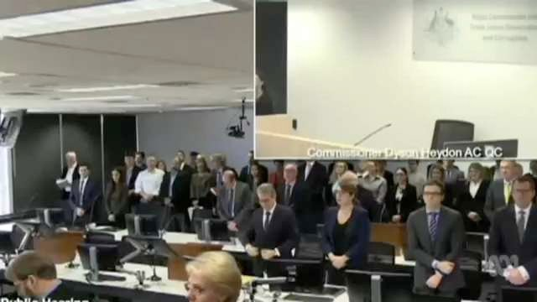

Slide 40

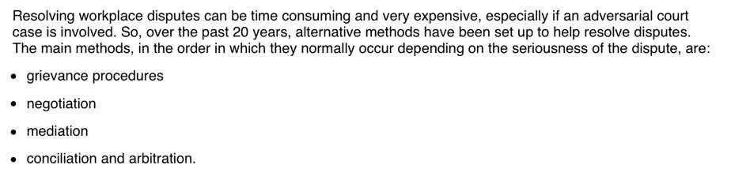

Resolving Disputes

Slide 41
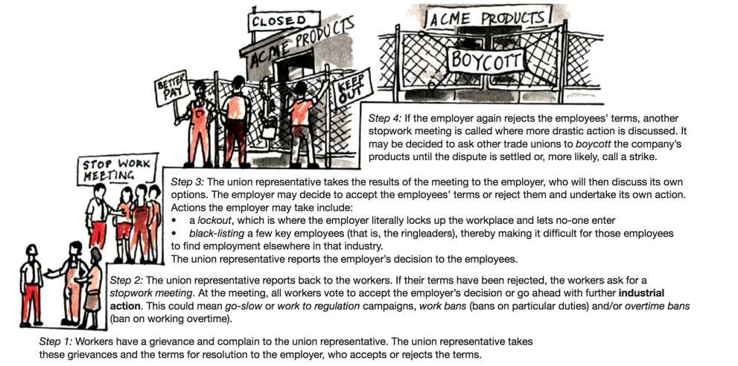

Slide 42
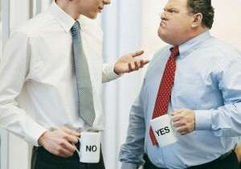
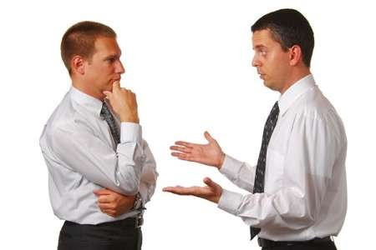
Grievance Procedures - complaints that an employee has formally recognised with a manager or union representative. Most businesses will have a system that is followed so that all parties can come to a quick resolution
Negotiation - All parties discuss the problem/issues and try to come to an agreement. This is often done internally and can be cost effective

Slide 43


Mediation - occurs when a 3rd party acts as a mediator between both parties. The mediator needs to be impartial to come to a fair decision
Conciliation - similar to mediation but the third party will be Fair Work Australia. If no agreement can be made, arbitration is the last alternative option

Slide 44


Case Time
What should be the best decision if you were the mediator in this case?

Slide 45
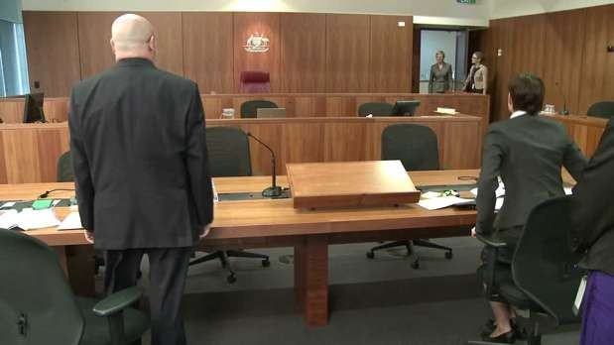
Arbitration - Fair Work Australia makes the decision. Disadvantage of this is that the decision will be out of the control of both parties
Court Action - Parties could take another to court but this should always be the last main option. Very costly and time consuming

Slide 46



Dispute Resolution

Slide 47


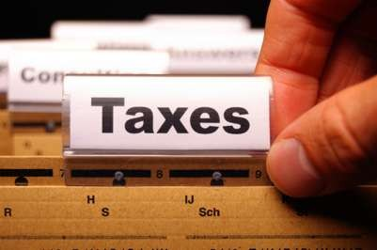
Taxation
Taxes are essential to pay for collective wants in society. Schools, roads, hospitals and defence forces
Taxes are the main source of revenue
The Australian taxation Office collects taxes

Slide 48
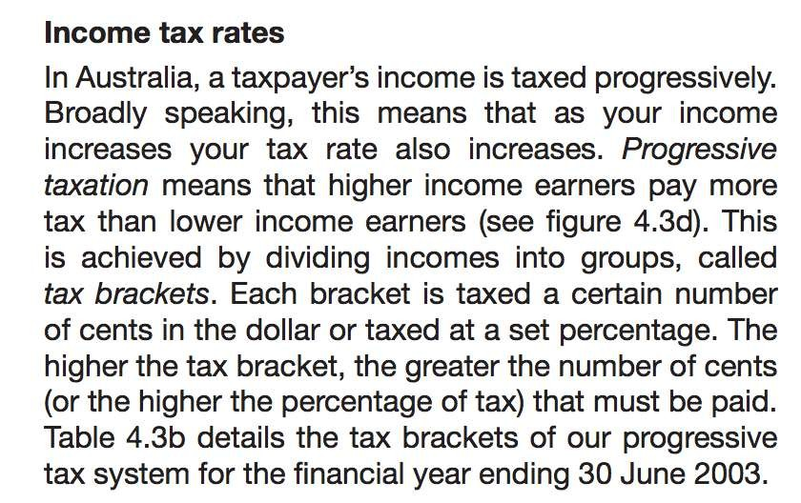

Slide 49
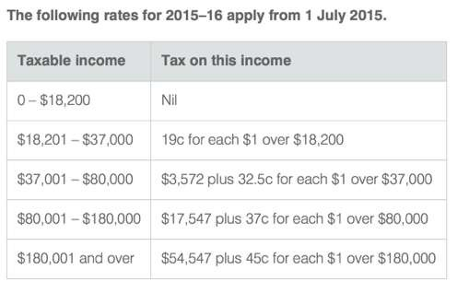
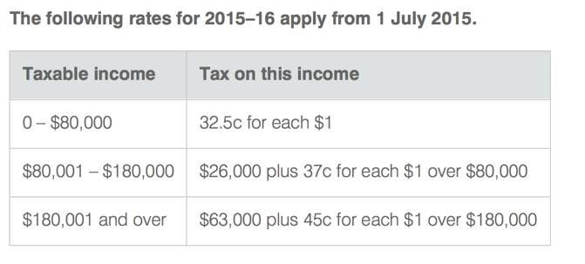
The rate of tax within each of these brackets is called the marginal rate of tax.

Slide 50
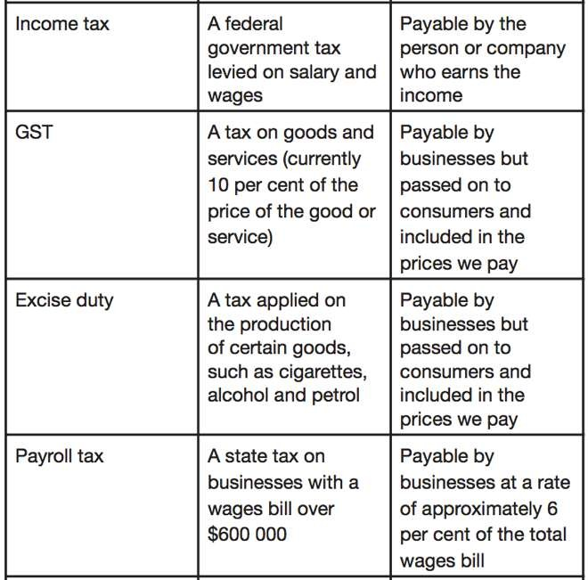

Slide 51
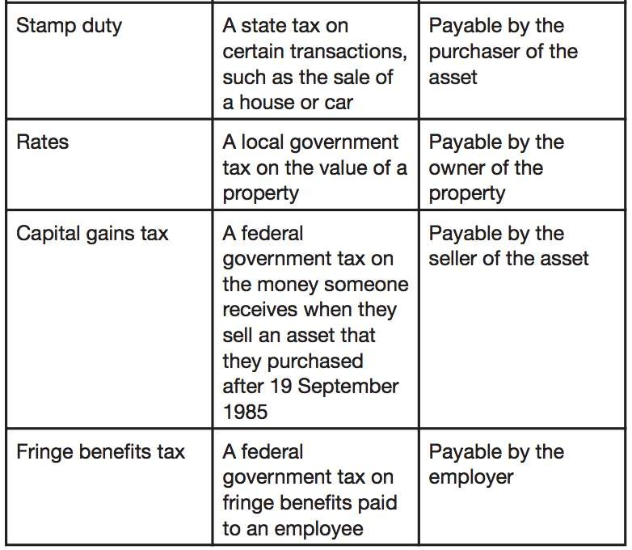

Slide 52


Fair or Unfair?

Slide 53
Voting Time - Do you agree or disagree with this statement?

Slide 54


Superannuation
Superannuation is money that you save for your retirement. Your super contribution is paid by your employer on a regular basis.
The current guarantee rate is 9.5% from employers. It has been proposed to increase to 12% by 2022
Your super is considered as a nest egg

Slide 55
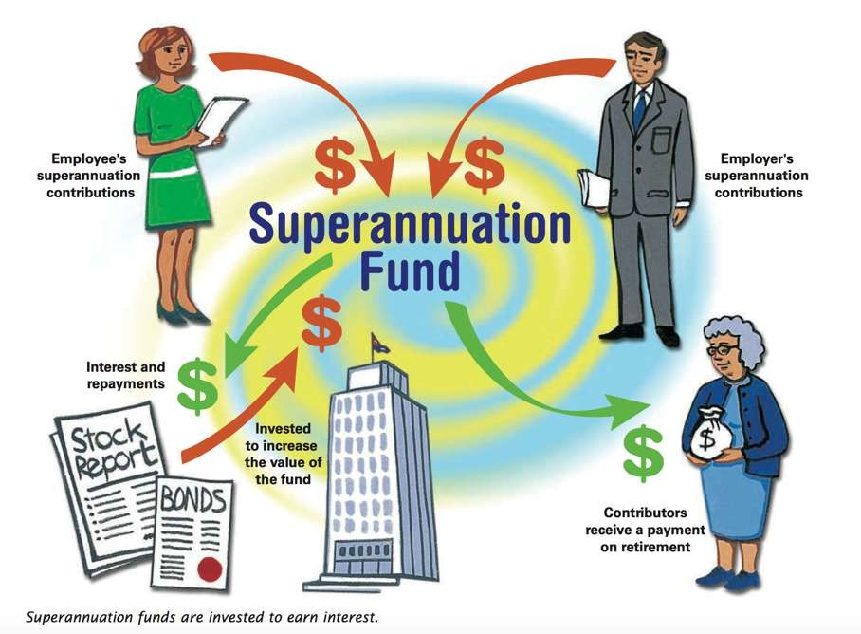

Slide 56
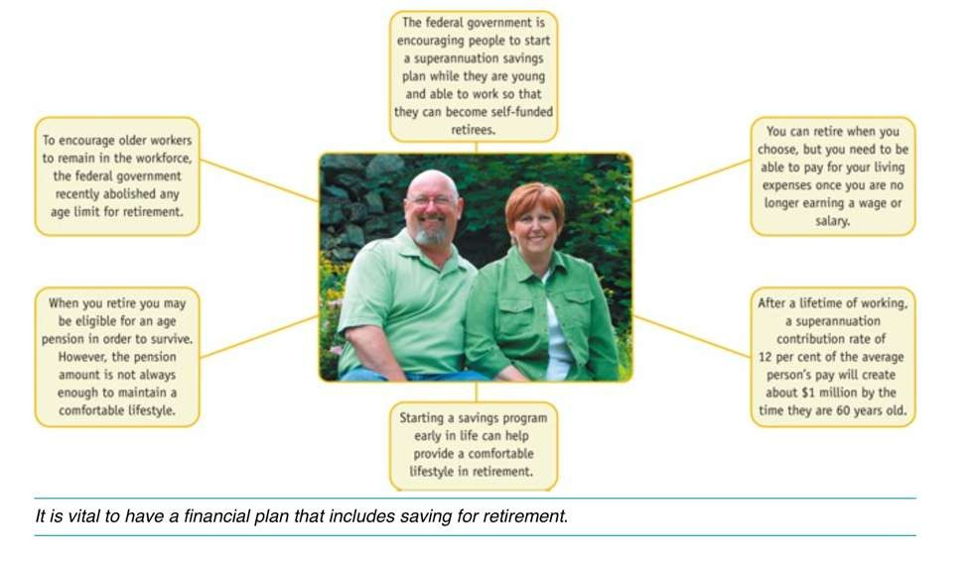

Slide 57
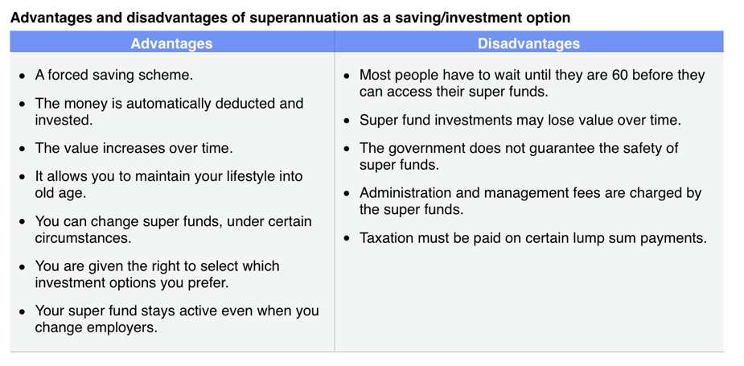

Slide 58


Slide 59


