Slide 1
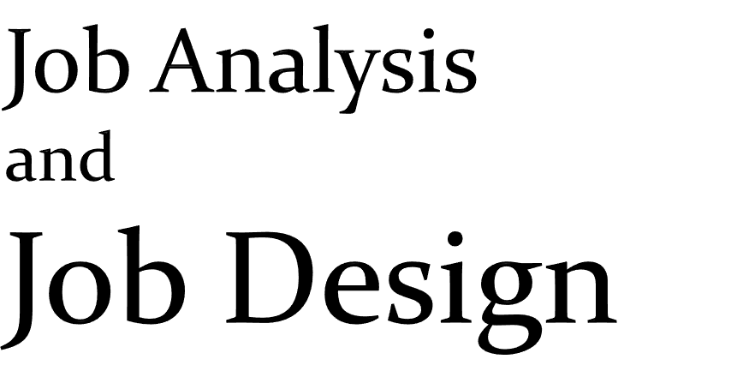

Slide 2


Contents
Definition of Job analysis
Job analysis steps
Components of Job analysis
Process of Job analysis
Job analysis information
Methods for data collection
Job analysis method
Uses of Job analysis

Slide 3
Contents Cont..
Advantages of Job analysis
Disadvantages of Job analysis
Problems with Job analysis
Definition of Job design
Approaches to Job design
Job design process
Job design methods
Advantages of Job design
Disadvantages of Job design

Slide 4


Job analysis is the process of studying and collecting information relating to the operations and responsibilities of a specific job.
-K.Aswathappa
Right Person for the Right Job at the Right Time and In a Right Place.

Slide 5



Slide 6


Before discussing job analysis in more detail, many related terms used in personnel should be carefully defined:
TASK: A distinct work activity which has an identifiable beginning and end.
Ex: post man sorting bag full of mails in appropriate boxes
DUTY: Several tasks which are related by some sequence of events.

Slide 7

Collecting and recording job information.
Checking the job information for accuracy.
Writing job description based on information.
Using the information to determine the skills, abilities, and knowledge that are required on the job.
Updating the information from time to time.

Slide 8

There are two components in job analysis.
Job description
Job specification

Slide 9

Job Specification
A written summary of tasks, duties and responsibilities of a job.
Job Description
The minimum skills, education, and experience necessary for an individual to perform a job.

Slide 10

Job Analysis
Job Description Job Specification
Job Title
Working Hours
Duties &
Responsibilities
Working Conditions
Salaries & Incentives
Qualifications
Qualities
Experience
Family Background
Training

Slide 11


Personnel planning
Performance appraisal
Hiring
Training and development
Job evaluation and compensation
Health and safety
Employee discipline
Work scheduling
Career planning

Slide 12
Jobs can be analyzed through a process, which consists of Six basic steps, these steps consist of:
1. Collection of background information
Selection of representative positions analyzed
Collection of job analysis data
Developing a job description
Developing of a job Specification
Developing Employee Specification
to be

Slide 13
Identify a job to
analyze
Update the task list based on individual task analyses findings
Survey is administer ed to job incumbent s and supervisors of job incumbent s
Develop the target audience description
Distribute the approved critical task list
Compile the total task inventory
Obtain critical individual task list approval
Collect task performance data
Survey data is complied in a report and provided to the critical task selection board
Identify critical individual shred tasks
Nominate critical individual tasks

Slide 14


Slide 15
Job identification
Significant characteristics of a job
What the typical worker does?
Job duties
What materials and equipments the worker uses
How a job is performed
Required personal attributes
Job relationships

Slide 16


Observation
Interview
Questionnaire
Checklist
Technical conference
Diary methods

Slide 17


Interview method
Technical conference method
Questionnaire method
Observation method
Diary

Slide 19

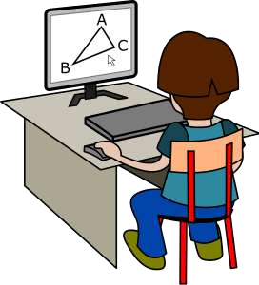
HR planning
Recruitment and selection
Orientation
Job evaluation
Training and development
Performance Appraisal
Compensation and Benefits
Career planning and development
Health and safety

Slide 20
Present immediate information
Assist in designing the requirements to perform a job.
Assist in the hiring process
Helps in performing evaluation and appraisal processes.
Assists in delivering appropriate training.
Assists in Deciding Compensation Package for a Specific Job

Slide 21
Subjective matters
Lengthy projects
Require lots of human efforts
Source of Data is Extremely Small
Unqualified Job Analyst
Mental Abilities Cannot be Directly Observed

Slide 22


Support from top management
Single means and source
No training or motivation
Activities may be distorted

Slide 23




Slide 24

Job Design is the process of deciding on the content of a job in terms of its duties and responsibilities; on the methods to be used in carrying out the job, in terms of techniques, systems and procedures and on the relationships that should exist between the job holder and the superiors, subordinates and colleagues.

Slide 25

To Meet the organizational requirements such as higher productivity, operational efficiency, quality of product/service etc
To satisfy
the needs of the like interests,
individual challenges,
employees
achievement or accomplishment, etc.
Integrate the needs of the individual with the organizational requirements.

Slide 26

Engineering Approach
Human Approach
Job Characteristics Approach

Slide 27
The work of every workman is fully planned out by the management at least on day in advance and each
man receives in most cases complete
written which
instructions, describing in detail the task he/she has to accomplish. -FW Taylor
Problem with this approach:
Repetition-Mechanical pacing-no end product-little social interaction-no input.

Slide 28

The Human relations approach recognized the need to design jobs which are interesting and rewarding.
Herzberg’s research popularized “The notion of enhancing need satisfaction through what is called job enrichment”
Factors involved:
Motivators like achievement, recognition, work itself, responsibility, advancement and growth and Hygienic factors.
According to Herzberg. The Employee is dissatisfied with the job if required maintenance factors to the required degree are not introduced into the job.

Slide 29
Theory by Hackman and Oldham states that employees will work hard when they are rewarded for the work they do and when the work gives them satisfaction.
Hence integration of motivation, satisfaction and
performance with job design.
According to this approach Job can be described in terms of five core job dimensions:
Skill Variety
Task Identity
Task significance
Autonomy
Feedback

Slide 30

Job Design Process has to start from what activity needs to be done in order to achieve organizational goals.
It requires use of techniques like work-study, process planning, organizational methods and organizational analysis and also technical aspects.

Slide 31

Work design
Job design
Work measurement
Method analysis
Job enlargement, rotation enrichment
Principles of motion economy
Stop- watch time study
Work sampling
Flow process
chart
Employee machine
activity chart

Slide 32

Job Rotation:
Refers to the
movement of an employee from one Job to
another.
Note That jobs themselves are not actually Changed, only employees are Rotated among various jobs.
Job Enlargement :
When a job is enlarged the tasks being performed are either enlarged or several short tasks are given to on worker, thus the scope of the Job is increased because there are many tasks to be performed by the same worker.
Job Enrichment:
Job enrichment as is currently practiced all over the work is a direct outgrowth of Herzberg’s Two factor theory of motivation.

Slide 33
Organizational Design
Structure Of Competent Employee
Motivation And Commitment Of Employees
Environmental Adaptation
Labor relation
Quality of work life
Organizational productivity

Slide 34

Lack of training
Increase work load
Conflict with non-participants
Poor performance

Slide 35


Employee Satisfaction Is Organization's Success

Slide 36

Time
for
Questions

Slide 37


