Slide 1
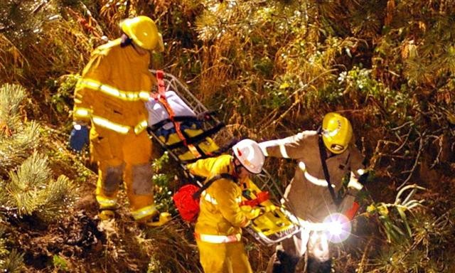
Social Psychology
Prosocial Behaviour

Slide 2
Overview
Prosocial behaviour vs. altruism
Why do we help?
Cooperation
Forgiveness
Obedience
Conformity
Who helps whom?
When do we help?
Bystander help
Impact of receiving help
Increasing helping

Slide 3
Questions
What is prosocial behaviour?
Why do people help?
Do people mainly help for selfish or altruistic reasons?
Thus, are people basically good and helpful, or are they basically selfish?
Can we be taught to act in non- natural ways?

Slide 4
Questions
Who helps who?
Why do humans behave in helpful and cooperative ways - even when it is not in their own self interest to do so?
Is there such a thing as genuine altruism?
How can we increase helping?

Slide 5
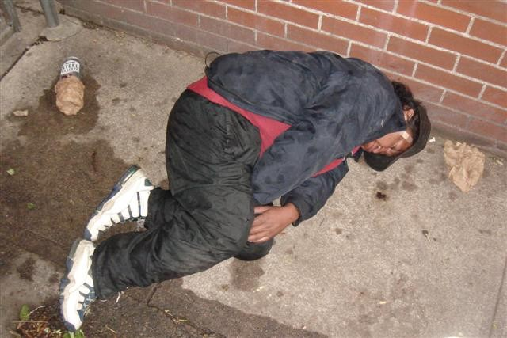
Imagine you encounter a stranger who appears to have collapsed on the street….
What factors would influence your decision whether to help this person or
not?

Slide 6
What is prosocial behaviour?
"voluntary actions that are intended to help or benefit another individual or group of individuals"
(Eisenberg & Mussen 1989, p. 3)

Slide 7
What is prosocial behaviour?
Doing something good for someone or society.
Building relationships
Helping society to function.
Adding to “social capital”

Slide 8
What is prosocial behaviour?
Includes:
Helping others
Obeying rules
Conforming to socially acceptable behaviour
Cooperating with others

Slide 9
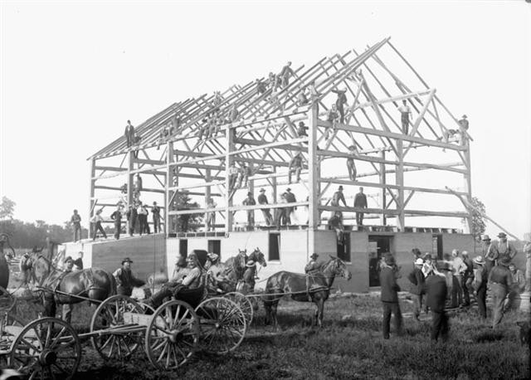
What is prosocial behaviour?
Example: Barn raising
A way of building social capital.

Slide 10
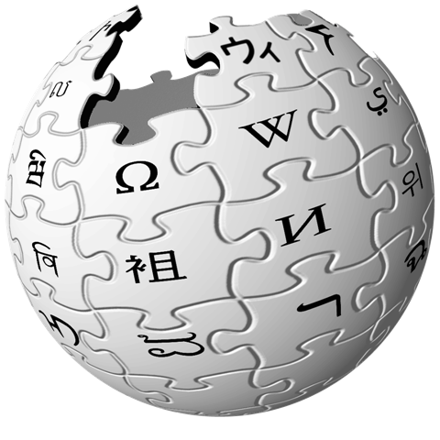

Example: Wikipedia
A collaboratively edited encyclopedia.
Contributions
↑ social
& knowledge capital.

Slide 11

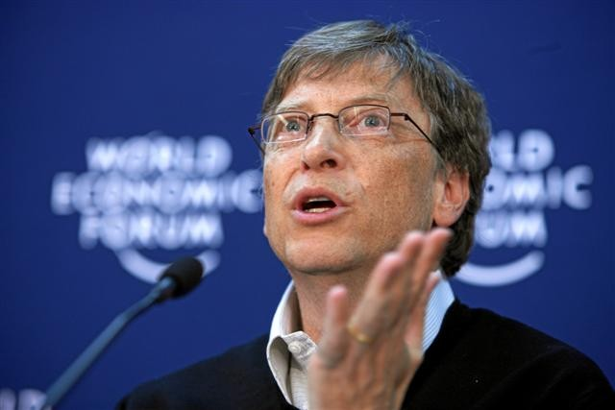
What is prosocial behaviour?
Example: Philanthropy
Largest philanthropic foundation in the world.
Aims to spend all of its ~$40 billion in the next 100 years.

Slide 12
Why is prosocial behaviour important?
Culture is more than the sum of its parts (but only if people cooperate and follow the rules)
Prosocial behaviour builds relationships
Antisocial behaviour destroys relationships

Slide 13
What is antisocial behaviour?
Doing something bad to someone or society.
Damaging relationships
Interfering with society’s functioning.
Reducing “social capital”

Slide 14
What is antisocial behaviour?
Includes:
Hurting others
Disobeying rules
Socially unacceptable behaviour
Conflicting with others

Slide 15
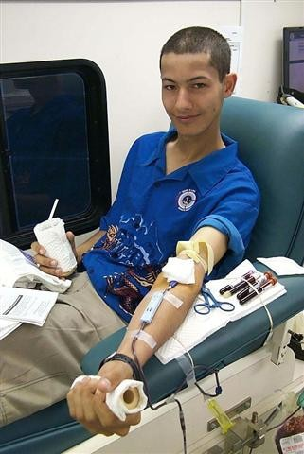
Reasons why people engage in prosocial behaviour
Self-interest
Social status
Reciprocity
Conformity
(e.g., to fairness)
Rule of law
Evolutionary
Altruism
Donating blood

Slide 16
What is altruism?
Helping behaviours focused only on the well-being of others (and often at personal cost).
Prosocial behaviour ≠ Altruism (because PS may involve self- interest)

Slide 17
Is altruism possible?
If altruistic helpers are only helping to make themselves feel good, aren’t they really just being selfish?
Does the innate pleasure we get from helping points to the basic goodness of human nature?
Is altruism, then, just as natural as selfishness?

Slide 18
Reciprocity
Obligation to return in kind what another has done for us
–Direct reciprocity: Helping someone who may help you later
–Indirect reciprocity: Help someone; someone else helps you later
Willingness to request or accept help is often predicated on ability to return in kind.

Slide 19
Fairness
Norms that promote fairness
–Equity - each person receives benefits in proportion to what he or she did
–Equality - everyone gets the same amount, regardless of performance
People desire a system based on fairness and social exchange
Sensitivity about being the target of a threatening upward comparison

Slide 20
Fairness
Following fairness norms helps us build and maintain good relationships with others
People become depressed and even suicidal when they feel they are taking and not giving
People also become distressed when they outperform others
  Sensitivity of being the target of a threatening upward comparison
  Those people we outperform might reject us or retaliate

Slide 21
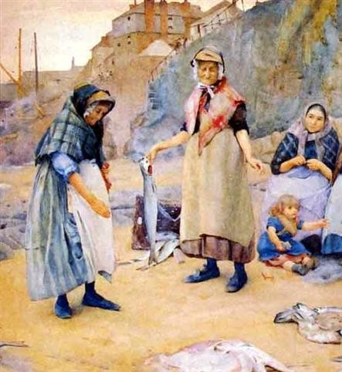
Fairness
Underbenefited
–Getting less than you deserve
Overbenefited
–Getting more than you deserve
Fairness requires balancing

Slide 22
Fairness
Underbenefitted people become angry & resentful.
Overbenefitted people experience guilt (e.g., survivor guilt).
We also pay people back after we have harmed them.
This sense of fairness, where we worry both about being overbenefitted & underbenefitted, is unique to humans.

Slide 23
Reciprocity
Found in all cultures
Found in animals
People are only willing to request or accept help if they think they can pay it back.

Slide 24
Social norms
Reciprocity - we should help those who help us.
Social responsibility - help others who are dependent & in need.
Social justice - help only when others deserve our assistance.
Cultural difference (e.g., Miller et al., 1990)

Slide 25
Rule of law
Everyone in the society is subject to the rule of law that governs the society
Boosts the quality of life e.g., positive correlation between happiness and rule of law (Veenhoven, 2004)

Slide 26
Learning theory
Classical & operant conditioning.
Observational learning - modelling behaviour of parents & media.
– If models are reinforced for helping -> increased helping in observers e.g., Rushton & Teachman (1978)

Slide 27
Tragedy of the commons
Depletion of resources owned collectively
Each person acts in his or her self-interest, overlooking the fact that overuse of a resource will in the end may destroy it.

Slide 28
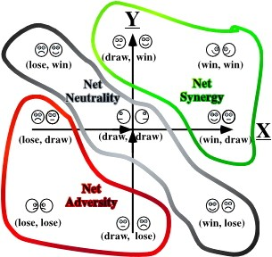
Game Theory

Slide 29
Cooperation
Prisoner’s dilemma: Balance tradeoffs b/w cooperation & competition.
Cooperation is fragile and easily destroyed. If either person is not cooperative, then cooperation typically breaks down
(“bad is stronger than good”)

Slide 30
Hoarding
Can be influenced by group and individual differences
Decreases when:
  Identifiable
  Individuals receive feedback on resource levels
Communication & a salient group identity can also decrease hording
We’re less likely to hoard when we trust others in the group

Slide 31
Obedience
Acting in accord with orders from an authority figure
Leader

Slide 32
Obedience
Some obedience necessary
Blind obedience to authority can be destructive (e.g., Nazi Germany)
Led to Milgram’s classic and controversial work on obedience

Slide 33
Milgram's study of obedience
Ps recruited for a study on learning
One person is the Teacher, the other is the Learner
Rigged so that Mr. Wallace is learner
Procedure: Teacher shocks Learner for mistakes
Shocks ↑ in 15 V increments to 450 (XXX)
How far will participant go?

Slide 34
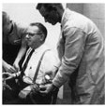
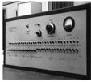
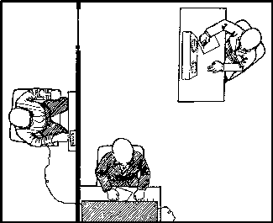

Milgram’s Study

Slide 35
Programmed responses of Mr. Wallace
75 V: moan and grunt
150 V: demand to be released
180 V: cried out that he could no longer stand the pain
330 V: protested that he had a heart condition and insisted that he would not longer take part in the experiment
Ominous silence

Slide 36
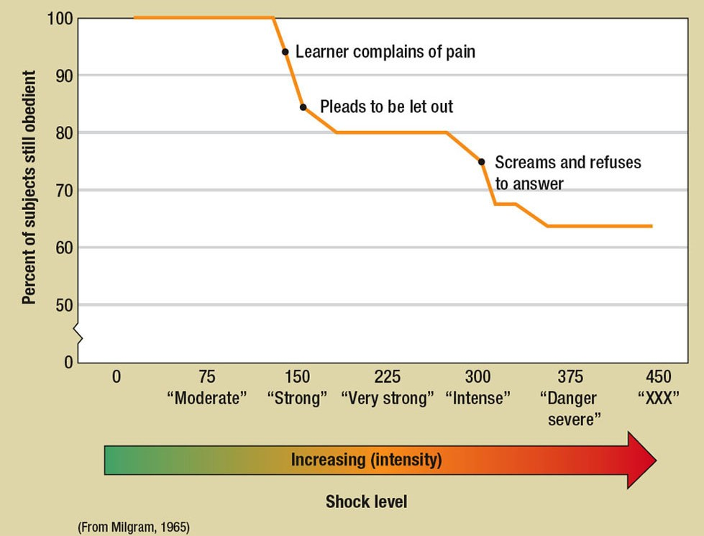
Fig. 8-1, p. 266

Slide 37
Programmed responses of the experimenter
“Please go on.”
“The experiment requires that you continue.”
“It is absolutely essential that you continue.”
“You have no other choice, you
must go on.”

Slide 38
Milgram’s study of obedience
Psychiatrists predicted only 1 in 1,000 would deliver most severe shock
65% delivered the most severe shock (to a screaming victim in obedience to an authority figure.)

Slide 39
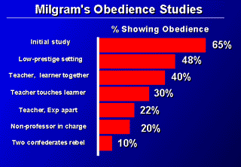
Reducing Obedience

Slide 40
Milgram’s study of obedience
Highest rates of obedience
–Experimenter sat next to the participant
–Victim was in an other room
Lowest rates of obedience
–Experimenter absent and out of sight
–Victim was next to the participant

Slide 41
Obedience
Can be prosocial, is often highly desirable, and can produce good outcomes
–Sports teams, corporations, groups, traffic
Supports group life and helps cultures to succeed

Slide 42
Obedience
Milgram’s research represented obedience as a -ve (-ve outcome)
Without obedience, society would not function
Obedience fosters
–Social acceptance
–Group life

Slide 43
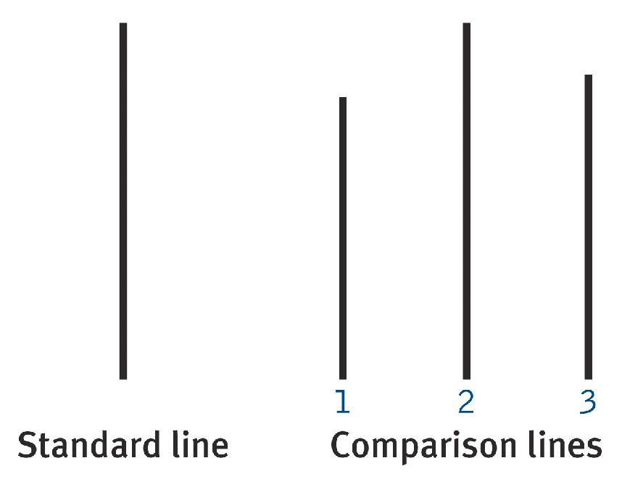
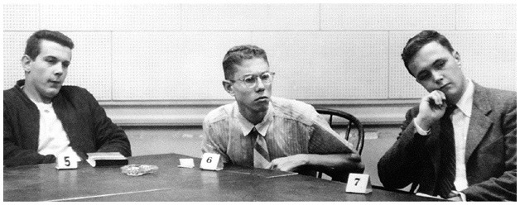
Conformity
Solomon Asch studies (1955, 1956).

Slide 44
Asch's line study
Participate in groups of 7
– 1 participant all others are confederates
Judge which of three lines matches a standard line

Slide 45
Asch's line study
Critical trials: all confederates give the wrong answer
  What does the participant do?
Conformity = number of errors that agree with the confederates

Slide 46
Asch's line study
75% conformed at least once (37% of critical trials)
–Conformity ↑d with group size up to 3
–Conformity ↓ if responses given privately
–Conformity much ↓ if one confederate disagrees

Slide 47
Conformity
Going along with the crowd
Normative social influence
  Conformity to be accepted by the group
Informational social influence
  Conformity based on actions of others as evidence about reality

Slide 48
Conformity
May be good or bad
People conform more when others are watching them
Public conformity
  Going along with the crowd regardless of what one privately believes
Private attitude change
  Altering one’s internal attitude

Slide 49
Conformity
Conformity has been given a bad name
  People will often do foolish, irrational, or bad things in order to conform
But conformity is also prosocial
  People show a strong desire to get along with others

Slide 50
Evolutionary perspectives
Innate tendency to help others for evolutionary reasons.
  e.g., animals exhibit helping behaviour.
Kin selection
  The closer we are genetically the more likely we are to help
Life-and-death helping is affected
more strongly by genetic relatedness
Reciprocal helping - expect to have favour returned

Slide 51
Types of victims, helpers, and need
Burnstein, Crandall, & Kitayama
(1994)
Participants were asked to imagine scenarios like the following:

Slide 52
There are three people who need you to run a small errand to the shops:
–A cousin
–A sister
–An acquaintance
You have time to help only one.
Whose errand do you run?

Slide 53
For everyday help, people tended to help
3.0
2.5
close relatives more than non-relatives
Tendency to Help
2.0
1.5
1.0
High
(parents, siblings, children)
Mod.
(grand- parents)
Low
(first cousins)
None
(acquaintances)
Degree of Relatedness

Slide 54
There are three people asleep in different rooms of a burning house:
–A cousin
–A grandfather
–An acquaintance
You have time to rescue only one. Which do you save?

Slide 55
The difference became even more pronounced in life-or-death situations
3.0
2.5
Tendency to Help
2.0
1.5
1.0
High
(parents, siblings, children)
Mod.
(grand- parents)
Low
(first cousins)
None
(acquaintances)
Degree of Relatedness

Slide 56
BUT humans help strangers and non-kin much more than other animals
What are some other reasons people help?

Slide 57
Motivations for helping
Egoism
  Helper wants a return for offering help
  Negative state relief theory
(help to reduce your own distress)
Altruism
  Expects nothing in return for helping
  Motivated by empathy

Slide 58
Motivations for helping
Batson (1994)
Egoism
Altruism
Collectivism
Principalism

Slide 59
Volunteer Process Model
(Clary & Snyder, 1999)
Volunteering serves functions for volunteers.
People more likely to continue volunteering (& be satisfied) if their motivations are met.

Slide 60
Volunteerism
Six motivations (Clary & Snyder):
Values
Understanding
Enhancement
Career
Social
Protective

Slide 61
Volunteer Functions Inventory
(Clary et al., 1998)
Values - express important values
Understanding - learn about world
Enhancement - psychological growth & development
Career - gain career related experience
Social - strengthen social relationships
Protective - reduce negative feelings

Slide 62
De Ropp’s Games
Game | Trophy
Hog in the trough | Wealth
Cock on Dunghill | Fame
Moloch Game | Glory or Victory
Householder Game | Raise family
Art Game | Beauty
Science Game | Knowledge
Religion Game | Salvation
Master Game | Awakening

Slide 63
Forgiveness
Ceasing to feel anger toward or seek retribution against someone who has wronged you
Forgiveness helps repair relationships
–Provides health benefits to both parties

Slide 64
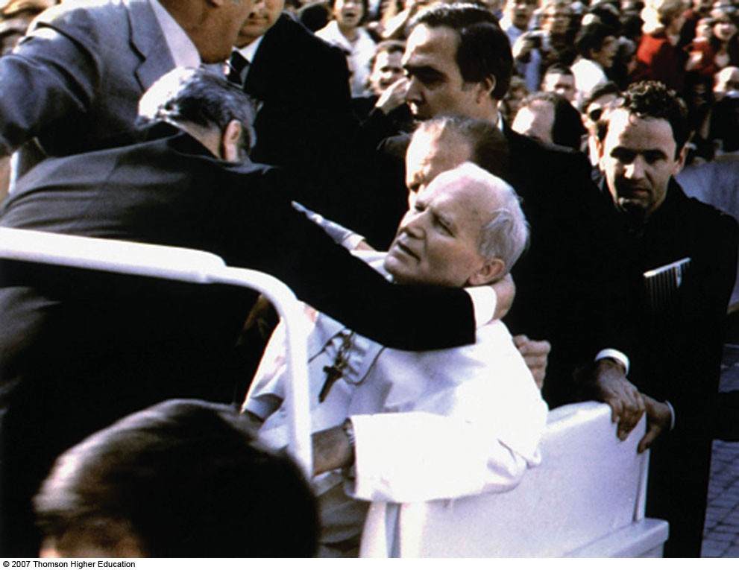
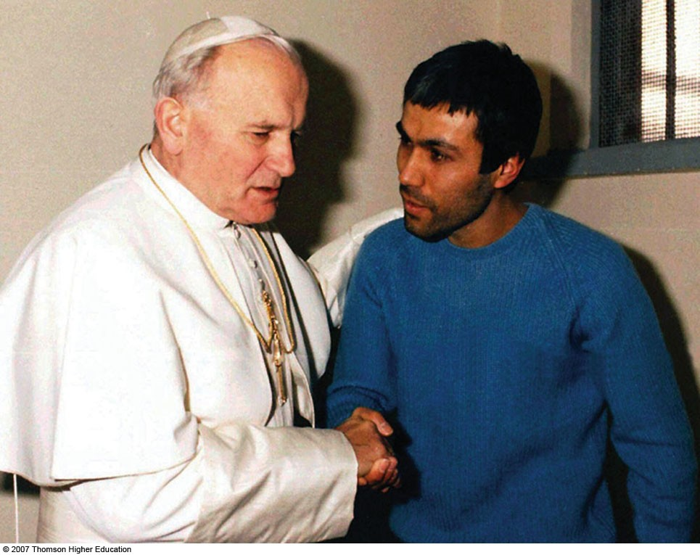

Slide 65
Forgiveness
When is forgiveness more likely?
  Minor offense
  Offender apologises
Who is more likely to forgive?
  Religious people
  People committed to a relationship
  Not self-centered or narcissistic

Slide 66
Empathy-altruism hypothesis (Batson, 1991)
Is helping ever based on altruistic motives? e.g., Binti
2 emotional components of empathy - personal distress & empathic concern.
Emotion experienced depends on perspective taken.
–Empathic concern -> altruistic motive.
–Personal distress -> egoistic motive.

Slide 67
Can we distinguish between egoistic & altruistic motives?
If empathic concern is low, reduce distress either by helping or escaping
If empathic concern is high, only one option - must help.

Slide 68
Empathy-altruism hypothesis
→ proposition that empathy motivates people to reduce other people’s distress, as by helping or comforting.

Slide 69
Empathy-altruism hypothesis
Empathy motivates people to reduce other’s distress
If low empathy, people can reduce their own distress by escaping the situation
If high empathy, emotional response corresponds to feelings of other person
↓ our distress by ↓ their distress

Slide 70
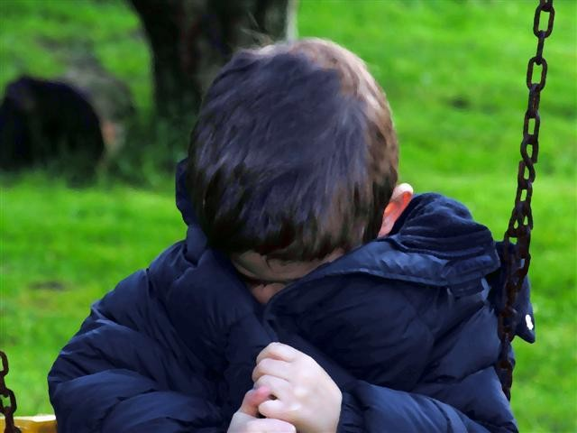
Negative state relief theory
→ proposition that people help others in order to relieve their own distress.

Slide 71
Batson's approach
Act to reduce Own distress
Distress
Egoistic Motivation
Distress
(help or escape)
Other’s Distress
Empathy
Altruistic
Help to reduce Other’s distress
Motivation

Slide 72
Personal determinants of helping
Personality - most personality variables are weak predictors of helping.
Competence - those high in appropriate skills more likely to help.

Slide 73
Personal determinants of helping
Attributions - influence whether help is given e.g., Just World Hypothesis
The self & personal norms - personal norms for helping based on personal values (e.g., religious beliefs)
If values central to self-concept, act in consistent ways.

Slide 74
Belief in a just world
Life is essentially fair and people generally get what they deserve
→ Blaming the victim
→ Fallacy of affirming the consequent
People who hold belief in a just world will help if they think those people deserve help

Slide 75
Belief in a just world
Belief that the world is fair and that people get what they deserve
Just world believers tend to
–Blame the victim
–Help others only if they think those people deserve help

Slide 76
Emotion and helping
■ +ve feelings ↑ helping
-ve emotions ↑ or ↓ helping
–Focus on self vs. the victim

Slide 77
Mood
Mood - people in good moods more likely to help.
Why?
Desire to maintain good mood
Focus on positive things
Positive expectation about helping (e.g., will be rewarded)

Slide 78
Mood
When does good mood not lead to helping?
Costs of helping are high
(e.g., if helping will ↓ good mood)
Positive thoughts about other activities that conflict with helping (e.g., on way to a party)

Slide 79
Mood
Bad moods → ↓ likely to help. Why?
Self-focussed
Blame others for bad mood
Think of personal values that don’t promote helping (put self first)
When does bad mood lead to helping?
If feeling guilty

Slide 80
Interpersonal determinants of helping
Females are more likely to receive help.
Beautiful victims.
Attractiveness - more likely to help attractive others.
– e.g., Benson et al. (1976)
Similarity - increases attractiveness & empathy.

Slide 81
Interpersonal determinants of helping
Closeness - more likely to help those we know.
Deservingness - help those we judge as deserving our help.
Gender

Slide 82
Gender
Males
More helpful in broader public sphere, toward strangers and in emergencies.
Help women more than men.
Females
More likely to help in the family sphere, in close relationships, and in situations that require repeated contact.
More likely to receive help.

Slide 83
Attraction
People are more likely to help attractive individuals than unattractive individuals
  Airport phone booth study
  Application of attractive vs. unattractive individual
  People more likely to send package of attractive individual

Slide 84
Attraction
People are more likely to help attractive individuals than unattractive individuals
Study done at FSU. Attractive vs. unattractive female victim, asked for money, needed for student health.

Slide 85
Attractiveness Study Conclusions
Real donations were much smaller than hypothetical
– People claim to be more generous and helpful than they really are
Attractiveness influenced actual helping but not hypothetical helping
Severe victims get more help
Pretty women get more help when need is big

Slide 86
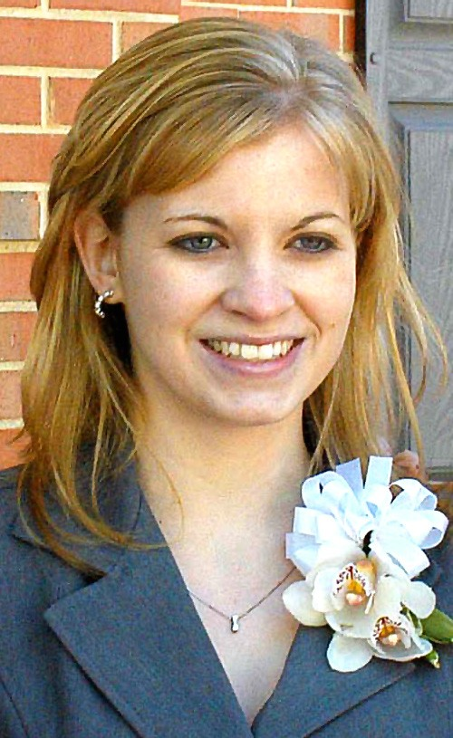
Jessica Lynch
(2003 rescue)
“Her Iraqi guards had long fled, she was being well cared for - and doctors had already tried to free her.”

Slide 87
Bystander effect
People are less likely to help when they are in a group (or presence of others) than when they are alone.

Slide 88
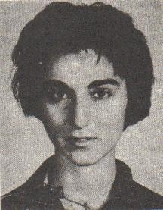
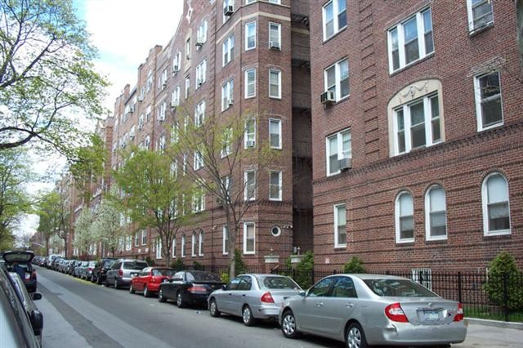

Slide 89
Kitty Genovese
On March 13, 1964 Kitty Genovese was attacked by a rapist with a knife outside her apartment in Queens, New York. Her screams for help aroused 38 of her neighbors. Many watched from their windows while, for 35 minutes, she tried to escape. None called the police.

Slide 90
Interpretation study
S alone, or 3 Subjects, or S plus two confederates
Smoke into room
Did subject report?
–Alone: 75% reported
–3 Real Subjects: 38% of groups
–S + confederates: almost never
–Explanations indicated different interpretations

Slide 91
Diffusion of responsibility
Assumption was that the more bystanders, the more help; maybe backwards?
Diffusion of responsibility: Pressure to intervene is divided among everyone who is present

Slide 92
Diffusion of responsibility
Experiment: Subject, Victim, and 0, 1, or 4 others complete group discussion
Feigned emergency (Seizure)
Does subject take action?
–Alone: 85%
–Subject and Victim: 62%
–S, V, and 4 others: 31%
–Yet no signs of indifference, apathy

Slide 93

Steps to helping
Five steps to NOT helping:
Bystanders must overcome each step.
Crowd can interfere at each step

Slide 94
Steps to helping
Notice that something is happening
Interpret meaning of event
  Pluralistic ignorance
Taking responsibility for providing help
  Diffusion of responsibility
Know how to help
Provide help

Slide 95
Latane & Darley’s cognitive model
5-step decision making process:
Do you notice something unusual happening? → YES →
Is the event interpreted as an emergency?
→ YES →
Do you think you have the responsibility to help? → YES →
Do you know the appropriate kind of help to give? → YES →
Do you decide to help? → YES

Slide 96
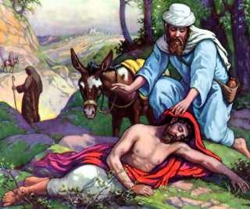
Parable of the Good Samaritan

Slide 97
Time pressure: Good Samaritan Study
Darley & Batson (1973)
Seminary students walking across campus to give talk on the Good Samaritan (or career)
Late for talk or plenty of time
Passed man in doorway groaning & coughing

Slide 98
Time pressure: Good Samaritan Study
If plenty of time: > 60% offered help
If running late: ~10% help
→ situational forces have a strong influence on whether people help others
Following:
–Samaritan parable: 53% helped;
–Career message: 29% helped; (but not a significant difference).

Slide 99

Time pressure
People in a hurry, help less
–Even when thinking about helping
The more time people had, the more likely they were to help

Slide 100
The decision process in Latane & Darley’s cognitive model
+ + +
Attend to what is happening
Define event as emergency
Assume responsibility
Decide what can be done
Give help

Slide 101
Empirical evidence in support of Latane & Darley’s model
Latane & Darley (1970) - participants alone more likely to report smoke than those with others.
Latane & Rodin (1969) - lone male participants more likely to help ‘lady in distress’ than those in pairs.
Darley & Latane (1968) - more bystanders meant less people offered help to someone they thought was having a fit.

Slide 102
What processes underlie bystander apathy?
Diffusion of responsibility - assume others will take responsibility
  e.g., Darley & Latane (1968)
Audience inhibition - fear negative evaluation from others if intervene & situation is not an emergency
  e.g., Latane & Darley (1970), Latane & Rodin (1969)
Social influence - look to others as a model for action - normative & informational influence.

Slide 103
Bystander-calculus model
Piliavin, Dovidio, Gaertner & Clark (1981)
Bystanders calculate the (perceived) costs & benefits of providing help.
3 stages:
1. Physiological arousal - witnessing an emergency → physiological arousal→ greater chance of helping.

Slide 104
Bystander-calculus model
Labelling the arousal - is arousal labelled as personal distress or empathic concern? - usually labelled as personal distress.
Evaluating the consequences - weigh up costs of helping, choose action that reduces personal distress to lowest cost.

Slide 105
Bystander-calculus model
Costs of helping
– Time & effort: Less likely to help if it involves greater time & effort.
Costs of not helping:
–Empathy costs
  bystander experiences distress
–Personal costs
  bystander experiences blame or guilt
Greater similarity to victim, the more likely bystander is to help.

Slide 106
How can we increase helping?
↓ distractions
↓ pluralistic ignorance
↓ diffusion of responsibility
↓ concerns about competence to help
↓ audience inhibitions

Slide 107
How can we increase helping?
↓ uncertainties of obstacles
Educate about bystander indifference
Model helpfulness
Teach moral inclusion

Slide 108
Increasing helping behaviour
Positive models in the media.
Reduce ambiguity, increase responsibility - reduce anonymity
Guilt & concern for self-image - use of compliance tactics
Attributing helpful behaviour to altruistic motives - overjustification effect
Learning about altruism

Slide 109
Summary & conclusions
Prosocial behaviour includes conformity, obedience, and cooperating with others, but may also include disobedience.
Human culture depends on people following rules.
Following the rules of society and culture generally brings immense personal and social benefits.
Is altruism unique to humans?

Slide 110
References
Baumeister, R. F., & Bushman, B. J. (2008).
Social psychology and human nature (1st ed.) Belmont, CA: Thomson Wadsworth.

