Slide 1
Group Influence

Slide 2
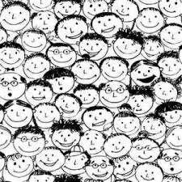
What is a Group?
🠶Exist when two or more people interact for more than a few moments, affect one another in some way, and think of
themselves as “us”.

Slide 3

Different groups help us meet different human needs…
🠶Affiliate – to belong to and connect with others.
🠶Achieve – to gain social identity.

Slide 4
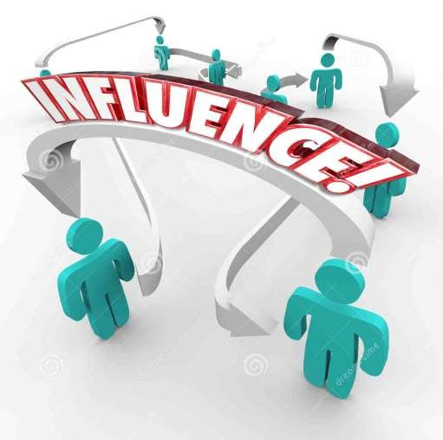
3 examples of Collective Influence
🠶 Social facilitation
🠶 Social loafing
🠶 Deindividuation
🠶 These three phenomena can occur in Minimal interaction “Minimal
Group Situations”

Slide 5
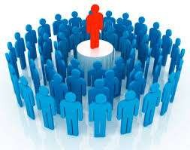
Social Facilitation: How are we affected by the presence of others?
🠶 The tendency of people to perform simple or well- learned tasks better when others are present.
Example:
Do you ride faster when bicycling with others?

Slide 6
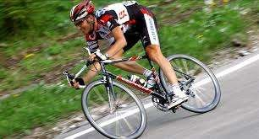
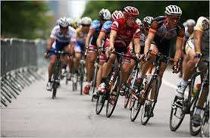

One of Norman Triplett’s study (1898)
🠶 He noticed that in bicycle racing, people were faster when the they raced together than each one raced alone against the clock. Before he puddled his hunch, The Other people’s presence boosts his performance.
🠶 “The bodily presence of another contestant . . . Serves to liberate latent energy”

Slide 7
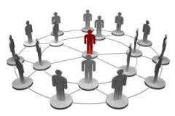
🠶Co-actors are people who are not competing, do not reward or punish, and in fact do nothing except be present as a passive audience.

Slide 8
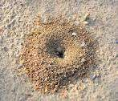
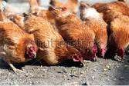
Social Facilitation also occurs in animals…
🠶By the presence of other species, Ants excavate more sand, chicken eat more grain etc.

Slide 9
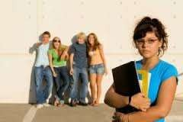
🠶 But Other studies revealed that on some tasks the presence of
others HINDERS their performance.

Slide 10
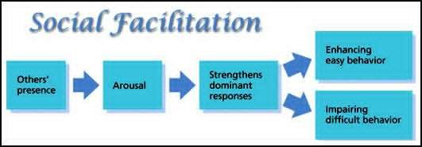

Slide 11
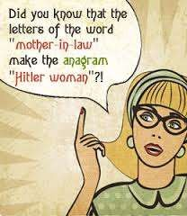
🠶 Increased arousal enhances performances on easy tasks for which the most likely – “Dominant” – response is correct.
Example:
🠶 People solve easy anagrams, fastest when aroused.

Slide 12
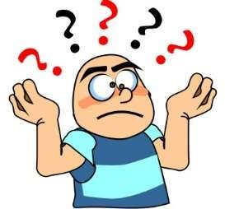
🠶 But on complex tasks, for which the correct answer is NOT DOMINANT. Increased arousal promotes Incorrect responding.
Example;
Problem-solving, abstract reasoning, Mathematical computations.

Slide 13
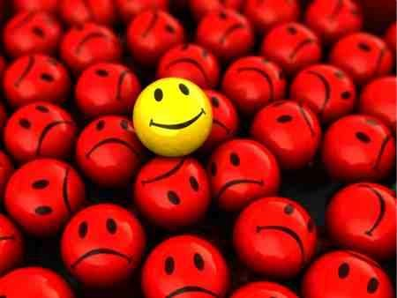
Could this principle solve the mystery of Social Facilitation?
🠶To assume that others’ presence will arouse or energize people

Slide 14
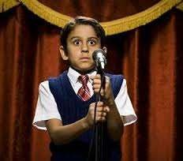
🠶But most of us can recall feeling tense in front of an audience.

Slide 15
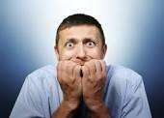
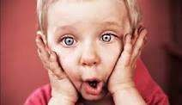
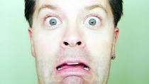
Example: James Michaels study (1973)
🠶 Good pool players in a student union made 71% of their shots while
No one is observing.
🠶 But when the four observers came up, most of them fail and they only made 25% of their shots.

Slide 16
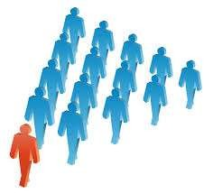
🠶“Social Arousal facilitates dominant responses and boost performance on easy tasks and hurt performance on difficult tasks, when other people are present”

Slide 17
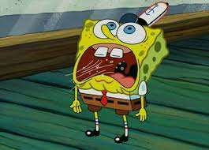
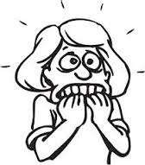
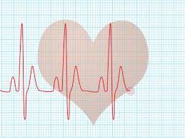
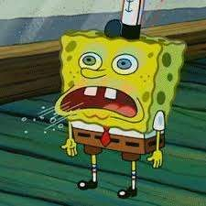
Crowding: The presence of many others
🠶 Does the presence of observers always arouse people?
🠶 In some cases, with others present people:
🠶 Perspire more…
🠶 Breathe faster…
🠶 And have higher blood pressure…

Slide 18
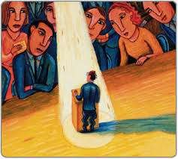
Example:
🠶Speaking in a large group of people or in a crowd increases arousal and self-conscious attention. Extreme pressure caused “Choking”.

Slide 19
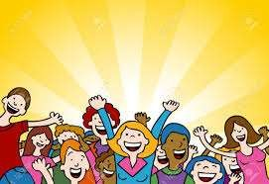
Why are we aroused in the presence of others?
🠶 What is about other people that creates arousal?
🠶 Evidence supports three possible factors…

Slide 20
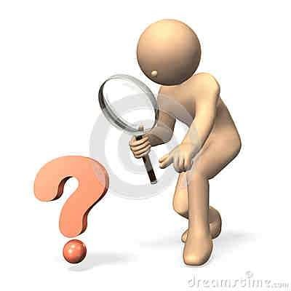
1. Evaluation Apprehension
🠶 Is the concern of how others
are evaluating us.

Slide 21
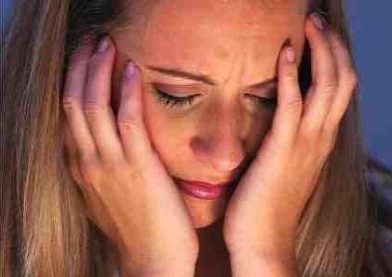
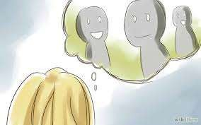
Nickolas Cottrell study (1968)
🠶 “The enhancement of dominant responses is strongest when people think they are being evaluated”

Slide 22
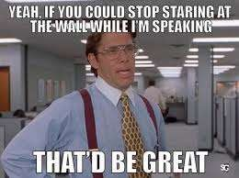
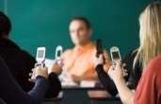
2. Driven by Distraction
🠶 When we wonder how our co-actors are doing or how an audience is reacting, we become distracted. (Sanders, Baron & Moore, 1986)

Slide 23
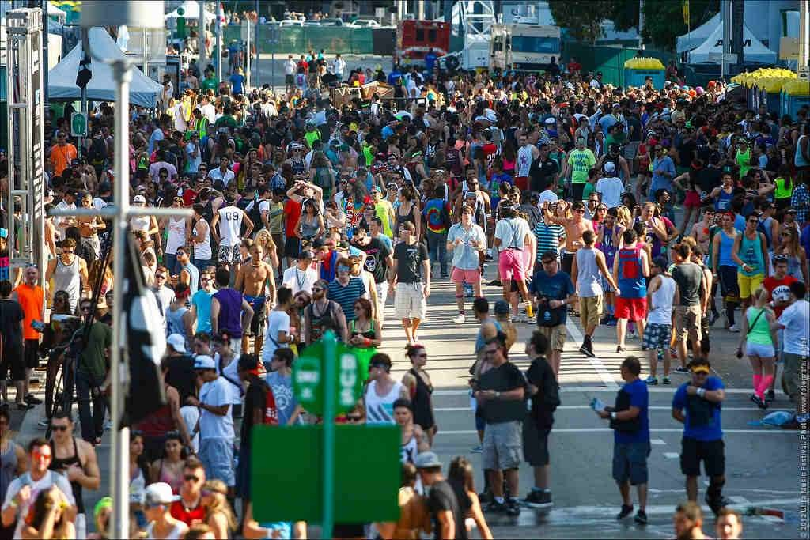
3. Mere Presence
🠶 Zajonc, believe that the mere presence of others produces some arousal even without evaluation apprehension or arousing distraction.

Slide 24
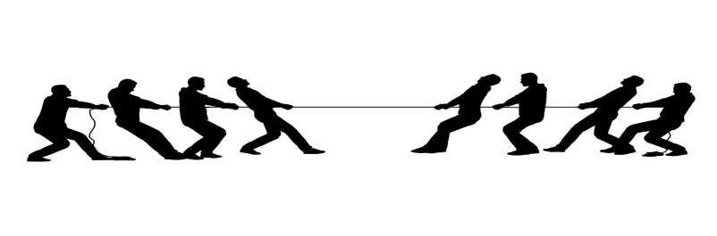
Social Loafing: Do individuals exert less
effort in a group?
🠶 The tendency for people to exert less effort when they pool their efforts toward a common goal than when they are individually accountable.
🠶 Example:
🠶 In a team of tug of war, will eight people on a side exert as much force as the
sum of their best efforts in individual tug of war?

Slide 25
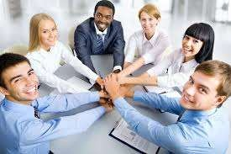
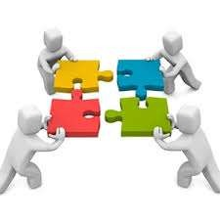
Many hands make light work…
🠶 “In unity there is strength”
🠶 Group members may be actually less motivated when performing additive task.

Slide 26
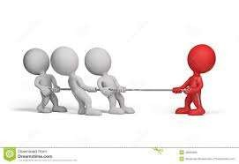
Massachusetts & Ingham (1974)
🠶 In the game tug of war, they make individuals think others were pulling with them, when in fact they were pulling alone. Blindfolded participants were assigned on the first position in the apparatus and told “Pull as hard as you can”, the participants’ thought that there are four to five people behind them, but honestly there is no one.

Slide 27
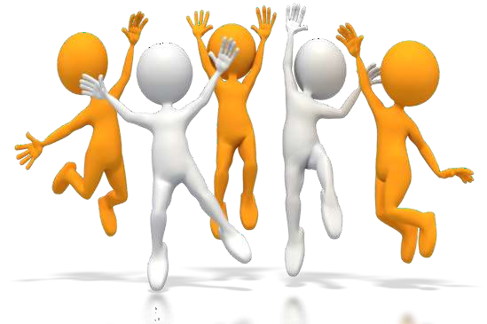
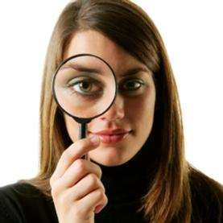
🠶 Free riders – people who benefit from the group but give little in return.
🠶 “People exert effort when their outputs are individually identifiable”
🠶 When being observed it increases evaluation concerns = Social Facilitation
🠶 When being lost in a crowd it decreases evaluation concern = Social Loafing

Slide 28
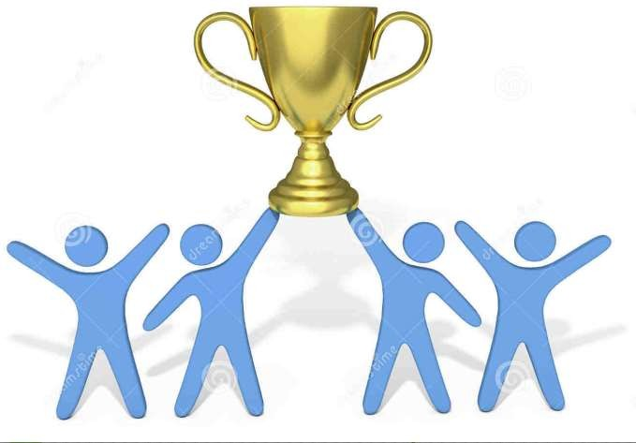
🠶 “People may, however, put forth even more effort in a group when
the goal is important, rewards are significant, and team spirit exists”

