Slide 1
Social Cognition

Slide 2
Social Cognition
■
How people think about themselves and the social world, or
more specifically, how people select, interpret, remember, and use social information to make judgments and decisions.
■
The assumption is that people are generally trying to form accurate impressions of the world and do so much of the time.
Because of the nature of social thinking, however, people sometimes form erroneous impressions.
■
■
Automatic Thinking
– Quick and automatic, “without thinking,” thinking that is nonconscious, unintentional, involuntary, and effortless.
■
Controlled thinking
– Is effortful and deliberate, pausing to think about self and environment, carefully selecting the right course of action.

Slide 3
Schemas
Mental structures that organize our knowledge about the social world (about people, ourselves, social roles, specific events).
  Schemas are typically very useful for helping us organize and make sense of the world and to fill in the gaps of our knowledge.
  Schemas are particularly important when we encounter information that can be interpreted in a number of ways, because they help us reduce ambiguity.
  Information consistent with our schemas are remembered more (e.g., perseverance effect)

Slide 4
Nature of Schemas
Self-Confirming nature of schemas
  Self-fulfilling prophecies
    Predictions that, in a sense, make themselves come true.
  Behavioral confirmation
    A type of self-fulfilling prophecy whereby people’s social expectations lead them to act in ways that cause others to confirm their expectations.
    Do we get from others what we expect of them?

Slide 5
What do schemas do?
“The human mind must think with the aid of categories…orderly living depends upon it.”
--Allport, 1954
Help us organize information
Help us remember certain things
Help us to fill in details when our information is incomplete
Can influence behavior
Help us to interpret ambiguous behavior
Influence what information we attend to

Slide 6

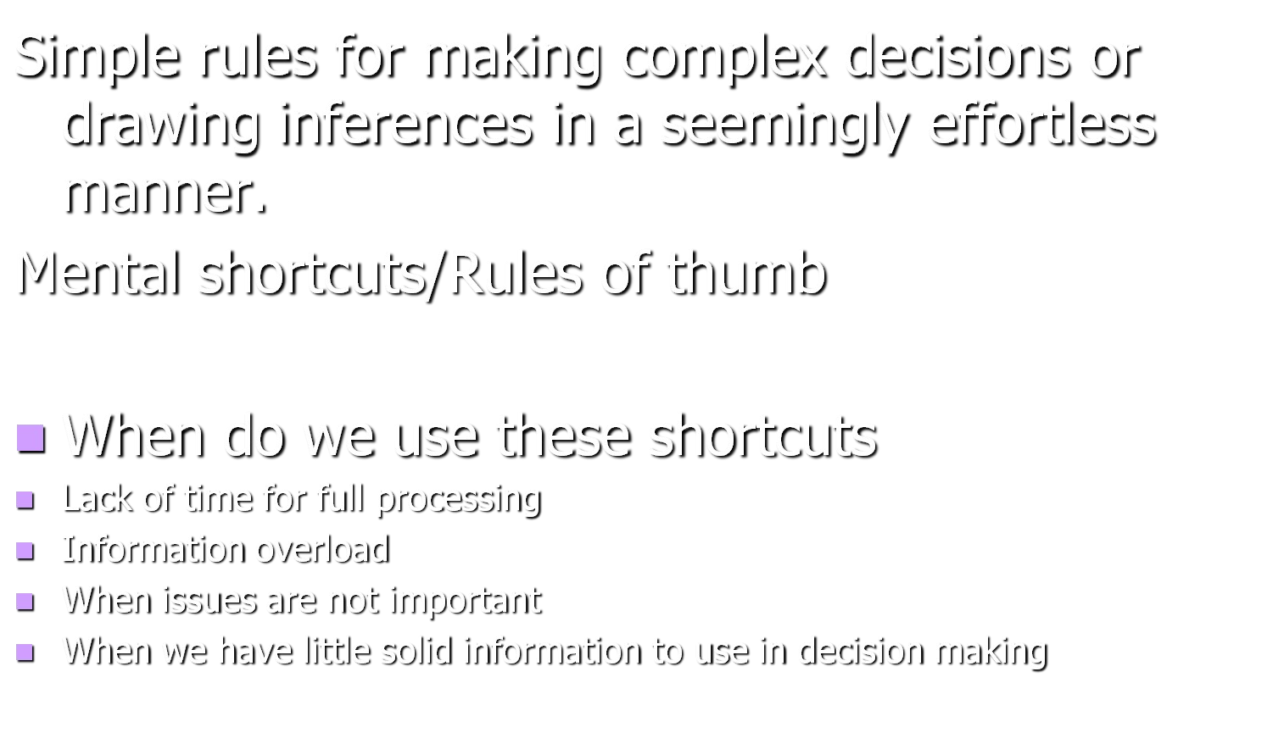
Heuristics

Slide 7
Representativeness Heuristic
A strategy for making judgments based on the extent to which current stimuli or events resemble other stimuli or categories.
Are these judgments accurate?

Slide 8
Availability Heuristic
“If I think of it, it must be important”
Suggests that the easier it is to bring information to mind, the greater it’s importance or relevance to our judgements or decisions.

Slide 9
Priming
Increased availability of information in memory or consciousness resulting from exposure to specific stimuli or events.

Slide 10
Automatic Priming
Effect that occurs when stimuli of which individuals not consciously aware alter the availability of various traits or concepts in memory.

Slide 11
False consensus Effect
The tendency to assume that other behave or think as people do to a greater than is actually true.

Slide 12
Potential Sources of
Error in Social Cognition
Rational versus Intuitive Processing
Dealing with Inconsistent Information
The Planning Fallacy
The Potential Costs of Thinking Too Much
Counterfactual Thinking
Magical Thinking
Thought Suppression

Slide 13
Rational versus Intuitive Processing
Going with our guts
Cognitive Experiential Self-Theory, Epstein, 1994
  Deliberate and intuitive thinking

Slide 14
The Planning Fallacy
The tendency to make optimistic predictions concerning how long a given task will take for completion
Also known as ‘optimistic bias’
Why to we do this? Three factors.

Slide 15
The Potential Costs of Thinking Too Much
Why, sometimes, our tendency to do as little cognitive work as possible may be justified.

Slide 16
Counterfactual Thinking
How it relates to Regret
Upward Counterfactual Thinking
Downward Counterfactual Thinking
Inaction Inertia
Overall, what it results in

Slide 17
Magical Thinking
Thinking involving assumptions that don’t hold up to rational scrutiny-for example, the notion that things that resemble one another share fundamental properties.
Three types of magical thinking.
Rozin, Markwith, & Nemeroff (1992)

Slide 18
Thought Suppression
Efforts to prevent certain thoughts from entering consciousness.
How do we do this?
  Automatic Monitoring Process
  Operating Process
Problems

Slide 19
Affect and Cognition
How feelings shape thought and thought shapes feelings.
Affect: Our current feelings and moods.
Cognition: The ways in which we process, store and remember, and use social information.
A reciprocal relationship.

Slide 20
The Influence of Affect on Cognition
Affect and style of information processing we adopt.
Affect and memory
Affect and plans and intentions
Mental contamination
  Edwards and Bryan (1995)

Slide 21
Influence of Cognition on Affect
Two ways we are going to talk about it
  Activation of schemas
  Cognition and emotion-provoking events

Slide 22
The Affect Infusion Model Forgas (1995)
Affect influences social thought and ultimately social judgements. How?
  Affect serves as a trigger
  Affect as information
When do these effects occur?

Slide 23
Thought Suppression
Efforts to prevent certain thoughts from entering consciousness.

