Slide 1
Carlson (7e) PowerPoint Lecture Outline Chapter 10: Reproductive
Behavior
This multimedia product and its contents are protected under copyright law. The following are prohibited by law:
any public performance or display, including transmission of any image over a network;
preparation of any derivative work, including extraction, in whole or in part, of any images;
any rental, lease, or lending of the program.
Copyright 2001 by Allyn & Bacon

Slide 2
Reproductive Behaviors
Reproductive behaviors are social behaviors that are critical for survival of the species
Courting, mating, parental behavior
Reproductive behaviors are sexually dimorphic
Behaviors vary systematically in males and females
Most forms of aggressive behavior are dimorphic
Early hormone experience plays a prominent role in the development and control of sexually dimorphic behaviors
10.2

Slide 3
Markers of Sex
Chromosomal: XX or XY (23rd chromosome pair) is determined at conception
Gonadal: testes or ovaries
Hormonal: Estrogen/androgen
Internal reproductive structures
Mullerian system: Fallopian tubes, uterus, inner 2/3 of vagina
Wolffian system: epididymis, vas deferens, seminal vesicles
External reproductive structures
Males: penis/scrotum
Females: labia, clitoris, outer 1/3 of vagina
10.3

Slide 4
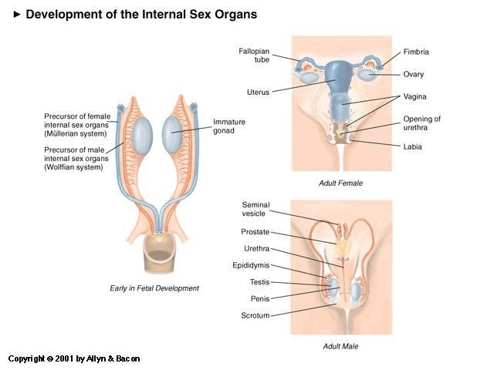

Slide 6
Sexual Development
“Nature’s Impulse is to create a female”
The internal reproductive structures can develop into a male or female pattern
Male testes secrete
Anti-Mullerian hormone prevents development of the Mullerian system
Androgens promote development of the Wolffian system
Testosterone
Dihydrotestosterone
In the absence of androgen secreted by testes, female pattern develops:
Mullerian system
External genitalia
Brain
10.6

Slide 7
Male Sexual Development
SRY gene on XY chromosome induces development of testis
Testes secrete:
Anti-Mullerian hormone (defeminizing effect)
Androgens: stimulate Wolffiian system development
External male reproductive structures require dihyrotestosterone (androgen)
10.6

Slide 8
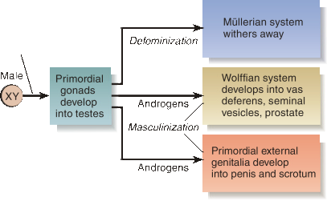
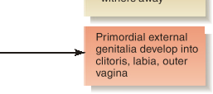
Internal Sex Organ Development
10.8

Slide 9
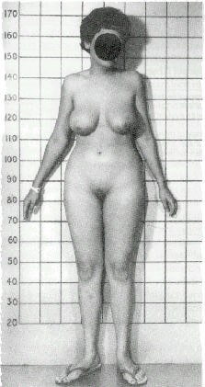

Slide 10
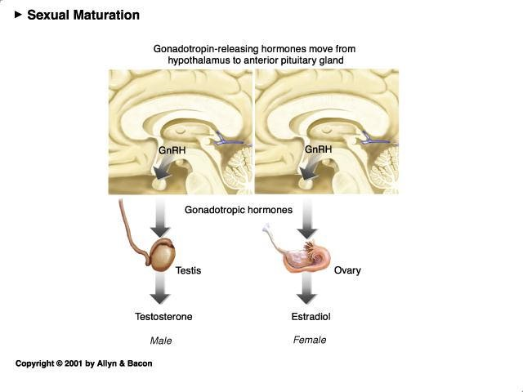

Slide 11
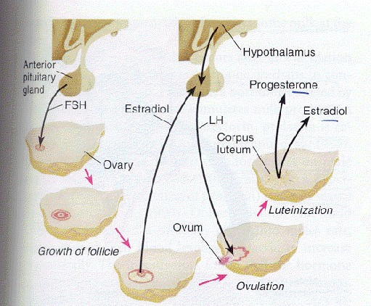

Slide 12
Sexual Maturation
Secondary sexual characteristics include
Female: enlarged breasts, widened hips;
Male: beard, deep voice
Secondary sex characteristics appear at puberty
Puberty is associated with secretion of gonadotropin-releasing hormones (GnRH)
GnRH in turn induces secretion from the anterior pituitary of
Follicle-stimulating hormone (FSH)
Luteinizing hormone (LH)
FSH and LH are secreted in females (develop the ovum) and males (stimulate development of sperm, secrete testosterone)
Estradiol secreted by the gonads induces breast development
Androgens stimulate facial hair, lowered voice, muscle development
10.12

Slide 13
Female Reproductive Cycles
Reproductive cycles in females involve a fixed sequence of hormonal events
Primates: menstrual cycle of uterine lining growth (and loss), mating is not tied to ovulation
Rats: estrous cycle is a four day cycle, no menses, mating is tied to ovulation
Cycle starts with secretion of gonadotropins from the ant. pituitary
FSH stimulates ovarian follicles
Follicles secrete estadiol, which stimulates uterine lining growth and triggers a pulse of LH from the anterior pituitary
The LH surge induces ovulation, the ruptured follicle (corpus luteum) produces estradiol and progesterone (which maintain the uterine lining)
If pregnancy does not result, the corpus luteum shuts down, resulting in menses

Slide 14
Adult Sexual Behaviors (Rodent)
Male
Intromission
Pelvic thrusting
Ejaculation
Post-ejaculatory refractory period
Female
Lordosis response
Receptivity: willingness to copulate
Proceptivity: behaviors that seek out and arouse male sexual interest
Attractiveness: physiological and behavioral changes that affect the male (odor)

Slide 15
Hormones: Male Sexual Behavior
Male sexual behavior depends on testosterone
Activational effects of hormones in the male:
Male sexual behavior requires testosterone
Testosterone is converted to estradiol which restores sexual behavior in a castrated male
Drugs that block the conversion of testosterone to estadiol reduces male sexual behavior
Oxytocin may contribute to smooth muscle contract during orgasm
Prolactin is released during ejaculation and may mediate male sexual refractory period
The endogenous opiate dynorphin may also contribute to male sexual satiety

Slide 16
Hormones: Female Sexual Behavior
Sexual behavior in the mammalian female depends on gonadal hormones secreted during estrus
Estrogen is secreted, followed by progesterone
Ovariectomized rats are not sexually receptive
Restoration of receptivity requires a small amount of estradiol followed by large levels of progesterone
Female mice that lack estrogen receptors are not receptive
Oxytocin: contributes to smooth muscle contractions during orgasm

Slide 17
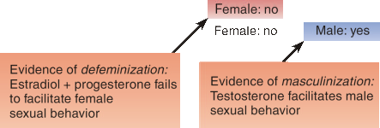
Organizational Effects of Testosterone
Early androgen exposure promotes:
Behavioral defeminization as an adult
Behavioral masculinization
Involve estrogen receptors

Slide 18
Pheromone Actions in Animals
Pheromones are chemicals that transmit a message from one animal to another
Pheromones can alter reproduction
Lee-Boot effect: the estrous cycle stops when groups of female mice are housed together
Whitten effect: the estrous cycle restarts in synchrony when a group of female mice are exposed to the urine of a male mouse
Bruce effect: involves the failure of pregnancy when a recently impregnated mouse is exposed to a normal male mouse (other than the one with which she mated)
The vomeronasal organ detects nonvolatile chemicals in urine
The vomeronasal organ projects to the accessory olfactory bulb which in turn projects to the amygdala which has connections with the hypothalamus
Lesions of the accessory olfactory bulb disrupt the Lee-Boot, Whitten and Bruce effects
10.18

Slide 19
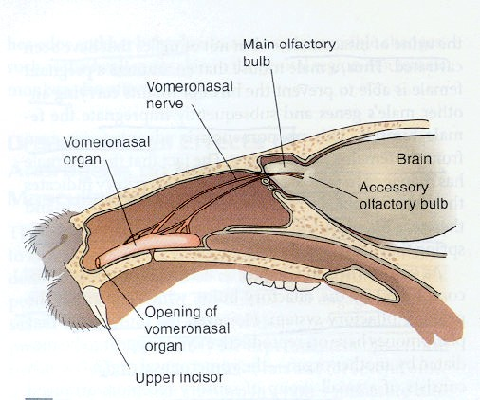

Slide 20
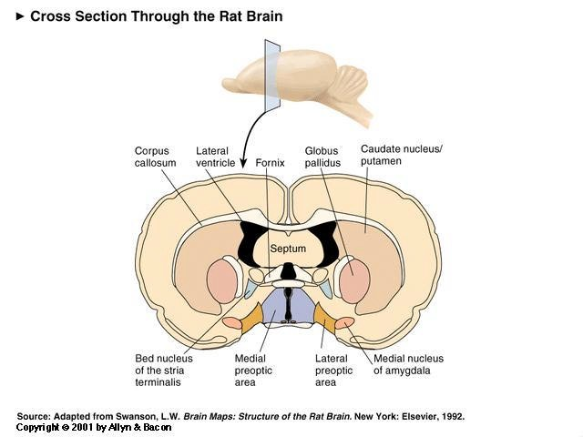

Slide 21
Pheromone Actions in Humans
Humans possess a vomeronasal organ
Exposure to chemical present in sweat can alter human behavior
McClintock studied the menstrual cycles of women who attended an all-female college
Women who spent time together showed synchronization of their menstrual cycles
Women who spent time with men showed shorter cycles
Exposure to underarm sweat elicited synchronization
Pheromones present in human sweat can alter social behavior
Androstenol placed on a necklace had no effect on the social interactions of men, but women exposed to androstenol showed more interactions with men

Slide 22
Sexual Orientation
Sexual orientation relates to the gender of a person’s preferred sexual partner
Only humans are exclusively homosexual (prefer a partner of the same sex)
Homosexuality does not appear to be a product of childhood experiences (domineering mother, submissive father)
Self-reports of homosexual feelings predate homosexual activity
Prenatal hormone exposure may play a role in sexual orientation
Congenital adrenal hyperplasia (CAH) results in exposure of female fetus to high levels of androgens
37-48% of CAH women reported themselves to be bisexual or homosexual
Twin studies indicate a higher concordance for homosexuality among monozygotic twins than for dizygotic twins
10.22

Slide 23
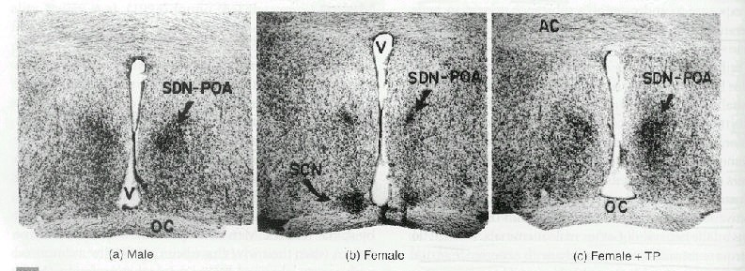

Slide 24
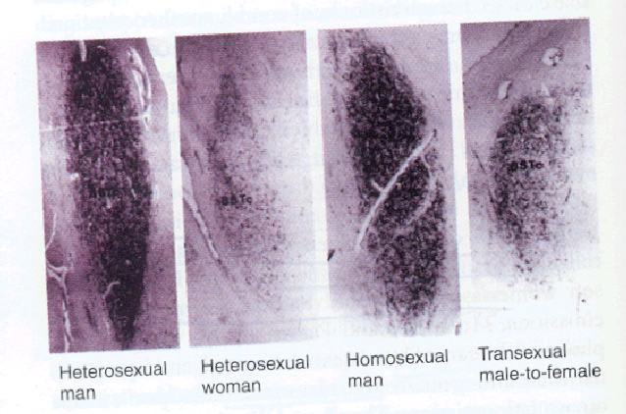

Slide 25
Male Spinal Sexual Reflexes
The spinal cord contains circuitry that is sufficient for certain sexual reflexes in the male
Erection and ejaculation can occur in animals and humans in which the spinal cord has been transected
The transection eliminates the experience of orgasm
Circuitry for these reflexes is located beneath the level of the transection
Spinal cord neurons that participate in sexual reflexes are sexually dimorphic
Spinal nucleus of the bulbocavernosus (SNB) is larger in males than in females
Development of the SNB requires androgen exposure

Slide 26
Medial Preoptic Area
The medial preoptic area (MPA) is involved in the control of male sexual behavior:
MPA contains testosterone receptors
Infusions of testosterone into the MPA restore copulation in castrated rats
MPA neurons are active during copulation
As indexed by firing rate and by c-fos studies
Electrical stimulation of the MPA induces copulation
Lesions of the MPA disrupt copulation
The MPA receives input from the vomeronasal organ
The MPA has outputs to the motor neurons of the spinal cord that control pelvic organs involved in copulation

Slide 28
Female Sexual Behavior
The ventromedial hypothalamus (VMH) has a critical role in modulating female sexual behavior in rats
VMH lesions block lordosis in female rats which is not restored by estrogen/progesterone
Electrical stimulation of VMH facilitates lordosis
Copulation is associated with fos production in the VMH (and amygdala)
Removal of the ovaries reduces female sexual behavior, this behavior is restored when estrogen and progesterone are placed directly into the VMH
Estrogen increases the number of hypothalamic progesterone receptors
The VMH projects to the PAG, which projects to the medulla and spinal cord
10.28
Copyright 2001 by Allyn & Bacon

Slide 30
Parental Behavior
Parental behavior serves to protect and nourish offspring
Maternal behavior in rodents
Pregnant female rats and mice build nests to house their offspring
Maternal behaviors that occur at the time of parturition (birth):
Delivering the offspring
Removing the placental and fetal membranes
Stimulating defecation/urination by licking the anogenital region
Retrieval of pups into the nest
Olfaction plays a role in maternal behavior
Lesions of the MPA disrupt maternal behavior
10.30
Copyright 2001 by Allyn & Bacon

