Slide 1
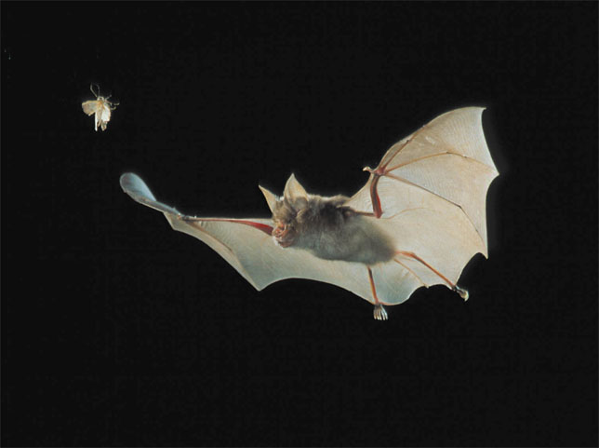
Sensory Systems

Slide 2
Environment-----> Sensing
Brain analysis
Action
organism
A view of animal behavior

Slide 4
What do sensory systems do?
Sensory receptors transduce the energy of stimuli and transmit signals to the central nervous systems.
Stimulus---->Reception/Transduction---->Sensation/Perception
Sensory Receptors CNS
Sensations are action potentials that reach specific areas of the brain. Once the brain recognizes a sensation, it interprets it, giving the perception (color, taste, sound, taste) of a stimulus.
Sensations and perceptions begin with sensory reception, which is the detection of a stimulus by sensory cells (or receptors)

Slide 5
Sensory receptors are specialized neurons. They can occur singly or in groups as part of sensory organs.
Exteroreceptors are receptors that detect stimuli coming from outside of the body (heat, light, chemicals, pressure).
Interoreceptors detect stimuli coming from within the body (blood pressure, plasma osmolality, blood pH).

Slide 6
-Sensory systems detect information from the environment (sensing), analyze it, and elicit actions.
-Sensory receptors transduce the energy of stimuli and transmit signals to the central nervous systems.
-Sensations are action potentials in response to specific stimuli that reach specific areas of the brain. Once the brain recognizes a sensation, it interprets it, giving the perception (color, taste, sound, taste) of a stimulus.
-Exteroreceptors are receptors that detect stimuli coming from outside of the body (heat, light, chemicals, pressure). Interoreceptors detect stimuli coming from within the body (blood pressure, plasma osmolality, blood pH).

Slide 7
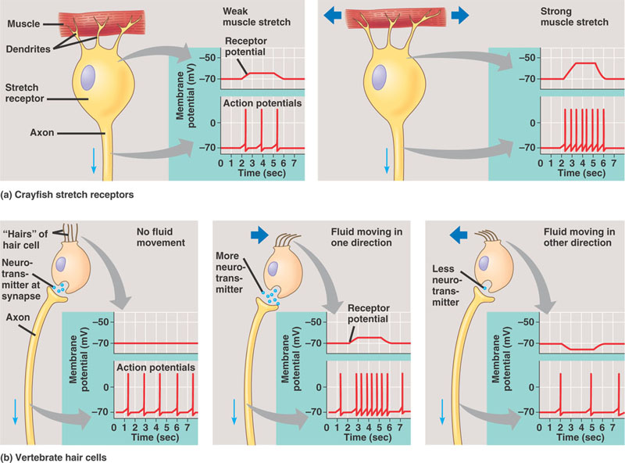
Receptors convert the energy of a stimulus into a change in their membrane potential. This change is graded (their magnitude depends on the magnitude of the stimulus) and is called a receptor potential. Receptor potentials result from the opening or closing of ion channels.

Slide 8
The receptor potential is transmitted either as a series of action potentials (their frequency depends on the magnitude of the receptor potential), or in the release of a neurotransmitter (the amount of neurotransmitter depends, again, on the magnitude of the receptor potential).

Slide 9
Sensory receptors have four functions:
Sensory transduction (they transduce [transform/translate] the energy of a stimulus into a change in membrane potential).
Amplification (they strengthen the energy of the stimulus. The action potential conducted from the eye to the brain contains 100,000 times more energy than the few photons of light that stimulated the receptor).
Transmission (action potentials from receptors, or from neurons connected to receptors, reach the CNS).
Integration (receptors contribute to the processing of a signal. For example many receptors show sensory adaptation. This term means that they respond less during continued stimulation. Of course some receptors “adapt” more quickly than others).

Slide 10
-Sensory receptors convert the energy of a stimulus into a graded change in their membrane potentialcalled a receptor potential.
-Receptor potentials result from the opening or closing of ion channels.
-A receptor potential is transmitted either as a series of action potentials or by the release of a neurotransmitter.
-Sensory receptors have 4 functions: Sensory transduction (transform/translate the energy of a stimulus into a change in membrane potential), Amplification (they strengthen the energy of the stimulus). Transmission (action potentials from receptors, or from neurons connected to receptors, reach the CNS). Integration (receptors contribute to the processing of a signal).

Slide 11
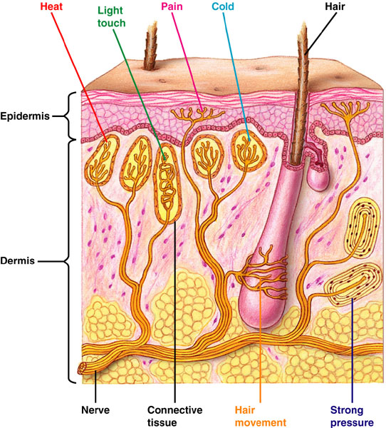
Thermoreceptors
(sense temperature)
Pain receptors
(nociceptors, from nocere (L) to hurt, usually have naked dendrites)
Mechanoreceptors
(sense physical deformation)
There are many types of sensory receptors:

Slide 12
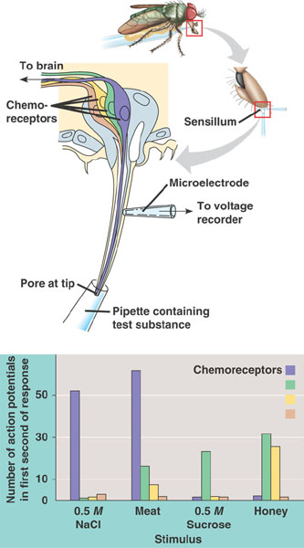
Chemoreceptors, include both receptors that transmit the total solute concentration of a solution (osmoreceptors), and specific receptors that respond to individual kinds of molecules. For example, many insects have gustatory hairs (sensilla) on their feet and mouthparts. Each sensillium contains 4 chemoreceptors, which respond differently to different chemical stimuli.

Slide 13
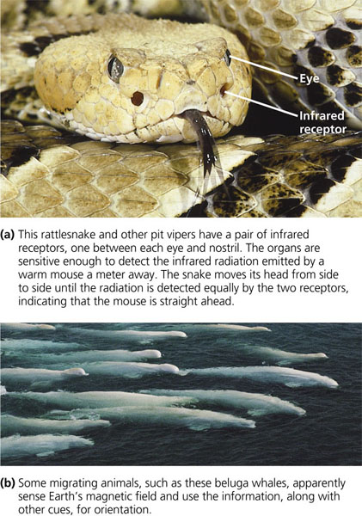
Animals also have Electromagnetic receptors which detect electromagnetic energy (including visible light, electricity, and magnetism)

Slide 14
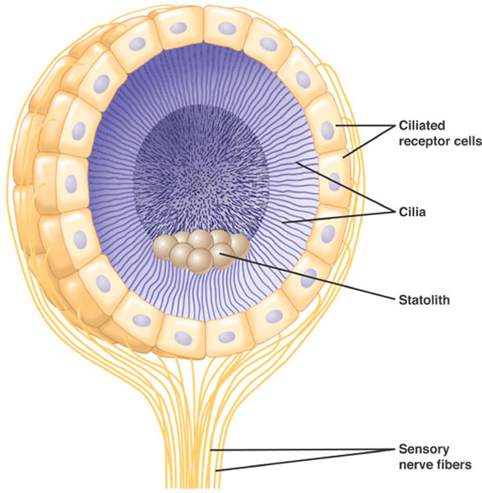
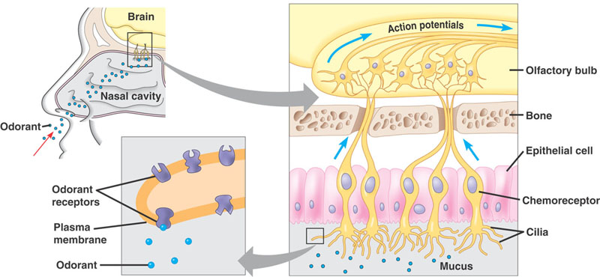
Types of Sensory Systems
Hearing and Equilibrium
(both rely on mechanoreceptors)
Vision
Taste and Smell
(both rely on chemoreceptors)
In many invertebrates, the position in which the statoliths (“position stones”) settle inside a statocyst (“position detector”) give the brain infoirmation about the orientation of the body.
In humans, odorant molecules bind to specific receptors in the plasma membrane of osmoreceptors triggering action potentials.

Slide 15
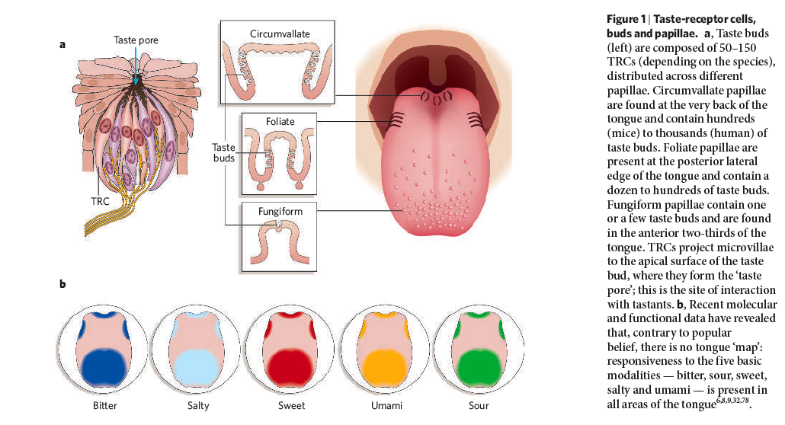
Taste
papillae
5 types of taste

Slide 16
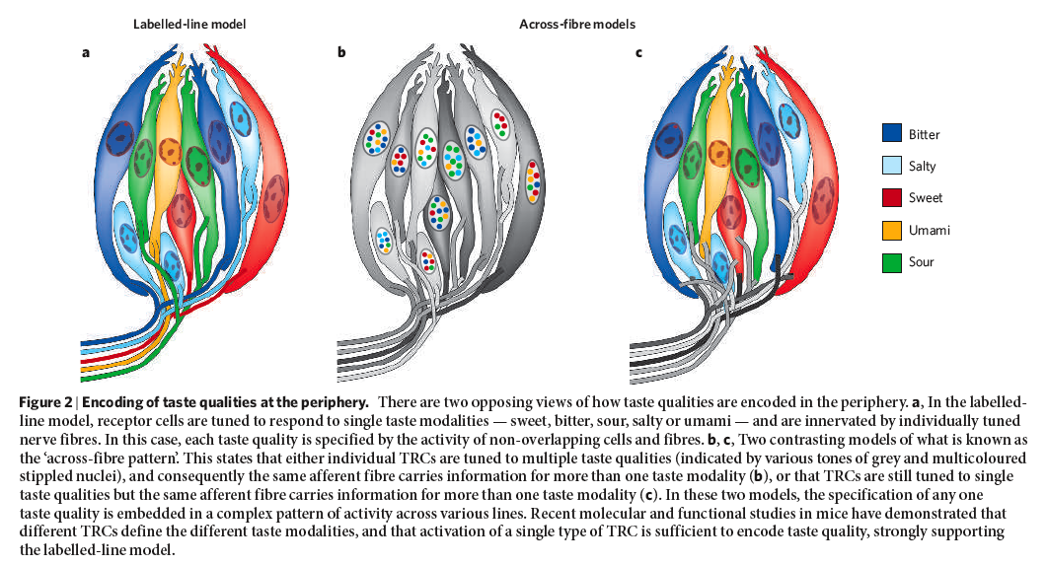
WE DON’T KNOW HOW THE RECEPTORS WORK!

Slide 17
-There are many types of receptors: thermoreceptors, nociceptors, mechanoreceptors, chemoreceptors (including osmoreceptors), electromagnetic receptors.
-These receptors are found as elements of sensory systems including:hearing and equilibrium, taste and smell, and vision.
-Both hearing and equilibrium depend on mechanoreceptors. Taste and smell depend on chemoreceptors.
-Taste receptors can detect 5 types of “tastes”, salty, sweet, bitter, sour, and umami.

Slide 18
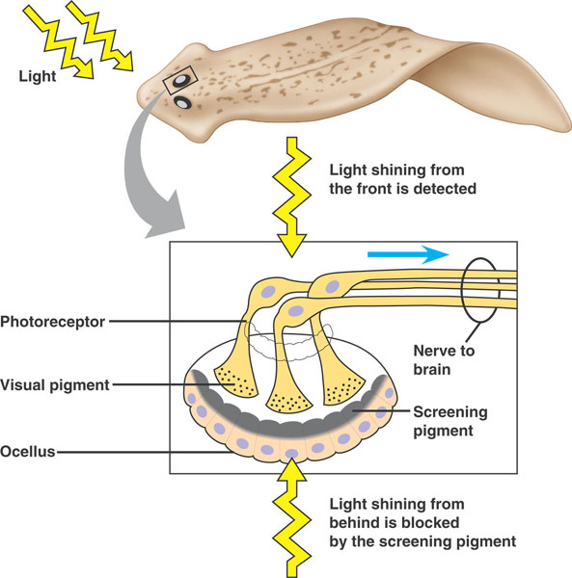
Vision
Many types of “light detectors” have evolved among animals. These range from simple clusters of cells that detect the direction and intensity of light to complex organs that form images. In spite of great diversity, all photoreceptors contain similar pigment molecules that absorb light. Most of these pigments (opsins) are homologous (evolved from a common ancestral molecule).
Planarians have two ocelli (light detecting organs, sometimes called eye spots or eye cups) that allow the animal to sense light (and often turn away from light). Orientation comes about by “comparing” light entering through each side.
The cross-eyes in planaria serve a purpose!!

Slide 19
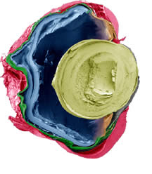
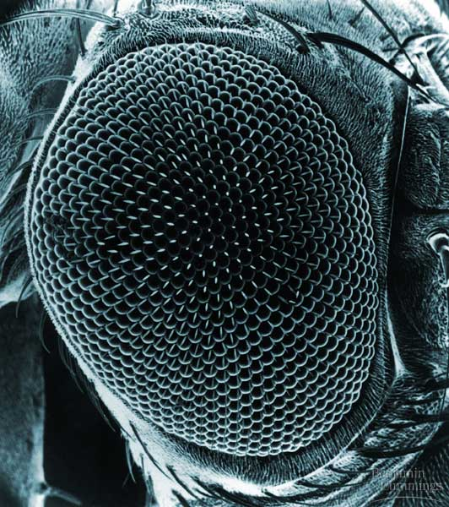
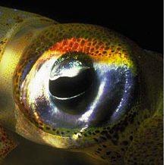
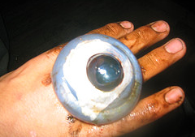
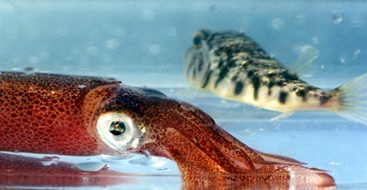
Two types of image-forming eyes have evolved among invertebrates. Compound eyes in arthropods (also some polychates) and single-lens eyes which have evolved in some polychaetes (annelids), in spiders, and in octopi and squid.
Single-lens eye of squid
Arthropod compound eye

Slide 20
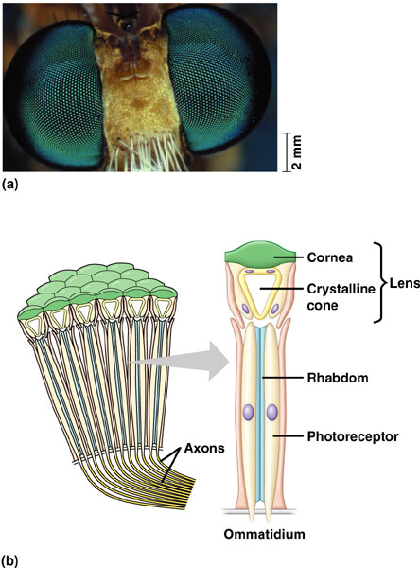
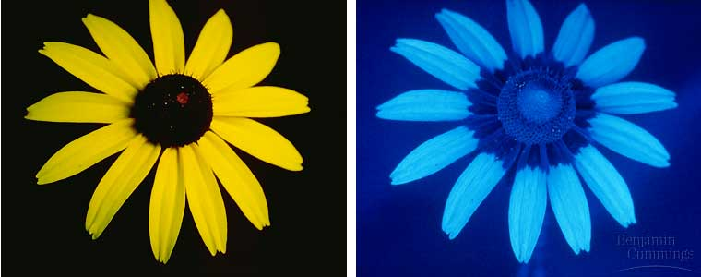
Compound eyes are made of lots of ommatidia. The cornea and crystalline act as a lens that focuses light. Each ommatidium detects light on a narrow portion of the visual field and then the brain integrates this mosaic. Some insects can detect color in the ultraviolet range. We cannot extrapolate our sensory world to other species.
We
Insect (maybe)

Slide 21
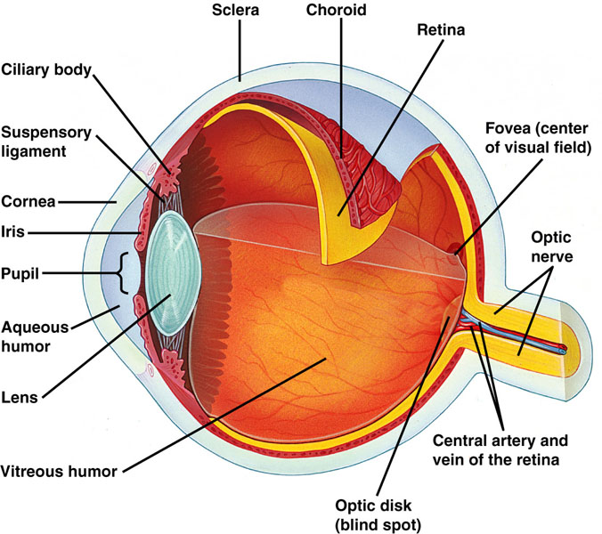
Vertebrate Eyes

Slide 22
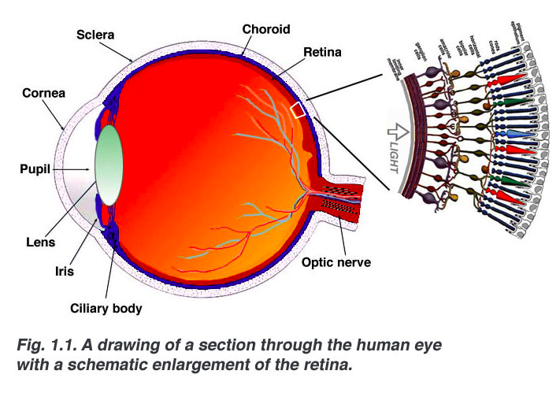

Slide 23
TO REMEMBER
-Although animals use many types of light detectors (phtoreceptors), all of them use similar pigments (opsins).
-Planaria have very simple ocelli (eye spots).
-Invertebrates have ocelli, compound eyes (artropods, annelids), and single-lens eyes (octopi, squid).
-Compound eyes are made of omatidia (cornea, crystalline, rhabdom, photoreceptor)..
-Single-lens eyes of vertebrates have sclera, cornea, lens, iris, retina, optic nerve.

Slide 24
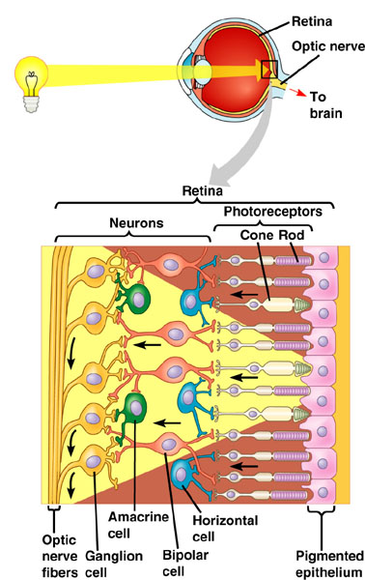
The retina contains photoreceptors (rods and cones), cells that integrate information across the retina (horizontal cells and amacrine cells), and cells that receive information from several rods and cones (bipolar cells) and relay it to ganglion cells which transmit action potentials to the brain by the optic nerve.

Slide 25
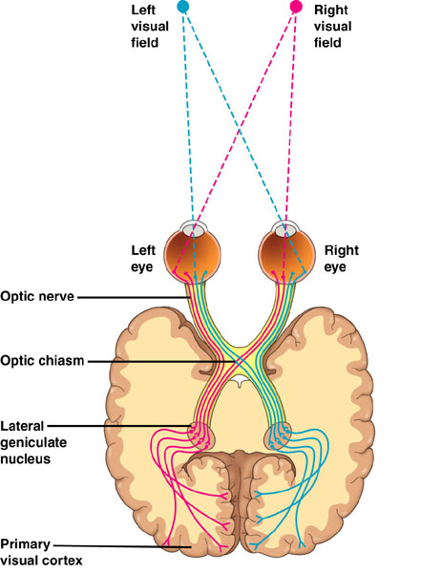
Each optic nerve has ≈ 10⁶ axons that connects with interneurons in a structure called the geniculate nuclei. These interneurons relay sensations to the primary visual cortex, which is one of the brain centers responsible in constructing visual perceptions.

Slide 26
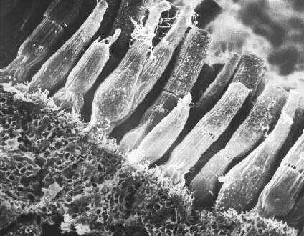
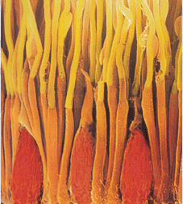
The photoreceptors in the retina of vertebrate eyes have two morphologies: they can be rod-like (“rods”)
or
cone-like (“cones”).
Rods
Cones

Slide 27
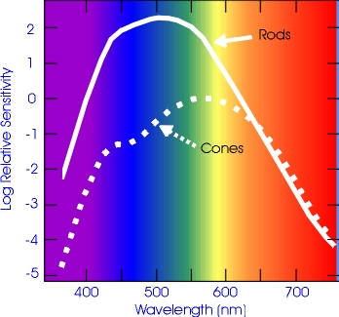
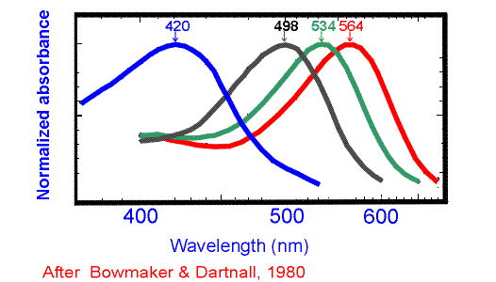
Rods are very good at detecting light at low intensities and at the low end of the electromagnetic spectrum, but are not good at distinguishing colors. Cones can detect variation in colors but are not as sensitive to light as rods. The reason for this difference is in the molecular structure of the pigments (opsins) contained in these two types of receptors. All vertebrate classes (fishes, amphibians, reptiles, and birds) have color vision. Most mammals are nocturnal and hence have mostly rods. Old World primates (including humans) are exceptional in that we have lots of cones (we will discuss the evolution of color vision a bit later).
rod

Slide 28
In addition to the opsin found in rods (called rhodopsin), humans (and most Old World primates) have 3 different pigments which absorb (and hence are stimulated) at different peaks of the spectrum. For this reason, our visual system is called “trichromatic”

Slide 29
TO REMEMBER
The retina contains photoreceptors (rods and cones), cells that integrate information across the retina (horizontal cells and amacrine cells), and cells that receive information from several rods and cones (bipolar cells) and relay it to ganglion cells which transmit action potentials to the brain by the optic nerve.
-Each optic nerve has axons that connects with interneurons in a structure called the geniculate nuclei. These interneurons relay sensations to the primary visual cortex, which is one of the brain centers responsible in constructing visual perceptions.
-Rods are good at detecting light at low intensities but are not good at distinguishing colors. Cones can detect variation in colors but are not as sensitive to light as rods.
-Our visual system is called “trichromatic” because in addition to rhodopsin, we have 3 different pigments which absorb at different peaks of the spectrum.

Slide 30
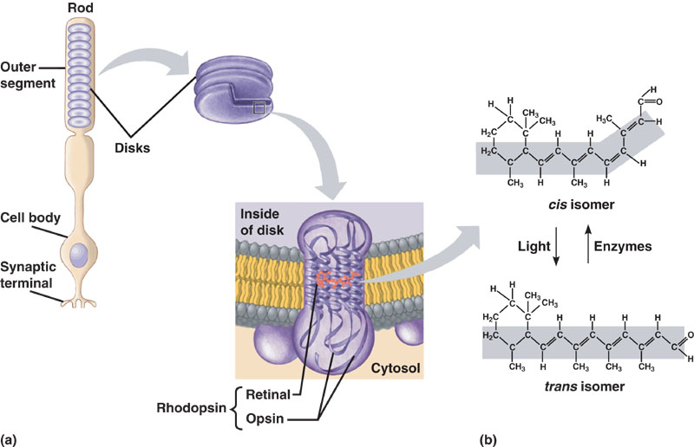
Rods contain the visual pigment rhodopsin, which is embedded in a stack of membrane disks. Rhodopsin consists of the protein (pigment) opsin and the light absorbing molecule retinal (there are many opsins!).
Retinal exists in two forms. Light converts the cis form to a trans form and enzymes return it to its original form.

Slide 31
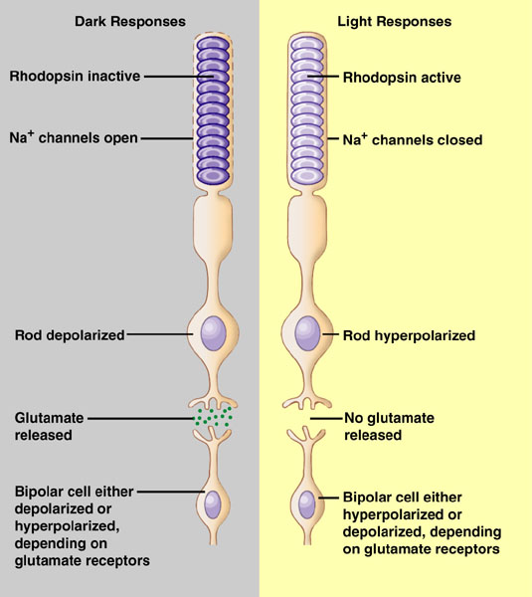
The stimulus by which rods and cone stimulate or inhibit bipolar cells is the release of the neurotransmitter glutamate.
+
-
To ganglion cells and then to brain by optic nerve.

Slide 32
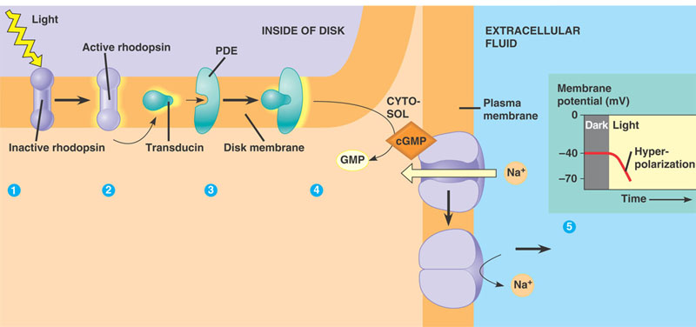
Transducin activates PDE (phosphodiesterase)
Light isomerizes retinal and activates rhodopsin
The channels close and the membrane hyperpolarizes and stops releasing the neurotransmitter glutamate.
Active rhodopsin
Activates transducin
Activated PDE detaches cGMP from Na+ channles in the plasma membrane.

Slide 33
TO REMEMBER
Rhodopsin, which is embedded in a stack of membrane disks. Rhodopsin consists of the protein (pigment) opsin and the light absorbing molecule retinal (there are many opsins).
Light starts a cascade in rhodopsin that leads to the closing of Na+ channels, the cell hyperpolarizes (its membrane potential becomes more negative) and stops releasing glutamate that stimulate a bipolar cell. The bipolar cell generates action potentials in the optic nerve.
The absence of light depolarizes the cell. The presence of light hyperpolarizes it.

Slide 34
Color vision, olfaction, fossil genes, and primate evolution
Background:
Olfactory receptor genes, which provide the basis for the sense of smell, represent the largest gene superfamily in mammalian genomes (> 1000 genes!!)

Slide 35
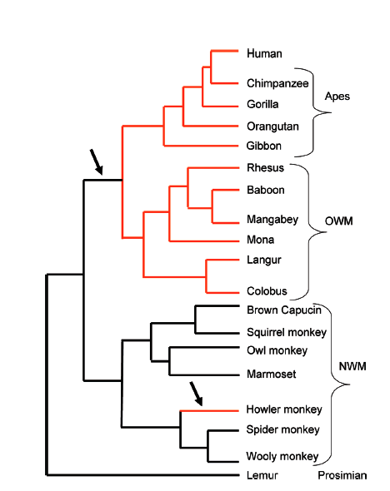
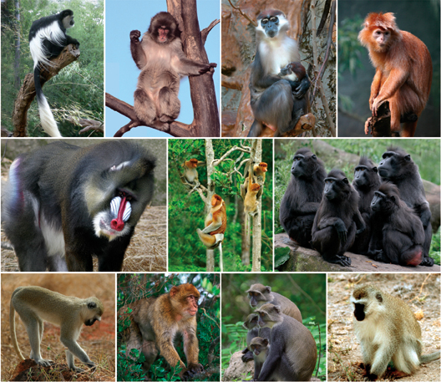
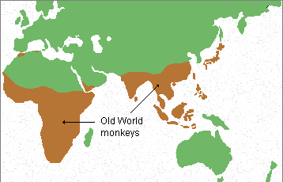
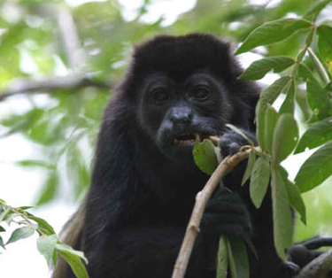
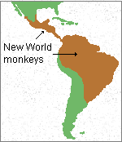
2) Trichromatic vision has evolved independently twice in primates. Both times as a result of opsin gene duplications, followed by mutations that modify the duplicated genes.

Slide 36
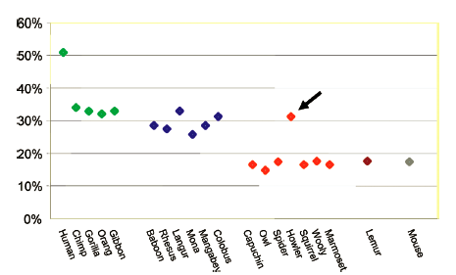
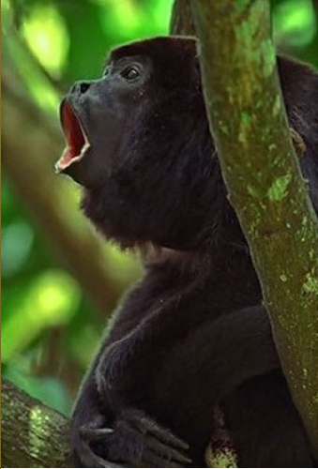
3) In the absence of natural selection, genes accumulate deleterious mutations that turn them into pseudogenes (“fossil genes”) that are not functional.
Vision and smell seem to be alternative senses.
In primates with trichromatic vision, a much higher % of olfactory receptor genes (30%) have become fossilized (pseudogenes) than in primates without trichromatic vision (≈ 15%).

Slide 37
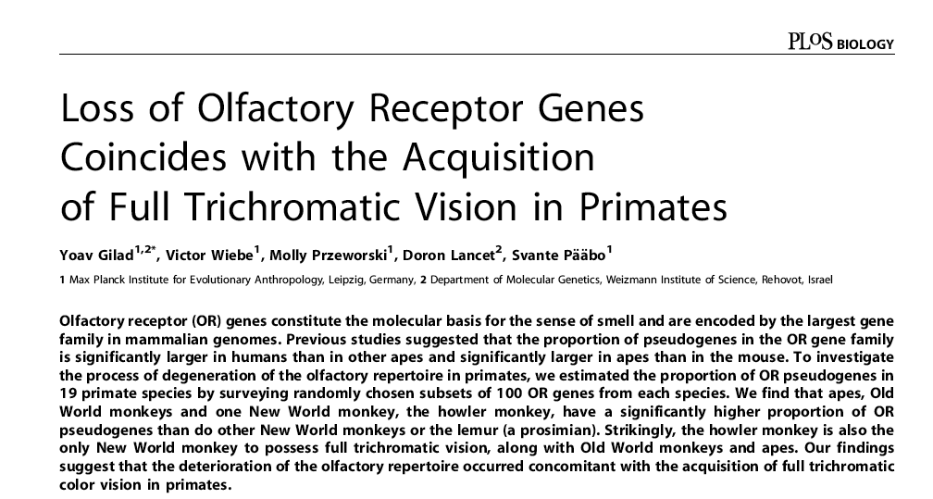

Slide 38
Next Skeletons and muscles (keep reading chapter 49)

Slide 39
Skeletons and Muscles

Slide 40
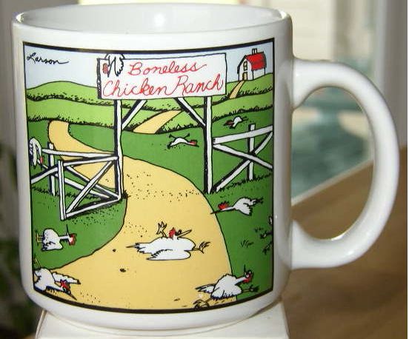
Animal skeletons have three primary functions
Support (most animals would sag against their own weight if they had no skeleton. We all fight gravity! Skeletons also preserve form)
2) Protection (a hard skeleton protects soft tissues. Think about skulls and ribs)
3) Movement (skeletons provide attachment sites for muscles, which are the engines for movement)

Slide 41
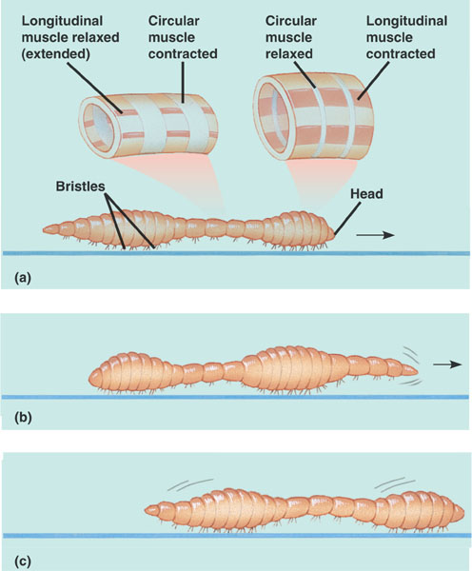
There are three main types of skeletons
1) Hydrostatic skeletons have fluid under pressure in a closed body compartment. Animals control movement by using muscles to change the shape of fluid-filled compartments. Hydrostatic skeletons are found in cnidarians, flatworms, and annelids.
In earthworms, contraction of longitudinal muscles thickens and shortens segments of the worm; contraction of circular muscles constrict and elongate the segments. Bristles act as anchors.

Slide 42
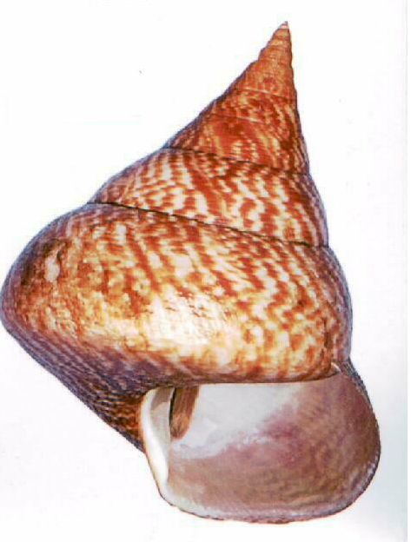
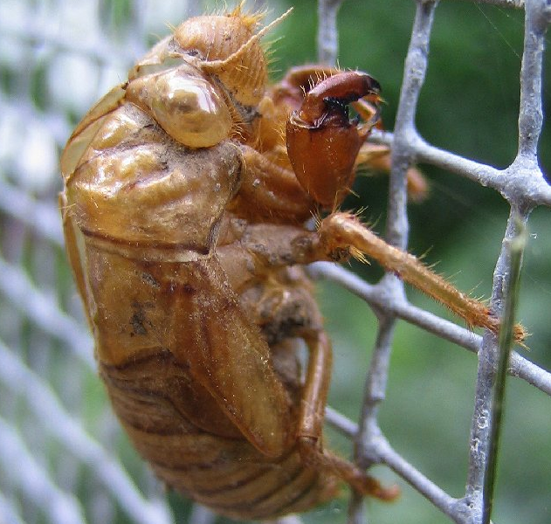
Exoskeletons are deposited on the surface of the animal. Examples:
The calcareous (made of calcite or calcium carbonate) shells of mollusks.
2) The jointed exoskeleton of arthropods and crustaceans are made of chitin and sometimes are reinforced by calcite and other materials.

Slide 43
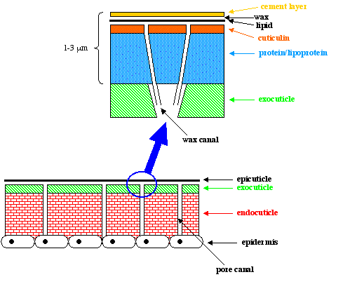
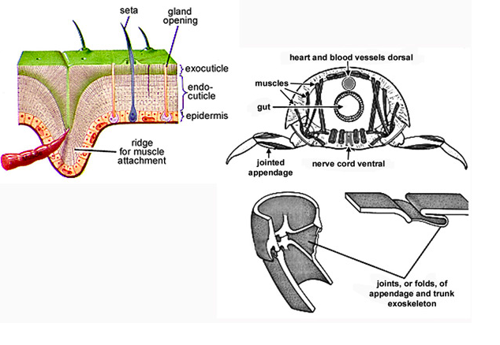
The exoskeleton of arthropods is secreted by the epidermis (a layer of living cells) and it is made of chitin and protein. In insects it is covered by a layer of impermeable wax, which reduces evaporation.

Slide 44
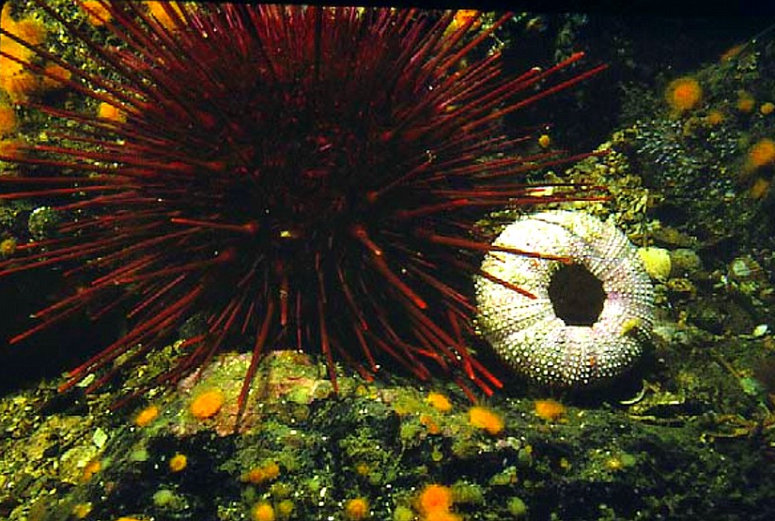
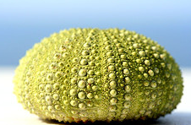
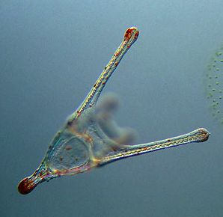
Endoskeletons consist of hard supporting elements (such as bones), buried within the animal’s soft tissues. Chordates have skeletons made of cartilage (mostly collagen) and bone.
Echinoderms have endoskeletons under made of hard plates called ossicles under their skin. The ossicles are made of magnesium and calcium carbonate bound by protein fibers.

Slide 45
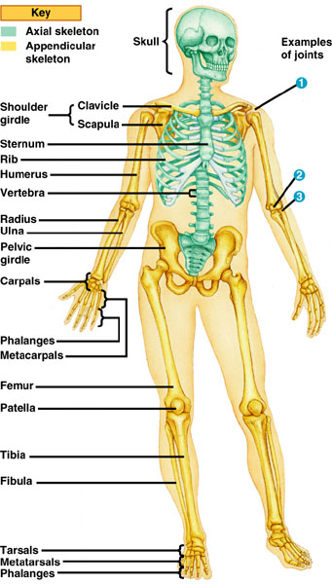
The skeleton of mammals has over 200 bones (some of you will have to learn all their names one day!), some fused, some connected at joins by ligaments. Anatomists divide the vertebrate skeleton into two main parts: the axial skeleton (skull, vertebral column, and rib cage), and the appendicular skeleton (limbs, and pectoral and pelvic girdles).

Slide 46
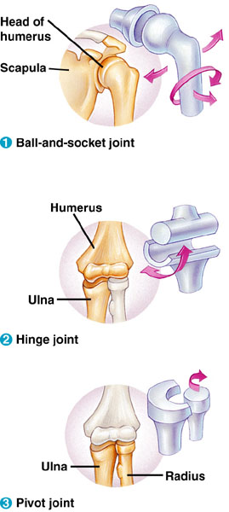
Three types of joints
Enable us to rotate our arms and legs (where the femur contacts the pelvic girdle) and move them in several planes.
Restrict movements to a single plane
Allow rotation of our forearm at the elbow (and our head from side to side).

Slide 47
To Remember

Slide 48
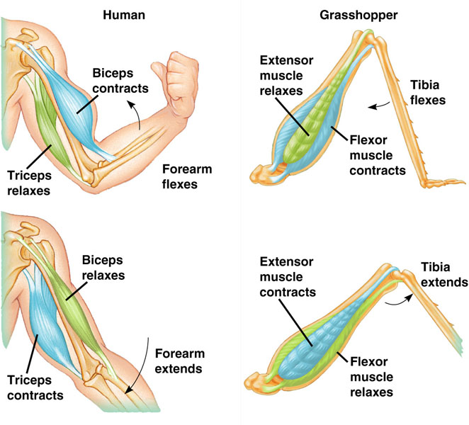
Animals can move as a result of the action of muscles
Muscles act by contracting. The ability to move parts of the body in opposite direction requires that different muscles are attached to the skeleton in “antagonic pairs” that work against each other.

Slide 49
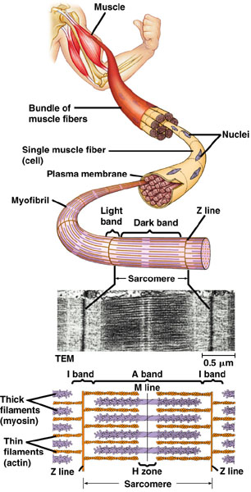
The structure of vertebrate skeletal (striated) muscle
Vertebrate skeletal muscle attaches to bones and is responsible for their movement. It is characterized by a hierarchy of smaller and smaller units. 1) Each muscle is a bundle of muscle fibers.
2) Each muscle fiber is a single multinucleated cell and is a bundle of many myofibrils.
3) The myofibrils, in turn, are made of two kinds of myofilaments.
4) Thin filaments made of actin and a regulatory protein, and
5) Thick filaments , which are arrays of the protein myosin.
The regular arrays of filaments give skeletal muscle as striated appearance.

Slide 50
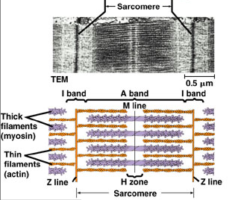
I bands and H zone are relatively wide
The sliding-filament model of muscle contraction is our best hypothesis to explain how muscle contracts. Note that the length of the thick and thin filaments remains the same as the muscle contracts. However, the length of the sarcomer is shorter.
Thick and thin filaments slide past each other.
The width of the I bands and and H zone is reduced

Slide 51
1) The myosin head is in a “resting” position and bound to ATP (low energy configuration).
4) Returns to its low energy configuration, sliding the thick filament over the thin one.
2) When the muscle is activated, the myosin head hydrolyzes ATP and adopts a high energy configuration.
3) The myosin head binds to actin.

Slide 52
What activates the contractions of a muscle?
Calcium (Ca++)!!
When the muscle fiber is at rest, the sites that myosin “heads” are blocked by a regulatory protein called tropomyosin. Another protein, called the troponin complex acts as a gate-keeper. In the presence of Ca++ it moves the tropomyosin out of the way and exposes the mysoin binding sites.

Slide 53
Ca++ is liberated by the endoplasmic reticulum of the muscle (called the sarcoplasmic reticulum). Note the structures called T tubules

Slide 54
Motor neurons release acetylcholine and generate an action potential in the muscle fiber. 2) The AP propagates through the T-tubules and stimulates Ca++ release by the sarcoplasmic reticulum.
3) Ca++ bind to troponin.
4) Troponin moves tropomyosin out of the way.
5) The myosin heads attach to actin and slide myosin over actin.
The muscle contracts, and uses lost of ATPs in the process!!

Slide 55
To remember (oh my!)

Slide 56
Not all muscle fibers have the same characteristics. Fast fibers are used for fast and rapid contractions. Slow fibers are used to maintain posture and can sustain long contractions.
Slow Oxidative Fast Oxidative Fast Glycolytic
(type I) (Type IIa) (Type II, IIb)
________________________________________
Contraction speed Slow Fast Fast
Source of ATP aerobic aerobic glycolysis (anaerobic)
Fiber diameter small intermediate large
Rate of fatigue slow intermediate fast
Mitochondria many many few
Myoglobin content high high low
Color red red-pink white
Function posture standing, walking jumping, high speed
rapid repetitive locomotion
movements

Slide 57
Slow Oxidative Fast Oxidative Fast Glycolytic
________________________________________
Contraction speed Slow Fast Fast
Source of ATP aerobic aerobic glycolysis (anaerobic)
Rate of fatigue slow intermediate fast
Mitochondria many many few
Myoglobin content high high low
Color red red-pink white
Function posture standing, walking jumping, high speed
rapid repetitive locomotion
movements
Most skeletal muscle has all three fiber types, but depending on the muscle’s function the proportion varies. Also there are different proportions of these muscle fibers among species.
Myoglobin is a protein that is used to store oxygen.

Slide 58
Myoglobin is a protein that, like hemoglobin, binds (and stores) oxygen. As you can imagine, it is present in high amounts in oxidative muscles (slow and fast). It is homologous to hemoglobin’s subunits and makes muscle red.

Slide 59
Most skeletal muscle has all three fiber types, but depending on the muscle’s function the proportion varies. Also there are different proportions of these muscle fibers among species.

Slide 60
In addition to skeletal muscle, vertebrates have smooth and cardiac muscle. To study cardiac muscle, you will have to wait until you take physiology.

Slide 61
Smooth muscle is found in “hollow” organs such as vessels (arteries and veins) and the gastrointestinal tract. It is called smooth because the actin and myosin filaments are not arranged in a regular pattern along the length of the cell. Smooth muscle has a very small sarcoplasmic reticulum, no troponin complex, and no T tubules.

Slide 62
It is called smooth because the actin and myosin filaments are not arranged in a regular pattern along the length of the cell.

Slide 63
Comparison of smooth and striated muscle
Skeletal Smooth
_____________________________
Structure large, cylindrical small, spindle-shaped
Visible striations yes no
Regulated by Ca++ yes yes (no troponin)
Innervation somatic autonomic
(voluntary, reflexes) (involuntary)
T tubules yes no
Sarcoplasmic reticulum abundant sparse
Hormone influence No yes
(angiostensin II)
Speed of contraction depends on type slow
(Fast--->slow)
Tissue “muscle” hollow organs

Slide 64
To Remember

Slide 65
Locomotion
Most plants do not move, many (not all!) animals do. Movement is a hallmark of animals. Animals move to catch food, to avoid becoming food, to mate, to avoid extreme environmental conditions…, etc.
Animal movements are defined by the medium in which the animals live. In all cases locomotion requires energy to overcome friction and, on land, gravity.
The study of how animals move is a branch of a field called “biomechanics”. Biomechanics is one of the coolest scientific fields imaginable!

Slide 66
Moving in water
In water animals swim. Animals are reasonably buoyant and hence overcoming gravity is not a problem. But water is dense and viscous (1000X more dense than air!), and therefore drag (friction) is a major problem. Competent swimmers tend to have fusiform bodies that minimize drag. Most phyla have members that swim.
Although the mode of propulsion differs among vertebrates, all aquatic ones have bodies that have converged on a fusiform shape.

Slide 67
Moving on land
Moving on land (by walking, running, hopping, or crawling) requires that animals support themselves and move against gravity. At low speeds, air resistance (drag) may not be a big problem. For animals that walk, run, or hop, powerful muscles and a strong skeleton are a must. Crawling is another matter. Crawling animals must overcome friction with the ground.

Slide 68
Flying
Flying has evolved many times independently: in insects, twice among reptiles (pterodactyls and birds), and once in mammals. Flying demands that animals overcome gravity’s downwards force (they must generate lift) and they must generate enough force to overcome air’s drag to move forward.

Slide 69
In addition, many non-flying taxa have gliding representatives.
Javan gliding tree frog
Paradise tree snake

Slide 70
What are the relative costs of locomotion?
At optimal speeds (those that minimize) the cost of locomotion, he cost per unit mass of moving is highest for running, lowest for flying, and intermediate for flying. The mass-specific cost of locomotion declines with body mass (it is cheaper to move 1 kg of horse than of cat…).

Slide 71
We are done!!!

