Slide 1
Main issues
Mind- brain
Nature and nurture
Ethics of research

Slide 2
What is neuroscience?
A multidisciplinary study of nervous system and
the role it plays in behavior!
Merging of several disciplines:
  anatomy and physiology
  Biology and chemistry
  Philosophy
  Psychology: Behavioral, social and cognitive areas, in particular
Biopsychology: Branch of psychology that studies relation between brain and behavior

Slide 3
Origins of BioPsychology:
Several problems and Controversies
The Mind-Brain problem
  Also called the mind-body problem, but here we want to emphasize the role of “mind” vs “brain”
  What is the mind versus what is the brain?
Monism vs. Dualism
  Monism:
    British Associationists, later Greek philosophers
    Idea that mind and brain are ONE
  Dualism
    DesCartes, Continentalists
    Idea that mind is separate from the brain
    Mind obeys rules of mind; brain obeys physical rules for body

Slide 4
Discovering Neural Mechanisms
Des Cartes and the Reflex Arc
A Model = proposed mechanism for how something works
  Can be a theory
  Can be an example
  Can be a figure, chart or prototype
Rene Des Cartes proposed hydraulic model of brain function
  Nerves = hollow tubes that carried fluid from brain to muscles and back
  This fluid = “animal spirits”
  Pumped by the pineal gland (due to it’s location, not observed function!)
Pineal gland = seat of the “soul”: place where mind interacted with the body

Slide 5
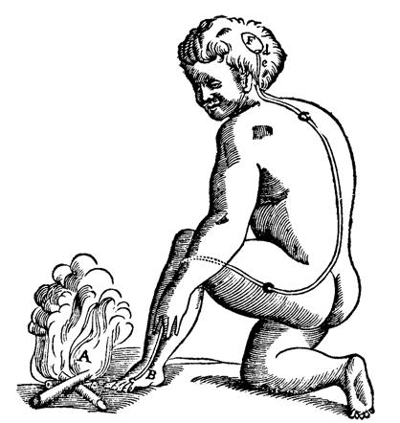
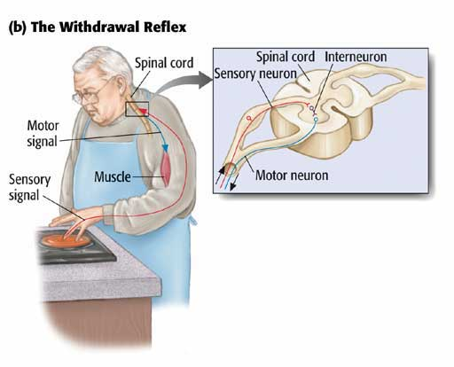
DesCartes’ Reflex Arc
Reflex arc is communication between spinal cord and target muscle.
Forms a reflex “arc”: sensory input-action output

Slide 6
Determining how the nerve functions
Discovering the action of nerves:
  Could make frog’s muscle twitch by stimulating nerve with electricity, even after removing nerve from frog’s body!
  Fritsch and Hitzig (1870): motor movements in dogs using electrical stimulation to brain
  Important: Nerves work via ELECTRICITY
Von Hemmholtz: nerves not like electrical wires!
  Important work in audition, vision
  Showed that nerves had own electrical properties
  Demonstrated how we could study the action of nerves and neurons
Notes:
6

Slide 7
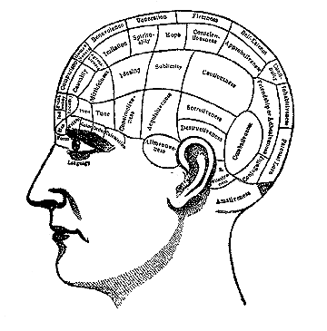
Localization Issue:
Localization: Idea that specific areas of brain carry out specific functions
  Is both right and wrong!
  Early evidence supported:
    Fritsch and Hitzig’s dog work
    Phineas Gage
    Broca’s and Wernicke’s work
Side bar: From this developed the “field of” Phrenology:
  Franz Gall in mid 1880s
  Theory that were specific locations for specific behaviors
  35 different faculties of emotion and intellect
  Could look at shape and bumps on head and tell how emotionally stable and intelligent a person was!

Slide 8
Localization today:
Localization is both right and wrong
  Are particular areas that are primarily responsible for different behaviors
  BUT: these areas are diffuse throughout the brain and work in conjunction with many other areas
Brain is distributed and localized!
  The brain has specific areas for different functions
  At same time, many locations for each function!

Slide 9
Importance of Heredity
A BRIEF INTRO TO GENETICS

Slide 10
Nature Nurture issues come back AGAIN!
Which is more important:
  Nature: innate, biological, what you are “born with”
  Nurture: environmental experiences that shape your brain (including in utero experiences)
Genetics vs experience
  Do your genes guide your experience?
  Can experience actually change your genes?
Which contributes more to who you are?

Slide 11
Quick review: What is your “Genetic Code”
Gene:
  biological unit that directs cellular processes
  Transmits inherited characteristics
  Typically found in chromosomes
Chromosomes
  In humans: each cell has 46 chromosomes arranged in 23 pairs
  23rd pair = sex chromosomes
  Each set of 46 chromosomes distinct from all others- even in identical twins!
  Sperm, eggs carry only 23 chromosomes: if put together- get the 46!
  Each chromosome carries unique set of information that makes you who you are

Slide 12

DNA: Watson and Crick (1953)
Deoxyribonucleic acid or DNA
  Double stranded chain of chemical molecules
  Forms a double helix
Forms rungs, like on a ladder (that’s the double helix!)
Each rung is composed of 2 of 4 bases:
  Adenine: A
  Thymine: T
  Guanine: G
  Cytosine: C
Order that they are put together is unique for every person
Genes influence most of our behavior
  Not cause, but influence
  Provide directions for making proteins
  Proteins = catalyst for making body parts and enzymes
  Enzymes = catalyst for modifying chemical reactions in body and particularly the brain!

Slide 13
Inheritance
Chromosomes are paired, so genes are also paired
  Allow inherited traits
  Genotype: actual inherited trait
  Phenotype: expression of that trait
Dominant gene effects
  One gene dominates the other
  If you have that gene, it will be expressed
Recessive gene effects:
  Takes two of the genes for effect to be expressed
  OR is x-linked or sex linked
    If only get that one, then it is expressed
    Carried and passed on by the mother

Slide 14
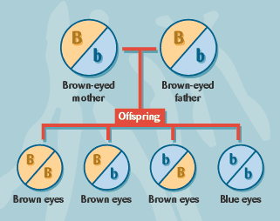
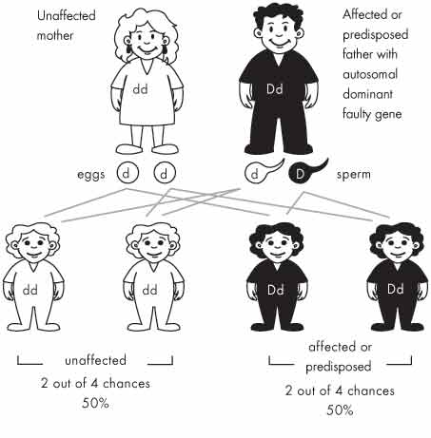
Examples of Inheritance
Recessive Gene Trait:
Autosomal dominant Gene

Slide 15
Blood type inheritance:
Slightly different inheritance
If someone has blood type A, they must have at least one copy of the A allele, but they could have two copies. Their genotype is either AA or AO.
Similarly, someone who is blood type B could have a genotype of either BB or BO.
Blood type Possible genotypes
  A AA or AO
  B BB or BO
A blood test of either type AB or type O is more informative.
  Someone with blood type AB must have both the A and B alleles. The genotype must be AB.
  Someone with blood type O has neither the A nor the B allele. The genotype must be OO
Blood type Possible genotypes
AB AB
O OO
A AA or AO
B BB or BO
Question: Could a mother with “type A” blood and a father with “type B” blood produce a child with “Type O”? How?

Slide 16
Genes cause behavior? Well, maybe……..!
Animal breeding studies: can breed for several kinds of traits
  Physical traits
  Behavioral traits
  But genetics not explain the WHOLE picture!
Not sure to what degree “behaviors” such as intelligence, mental illness, addiction are inherited or are environmentally elicited.

Slide 17
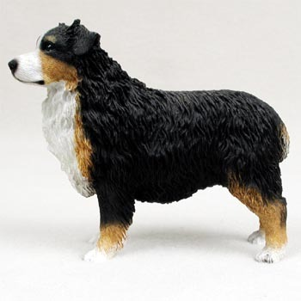
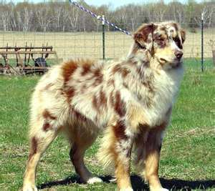
Genes cause behavior? Well, maybe……..!
Look at disorders in dogs: The Merle Coloring Gene
  Merle = patterned coloring
  Tricolored or bicolored: Dog is black/white or red/white or black/white/red
  Merle pattern: diffuses these colors so is more spotted
To get a Merle pattern dog:
  Breed a Merle to a Tri or Bicolored:
  M m M MM Mm two bi colored
  M MM Mm two merles

Slide 18
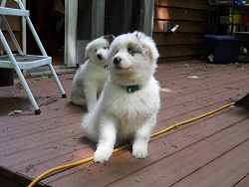
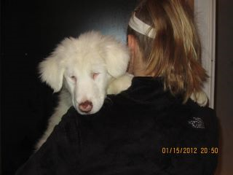
Genes cause behavior?
Now: What if breed two merle with a tri with a merle gene? Or two merles?
M m m m
    m Mm mm m mm mm
    m Mm mm m mm mm
Great, right? They are all merles (and I make lots of money)
But wait: mm produces:
  Deafness
  Underdeveloped eyes
  Dogs are blind, deaf or both!
  So, playing with color produces side effects!

Slide 19
Genes cause behavior? Well, maybe……..!
Human Genome Project also may help understand relation between behavior and genes
  Goal: map the location of all genes on the human chromosomes and determine genetic codes: order of the bases on each gene
  Only have approximately 20,000 functioning genes- about as many as a roundworm
  97% of DNA does not encode proteins- appear to be ‘junk’
Genetic research investigates role of genes in behavior
  Fragile X
  Huntington’s disease
Bigger question: Is heredity a destiny or a predisposition?

Slide 20
Side trip to understand importance of inheritance
A BRIEF INTRO TO EVOLUTION

Slide 21
Our bodies change over time:
Evidence for evolution
  Charles Darwin (1809-1882): 1859 book: Origin of Species
    argued species originated from other species and eventually become distinct from their ancestors
    thus: many animals have common, but very distant, ancestors
  Evidence from domesticated plants and animals
    breeding programs; hybrid plants, purebred dogs, cats, etc.
    Great similarity in body parts across animals: paws, arms, etc.
    embryology: most embryos look HIGHLY similar
    Fossil records:

Slide 22
Natural Selection: Darwin’s 5 major premises:
Members of particular species have characteristics that vary
Some of these variable characteristics are passed on from parents to siblings
Some of these variable characteristics aid survival
Species produce more offspring that survive to become adults
Characteristics that aid survival will become more common across generations, those that impede survival will die out.

Slide 23
Heritability
Heritability = percentage of variation in a characteristic that can be attributed to genetic factors
  Identical twins versus fraternal twins
    Intelligence about 50%
    60-90% heritability for schizophrenia
    40-50% for personality characteristics
    90% for height
  Appears about ½ of differences in behavioral characteristics are due to heritability
    Rest must be due to environment
    or interaction of genes and environment
Vulnerability: genes contribute to predispositon for disorder
Must exceed required threshold to elicit disorder
  Diathesis stress model
  Takes both genetic predisposition AND stress to elicit certain mental disorders such as schizophrenia

Slide 24
Most important take home lesson:
Our brain controls behavior AND
Behavior changes our brain
  Two way street
  Interactions
  These interactions are explainable and able to be scientifically studied.
Genetic traits are important
  We inherit dispositions, not inevitabilities.
  Genes must interact with environment
  Not what WILL happen, but what COULD happen
  Takes an eliciting stimulus to turn on/off the gene

Slide 25
Practice Quiz Questions:
Who showed that nerves operate cannot operate like an electric wire because that would be too slow?
  Hermann von Hemmholtz
  Rene DesCartes
  Wilhelm Wundt
  Paul Broca

Slide 26
Practice Quiz Questions:
The idea that specific areas of the brain carry only one specific function is called__________.
  localization and has shown to be incorrect.
  localization and has shown to be correct.
  specialization and has shown to be incorrect.
  specialization and has shown to be correct.

Slide 27
Practice Quiz Questions:
A proposed mechanism for how things work is called a _______________.
  Theory
  Mechanism
  Model
  Predisposition

Slide 28
Practice Quiz Questions:
Extra Credit Question:
A person has a gene that is linked with a disease, but he or she does not have the disease. The book mentions several reasons why this could occur. Describe two of them.

