Slide 1
Sensation & Perception
GIT

Slide 2
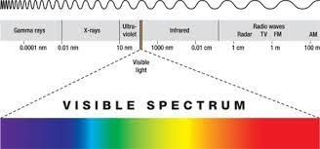
Detecting Light
Stimuli
Receptors
Electromagnetic Spectrum

Slide 3
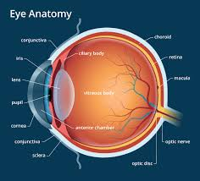
The Structure of Eyes
Pupil
Iris
Vitreous humor
Retina
Cornea
Lens
Accommodation
Fovea

Slide 4
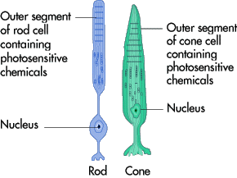
The Visual Receptors
Rods
Cones
Dark adaptation

Slide 5
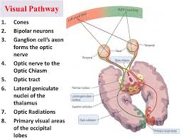
The Visual Pathway
Ganglion cells
Optic nerve
Blind spot

Slide 6
Color Vision
The Trichromatic Theory
The Opponent Process
The Retinex Theory
Color Vision Deficiency

Slide 7
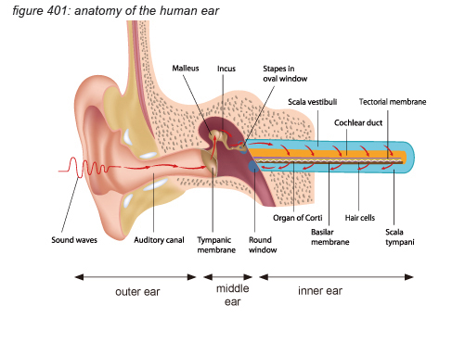
Hearing
Sound waves
Pitch
Loudness
Cochlea
Conduction Deafness
Nerve Deafness
Pitch Perception
Frequency Principle
Volley Principle
Place Principe

Slide 8
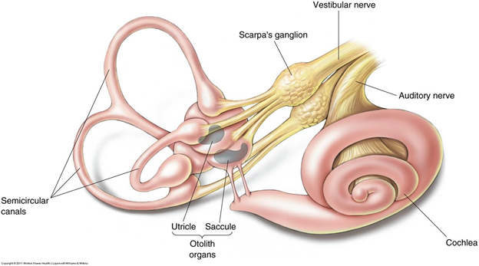
The Vestibular Sense
Vestibular Sense

Slide 9
The Cutaneous Senses
Cutaneous senses
Pain
The Gate Theory of Pain
Ways of Decrease Pain
Phantom Limbs

Slide 10
The Chemical Senses
Taste
Types of Taste Receptors
Smells
Synesthesia

Slide 11
Perception
Just Noticeable Difference
Absolute Sensory Threshold
Signal-detection theory
Subliminal perception

Slide 12
Perceiving & Recognizing Patterns
Brightness
The feature-detector approach
Gestalt psychology
Bottom-up process
Top-down process
Figure and ground
Reversible figures
Proximity
Similarity
Continuation
Closure
Good figure

Slide 13
Perceiving Movement & Depth
Visual constancy
Induced movement
Stroboscopic movement
Depth perception
Convergence
Binocular cues
Monocular cues

Slide 14
Optical Illusion
Optical illusion
Moon illusion

