Slide 1
Week 2
Biopsychology

Slide 2
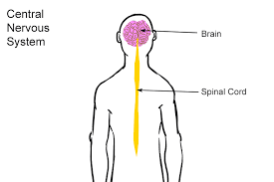
Central Nervous System

Slide 3
Neuron System Cells

Slide 4
The Action Potential

Slide 5
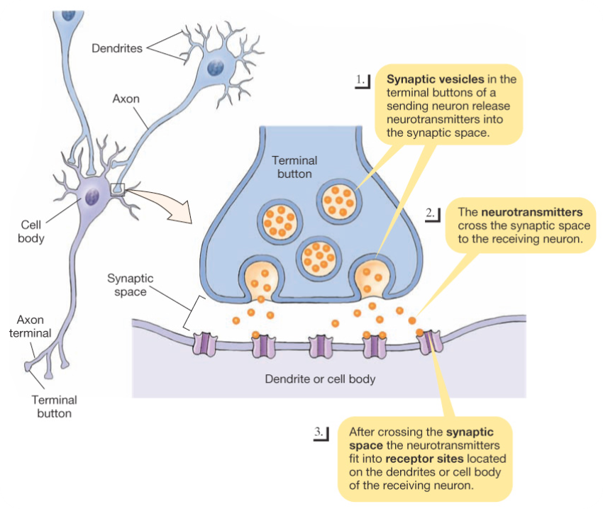
Synapse

Slide 6
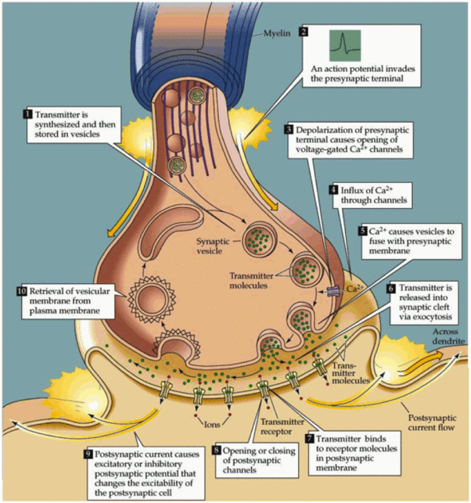
Neural Communication

Slide 7
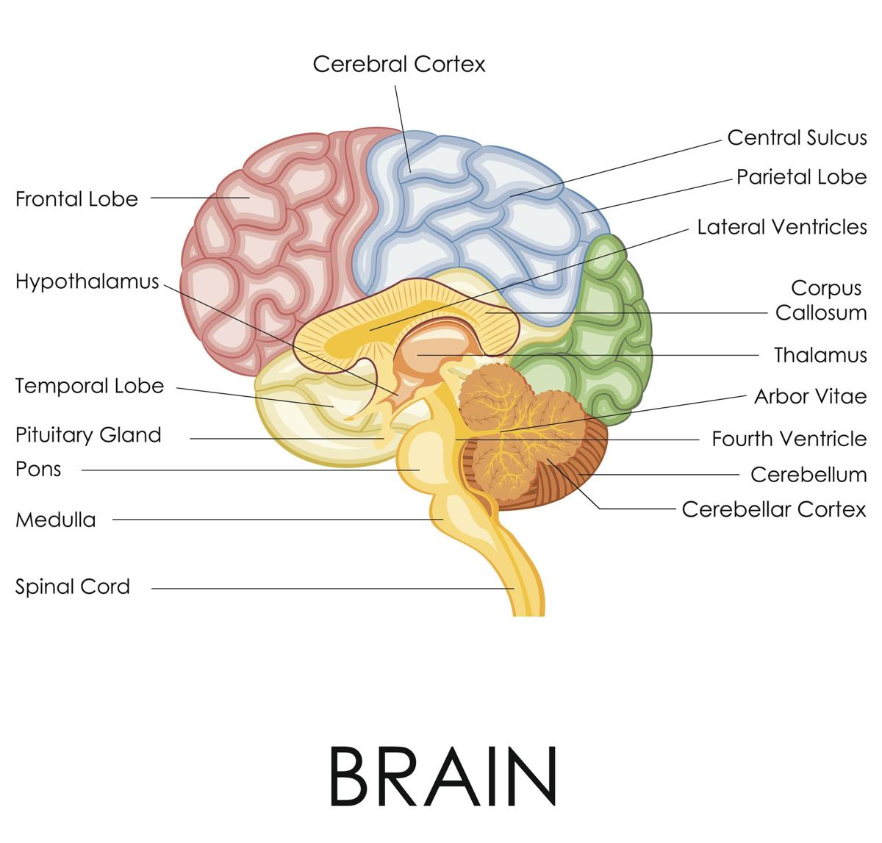
Brain

Slide 8
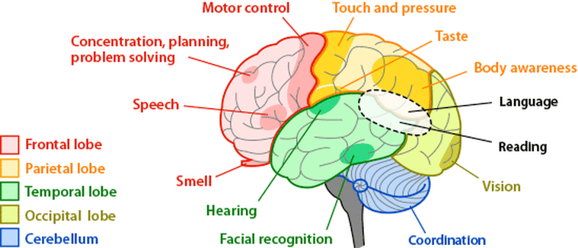
Lobes

Slide 9
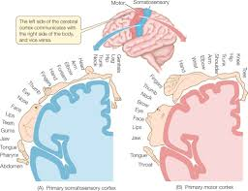
Parietal Lobe

Slide 10
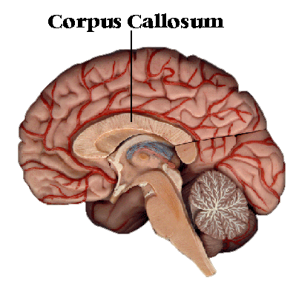
Hemispheres - Connection

Slide 11
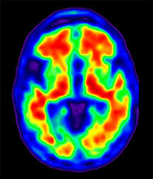
Brain Activity

Slide 12
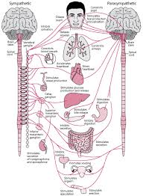
Sympathetic Nervous System

Slide 13
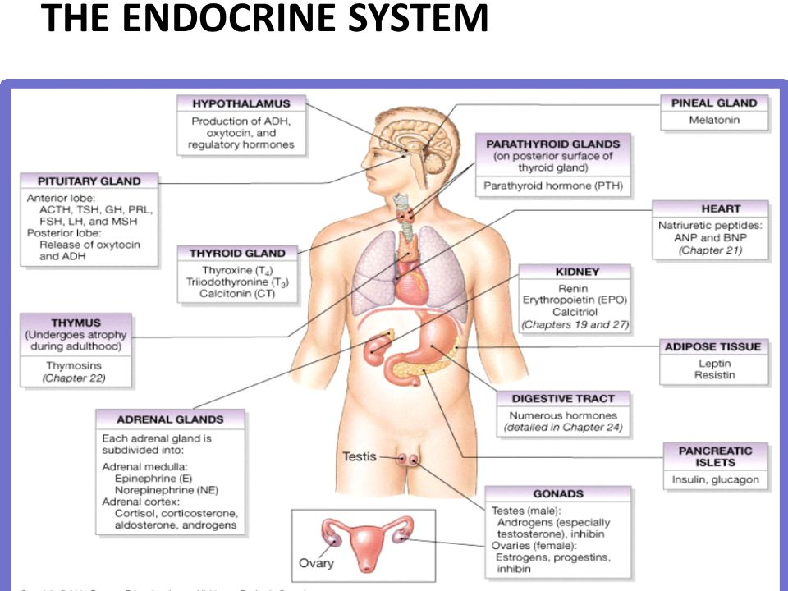
Hormones

Slide 14
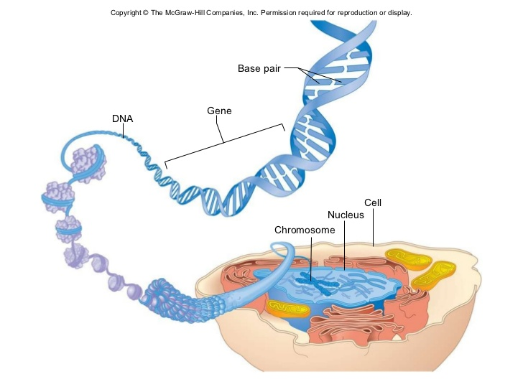
Genes

