Slide 1
TYPES OF FASHION
APPAREL & ACCESSORIES

Slide 2
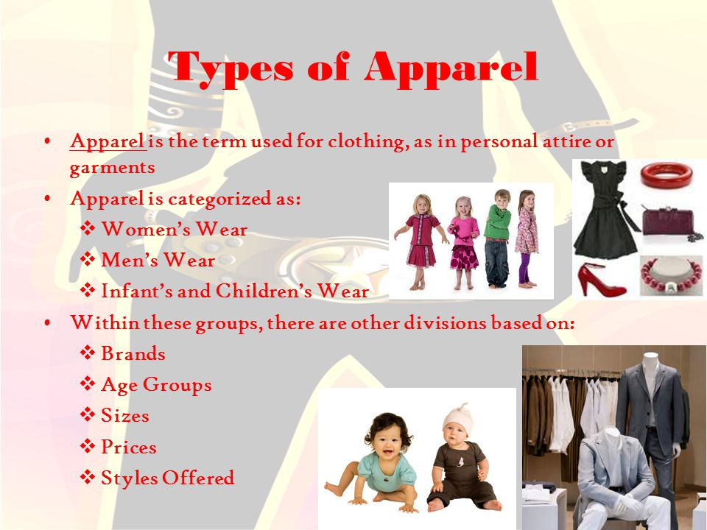

Slide 3
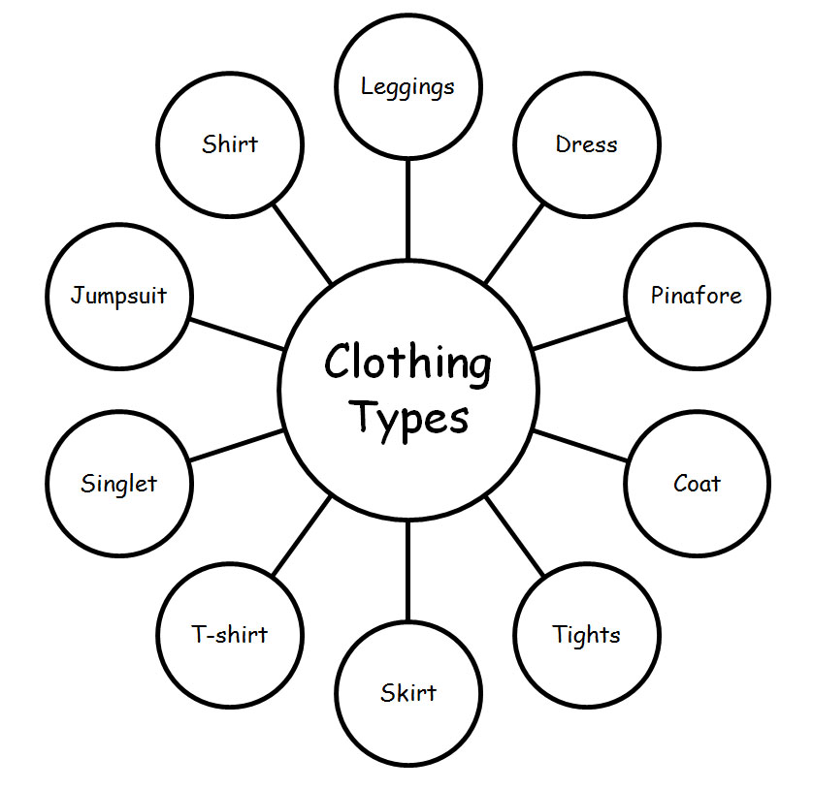
Fashion Apperal
Dress
Skirt
Pants
Trousers
Jacket
Cardigan
Gown
T-shirt

Slide 4
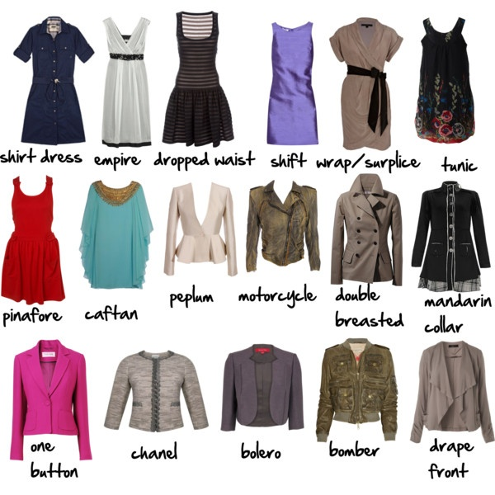
Types of Apparel / Clothing

Slide 5
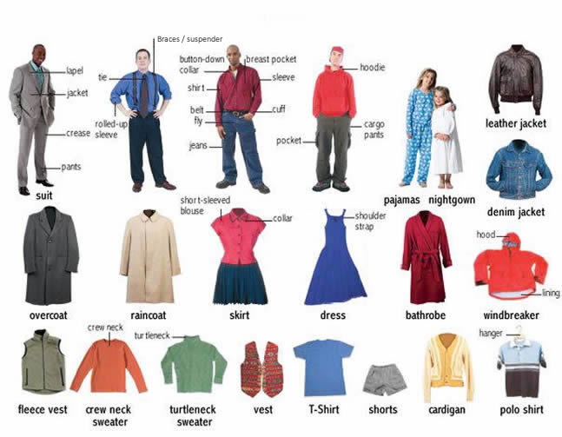

Slide 6
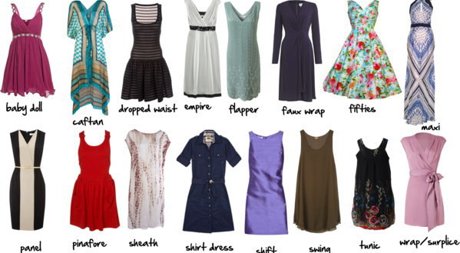
Types of Dresses

Slide 7
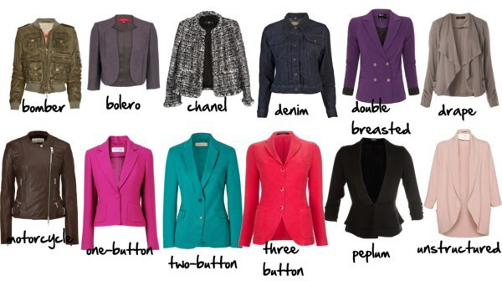
Types of Jacket

Slide 8
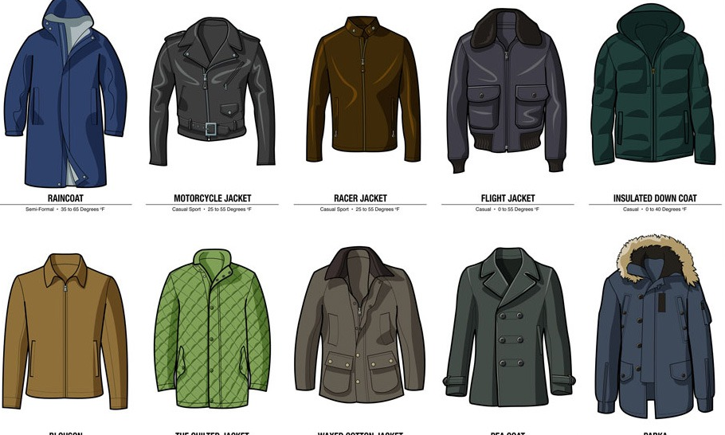
Types of Men’s Jacket

Slide 9
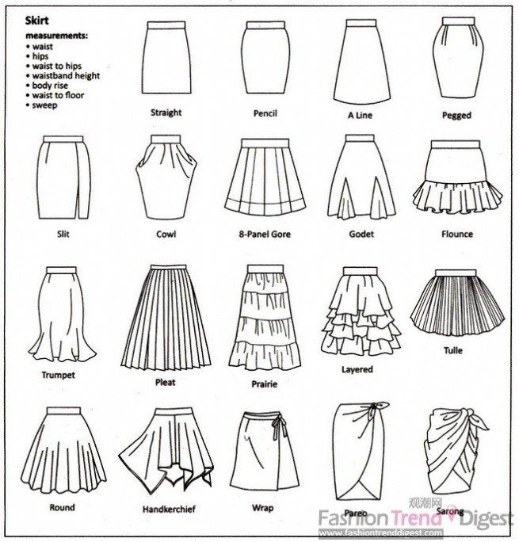
Skirt’s Shape

Slide 10
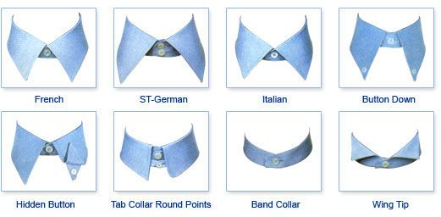
Tipe Kerah Baju

Slide 11
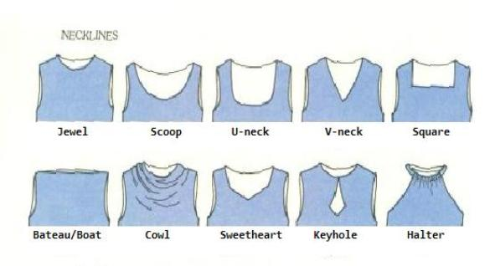
Dress Cutting

Slide 12
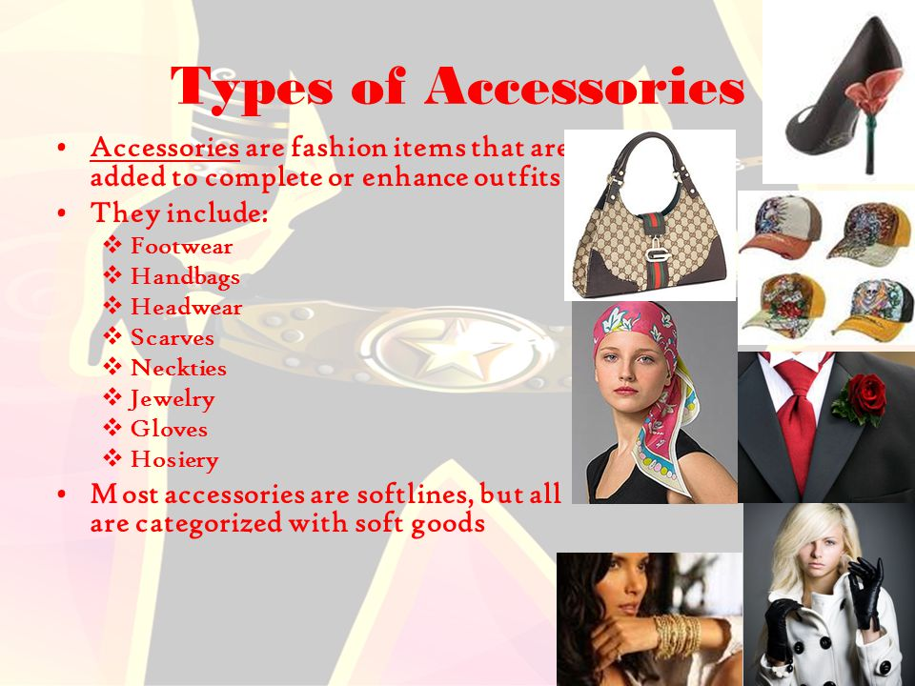
Fashion Accessories

Slide 13
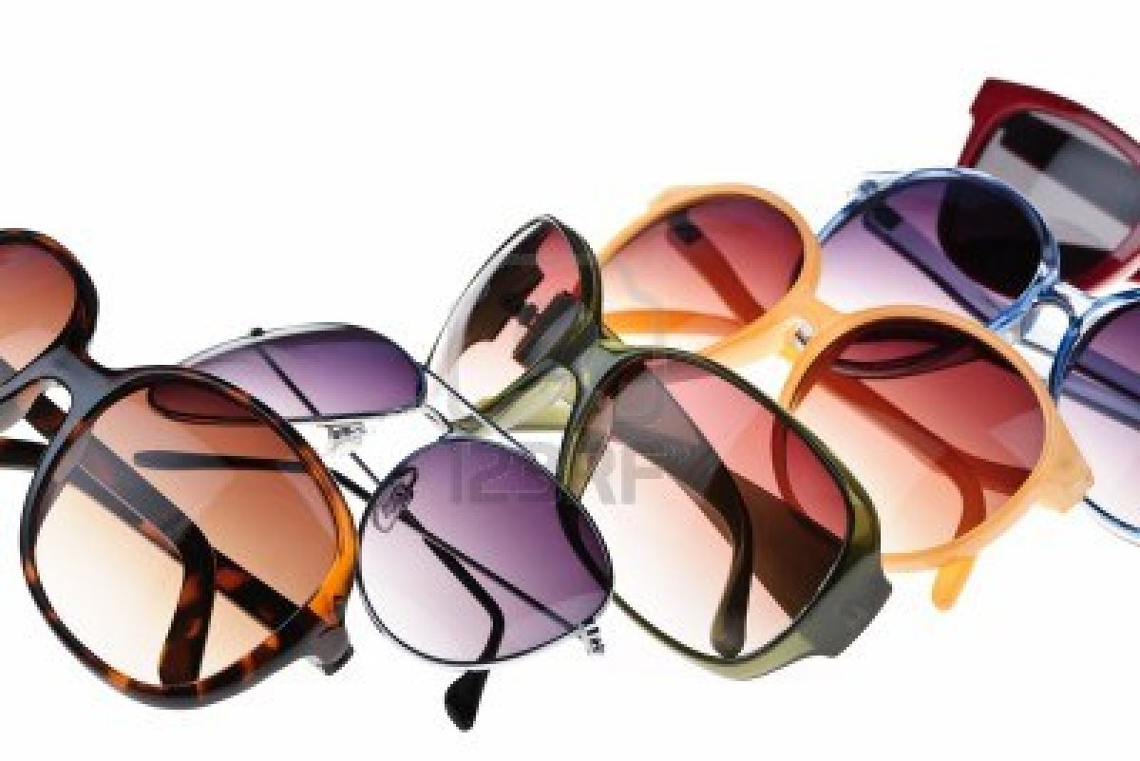
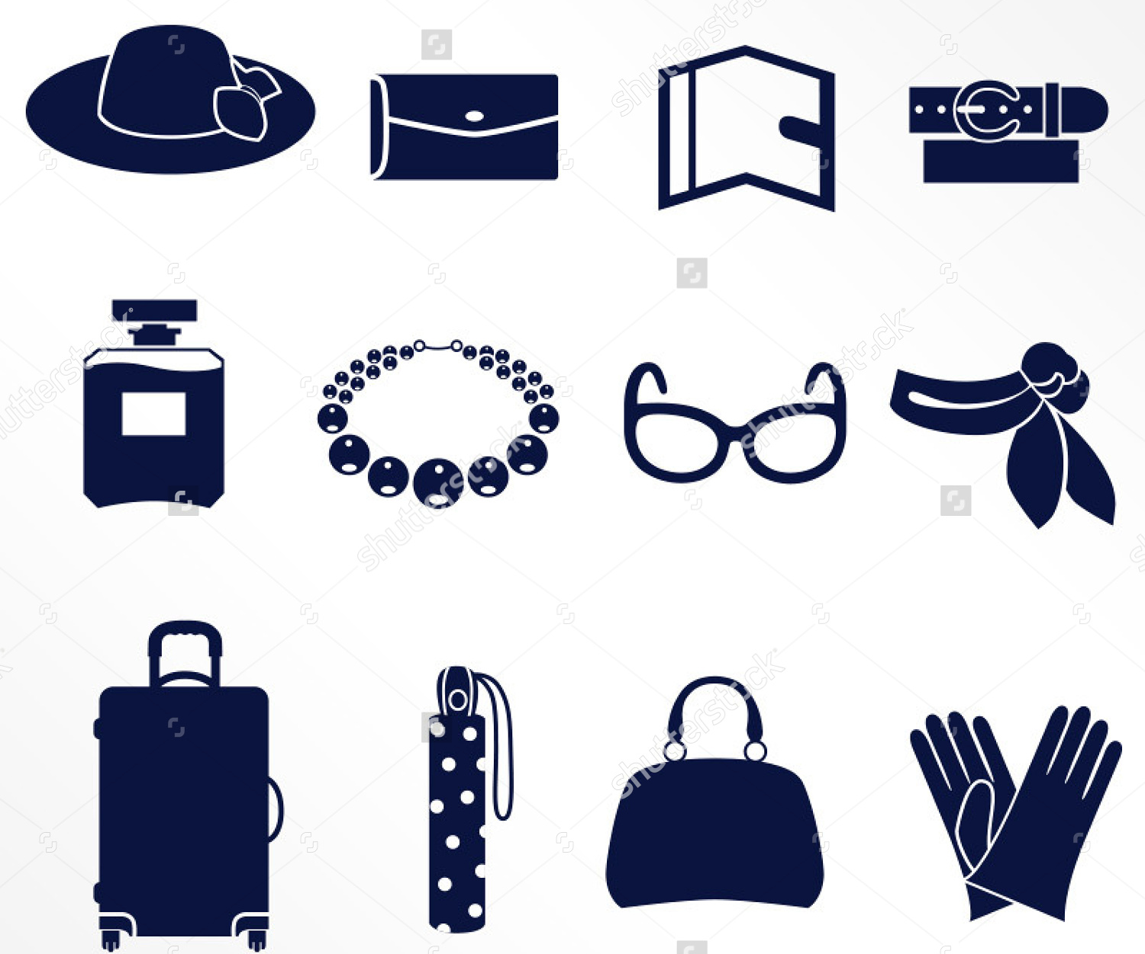

Slide 14
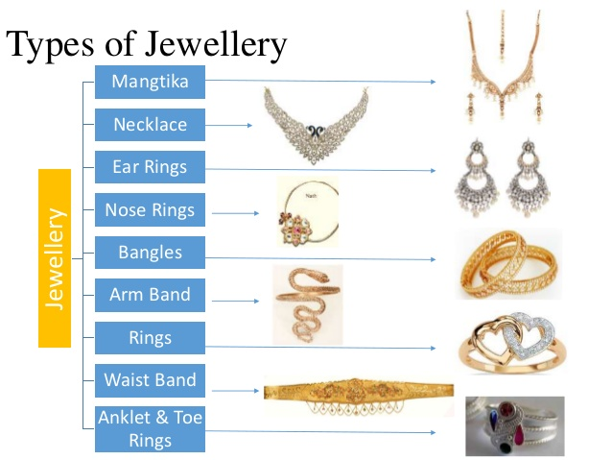

Slide 15
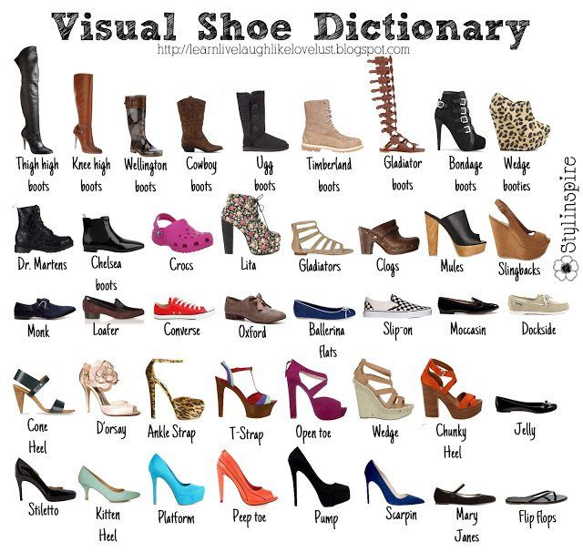

Slide 16
