Slide 1

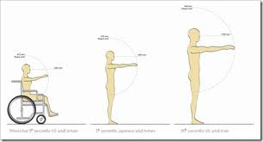
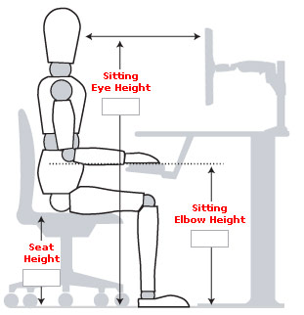
ERGONOMICS
10 PRINCIPLES OF ERGONOMICS

Slide 2
ERGONOMI
Definition by IEA International Ergonomics Association
Ergonomics (or human factors) is the scientific discipline concerned with the understanding of the interactions among humans and other elements of a system, and the profession that applies theoretical principles, data and methods to design in order to optimize human well being and overall system
Derived from the Greek ergon (work) and nomos (laws) to denote the science of work, ergonomics is a systems-oriented discipline, which now applies to all aspects of human activity.

Slide 3
ERGONOMICS
TYPES of ERGONOMICS
Physical Ergonomics
  Physical ergonomics is concerned with human anatomical, anthropometric, physiological and biomechanical characteristics as they relate to physical activity. The relevant topics include working postures, materials handling, repetitive movements, work-related musculoskeletal disorders, workplace layout, safety and health.
Cognitive Ergonomics
  Cognitive ergonomics is concerned with mental processes, such as perception, memory, reasoning, and motor response, as they affect interactions among humans and other elements of a system. The relevant topics include mental workload, decision-making, skilled performance, human-computer interaction, human reliability, work stress and training as these may relate to human-system design.
Organizational Ergonomics
  Organizational ergonomics is concerned with the optimization of sociotechnical systems, including their organizational structures, policies, and processes. The relevant topics include communication, crew resource management, work design, design of working times, teamwork, participatory design, community ergonomics, cooperative work, new work paradigms, organizational culture, virtual organizations, telework, and quality management.

Slide 4
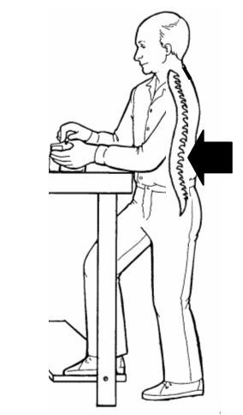

10 Principles of Ergonomics
©Dan MacLeod, 1990, 2008
Principle 1
Work in Neutral Postures
  Your posture provides a good starting point for evaluating the tasks that you do. The best positions in which to work are those that keep the body "in neutral."
Maintain the "S-curve" of the spine Your spinal column is shaped more or less like an "S."
It is important to maintain the natural S-curve of the back, whether sitting or standing. The most important part of this "S" is in the lower back, which means that it is good to keep a slight "sway back,"When standing, putting one foot up on a footrest helps to keep the spinal column in proper alignment.

Slide 5
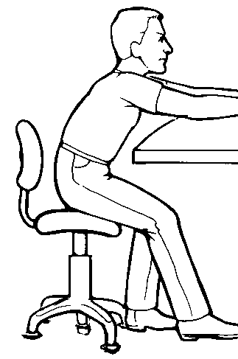
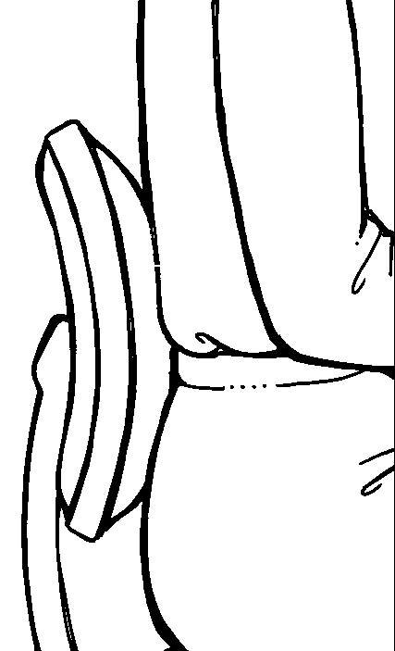
Working for long periods with your back in a “C-curve” can place strain on your back.Good lumbar support is often helpful to maintain the proper curve in the small of your back.

Slide 6
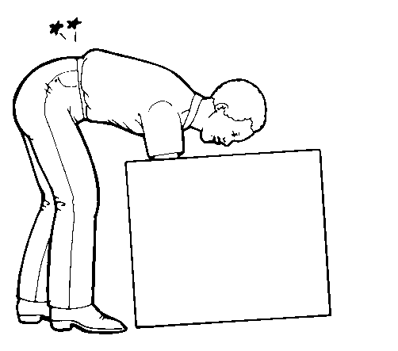
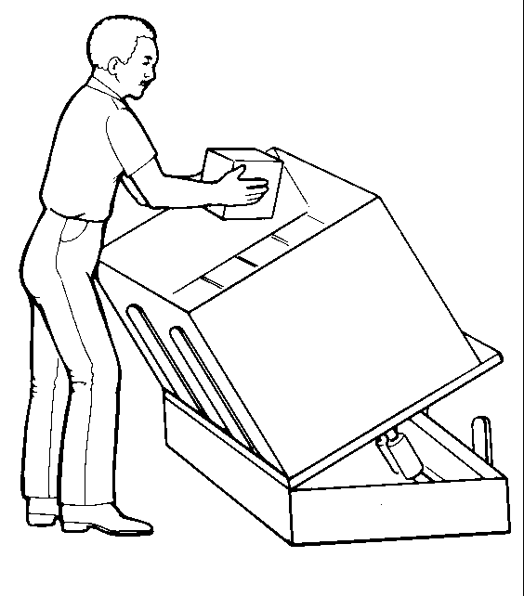
The “Inverted V-curve” creates an even greater strain on your back. Even without lifting a load, bending over like this creates a great deal of pressure on the spine. One common improvement is to use a lifter or tilter. Or there may be other ways of making improvements depending upon the situation.

Slide 7
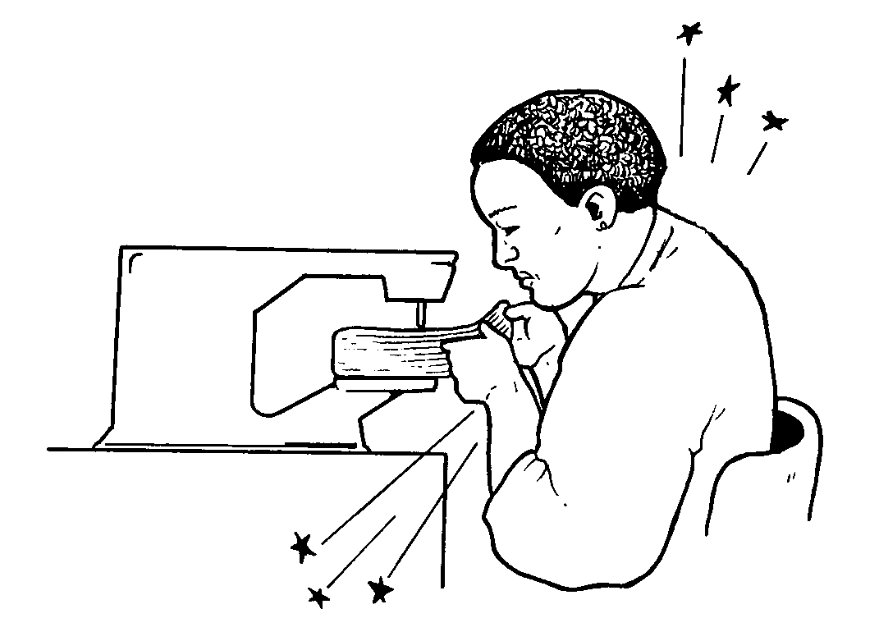
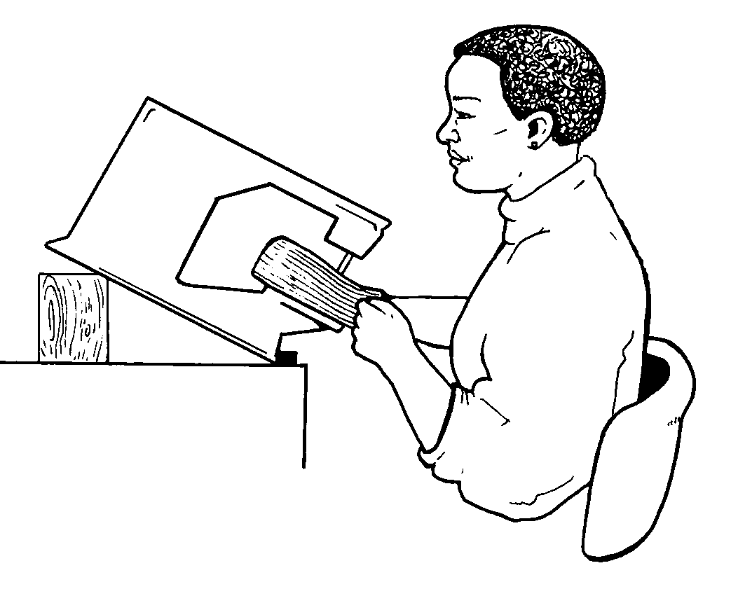
Keep the neck aligned The neck bones are part of the spinal column and thus are subject to the same requirements of maintaining the S-curve. Prolonged twisted and bent postures of the neck can be as stressful as its equivalent for the lower back. The best way to make changes is usually to adjust equipment so that your neck is in its neutral posture.

Slide 8
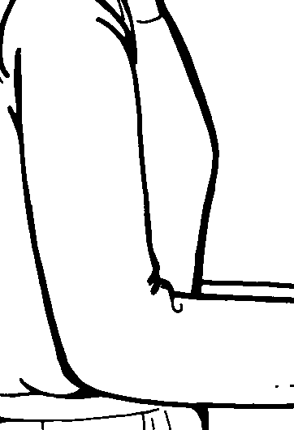
Keeps elbows at sides The neutral posture for your arms is to keep you elbows at your sides and your shoulders relaxed. This is pretty obvious once you think about it, but we don’t always do it.

Slide 9
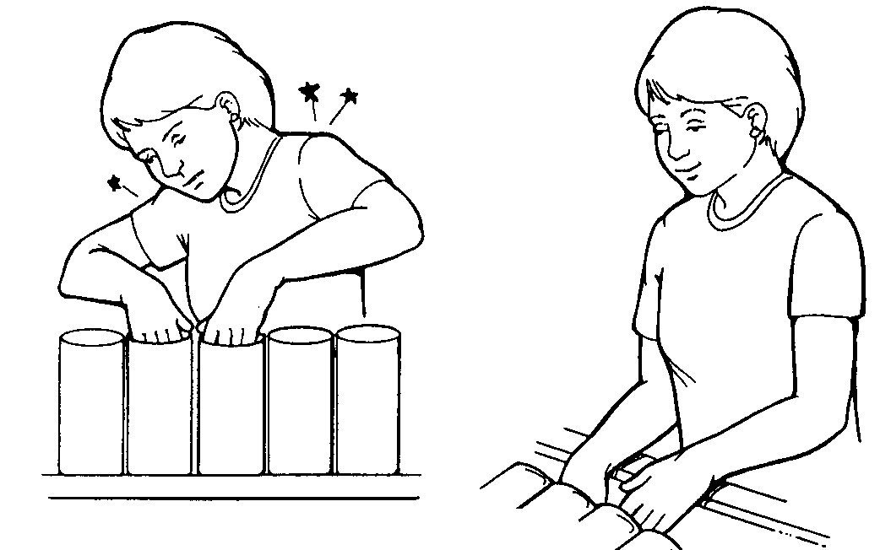
Here’s an example of changing a workstation to get the arms in neutral. In the illustration at the left, the product is too high, and the employee is hunching her shoulders and winging out her elbows.In the right-hand illustration, the product has been reoriented and the shoulders and elbows drop to their relaxed position.

Slide 10
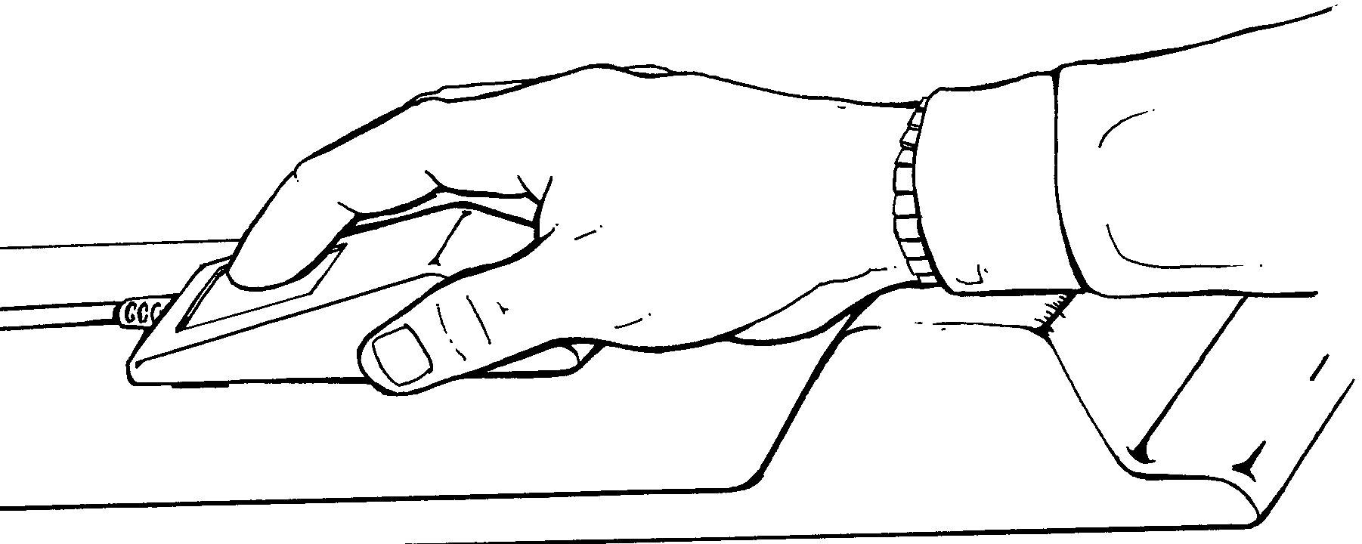
Keep Wrists in Neutral There are several good ways to think about wrist posture. One way is to keep the hand in the same plane as the forearm, as this person is doing here by using a wrist rest along with the computer mouse.

Slide 11
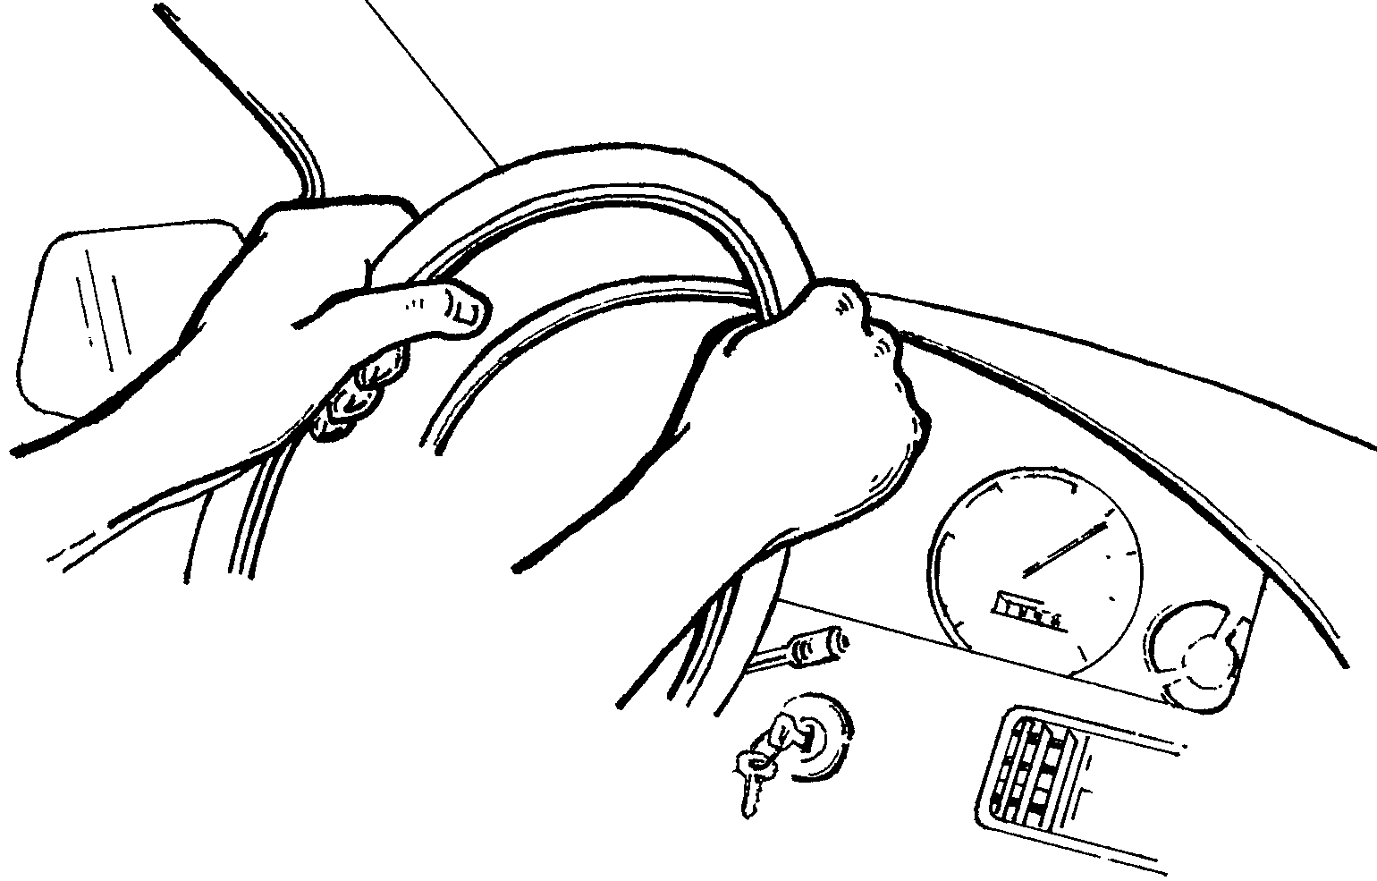
A slightly more accurate approach is to keep your hands more or less like they would be when you hold the steering wheel of your car at the 10 and 2 o’clock position — slightly in and slightly forward.

Slide 12
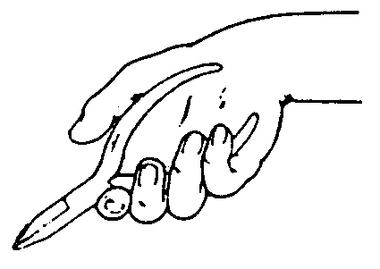
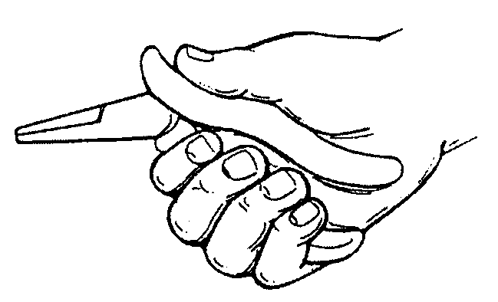
Here’s an example of how this principle applies to tool design. Working continuously with the pliers as shown in the left-hand picture can create a lot of stress on the wrist. By using pliers with an angled grip, however, the wrist stays in its neutral posture.

Slide 13
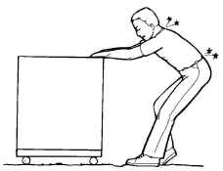
Principle 2
Reduce Excessive Force
For example, pulling a heavy cart might create excessive force for your back. To make improvements it might help to make sure the floor is in good repair, that the wheels on the cart are sufficiently large, and that there are good grips on the cart. Or a power tugger might be needed.

Slide 14
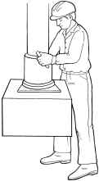
Or another example of reducing force is to use a hoist for lifting heavy objects, like this vacuum hoist in the drawing.

Slide 15


Another kind of example is having handholds on boxes or carrying totes. Having the handhold reduces the exertion your hands need to carry the same amount of weight.

Slide 16
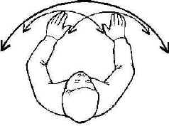
Principle 3
Keep Everything in Easy Reach
Reach Envelope One concept is to think about the "reach envelope." This is the semi-circle that your arms make as you reach out. Things that you use frequently should ideally be within the reach envelope of your full arm. Things that you use extremely frequently should be within the reach envelope of your forearms.

Slide 17
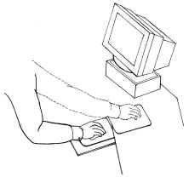
Much of the time, problems with reach are simply matters of rearranging your work area and moving things closer to you. This is not exactly a hard concept to grasp; what is difficult is having the presence of mind to notice and change the location of things that you reach for a lot.Often it is a matter of habit — you are unaware that you continually reach for something that could be easily moved closer.

Slide 18
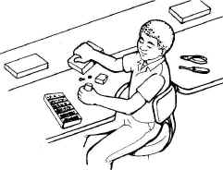
Or sometimes, the work surface is just too big, causing you to reach across to get something. One option is just to get a smaller surface. Another option is to make a cutout — this way your reaches are cut, but you still have plenty of space for things.

Slide 19
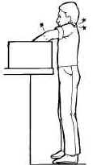
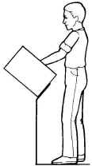
Or another common problem is reaching into boxes. A good way to fix this is to tilt the box.Once again, there are thousands of other examples of ways to reduce long reaches. The point is for you to think about when you make long reaches, then figure out how to reduce that reach.

Slide 20

Principle 4
Work at Proper Heights
Do most work at elbow height A good rule of thumb is that most work should be done at about elbow height, whether sitting or standing. A real common example is working with a computer keyboard. But, there are many other types of tasks where the rule applies.

Slide 21
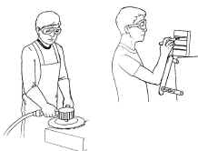
Exceptions to the Rule There are exceptions to this rule, however. Heavier work is often best done lower than elbow height. Precision work or visually intense work is often best done at heights above the elbow.

Slide 22
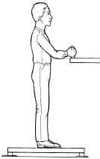
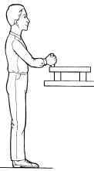
Sometimes you can adjust heights by extending the legs to a work tables or cutting them down. Or you can either put a work platform on top of the table (to raise the work up) or stand on a platform (to raise YOU up).Or to be a little more complicated, there are ways to make stands and work tables instantaneously adjustable with hand cranks or pushbutton controls.

Slide 23

Principle 5
Reduce Excessive Motions
One of the simplest ways to reduce manual repetitions is to use power tools whenever possible.

Slide 24
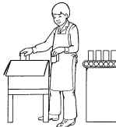
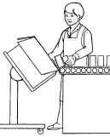
Another approach is to change layouts of equipment to eliminate motions. In the example here, the box is moved closer and tilted, so that you can slide the products in, rather than having to pick them up each time.

Slide 25
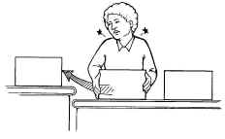
Or sometimes there are uneven surfaces or lips that are in the way. By changing these, you can eliminate motions.As always, there are more examples, but you should be getting the idea.

Slide 26
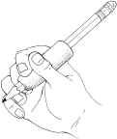
Principle 6
Minimize Fatigue and Static Load
Holding the same position for a period of time is known as static load. It creates fatigue and discomfort and can interfere with work.
A good example of static load that everyone has experienced is writer’s cramp. You do not need to hold onto a pencil very hard, just for long periods. Your muscles tire after a time and begin to hurt.

Slide 27

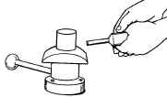
In the workplace, having to hold parts and tools continually is an example of static load. In this case, using a fixture eliminates the need to hold onto the part.

Slide 28

Having to hold your arms overhead for a few minutes is another classic example of static load, this time affecting the shoulder muscles. Sometimes you can change the orientation of the work area to prevent this, or sometimes you can add extenders to the tools.

Slide 29
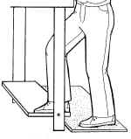
Having to stand for a long time creates a static load on your legs. Simply having a footrest can permit you to reposition your legs and make it easier to stand. We’re going come back to this point later.

Slide 30


Principle 7
Minimize Pressure Points
Another thing to watch out for is excessive pressure points, sometimes called "contact stress."
A good example of this is squeezing hard onto a tool, like a pair of pliers. Adding a cushioned grip and contouring the handles to fit your hand makes this problem better.

Slide 31
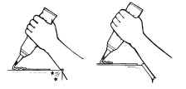
Leaning your forearms against the hard edge of a work table creates a pressure point. Rounding out the edge and padding it usually helps.

Slide 32
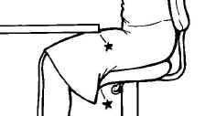
We’ve all had to sit on chairs that had cushioning and so understand almost everything we need to know about pressure points. A particularly vulnerable spot is behind your knees, which happens if your chair is too high or when you dangle your legs. Another pressure point that can happen when you sit is between your thigh and the bottom of a table.

Slide 33
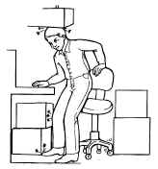
Principle 8
Provide Clearance
Work areas need to be set up so that you have sufficient room for your head, your knees, and your feet. You obviously don’t want to have to bump into things all the time, or have to work in contorted postures, or reach because there is no space for your knees or feet.

Slide 34
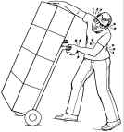
Being able to see is another version of this principle. Equipment should be built and tasks should be set up so that nothing blocks your view.

Slide 35

Principle 9
Move, Exercise, and Stretch
To be healthy the human body needs to be exercised and stretched.
Depending upon the type of work you do, different exercises on the job can be helpful. If you have a physically demanding job, you may find it helpful to stretch and warm up before any strenuous activity. If you have a sedentary job, you may want to take a quick "energy break" every so often to do a few stretches.

Slide 36
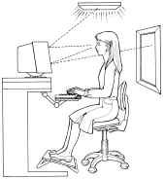
Principle 10
Maintain a Comfortable Environment
Lighting and Glare One common problem is lighting. In the computerized office, lighting has become a big issue, because the highly polished computer screen reflects every stray bit of light around.

Slide 37
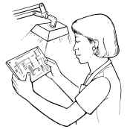
But many other types of tasks can be affected by poor lighting, too. Concerns include glare, working in your own shadow, and just plain insufficient light.One good way to solve lighting problems is by using task lighting; that is, having a small light right at your work that you can orient and adjust to fit your needs.

Slide 38

Vibration Vibration is another common problem that can benefit from evaluation. As an example, vibrating tools can be dampened.

