Slide 1
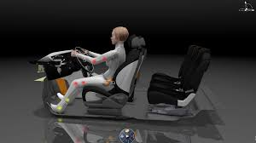
Ergonomics & Anthropometrics
MK PILIHAN
TRANSPORTATION DESIGN

Slide 2
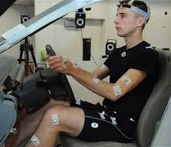
DEFINITION
ergonomics
the scientific study of people and their working conditions, especially done in order to improve effectiveness
(Source: Cambridge Dictionary)
anthropometrics
Anthropometrics is the comparative study of human body measurements and properties.
(Source: University of Texas Online)
Ergonomics, or human factors engineering, is, loosely speaking, the science of designing for the human form and human behaviour. As a field, ergonomics covers everything from door handles and buttons to vehicle proportions and door apertures. With the increasing use of information technology within cars, ergonomics is becoming a major consideration in the design of user interfaces and information and entertainment systems.

Slide 3
Considering Humans
People vary dramatically in size and proportion around the world. Scandinavian men are amongst the tallest whilst far eastern women are among the shortest. Similar variations appear in other factors - width (at various points of the body), hand size, reach, weight and so on. Traditionally these factors have largely depended upon the geographical location of a person - and how humans have developed over thousands of years. However, lifestyle is increasingly affecting the physical attributes of people. A particular example is the increasing levels of obesity in western countries, especially the US. This dramatically affects average figures for dimensions such as width as well as movement and reach considerations.
Another very major issue affecting designers is the increasing life expectancy of people. This is particularly pertinant in developed countries but will increasingly affect all developing countries. As life expectancy increases, people perform tasks and activities for longer and later in life. At the same time, people may experience a deterioration in mobility and dexterity. Here lies another important ergonomic consideration - designing for people who may have trouble with awkward controls, openings and other features of a vehicle whilst still expecting to use the vehicle to its fullest. Changes in response to these concerns can be seen on almost every new car - exterior door handles are often larger, simpler and bolder than a decade or more previously.

Slide 4
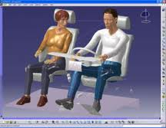
Models and Mannequins
Within the automotive industry, representative models and mannequins are used to form the basis for vehicle size and form. Tradionally, these would be simple, actual size 2D models based on the Dreyfuss human dimension data. Henry Dreyfuss was a pioneer of human measurement and captured the first significant data on human measurement. This method has been superceded by computer models which have been developed from more recent data.

