Slide 1
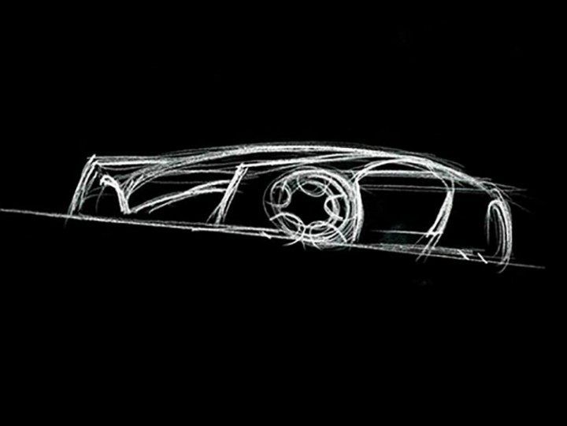
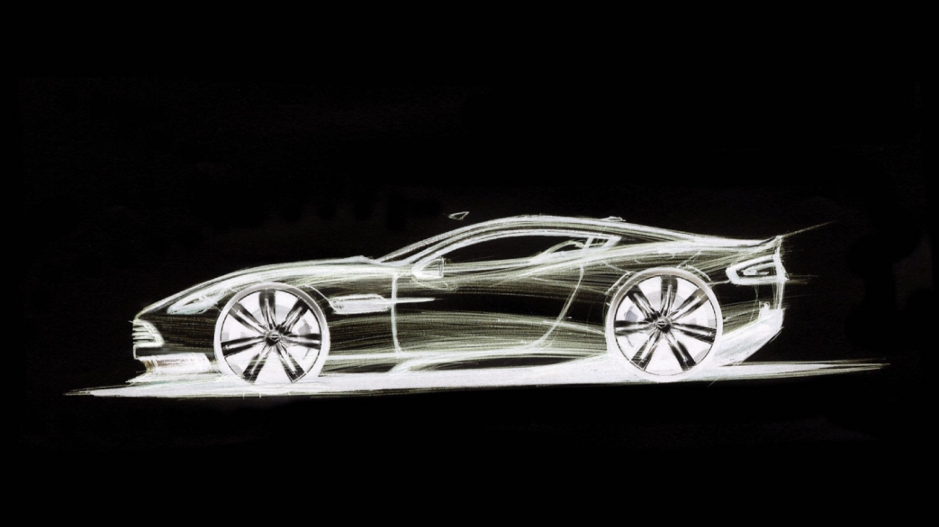
TRANSPORTATION DESIGN INTRO
MK PILIHAN

Slide 2
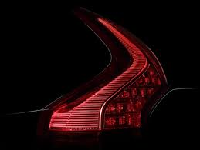
Apa saja yang dipelajari?
Teori Transportasi desain
  Anatomi kendaraan (Glossary)
  Packaging dan Ergonomi Kendaraan
SKETSA
SKETSA
SKETSA
RENDERING

Slide 3
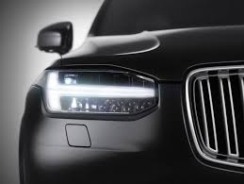
Isi Pertemuan
Week 1 | Week 2 | Week 3 | Week 4 | Week 5 | Week 6 | Week 7 | WEEK 8 UTS PRESENTASI INDIVIDUAL
INTRO TRANSPORTATION DESIGN & TEORI | DESIGN HISTORY | TEORI & SKETSA PERSPEKTIF | TEORI & SKETSA | PEMBUATAN KONSEP SKETSA SKETSA SKETSA SKETSA SKETSA SKETSA SKETSA SKETSA SKETSA SKETSA SKETSA SKETSA SKETSA | SKETSA SKETSA SKETSA SKETSA SKETSA SKETSA SKETSA SKETSA SKETSA SKETSA SKETSA SKETSA SKETSA SKETSA SKETSA | PEMILIHAN DESAIN PERSIAPAN PRESENTASI

Slide 4
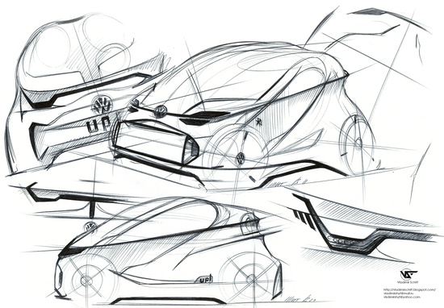
TEORI TRANSPORTATION DESIGN?
Aerodynamics
Ergonomics
Packaging
Hard Point
Sketching
Modelling

