Slide 1
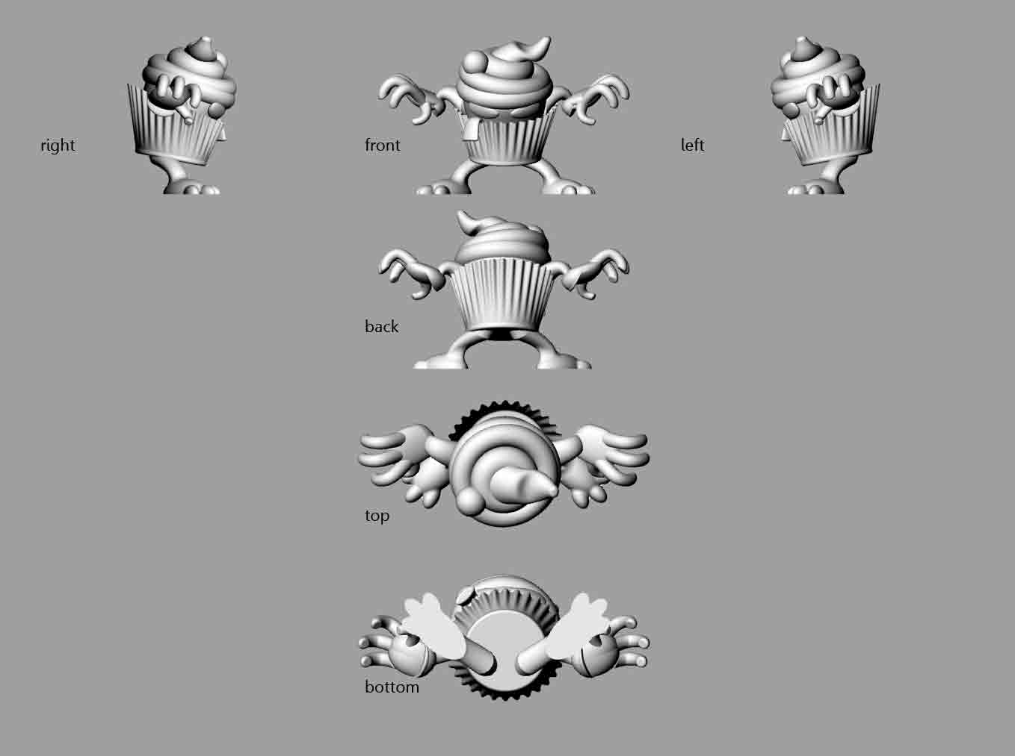

Slide 2
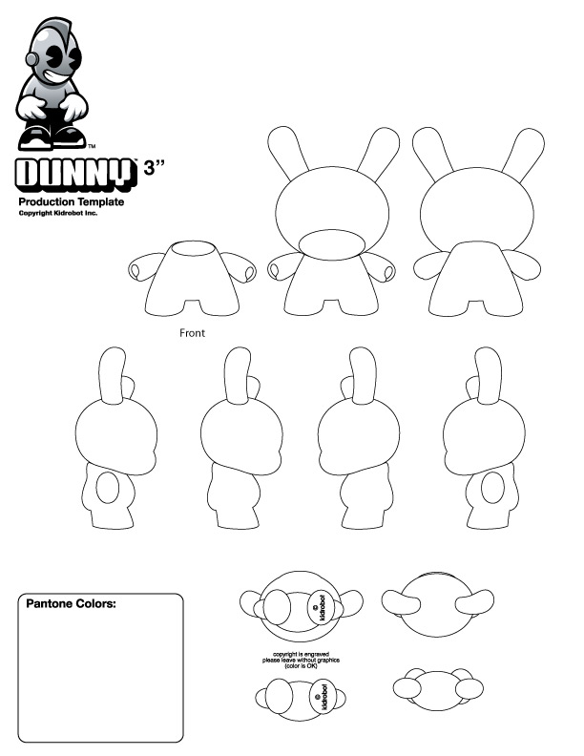
FINAL SKETCH
Dunny example attached, courtesy of Kidrobot

Slide 3
COLOUR SKETCH
Create a “color” version, of your control drawing, one which shows different colors for each paint placement. Take into account the fact that the machinery that makes toy has limited ability to make complex, shaded gradients. Colors should be put down in solid blocks.
Also mark any colored areas that might be shiny (or matte).
If you can get ahold of a Pantone book, you can mark each color with a number.
Also mark the scale of your toy. How big is it? 3 inches or 3 feet?

Slide 4
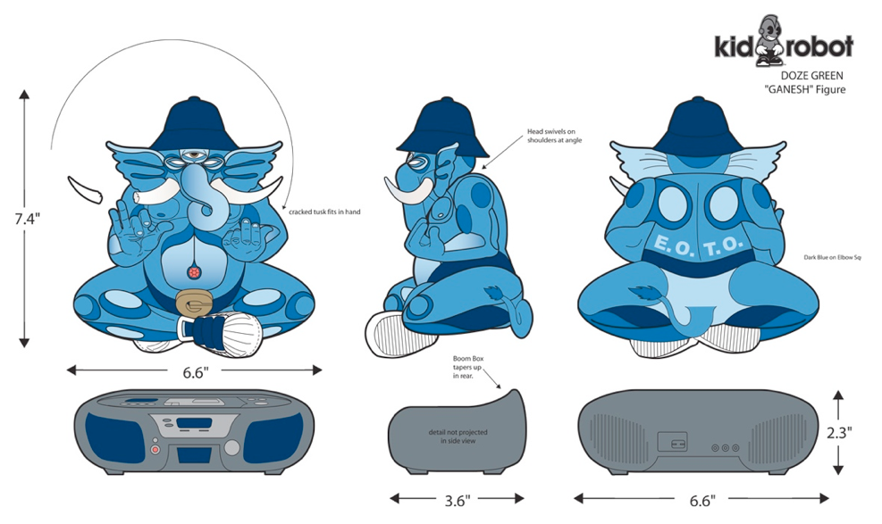
COLOUR SKETCH example by artist Doze Green, courtesy of Kidrobot

