Slide 1
KERJA PRAKTEK
DESAIN PRODUK

Slide 2
Presentasi Penilaian
Absensi
Tugas 1 (portofolio, referensi tempat kerja praktek, surat lamaran)
UTS : portofolio final
Tugas 2 : laporan kerja praktek
UAS : Presentasi kerja praktek & penilaian supervisi kerja praktek
10 %
10 %
20 %
20 %
40 %
Notes:
Setelah UTS coba lamar ke tempat KP, observasi tempat kerja dan presentasikan di tengah semester akhir, observasi absen dikelas lalu ke industri

Slide 3
1 Latar Belakang
Tujuan pendidikan tinggi desain adalah simulasi dan latihan
Belum memiliki jam kerja profesional
Uji coba penerapan ilmu mahasiswa
Prototype dan Laporan dari proses kerja.
Etika bersosialisasi masih dalam lingkup akademik

Slide 4
2 Tujuan
Memperluas wawasan bidang desain dan kegiatan profesinya
Memahami proses kerjasama antar disiplin
Mengerti dan yakin akan manfaat profesi desain dalam masyarakat
Mendidik mental profesional dalam diri masing-masing
Mempelajari peralatan atau sistem baru dalam dunia profesinya
Menumbuhkan rasa percaya diri terhadap profesinya
Mempelajari kemampuan emosional kerja di lapangan

Slide 5
3 Tujuan Khusus
Mengenalkan mahasiswa pada kegiatan profesi secara nyata
Mengembangkan kemampuan profesional dalam bidang desain produk
Terlibat secara langsung dalam satu proyek desain
Memahami seluk beluk organisasi industri atau pusat R&D
Mengenal secara nyata kegiatan desain dan proses industri
Mengembangkan kemampuan membuat laporan proyek desain
Mengembangkan kemampuan mempresentasikan karya desain
Mengembangkan kemampuan berkomunikasi dengan dunia nyata

Slide 6
4 Mata kuliah terkait
Teknik Presentasi

Slide 7
4 Prasyarat
Portofolio
Lokasi kerja praktek
Kontak dan alamat lokasi kerja praktek
Lamaran posisi kerja praktek

Slide 8
Creative Portofolio
Prasyarat
“A design portfolio is a collection of work samples, created for the purpose of presenting it to customers, clients, prospective employers and the like as an example of the type and quality of work they are to expect from the designer.
A well-made design portfolio can mean the difference between winning or missing out on an opportunity “
Source: http://www.wikihow.com/Create-a-Design-Portfolio
Pembuatan portofolio sangatlah penting, portofolio harus dibuat semenarik mungkin namun tetap informatif.
Jenis Portofolio
Soft copy / Digital
Hardcopy

Slide 9
Portofolio content
1) A portfolio is a story about you.
A lot people say a portfolio is a selling tool. I fully agree. But a portfolio is more than that. If you think of your portfolio as a sales tool, you tend to just focus on execution skills or how many pieces of software you can use. A portfolio should instead tell an engaging story about you. It should show, through your projects, where you are in design, your passions, your goals, and your strengths. A good way to start your portfolio story is to have a 2-sentence summary about who and what you are all about.
2) Have an intro page.
This might be a no brainer, but a well-designed introduction page sets the tonality of your portfolio presentation. Many designers just have a title page at the start that says: “Jack’s portfolio.” That’s not good enough. Expanding from the first point you need to share a little about your background to give your portfolio story more depth. Keep it light though; you are summarizing your design career not writing a biography.
Source: http://www.designsojourn.com/10-essential-tips-for-creating-that-killer-portfolio/

Slide 10
3) Keep the number of projects in your portfolio to between 8-10.
There is one caveat to this number, and that is the number of pages per project. If your portfolio tends to have more pages for each project, you should cut the total number of projects down. If you have fewer pages per project, then you may need to bump the total number of projects up.
4) Ensure that projects in your portfolio are no older than 3 years.
To help make your selection process easier, consider removing projects that are older than 3. A big and extensive design project, could sit in your portfolio for up to 5 years as it probably took more than 2 years to complete, but try to avoid anything pass that timeframe as the work could start to look a little dated. When in doubt, prioritize commercial work over concept or schoolwork.
5) Know the purpose of each project in your portfolio.
Every project in your portfolio should have a purpose, a reason for it to exist in your portfolio. That purpose should be somehow related to highlighting your strengths and ability as a designer.
Does this project show your potential employer you can deliver award-winning designs? Is this project all about your 3D rendering skills? Or does this project share a little about your design process? In many cases designers tend to double up projects, for example show a lot of 3D work and as a result unknowingly make their portfolio very 3D heavy. Try to avoid repeating skills and be ruthless in your selection criteria.
Source: http://www.designsojourn.com/10-essential-tips-for-creating-that-killer-portfolio/

Slide 11
6) Who did what?
Always be crystal clear when a project you show was group work, and especially highlight your role in that project. Managers are always very happy to hear how designers can work as a team and produce great work. Not only that, as the design industry is small, many designers tend to vie for the same jobs which could put you into an awkward situation.
7) Create customized portfolios.
Selecting and deciding on projects for your portfolio can be hard. On the flip side, having a lot of projects allows you the flexibility of customizing a portfolio suitable to the type of employer or client you will be showing your work to. Are you meeting a marketing guy, or a head of R&D, or perhaps even a CEO? Having a variety of projects and presentation styles helps make your portfolio more relevant to that individual.
8) Know what you want to do as a designer.
Knowing what type of design you want to do can help you build a more engaging portfolio. Do you want to work in a consultancy? What about in an in-house design team, or even in a cross disciplinary role that reports to the CEO?
Knowing what you want in your design career can also help you shape the projects you yet to do. If you want to work in a consultancy, and you find you are weak in 3D rendering skills, this may prompt you to seek out more 3D rendering projects to shore up your portfolio content.
Source: http://www.designsojourn.com/10-essential-tips-for-creating-that-killer-portfolio/

Slide 12
9) A portfolio is a living document.
A portfolio should always be evolving and living in beta. My advice is to update your portfolio every 6 months, or at the very least, update it yearly. Waiting longer tends to allow for work or documentation to go missing. Not only that, a juicy job opportunity might just pop up that could leave you scrambling to get things organize before the submission dateline is over. The Scout’s motto applies here: “Be prepared.”
10) A killer portfolio is well designed.
It is logical that as a designer, you should take every step to make sure that your portfolio is well designed and not just a bunch of images sitting in a plastic folder. Unfortunately, there are a lot of portfolios out there that are poorly designed, even though the content might be acceptable.
Not only it is advisable to have a consistent portfolio layout, the flow and organization of the content should be designed to work in your favor. Do all of your projects start with a beauty shot of the design? What about ensuring a consistent landscape or portrait format? The industrial designers reading this may be forgiven for a poor layout, but the graphic designers will need to be extra careful to ensure their portfolio reflects their capabilities.
A good way to get started is to create a template by using the grid technique (popular with graphic designers) and populate your design work from there. It is always tempting to over style your portfolio, especially if you have a high octane personal brand, but at the end of the day, the best thing to do is keep your layout design simple. You don’t want the background or portfolio layout to overshadow your design work.
Source: http://www.designsojourn.com/10-essential-tips-for-creating-that-killer-portfolio/

Slide 13
Kesimpulan
Prasyarat
Wajib terdapat informasi data diri (nama, alamat, pendidikan, pengalaman)
Karya desain, termasuk proses dan penjelasan.
Kualitas visual
Informasi jujur dan tidak berlebihan,namun tetap tersampaikan
Pemakaian bahasa yang baik
Mampu membuat 2 versi: printed dan digital

Slide 14
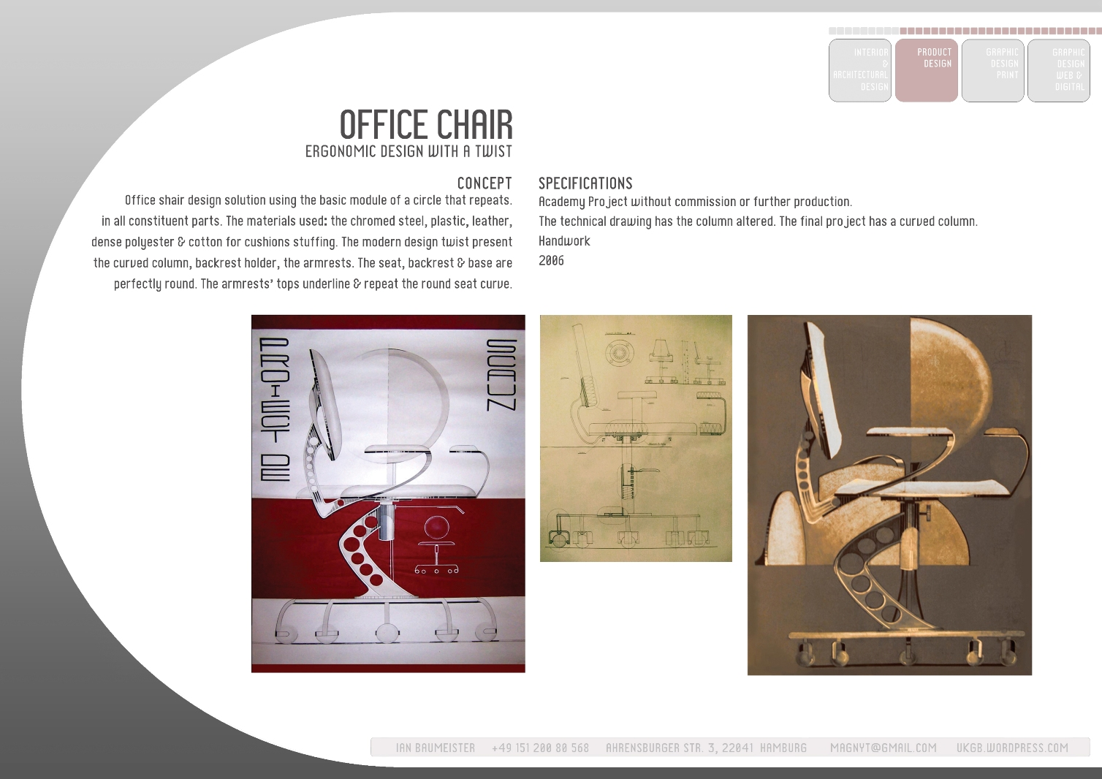

Slide 15
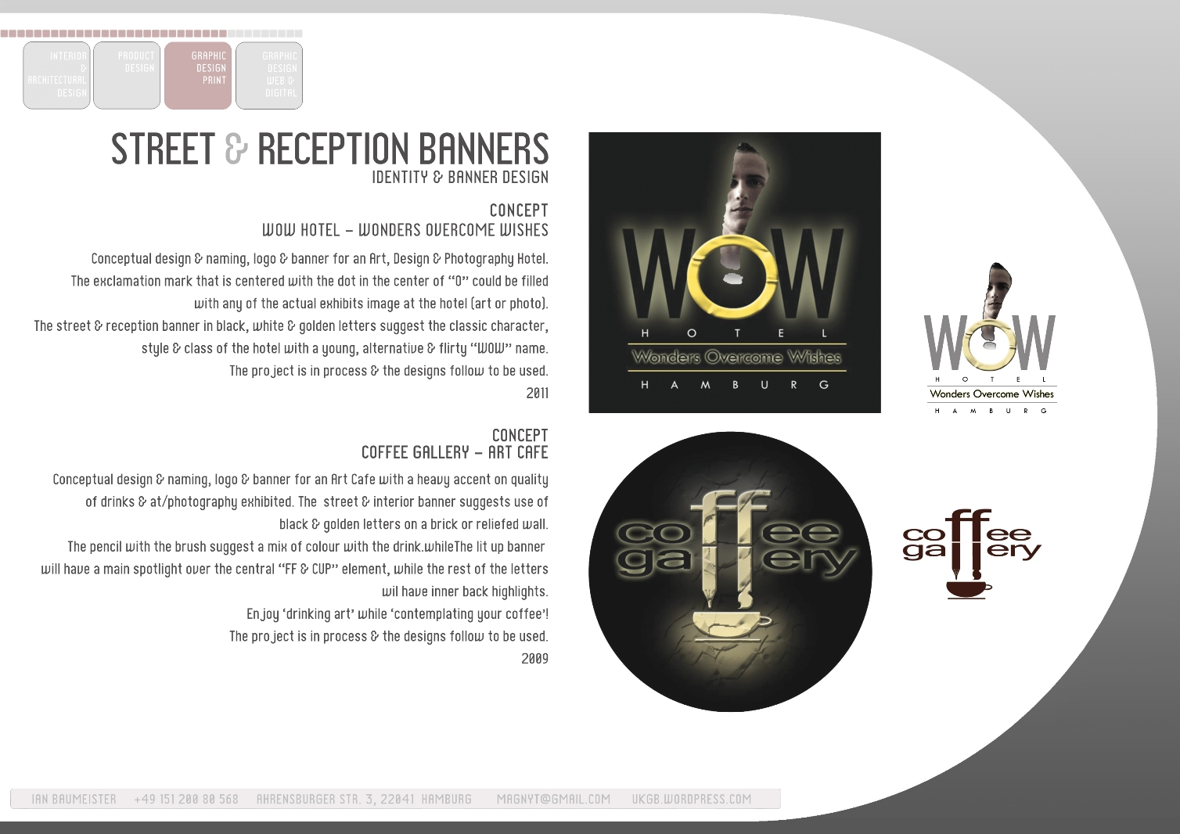

Slide 16
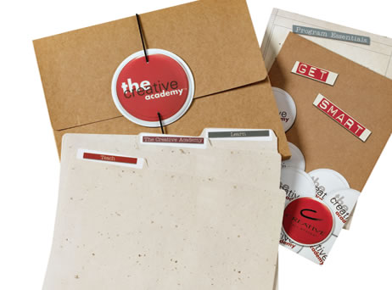
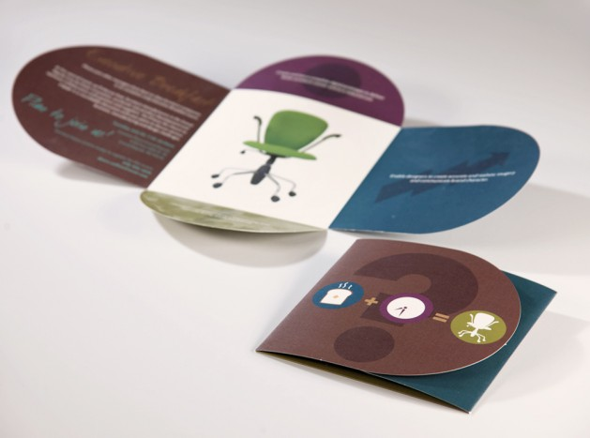
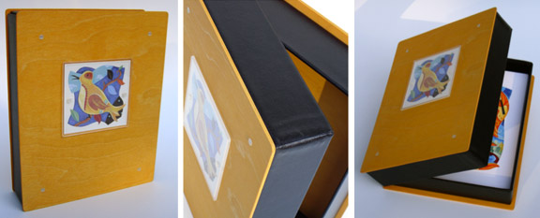

Slide 17
Format Lamaran kerja praktek

Slide 18
Pengajuan Kerja Praktek di PT. Pertamina (Persero)
JL. Medan Merdeka
Jakarta
Kepada Yth. Direktur Personalia
PT. Pertamina (Persero)
Jakarta
Yang bertanda tangan di bawah ini saya :
N a m a : ………………………………………………………………..
N I M : …………………………………………………………….….
Program Studi/ Jurusan : …………………………………………………………….….
Fakultas : …………………………………………………………….….
Semester : …………………………………………………………….….
Mengajukan permohonan untuk kegiatan magang dalam bidang Teknologi Informasi yang dilaksanakan oleh PT. Pertamina (Persero).
Sebagai bahan pertimbangan, dengan ini kami lampirkan :
1. Portofolio
2. Foto copy Kartu Mahasiswa
3. KHS terakhir dengan I P K : ………..
4. Pas Foto ukuran 3 x 4 = 2 lembar (ditempel)
Apabila diterima kami sanggup mentaati peraturan dan ketentuan yang berlaku di PT. Pertamina (Persero).
Demikian permohonan ini kami ajukan, atas perhatiannya kami ucapkan terima kasih.
Jakarta, …………………….
Mengetahui: Hormat saya,
Ketua Program Studi/ Jurusan
………………………….… ................................

Slide 19
List target lokasi kerja praktek

Slide 20
Buat portofolio
Buat format lamaran
Buat list target tempat kerja
Buat gambaran kerja
Buat ...........

