Slide 1
Consumer Perception
Chapter 4

Slide 2
Perception
The process by which individuals select, organize, and interpret stimuli into a meaningful and coherent picture of the world. It can be described as “how we see the world around us.”

Slide 3
Sensation
The immediate and direct response of the sensory organs to stimuli (units of input to the senses, as captured by the sensory receptors).
Notes:
Examples of stimuli (i.e., sensory inputs) include products, packages, brand names, advertisements, and commercials. Sensory receptors are the human organs (the eyes, ears, nose, mouth, and skin) that receive sensory inputs. As sensory input decreases, however, our ability to detect changes in input or intensity increases, to the point that we attain maximum sensitivity under conditions of minimal stimulation.

Slide 4
Ambush Marketing
Placing ads in places where consumers do not expect to see them and cannot readily avoid them.
Experiential Marketing
Allows customers to engage and interact with offerings in sensory ways in order to create emotional bonds between consumers and marketing offerings

Slide 5
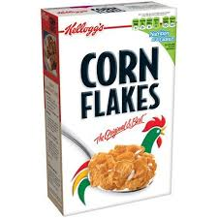
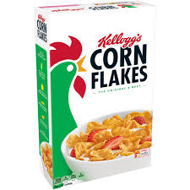
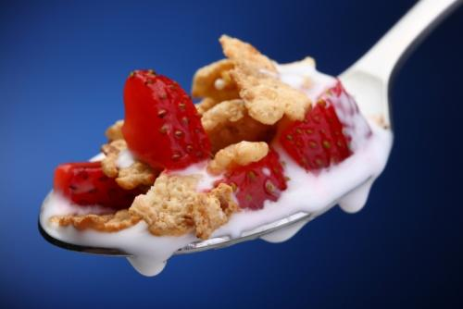
Discussion Question
How might a cereal manufacturer such as Kellogg’s use the j.n.d. (just noticable difference) for Frosted Flakes in terms of:
Product decisions
Packaging decisions
Advertising decisions
Sales promotion decisions
Notes:
Kellogg’s might want to change their ingredients, either to make the product healthier or because they have secured lower-priced raw materials. They might want to reduce package size to avoid a price increase and they would not want this to be noticed. Perhaps Tony the Tiger could look a little different. At one point, Pillsbury made a decision to make the Pillsbury Dough Boy a bit thinner. They wanted to make sure he still was cute but looked a bit more fit and lean.

Slide 6
Perceptions are affected by…
Expectations
Motives
Selective Perception
Selective Exposure
Selective Attention
Perceptual Defense
Perceptual Blocking
Notes:
Expectations: People usually see what they expect to see, and what they expect to see is usually based on familiarity, previous experience, or a preconditioned set of expectations. In a marketing context, a person tends to perceive products and product attributes according to his or her own expectations.
Motives: People tend to perceive the things they need or want: The stronger the need, the greater the tendency to ignore unrelated stimuli in the environment.
The consumer’s selection of stimuli from the environment is based on the interaction of expectations and motives with the stimulus itself. Selective exposure occurs when consumers tune out messages that they find pleasant or with which they are sympathetic, and they actively avoid painful or threatening ones. They also selectively expose themselves to advertisements that reassure them of the wisdom of their purchase decisions. Selective attention is consumers’ heightened awareness of stimuli that meet their needs or interests and minimal awareness of stimuli irrelevant to their needs. Thus, consumers are likely to note ads for products that would satisfy their needs and disregard those in which they have no interest. People also vary in terms of the kinds of information in which they are interested and the form of message and type of medium they prefer. Perceptual defense takes place when consumers subconsciously screen out stimuli that they find psychologically threatening, even though exposure has already taken place. Furthermore, individuals sometimes unconsciously distort information that is not consistent with their needs, values, and beliefs. Consumers often protect themselves from being bombarded with stimuli by simply “tuning out”—blocking such stimuli from conscious awareness. They do so out of self-protection, because of the visually overwhelming nature of the world in which we live.

Slide 7
Perceptual Interpretation
Stereotyping
Triggers
Physical appearance
Descriptive terms
First impressions
Halo Effect
Notes:
Individuals carry biased pictures in their minds of the meanings of various stimuli, which are termed stereotypes. Sometimes, when presented with sensory stimuli, people “add” these biases to what they see or hear and thus form distorted impressions. Generally, people stereotype because it makes the processing of sensory input quicker and easier. The triggers of stereotyping are physical appearance, descriptive terms, first impressions, and the halo effect. We often make decisions based on how people or products appear. A beautiful spokesperson might be perceived as possessing expertise for beauty products. A certain color to a food might make us think it is healthier. Stereotypes are often reflected in verbal messages/descriptive terms. First impressions are lasting so a marketer should be careful how they advertise new products. The perceiver is trying to determine which stimuli are relevant, important, or predictive. The Halo effect refers to the overall evaluation of an object that is based on the evaluation of just one or a few dimensions. In marketing, the term refers to a prestigious image of a product “rubbing off on” other products marketed under the same brand name.

Slide 8
How Does This Ad Depict Perceptual Interpretation?
Notes:
In this ad, the marketer uses descriptive terms; s/he has stereotyped the person who eats a cheeseburger vs. tofu and applied them in a descriptive sense to their product.

Slide 9
Brand Image
Positioning
Brand image updates
Package image
Service image
Notes:
The desired outcome of effective positioning is a distinct “position” (or image) that a brand occupies in consumers’ minds. This mental “position” must be unique and represent the core benefit the brand provides. Table 4.2 shows the positioning of different detergent brands.
Occasionally, a brand’s image must be updated. Consumers often view products that have been around for a long time as boring, especially when newer alternatives are introduced. Examples in Table 4.3 include Dell, StarKist, Quaker Oats, and Google.
In addition to the product’s name, appearance, and features, packaging also conveys the brand’s image. For example, to buyers of perfumes, the only tangible evidence of the product’s nature and quality is the packaging, the cost of which often accounts for up to 50% of the total cost of the perfume.
Because services are intangible, image becomes a key factor in differentiating a service from its competition. Thus, the marketing objective is to enable the consumer to link a specific image with a specific brand name. Many service marketers have developed strategies to provide customers with visual images and tangible reminders of their service offerings (e.g. distinctive service environments, delivery vehicles painted in distinct colors, restaurant matchbooks, packaged hotel soaps and shampoos, featuring real service employees in their ads (as tangible cues) and using people-focused themes to differentiate themselves).

Slide 10
Quality
Product quality
Intrinsic cues
Extrinsic cues
Service quality
Price/quality relationship
Store image
Manufacturer image
Notes:
Intrinsic cues are physical characteristics of the product itself, such as size, color, flavor, or aroma. In some cases, consumers use physical characteristics (e.g., the flavor of ice cream or cake) to judge product quality. Consumers like to believe that they base their evaluations of product
quality on intrinsic cues, because that enables them to justify their product decisions (either positive or negative) as being “rational” or “objective” choices. More often than not, however, consumers use extrinsic cues—that is, characteristics that are not inherent in the product (e.g. color, packagin, brand image, price, manufacturer’s image)—to judge quality.
Services are intangible, they are variable, they are perishable, and they are simultaneously produced and consumed. Consumers often rely on surrogate cues (i.e., extrinsic cues) to evaluate service quality. The most widely accepted framework for researching service quality stems from the premise that a consumer’s evaluation of service quality is a function of the magnitude and direction of the gap between the customer’s expectations of service and the customer’s assessment (perception) of the service actually delivered. The SERVQUAL scale measures the “gaps” between customers’ expectations of the services that they had purchased and their perceptions of the services that they had actually received on two factors: outcomes and processes.
A price/quality relationship forms when consumers rely on price as an indicator of product quality; in short, they believe more expensive products are better (you get what you pay for). Some consumers who decide according to a price/quality relationship are actually relying on a well-known (and, hence, more expensive) brand name as an indicator of quality without actually relying directly on price.
Store image stems from the merchandise it carries, the brands sold and their prices, the level of service, the store’s physical environment and ambiance, and its typical clientele (this can often be determined from the cars parked in the store’s parking lot). The width and type of product assortment affect retail store image. Customers often use brand, store image, and price together as a product quality indicators.
Manufacturers who enjoy a favorable image generally find that their new products are accepted more readily than those of manufacturers
who have a less favorable or even a “neutral” image. Consumers also associate certain attributes with manufacturers. Institutional advertising is promotion that is designed to promote a company’s overall image without overtly referring to specific products.

Slide 11
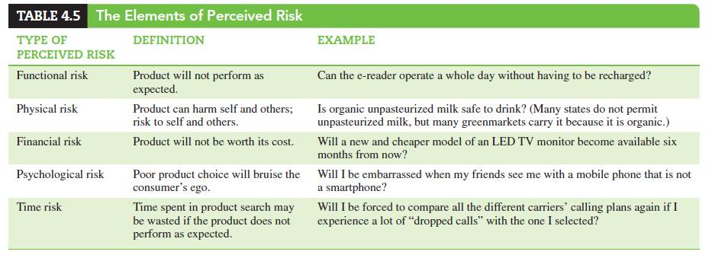
Perceived Risk
The degree of uncertainty perceived by the consumer as to the consequences (outcome) of a specific purchase decision
Notes:
Consumer purchase decisions are determined by the degree of risk that consumers perceive, and their tolerance for risk. The major types of risk are listed in this slide. The first, functional risk, deals with the risk that the product will not perform as expected. Physical risk is the risk to self and others. Financial risk is that the product will not be worth its cost and social risk is that the choice of the product might lead to social embarrassment. Psychological risk is that a poor product choice will hurt the consumer's ego and time risk is that the time has been wasted in purchasing this product.

Slide 12
How Consumers Handle Risk
Notes:
How consumers handle risk will differ by their own individual strategy. That being said, there are a handful of strategies that people tend to use when dealing with risk. The first of these is to seek information so that they have more knowledge when they purchase. Consumers can also stay brand loyal, thereby avoiding risk by sticking with a known product. Consumers can select by brand image to reduce their risk because they may already know and trust the brand, perhaps from buying a different product by the same brand or company. Some consumers will rely on store image to help them reduce risk. Some customers buy the most expensive model assuming that the price/quality relationship will safely deliver them the best product. Finally, consumers seek reassurance through money-back guarantees, warranties, seals of approval and free trials.

