Slide 1
Consumer Motivation and Personality
Chapter 3

Slide 2
Opening example: Brand personification
Notes:
Brand personification occurs when consumers attribute human traits or characteristics to a brand. A “brand personality” provides an emotional identity for a brand, which produces sentiments and feelings toward the brand among consumers. Brand personification is a form of anthropomorphism, which refers to attributing human characteristics to something that is not human. Mr. Clean is one of America’s most beloved and instantly recognized “persons.” The brand and mascot are owned by Procter and Gamble and used for positioning and marketing cleaning solutions and related items. The mascot was introduced in the 1950s, quickly became a best seller, and “his” product line now includes bathroom cleaners, a magic eraser, multisurface liquids and sprays, cleaning tools, and “Pro” items for heavy and outdoor cleaning.

Slide 3
The Motivation Process
Notes:
Individuals strive both consciously and subconsciously to reduce tension that is created by unfulfilled needs through selecting goals and subsequent behavior that they anticipate will fulfill their needs and thus relieve them of the tension they feel. Whether gratification is actually achieved depends on the course of action pursued. Personality characteristics guide the goals that people set and the courses of action they take to attain
these goals.

Slide 4
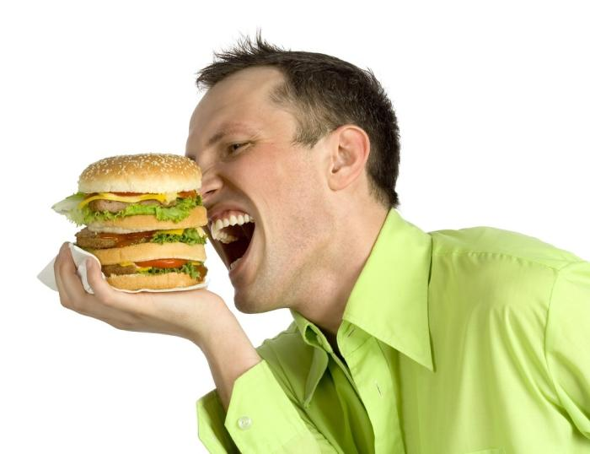
Needs and Goals
Needs
Physiological
Psychological
Goals
Generic
Product-specific
Notes:
Physiological needs are innate (biogenic, primary) and fulfilling them sustains biological existence. They include the need for food, water, air, protection of the body from the outside environment (i.e., clothing and shelter), and sex. Psychological needs are learned from our parents, social environment, and interactions with others. Among many others, they include the needs for self-esteem, prestige, affection, power, learning, and achievement.
Goals are the sought-after results of motivated behavior, and all human behavior is goal oriented. There are two types of goals: Generic goals are outcomes that consumers seek in order to satisfy physiological and psychological needs. Product-specific goals are outcomes that consumers seek
by using a given product or service. When a consumer states they want a pair of jeans, they have stated a generic goal. When they announce they really want a pair of Calvin Klein jeans, then they have stated product-specific goals.

Slide 5
Need Arousal and Selecting Goals
Need Arousal
Selecting Goals
Internal stimuli
Emotional or cognitive processes
External stimuli
Factors
personal experiences and knowledge
physical capacity
cultural norms and values
goal accessibility
Approach objects
Avoidance objects
Notes:
Needs can be aroused by internal stimuli found in the individual’s physiological condition, emotional or cognitive processes, or stimuli in the outside environment. Many promotional messages are cues designed to arouse consumer needs. Creative marketing messages arouse needs by
stimulating a psychological desire or imbalance in consumers’ minds. The goal then becomes to act on the desire, and reduce the felt imbalance by buying products.
Purchase-related goals usually satisfy more than one need. And, for any given need, there are many different and appropriate goals. The goals that individuals select depend on those individuals’ personal experiences and knowledge, physical capacity, prevailing cultural norms and values, and the goal’s accessibility in the individuals’ physical and social environments. The goal object has to be both socially acceptable and physically accessible. The motivation to select goals can be either positive or negative. We may feel a driving force toward some object or condition or a driving force away from some object or condition. Positive outcomes that we seek are called approach objects; negative outcomes that we want to prevent are called
avoidance objects.

Slide 6
Needs and Goals
Needs and goals are interdependent
Needs are never fully satisfied
New needs emerge as old ones are satisfied
Success and failure influence goals
Notes:
Needs and goals are interdependent; neither exists without the other. However, people are often not as aware of their needs as they are of their goals.
Human needs are never fully or permanently satisfied. As individuals attain their goals, they develop new ones. If they do not attain their goals, they continue to strive for old goals or they develop substitute goals.
Some motivational theorists believe that a hierarchy of needs exists and that new, higher-order needs emerge as lower-order needs are fulfilled.
Individuals who achieve their goals usually set new and higher goals for themselves. Conversely, those who do not reach their goals sometimes lower their aspirations.

Slide 7
Maslow’s Hierarchy of Needs
Notes:
Psychologist Abraham Maslow formulated a theory of human motivation based on the notion that there is a hierarchy of human needs which rank in order of importance from lower-level (biogenic) needs to higher-level (psychogenic) needs. Individuals seek to satisfy lower-level needs before
higher-level needs. The needs appear to be mutually exclusive, but there is some overlap.
Maslow maintained that physiological needs (primary needs which are required to sustain biological life, including food, water, air, shelter, clothing,
and sex—all biogenic needs) are the first and most basic level of human needs. After physiological needs have been satisfied, safety and security needs (physical safety, order, stability, routine, familiarity, and control over one’s life and environment) become the driving force behind an individual’s behavior. The third level of Maslow’s hierarchy consists of social needs, such as love, affection, belonging, and acceptance. When social needs are more or less satisfied, egoistic needs (inwardly directed: needs for self-acceptance, self-esteem, success, independence, and personal satisfaction; outwardly directed: needs for prestige, reputation, status, and recognition from others) become operative. The fifth level, self-actualization need, refers to an individual’s desire to fulfill his or her potential—to become everything that he or she is capable of becoming.

Slide 8
To Which of Maslow’s Needs Does This Ad Appeal?
Notes:
The ad appeals to both Physiological and Social Needs

Slide 10
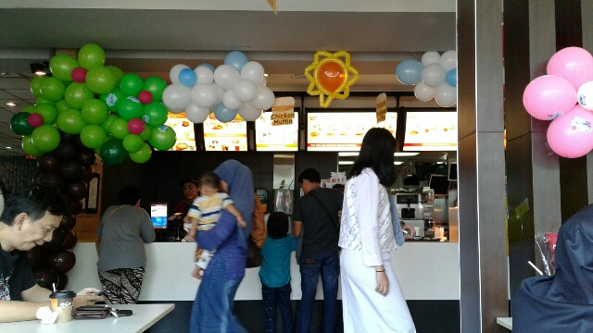
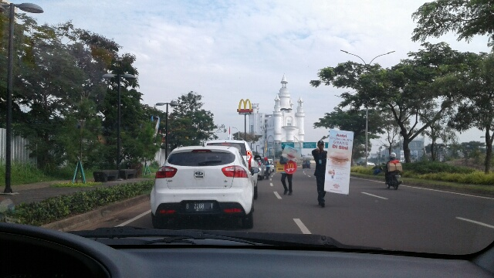

Slide 11
Personality
The inner psychological characteristics (the specific qualities, attributes, traits, factors, and mannerisms that distinguish one individual from other individuals) that both determine and reflect how we think and act.
Notes:
Although research does not agree regarding the role of heredity and early childhood experiences on personality development vs. the role of broader social and environmental influences or on whether personality should be viewed ad a unified whole or as specific traits, researchers agree that: (1) personality reflects individual differences; (2) personality is generally consistent and enduring; and (3) although it is enduring, personality can sometimes change.

Slide 12
How Does This Marketing Message Apply the Notion of the Id?
Notes:
It Captures Some of the Mystery and The Excitement Associated With the “Forces” of Primitive Drives.

Slide 13
Other Personality Factors
Visualizers vs. Verbalizers
Materialism
Ethnocentrism
Is the ad trying to appeal to visualizers or verbalizers? Explain.
Notes:
Verbalizers prefer promotional messages containing a lot of written, textual, and verbal information. Visualizers are more receptive to pictorial images, and include: 1. Object visualizers, who encode and process images as a single perceptual unit. 2. Spatial visualizers, who process images piece by piece.
Materialism gauges the extent to which an individual is preoccupied with purchasing and showing off physical possessions that are mostly nonessential and often conspicuous luxury goods.
Ethnocentrism is the consumer’s willingness to buy or not buy foreign-made products.

Slide 14
Brand Personality Framework
Notes:
Figure 3.14 depicts 5 underlying dimensions of a brand’s personality—sincerity, excitement, competence, sophistication, and ruggedness—and 15 more narrowly defined characteristics, such as down-to-earth, daring, reliable, upper class, and outdoors.

