Slide 1
Information Technology Project Management
By
Denny Ganjar Purnama, MTI
Universitas Pembangunan Jaya
May 2014

Slide 2
Learning Objectives
Describe the three tactical approaches to information implementation and installation: (1) direct cutover (2) parallel (3) phased. Compare the advantages and disadvantages of each approach.
Describe the processes associated with project closure to ensure that the project is closed in an orderly manner.
How to evaluate a project

Slide 3
Project Implementation and Closure

Slide 4
Project Implementation
Focuses on installing or delivering the project’s major deliverable – the information system that was built or purchased
Three general tactical implementation plans:
  Direct cutover
  Parallel
  Phased

Slide 5
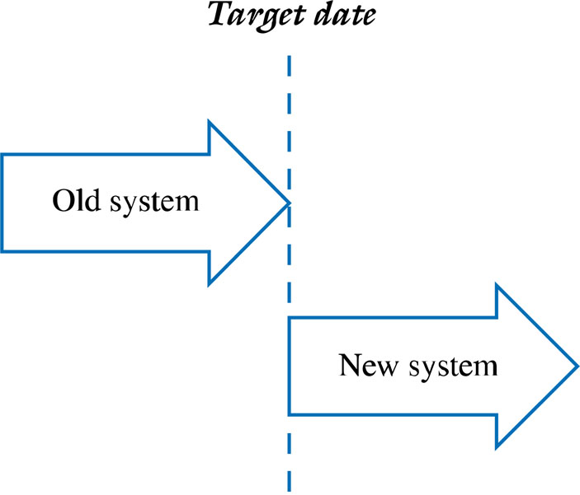
Direct Cutover
Figure 14.1

Slide 6
Direct Cutover
Old system is shut down and new turned on
May be appropriate when :
  Quick delivery critical
  Old system so poor it must be replaced ASAP
  System not mission critical
Risks associated with direct cutover:
  Not always painless – like walking a tightrope without a safety net.
  May result in major delays, frustrated users, lost revenues, and missed deadlines
  Places more pressure and stress on project team

Slide 7
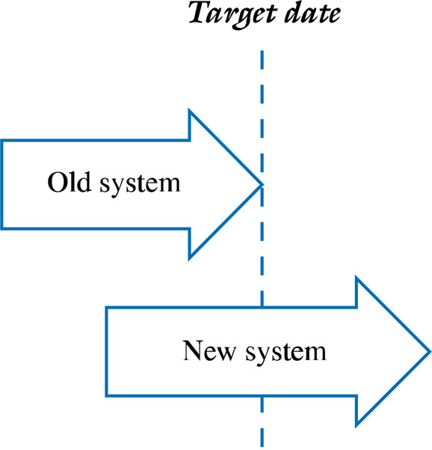
Parallel
Figure 14.2

Slide 8
Parallel
Old and new systems run concurrently
May be appropriate when problems or the failure of the system can have a major impact on the organization
Provides a safety net or backup in case of problems
Can increase confidence in the new system
Takes longer and requires more resources than direct
Places more pressure on the users

Slide 9
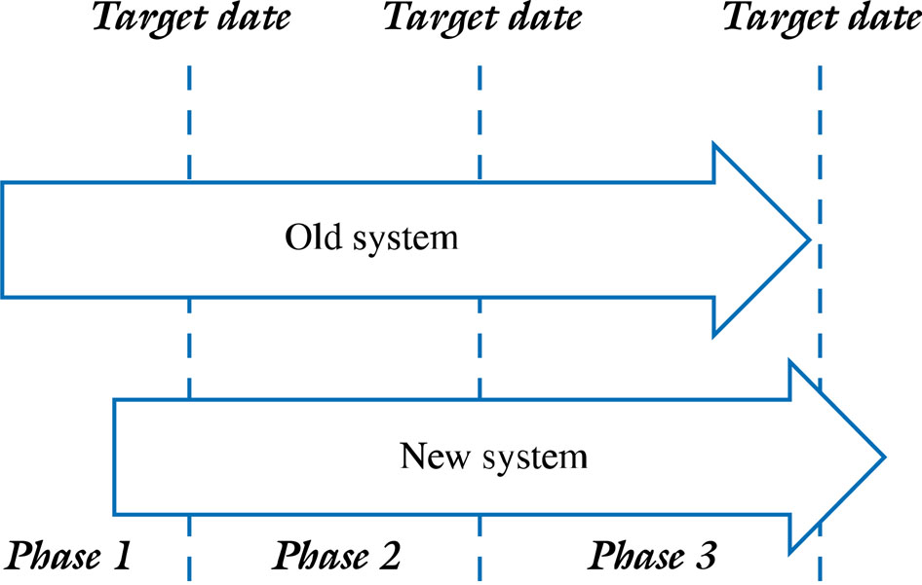
Phased
Figure 14.3

Slide 10
Phased
System is introduced in modules or in different parts of the organization incrementally
Allows for an organized and managed approach for implementing system modules or a system/upgrades in different departments or geographical locations
Experience with early implementation can guide and make later implementations go more smoothly
Takes longer and may cost more than the direct cutover approach
Problems encountered during early phases can impact the overall implementation schedule

Slide 11
Administrative Closure
Normal – as planned
Premature – early even if not complete
Perpetual – runaway, never ending
Failed – unsuccessful – cost of completion outweigh the benefits
Changed Priority – due to resource constraints, misjudged value, needs changes, “starvation”

Slide 12
Realities of Project Closure
Team members are concerned about future jobs
Bugs still exist
Resources are running out
Documentation becomes important
Promised delivery dates may not be met
The players may possess a sense of panic

Slide 13
Administrative Closure
The Final Project Report includes
  Project Summary
  Comparison of Planned versus Actual
  Outstanding Issues
  Project Documentation List

Slide 14
Administrative Closure
The Final Meeting and Presentation
  Communicates that the project is over
  Formally transfers the system from the team to the organization
  Acknowledge contributions
  Formal signoff

Slide 15
Administrative Closure
Closing the Project – requirements include:
  Verifying that all deliverables and open items are complete.
  Verifying the project sponsor or customer’s formal acceptance of the project.
  Organizing and archiving all project deliverables and documentation.
  Planning for the release of all project resources (i.e., project team members, technology, equipment, facilities, etc.).
  Planning for the evaluations and reviews of the project team members and the project itself.
  Closing of all project accounts.
  Planning a celebration to mark the end of a (successful) project.

Slide 16
Project Evaluation

Slide 17
Individual Performance Review
Begin with the Individual evaluating his/her performance
  Don’t review others, ask them on how they want to be evaluated
Avoid “Why can’t you be more like...”
  We may misjudge a person
  Each individual is unique
Focus on specific behaviours, not the individual
  Do not associate a behaviour with certain individual
Be consistent and fair
  Having policies and procedure in place and stick with it can mitigate inconsitency and unfair evaluation
Reviews should provide a consensus on improving performance
  Evaluation is conducted to provide constructive feedback to an individual
  Follow up might be needed
Notes:
Don’t review others, ask them on how they want to be evaluated

Slide 18
Postmortem Review
Review the initial project’s MOV
Review the project scope, schedule, budget, and quality objectives
Review each of the project deliverables
Review the various project plans and Project Management Body of Knowledge ares
How well did the project team perform
Notes:
Should be conducted before project member assigned to another project
Focus on MOV and Project Management Knowledge areas

Slide 19
Project Audit
Conducted by outside reviewer, so it can result objective evaluation
The evaluated items can be the same as Postmortem Review
It can also assess project manager and his team whether their action in professional and ethical manner
Some qualification for auditor:
  Have no direct involvement or interest in the project
  Be respected and viewed as impartial and fair
  Be willing to listen
  Present no fear of recrimination from special interest
  Act in the organization’s best interest
  Have broad base of project and/or industry experience

Slide 20
Evaluating Project Success
Conducted by project sponsor and project team
Make sure the system delivered is not altered, so it can’t give unintended adverse effect
Items to be evaluated:
  Did the project achieve its MOV ?
  Was the sponsor/customer satisfied ?
  Was the project managed well ?
  Did the project manager and team act in a professional and ethical manner ?
  What was done right ?
  What can be done better next time ?

