Slide 1
Information Technology Project Management
By
Denny Ganjar Purnama, MTI
Universitas Pembangunan Jaya
May 2014

Slide 2
Chapter 8
Managing Project Risk

Slide 3
Learning Objectives
Describe the project risk management planning framework introduced in this chapter.
Define risk identification and the causes, effects, and integrative nature of project risks.
Describe the various risk strategies, such as insurance, avoidance, or mitigation.
Describe risk monitoring and control.
Describe risk evaluation in terms of how the entire risk management process should be evaluated in order to learn from experience and to identify best practices.

Slide 4
The Baseline Project Plan
Is based on:
  Our understanding of the current situation
  The information available
  The assumptions we make

Slide 5
This Leads to Uncertainty
Because…
  Estimates are really forecasts or predictions
  Uncertainty is highest at the beginning of the project because we don’t all the information we would like to have
  Sometimes things happen that are out of our control
Although no one can predict the future with 100% accuracy, having a solid foundation in terms of the processes, tools, and techniques, can increase our confidence in these estimates.

Slide 6
Some Common Mistakes
Benefits of risk management are not well-understood
  Just do it!
Not providing adequate time for risk management
  Should be part of the ITPM
Not identifying and assessing risk using a standardized approach
  Miss threats & opportunities
Crisis management (i.e. firefighting) is “reactive”
  Risk management is “proactive”
  Cheaper & less embarrassing than crisis management

Slide 7
Effective and Successful Project Risk Management Requires:
Commitment by all stakeholders
Stakeholder Responsibility
  each risk must have an owner
Different Risks for Different Types of Projects

Slide 8
PMBOK® Risk Management Processes
Risk Management Planning
Risk Identification
Qualitative Risk Analysis
Quantitative Risk Analysis
Risk Response Planning
Risk Monitoring and Control
Notes:
Risk management planning: how to approach and plan risk management activities.
Output: Risk management plan
Risk Identification: decide wich risk will impact the project. Involve all project stake holder
Qualitative risk analysis: using qualitative analysis to examine likelihood and impact of a risk
Quantitative risk analysis: using quantitative analysis to determine probabilistic of risk
Risk response planning: develop procedure & technique to reduce risk
Risk monitoring & control: early warning system

Slide 9
MIS Software Risks
Systems Software Risks
Commercial Software Risks
Military Software Risks
Contract or Outsourced Software Risks
End-User Software Risks
Creeping User Requirements
80%
Long Schedules
70%
Inadequate User Documentation
70%
Excessive Paper Work
90%
High Maintenance Costs
60%
Non-transferable Application
80%
Excessive Schedule Pressure
65%
Inadequate Cost Estimates
65%
Low User Satisfaction
55%
Low Productivity
85%
Friction Between Contractor & Client Personnel
50%
Hidden Errors
65%
Low Quality
60%
Excessive Paper Work
60%
Excessive Time to Market
50%
Long Schedules
75%
Creeping User Requirements
45%
Un-maintainable Software
60%
Cost Overruns
55%
Error-prone Modules
50%
Harmful Competitive Actions
45%
Creeping User Requirements
70%
Unanticipated Acceptance Criteria
30%
Redundant Application
50%
Inadequate Configuration Control
50%
Cancelled Projects
25%
Litigation Expense
30%
Unused or Unusable software
45%
Legal Ownership of Software & Deliverables
20%
Legal Ownership of Software and Deliverables
20%
Various Software Risks for IT Projects (source: Jones, 1994)

Slide 10
PMBOK® Definitions
Risk
  An uncertain event or condition that, if it occurs, has a positive or negative effect on the project objectives.
Risk Management
  The systematic process of identifying, analyzing, and responding to project risk. It includes maximizing the probability and consequences of positive events and minimizing the probability and consequences of adverse events.

Slide 11
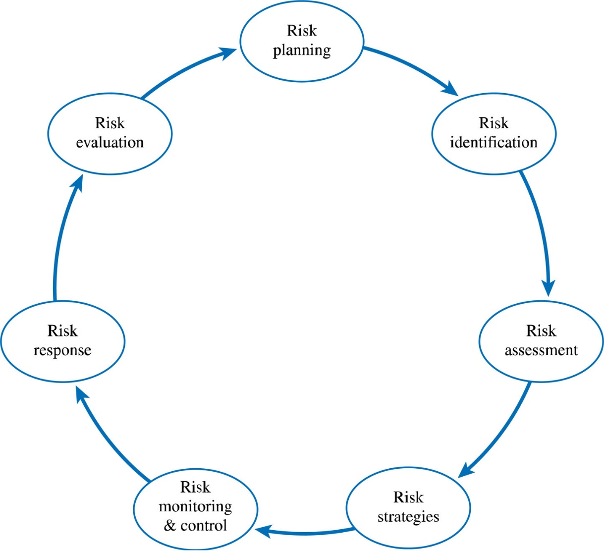
IT Project Risk Management Processes
Figure 8.1

Slide 12
IT Project Risk Management Process
Risk Planning
  Requires a firm commitment to risk management from all project stakeholders
  Ensures adequate resources to plan for and manage risk
  Focuses on preparation

Slide 13
IT Project Risk Management Process
Risk Identification
  Identify potential risks that can impact the project
    Includes both threats and opportunities
  Should include many of the project stakeholders
  The IT Project Risk Framework provides a tool for understanding the timing and interrelatedness of IT project risks

Slide 14
IT Project Risk Identification Framework
Notes:
Layer 1:MOV sebagai tolok ukur keberhasilan project
Layer 2: pendukung utama terwujudnya MOV
Layer 3: Resiko bisa muncul karena adanya interaksi elemen pada layer tersebut
Layer 4: Sumbe resiko bisa dari internal atau eksternal. Eksternal bukan tanggung jawab Project Manager, namun bisa berdampak pada project
Layer 5: Tiga tipe risk → known, known-unknown, dan unknown-unknown
Layer 6: resikon selalu berubah dan bisa terjadi disetiap fase IT Project Management Life cycle

Slide 15
Tools and Technique Risk Identification
Learning cycles
  Mengidentifikasi berdasarkan fakta, asumsi, penelitian
Brainstorming
  Setiap orang mengusulkan resiko yang mungkin terjadi
Nominal Group Technique (NGT)
  Mirip brainstorming, tetapi lebih terstruktur dan tertutup

Slide 16
Tools and Technique Risk Identification
Delphi Technique
  Sekelompok ahli mengidentifikasi resiko
Interviewing
  Mewawancara setiap stakeholder untuk mendapat persepsi yang berbeda
Checklist
  Membuat daftar resiko yang terjadi pada project sebelumnya

Slide 17
Tools and Technique Risk Identification
SWOT (Strength, Weakness, Opportunity, Threat)
Cause-effect diagram
  Alat untuk memberikan pemahaman sebab-akibat
Past Projects
  Berdasarkan knowledge management

Slide 18
IT Project Risk Management Process
Risk Analysis
  Risk = f(Probability * Impact)
    What is the probability of a particular risk occurring?
    What is the impact on the project if it does occur?
Risk Assessment
  Focuses on prioritizing risks so that an effective strategy can be formulated for those risks that require a response.
    Depends on Stakeholder risk tolerances
    You can’t respond to all risks!

Slide 19
Qualitative Approach
Expected value
  Nilai dari project ketika resiko terjadi
Decision tree
  Mempertimbangkan semua alternatif
Risk impact Table
  Melakukan skoring terhadap resiko untuk menentukan prioritas
  Dapat dipetakan ke Tusler’s risk classification

Slide 20
Quantitative Approach
Discrete Probability Distribution
Continuous Probability Distribution
PERT distribution
Triangular distribution
Simulation
  Bisa menggunakan teknik sebelumnya namun secara otomasi
  Pemilihan sample secara random

Slide 21
IT Project Risk Management Process
Risk Strategies
  Accept or ignore the risk.
    Management Reserves
    Contingency Reserves
    Contingency Plans
  Avoid the risk completely.
  Reduce the likelihood or impact of the risk (or both) if the risk occurs.
  Transfer the risk to someone else (i.e., insurance).

Slide 22
IT Project Risk Management Process
Risk Monitoring and Control
  Tools for monitoring and controlling project risk
    Risk Audits by external people
    Risk Reviews by internal team members
    Risk Status Meetings and Reports

Slide 23
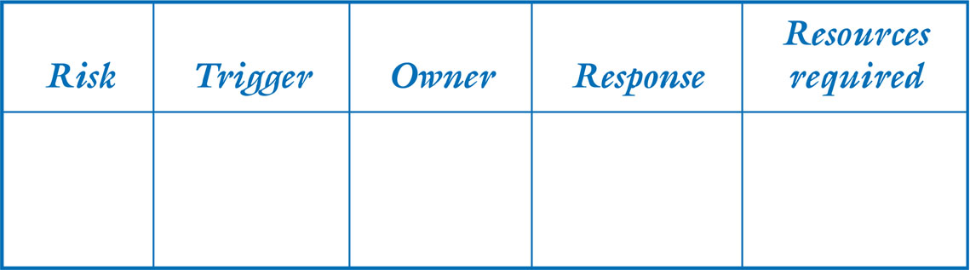
IT Project Risk Management Process
Risk Response Plan should include:
  The project risk
  The trigger which flags that the risk has occurred
  The owner of the risk (i.e., the person or group responsible for monitoring the risk and ensuring that the appropriate risk response is carried out)
  A risk response based on one of the four basic risk strategies
Figure 8.15

Slide 24
IT Project Risk Management Process
Risk Evaluation
  How did we do?
  What can we do better next time?
  What lessons did we learn?
  What best practices can be incorporated in the risk management process?

Slide 25
THANK YOU

