Slide 1
Information Technology Project Management
By
Denny Ganjar Purnama, MTI
Universitas Pembangunan Jaya
April 2014

Slide 2
Chapter 7
The Project Schedule and Budget

Slide 3
Learning Objectives
Describe the Project Management Body of Knowledge (PMBOK®) called Project Cost Management.
Develop a Gantt chart.
Develop a project network diagram using the activity on the node (AON) technique.
Identify a project’s critical path and explain why it must be controlled and managed.
Develop a PERT diagram.
Describe the concept of precedence diagramming and identify finish-to-start, start-to-start, finish-to-finish, and start-to-finish activity relationships.
Describe the various costs for determining the project’s budget.
Define what is meant by the baseline project plan.

Slide 4
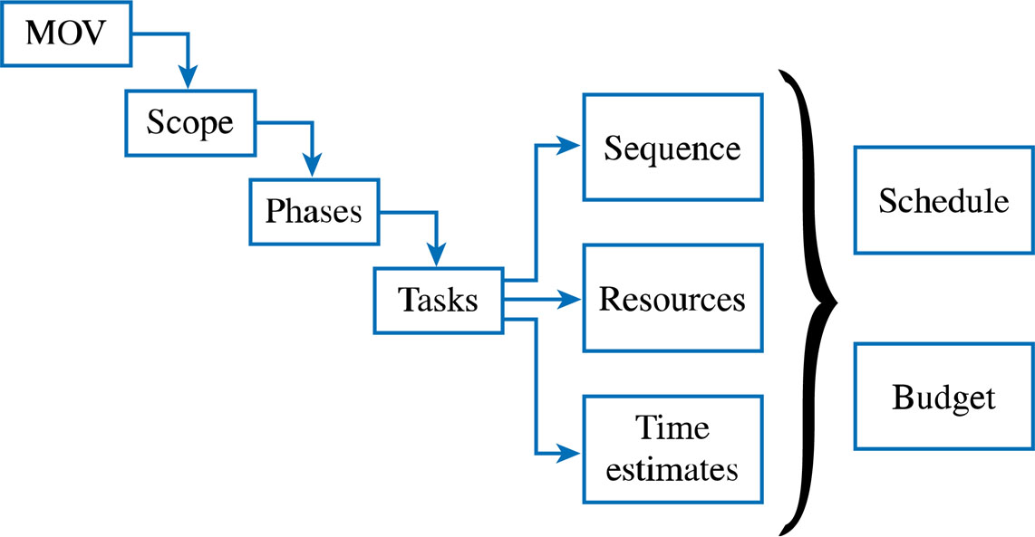
The Project Planning Framework

Slide 5
PMBOK®
Project Cost Management
Resource planning
Cost estimating
Cost budgeting
Cost control

Slide 7
Schedule Development
Put it all together to determine the start and end dates for the project
Iterations may be necessary
A realistic project schedule is the goal!

Slide 8
Developing the Project Schedule
Project Management Tools
  Gantt Charts
  Project Network Diagrams
    Activity on the Node (AON)
    Critical Path Analysis
    Program Evaluation and Review Technique (PERT)
    Precedence Diagramming Method (PDM)

Slide 9
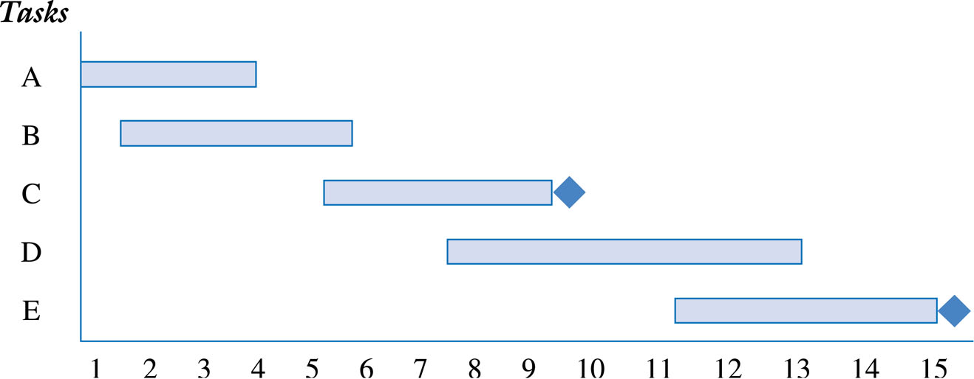
Gantt Chart for Planning

Slide 10
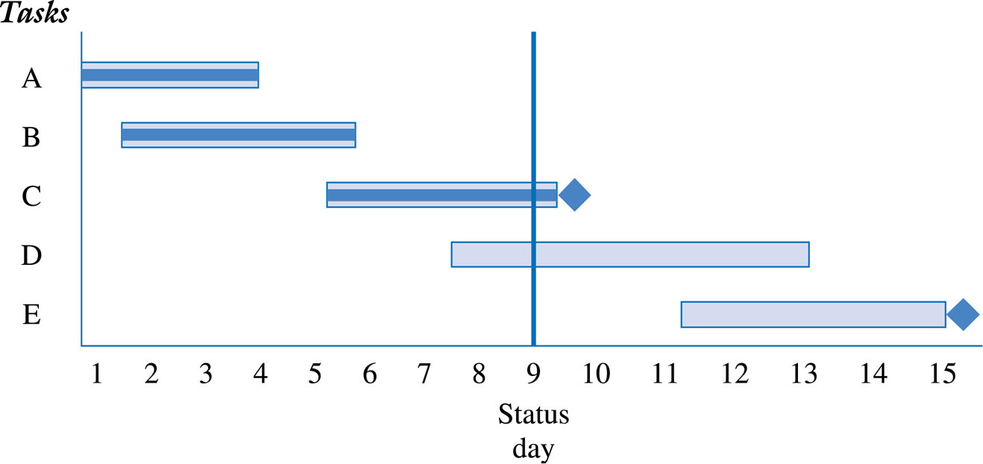
Gantt Chart Reporting
Project’s Progress

Slide 11
Activity Analysis for AON
(Activity On the Node)
Activity | Description | Estimated Duration (Days) | Predecessor
A | Evaluate current technology platform | 2 | None
B | Define user requirements | 5 | A
C | Design Web page layouts | 4 | B
D | Set-up Server | 3 | B
E | Estimate Web traffic | 1 | B
F | Test Web pages and links | 4 | C,D
G | Move web pages to production environment | 3 | D,E
H | Write announcement of intranet for corp. newsletter | 2 | F,G
I | Train users | 5 | G
J | Write report to management | 1 | H,I

Slide 12
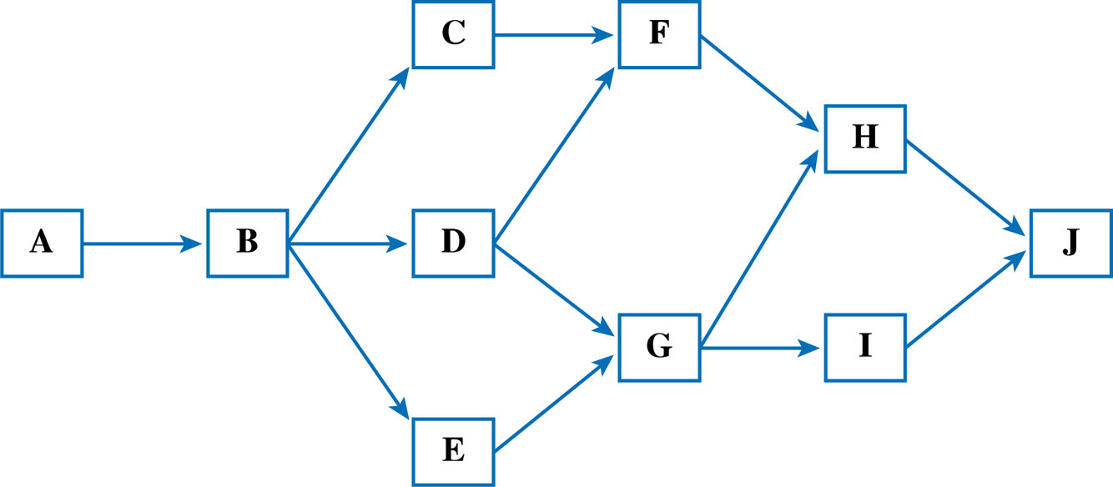
Activity on the Node (AON)
Network Diagram

Slide 13
Possible Activity Paths
Possible Paths | Path | Total
Path 1 | A+B+C+F+H+J | 18
 | 2+5+4+4+2+1
Path 2 | A+B+D+F+H+J | 17
 | 2+5+3+4+2+1
Path 3 | A+B+D+G+H+J | 16
 | 2+5+3+3+2+1
Path 4 | A+B+D+G+I+J | 19*
 | 2+5+3+3+5+1
Path 5 | A+B+E+G+I+J | 17
 | 2+5+1+3+5+1

Slide 14
Critical Path
Longest path
Shortest time project can be completed
  Zero slack (or float)
    The amount of time an activity can be delayed before it delays the project
Must be monitored and managed!
  Project manager can expedite or crash by adding resources
  Fast tracking – running activities in parallel which were originally planned as sequential
  The CP can change
  Can have multiple CPs

Slide 15
PERT
Program Evaluation and Review Technique
Developed in 1950s to help manage the Polaris Submarine Project
Developed about the same time as the Critical Path Method
  Often combined as PERT/CPM
Employs both a project network diagram with a statistical distribution

Slide 16
Activity Analysis for PERT
Activity | Predecessor | Optimistic Estimates (Days) | Most Likely Estimates (Days) | Pessimistic Estimates (Days) | Expected Duration (a+4b+c) 6
A | None | 1 | 2 | 4 | 2.2
B | A | 3 | 5 | 8 | 5.2
C | B | 2 | 4 | 5 | 3.8
D | B | 2 | 3 | 6 | 3.3
E | B | 1 | 1 | 1 | 1.0
F | C,D | 2 | 4 | 6 | 4.0
G | D,E | 2 | 3 | 4 | 3.0
H | F,G | 1 | 2 | 5 | 2.3
I | G | 4 | 5 | 9 | 5.5
J | H,I | .5 | 1 | 3 | 1.3

Slide 17
Possible PERT Activity Paths
Possible Paths | Path | Total
Path 1 | A+B+C+F+H+J | 18.8
 | 2.2+5.2+3.8+4.0+2.3+1.3
Path 2 | A+B+D+F+H+J | 18.3
 | 2.2+5.2+3.3+4.0+2.3+1.3
Path 3 | A+B+D+G+H+J | 18.6
 | 2.2+5.2+3.3+3.0+2.3+1.3
Path 4 | A+B+D+G+I+J | 20.5*
 | 2.2+5.2+3.3+3.0+5.5+1.3
Path 5 | A+B+E+G+I+J | 18.2
 | 2.2+5.2+1.0+3.0+5.5+1.3

Slide 18
Precedence Diagramming Method - PDM
Based on 4 fundamental relationships
  Finish-To-Start (FS)
  Start-To-Start (SS)
  Finish-To-Finish (FF)
  Start-To-Finish (SF)

Slide 19
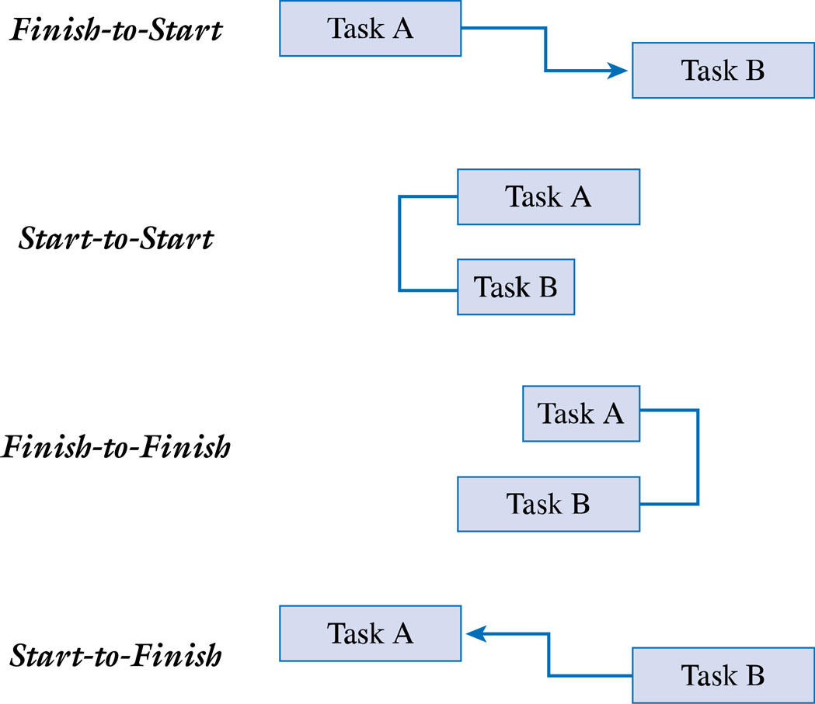
PDM Relationships

Slide 20
Lead and Lag times
Lead is starting the next task before the first task is complete
    Example: Begin installing the operating systems when half of the PCs are set up
Lag (or negative lead) is the adding of a buffer of time before the next task begins
    Example: Once the walls have been painted, wait one day before laying the carpet so that the walls have had a chance to dry

Slide 21
Developing the Project Budget
Define what resources will be needed to perform the work
Determine the quantity of resources that are needed
Define the cost of using each resource
Calculate the cost of the task or activity
Ensure that the resources are leveled, that is, resources have not been over allocated assigned to more than one task scheduled at the same time

Slide 22
Project Management Software Tools
A number of project management software tools are available to plan and track the progress of your project
However, having a fundamental understanding of these project management techniques is important to make the most of these software tools

Slide 23
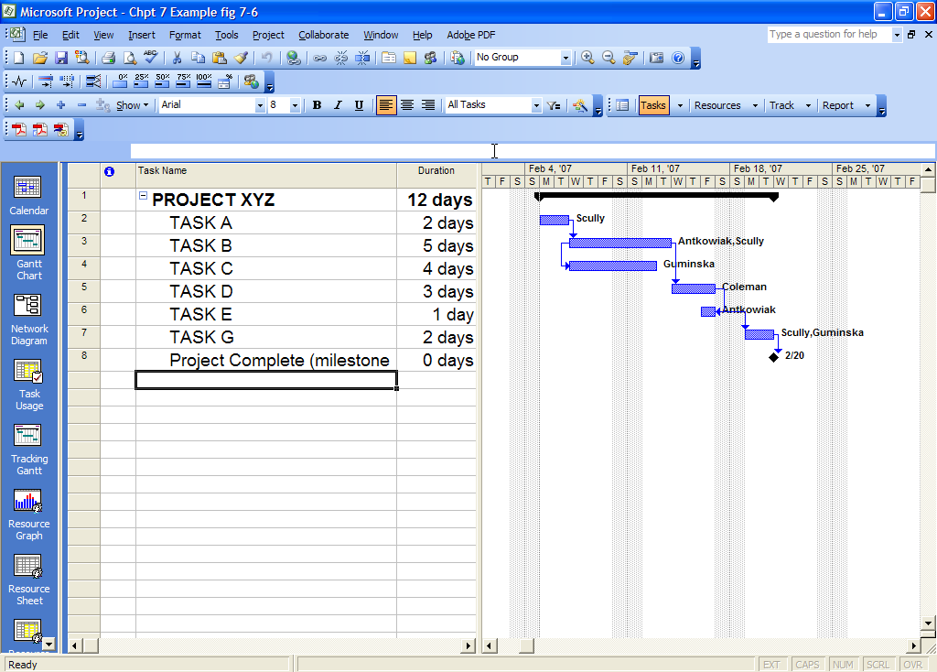
Microsoft Project ® 2003
Gantt Chart View

Slide 24
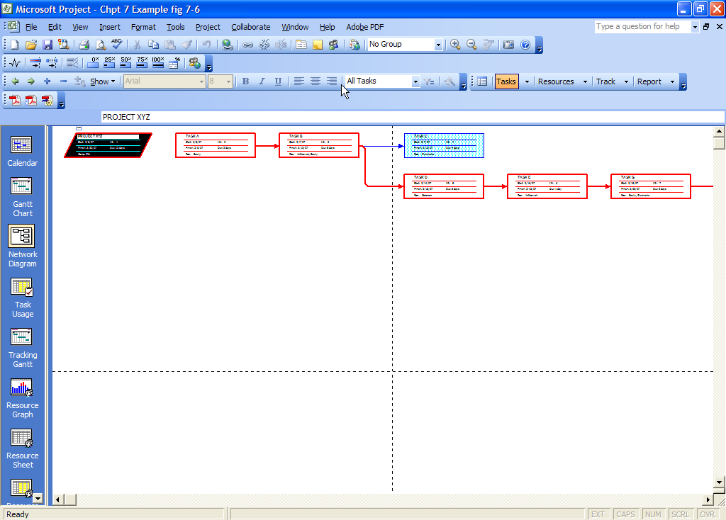
Microsoft Project® 2003
PERT Chart View

Slide 25
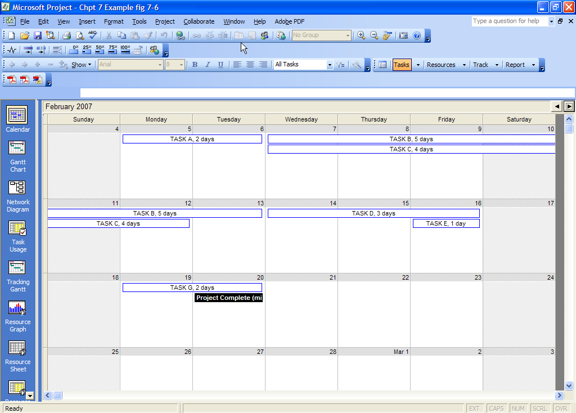
Microsoft Project® 2003
Calendar View

Slide 26
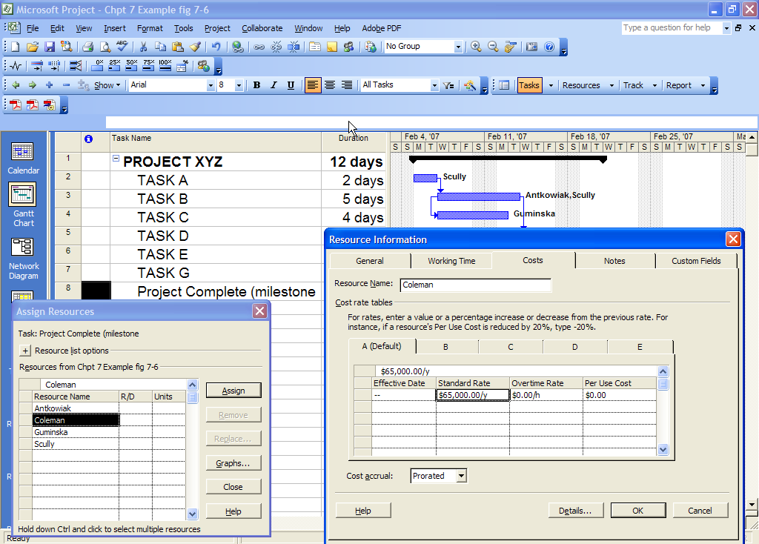
Microsoft Project® 2003
Adding Resources to A Project

Slide 27
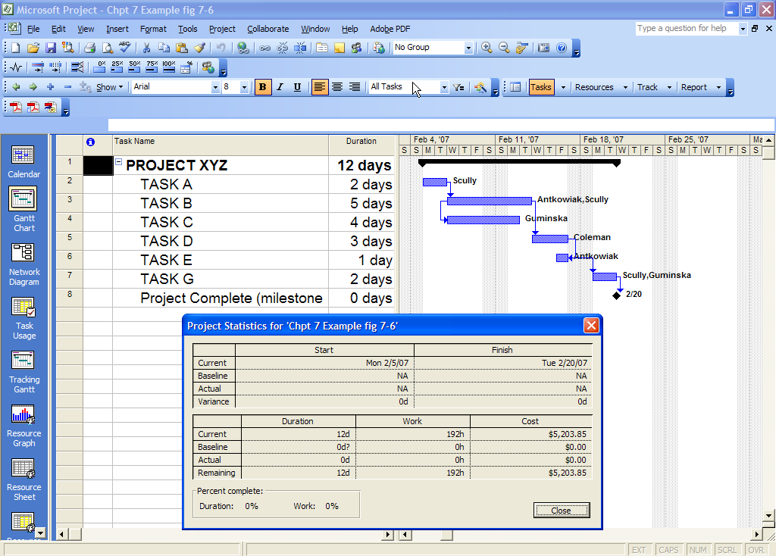
Microsoft Project® 2003
Project Status

Slide 28
Finalizing the Project Schedule and Budget
The project schedule and budget may require several iterations before it is acceptable to the sponsor, the project manager, and the project team
Once the project schedule and project plan are accepted, the project plan becomes the baseline plan.
Once accepted, the project manager and project team have the authority to execute or carry out the plan.

