Slide 1
Information Technology Project Management
by
Denny Ganjar Purnama, MTI
Universitas Pembangunan Jaya
April 2014

Slide 2
Chapter 6
The Work Breakdown Structure & Estimation

Slide 3
Learning Objectives
Develop a work breakdown structure (WBS).
Describe the difference between a deliverable and a milestone.
Describe and apply several project estimation methods. These include the Delphi technique, time boxing, top-down estimation, and bottom-up estimation.

Slide 4
Project Time Management as defined in PMBOK®
Activity definition
Activity sequencing
Activity duration estimation
Schedule development
Schedule control

Slide 5
The Work Breakdown Structure (WBS)
The WBS represents a logical decomposition of the work to be performed and focuses on how the product, service, or result is naturally subdivided. It is an outline of what work is to be performed.
Gregory T. Haugan (2002)

Slide 6
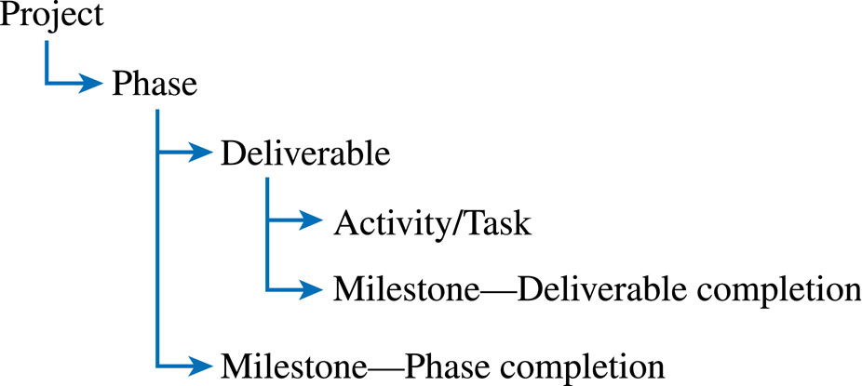
Work Package

Slide 7
Deliverables and Milestones
Deliverables => Object
  Tangible, verifiable work products
  Reports, presentations, prototypes, etc.
Milestones => Moment
  Significant events or achievements
  Acceptance of deliverables or phase completion
  Cruxes (proof of concepts)
  Quality control
  Keeps team focused

Slide 8
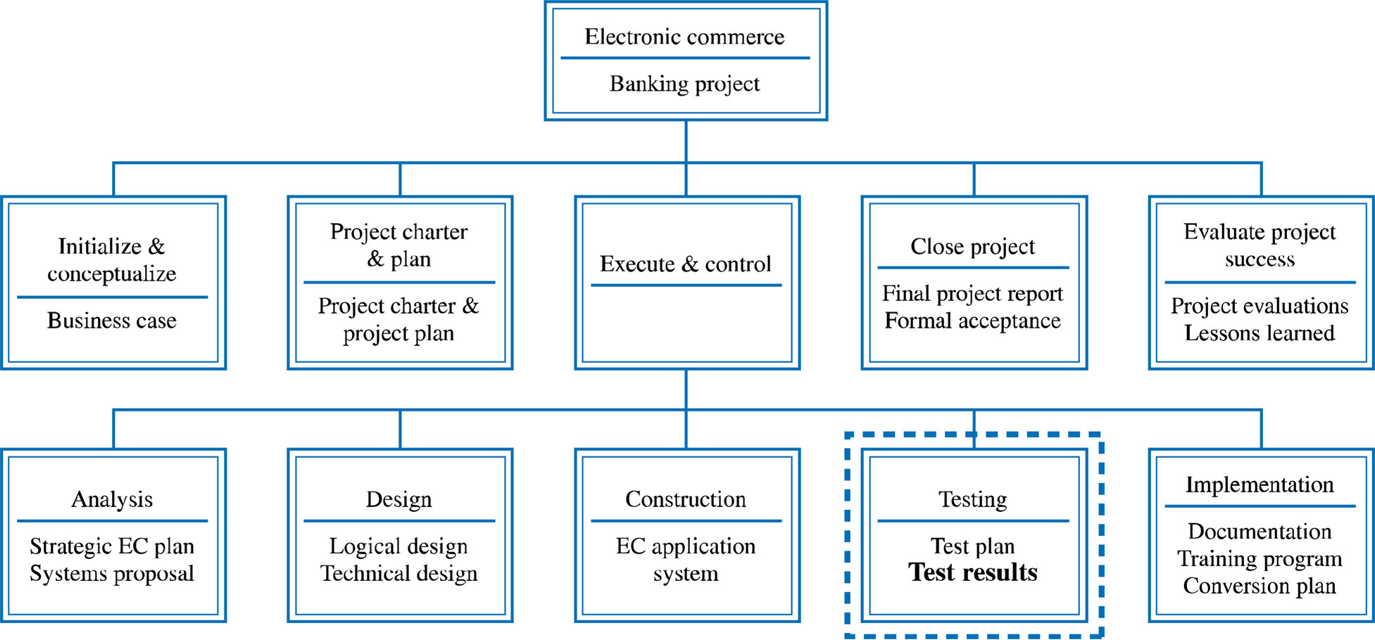
Developing the WBS
Develop work packages for each of the phases and deliverables defined in the Deliverable Structure Chart (DSC)

Slide 9
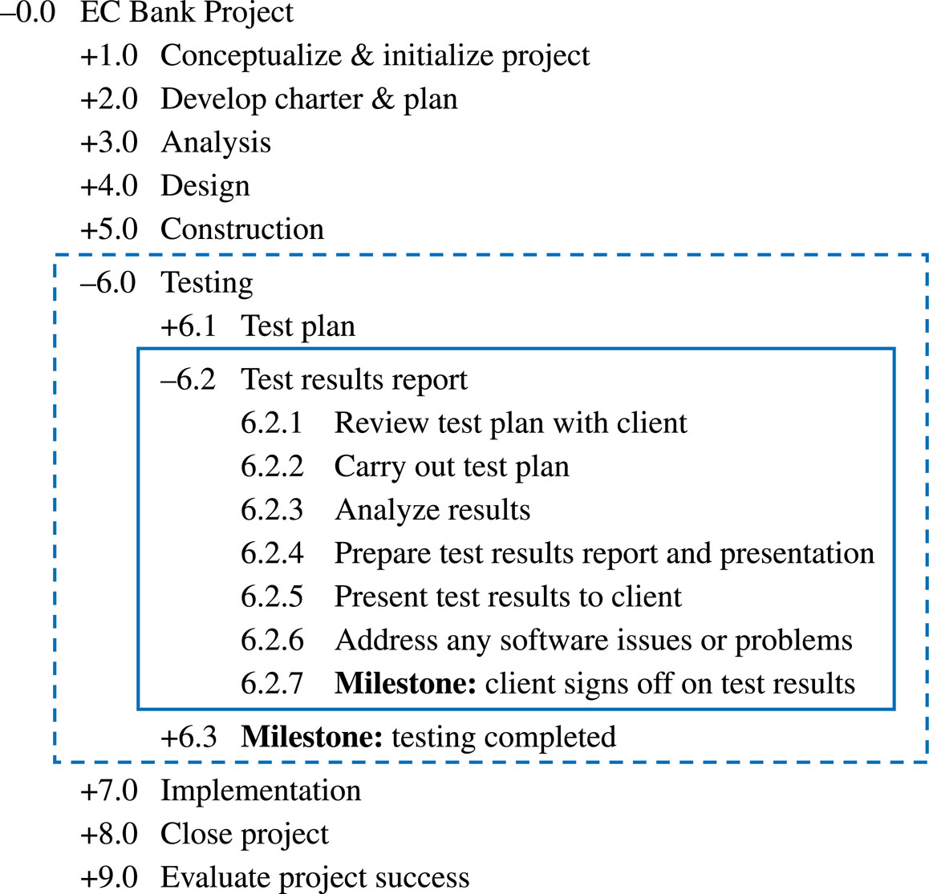
Example Work Breakdown Schedule

Slide 10
The WBS Should Follow the Work Package Concept

Slide 11
Developing the WBS
The WBS Should Be Deliverable-Oriented
The WBS Should Support the Project's MOV
  Ensure WBS allows for the delivery of all the project’s deliverables as defined in project scope
  100 percent rule
The Level of Detail Should Support Planning and Control
Developing the WBS Should Involve the People Who Will Be Doing the Work
Learning Cycles and Lessons Learned Can Support the Development of a WBS

Slide 12
Estimation Techniques
- The Project Management Approach
Guesstimating
Delphi Technique
Time Boxing
Top-Down
Bottom Up
Analogous Estimates (Past experiences)
Parametric Modeling (Statistical)

Slide 13
Project Estimation
Guesstimating
  Based on feeling and not facts
  Not a good method for estimating but often used by inexperienced project managers
Delphi Technique
  Involves multiple, anonymous experts
  Each expert makes an estimate
  Estimates compared
    If close, can be averaged
    Another iteration until consensus is reached

Slide 14
Project Estimation
Time Boxing
  A “box” of time is allocated for a specific activity, task, or deliverable
  Can focus a team if used effectively
  Can demoralize a team if used too often or ineffectively because of the increased stress or pressure on the project team to get things done

Slide 15
Project Estimation
Top-Down Estimating
  Top and middle managers determine overall project schedule and/or cost.
  Lower level managers are expected to breakdown schedule/budget estimates into specific activities (WBS).
  Often couched in terms of what a project should cost and how long it should take as decreed by a member of top management who thinks those parameters are appropriate.
  May be a response to the business environment.
  May lead to a death march project.

Slide 16
Project Estimation
Bottom-Up Estimating
  Most common form of project estimation
  Schedules & budgets are constructed from the WBS
  Starts with people who will be doing the work
  Schedules & budgets are the aggregate of detailed activities & costs

Slide 17
Project Estimation
Analogous estimating
  based on similarity between current projects and others
  Use information from previous, similar projects as a basis for estimation

Slide 18
Project Estimation
Parametric Modeling
  Use project characteristics (parameters) in a mathematical model to estimate
  Example: $50 / LOC based on:
    Programming language
    Level of expertise
    Size & complexity

Slide 19
Example WBS with Estimated Task Durations
6.2 Test Results Report
6.2.1 Review test plan with client 1 day
6.2.2 Carry out test plan 5 days
6.2.3 Analyze results 2 days
6.2.4 Prepare test results report and presentation 3 days
6.2.5 Present test results to client 1 day
6.2.6 Address any software issues or problems 5 days

