Slide 1
Information Technology Project Management
by
Denny Ganjar Purnama, MTI
Universitas Pembangunan Jaya
April 2014

Slide 2
Chapter 5
Defining and Managing Project Scope

Slide 3
Learning Objectives
Identify the five processes that support project scope management. These processes, defined by PMBOK®, include initiation, planning, scope definition, scope verification and scope change control.
Describe the difference between product scope and project scope.
Apply several tools and techniques for defining and managing the project’s scope.

Slide 4
Scope
The deliverables or work products that must be completed in order to achieve the project’s MOV.
Provides a boundary so that what needs to get done – gets done.
  Otherwise, schedule and budget are increased for no reason
Defines what is part of the project team’s work and what is not.
  This also sets expectations for all of the project’s stakeholders
Provides a link between the project’s MOV and the project plan.

Slide 5
PMBOK Scope Management Processes
Scope Management Process | Description
Scope Planning | The development of a scope management plan that defines the project’s scope and how it will be verified and controlled throughout the project.
Scope Definition | A detailed scope statement that defines what work will and will not be part of the project and will serve as a basis for all future project decisions
Create Work Breakdown Structure (WBS) | The decomposition or dividing of the major project deliverables into smaller and more manageable components.
Scope Verification | Confirmation and formal acceptance that the project’s scope is accurate, complete, and supports the project’s MOV.
Scope Change Control | Ensuring that controls are in place to manage proposed scope changes once the project’s scope is set. These procedures must be communicated to all project stakeholders.

Slide 6
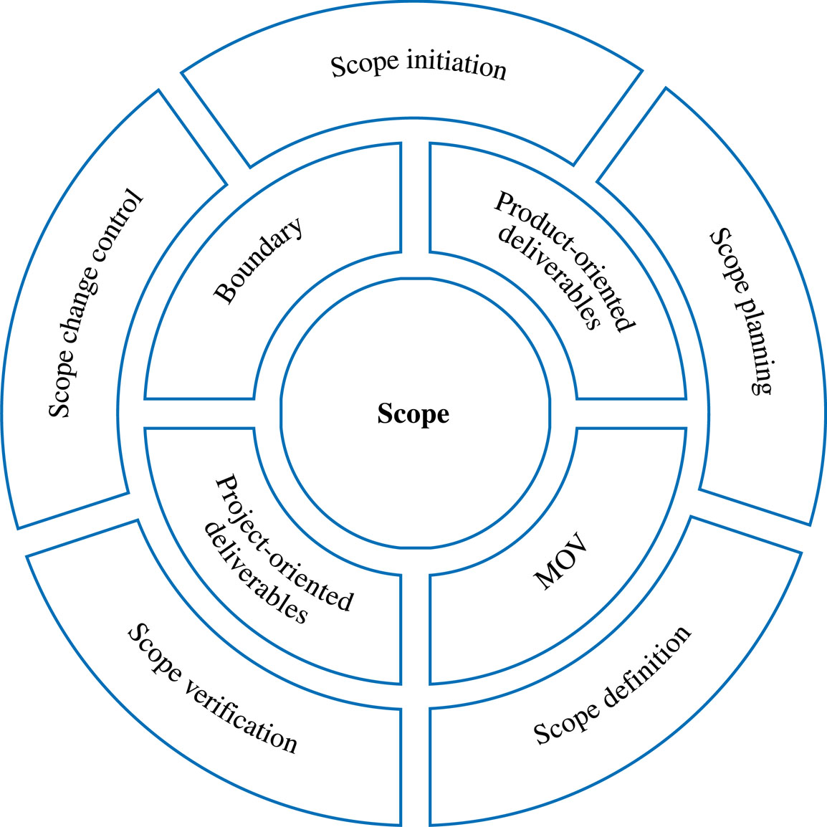
Scope Management Plan
Figure 5.1

Slide 7
Project Scope Initiation & Planning
A beginning process that formally authorizes the project manager and team to develop the scope management plan
This entails :
  Conceptualizing the Scope Boundary
  Developing the Scope Statement

Slide 8
The Scope Statement
A narrative of what deliverables or work-products the project team will and will not provide throughout the project.
A first step that provides a high-level abstraction of the project’s scope that will be defined in greater detail as the project progresses.

Slide 9
Scope Statement Example
Develop a proactive electronic commerce strategy that identifies the processes, products and services to be delivered through the World Wide Web.
Develop an application system that supports all of the processes, products and services identified in the electronic commerce strategy.
The application system must integrate with the bank’s existing enterprise resource planning system.
Technology and organizational assessment of the current environment
Customer resource management and data mining components

Slide 10
Project Scope Definition
Project-Oriented Scope
  Deliverables that support the project management and IT development processes defined in the Information Technology Project Methodology (ITPM).
  Examples
    Business case, project charter and project plan, etc.
Product-Oriented Scope
  High-level features and functionality of the application system
  First cut for requirements definition that will be defined in greater detail during the systems development life cycle (SDLC)
  Examples
    Add new customer, look up customer balance, print daily sales report by region, etc.

Slide 11
Project-Oriented Scope Definition Tools
Deliverable Definition Table (DDT)
Deliverable Structure Chart (DSC)
Product-Oriented Scope Definition Tools
Context Dataflow Diagram (DFD)
Use Case Diagram (USD)

Slide 12
Scope Verification
Ensures:
  That the project’s scope is well-defined, accurate and complete
  The project’s scope is acceptable to the project stakeholders
  That standards exist so that the project’s scope will be completed correctly
  That the project’s MOV will be achieved if the project scope is completed
Tools
  Scope Verification Checklist

Slide 13
Scope Change Control
Ensures that any changes to the project’s scope will help the project achieve its MOV.
Keeps the “triple constraint” in balance.
  i.e., an increase in scope will require an increase in the project’s schedule and budget.
Scope
Schedule
Budget

Slide 14
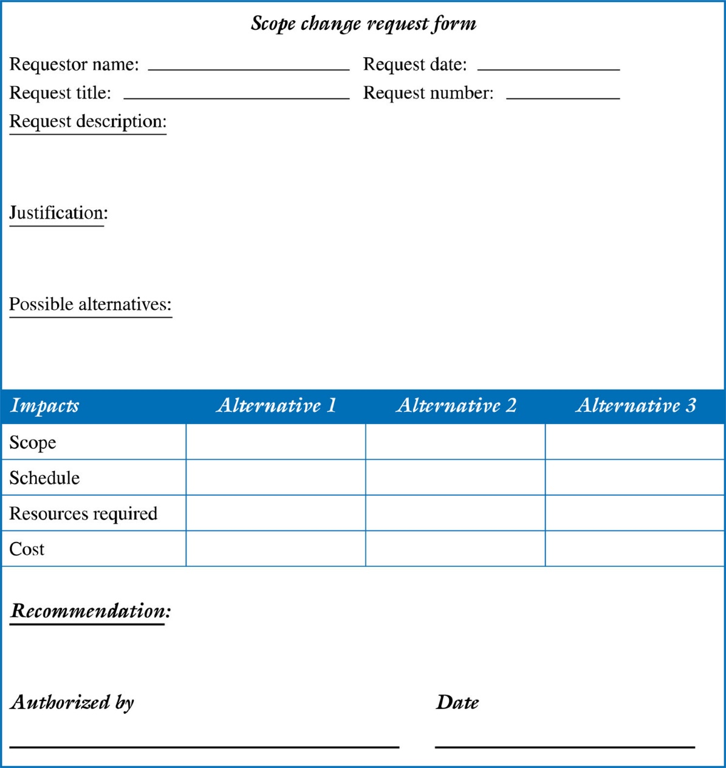
Example of a Scope Change Request Form

Slide 15
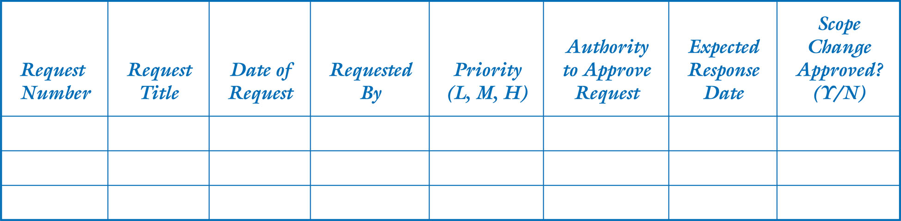
Example of a Scope Change Request Log

