Slide 1
Information Technology
Project Management
By Denny Ganjar Purnama, MTI
Universitas Pembangunan Jaya – April 2014

Slide 2
Developing the Project Charter & Baseline Project Plan
Chapter 3

Slide 3
Learning Objectives
Describe the five project management processes and how they support each phase of the project life cycle.
Define the project management knowledge area called project integration management and describe its role in project plan development, project plan execution, and overall change control.
Develop a project charter and describe its relationship to the project plan.
Identify the steps in the project planning framework introduced in this chapter and describe how this framework links the project’s measurable organizational value (MOV) to the project’s scope, schedule, and budget.

Slide 4
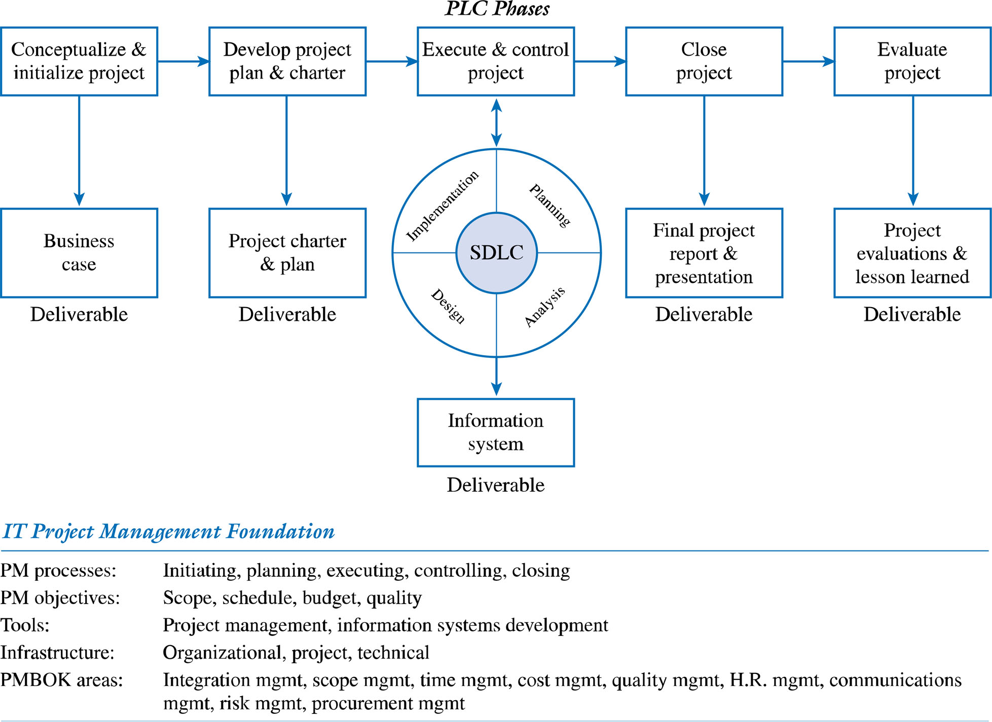
An IT Project Methodology
Figure 2.1

Slide 5
The Business Case has been approved, but…
Who is the project manager?
Who is the project sponsor?
Who is on the project team?
What role does everyone associated with the project play?
What is the scope of the project?
How much will the project cost?
How long will it take to complete the project?
What resources and technology will be required?
What approach, tools, and techniques will be used to develop the information system?
What tasks or activities will be required to perform the project work?
How long will these tasks or activities take?
Who will be responsible for performing these tasks or activities?
What will the organization receive for the time, money, and resources invested in this project?

Slide 6
PMBOK - Definition
Process
  A set of interrelated actions and activities that are performed to achieve a pre-specified set of products, results, or services

Slide 7


Projects versus Processes
Processes are ongoing
    If you’re building cars on an assembly line, that’s a process!
    If you’re designing and building a prototype of a specific car model, that’s a project!

Slide 8
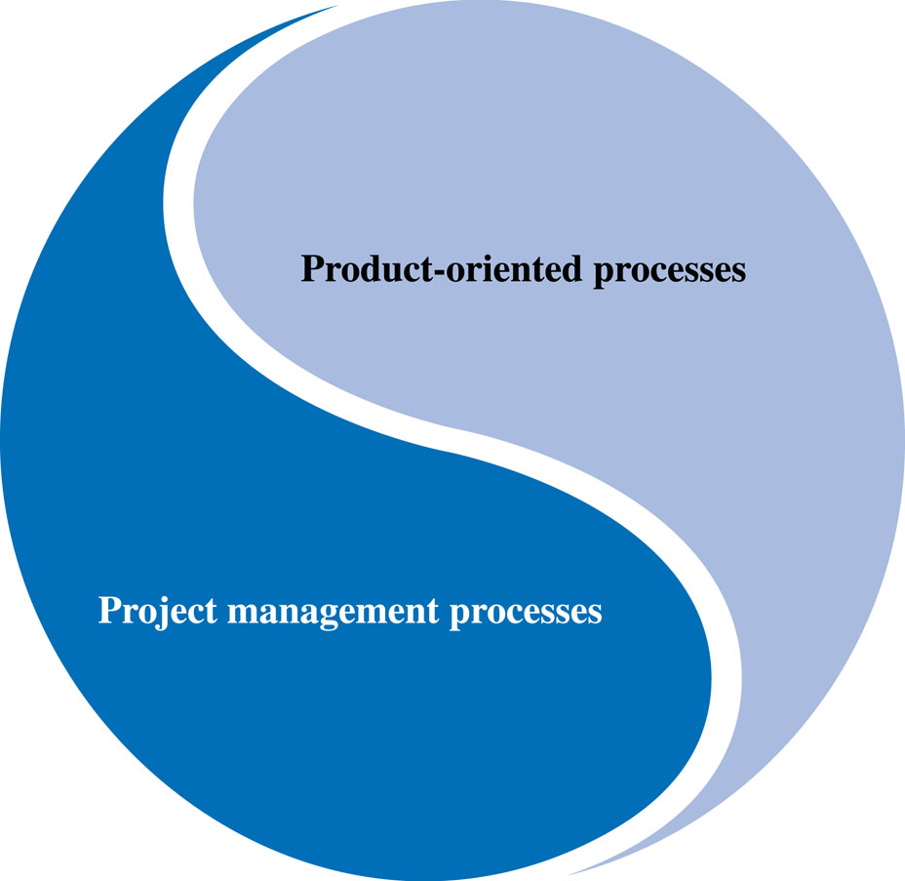
Project Management Processes
Project vs. Product Management processes
Figure 3.1

Slide 9
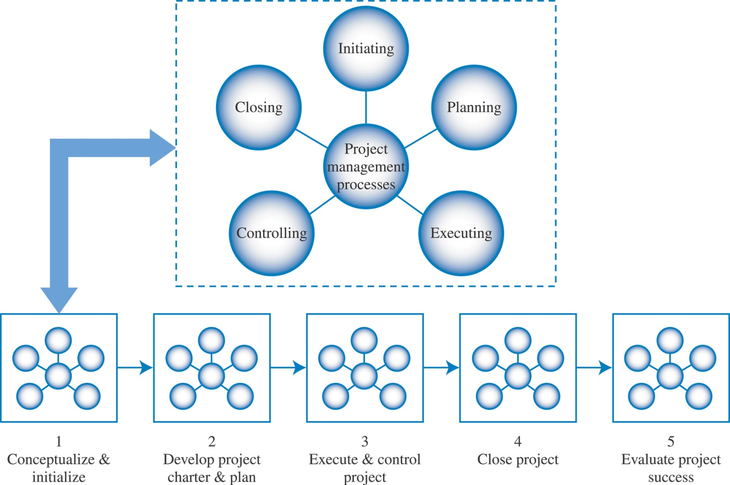
Project Management Processes and ITPM Phases
Figure 3.2

Slide 10
Project Management Process Groups
  Initiating
    Signals the beginning of the project or a phase
  Planning
    Supports planning of the entire project and each individual phase
  Executing
    Focuses on integrating people and resources to carry out the planned activities of the project plan or phase
  Monitoring & Controlling
    Allows for managing and measuring progress towards the project’s MOV and scope, schedule, budget, and quality objectives.
    Also allows the project manager and team to measure and keep an eye on project variances between actual and planned results so that appropriate corrective actions can be taken when necessary.
  Closing
    Provides a set of processes for formally accepting the project’s product, service, or end result so that the project or phase can be brought to an orderly end

Slide 11
Project Integration Management
Integration, in the context of managing a project, is making choices about where to concentrate resources and effort on any given day, anticipating potential issues, dealing with these issues before they become critical, and coordinating work for the overall project good. The integration effort also involves making trade-offs among competing objectives and alternatives. (77)

Slide 12
Project Integration Processes
Develop Project Charter
Develop Preliminary Scope Statement
Develop Project Management Plan
Direct & Manage Project Execution
Monitor and Control Project Work
Integrate Change Control
Close Project

Slide 13
The Project Charter
Together with the baseline project plan, provides a tactical plan for carrying out the project
Serves as an agreement or contract between the project sponsor and team
Provides a framework for project governance

Slide 14
The Project Charter
Documents the project’s MOV
Defines the project infrastructure
Summarizes the details of the project plan
Defines roles & responsibilities
Shows explicit commitment to the project
Sets out project control mechanisms

Slide 15
What Should Be in a Project Charter?
Project ID
Project Stakeholders
Project Description
MOV
Project Scope
Project Schedule (summary)
Project Budget (summary)
Quality issues/standards/requirements
Resources
Assumptions & Risks
Project Administration
Acceptance & Approval
References
Terminology (acronyms & definitions)

Slide 16
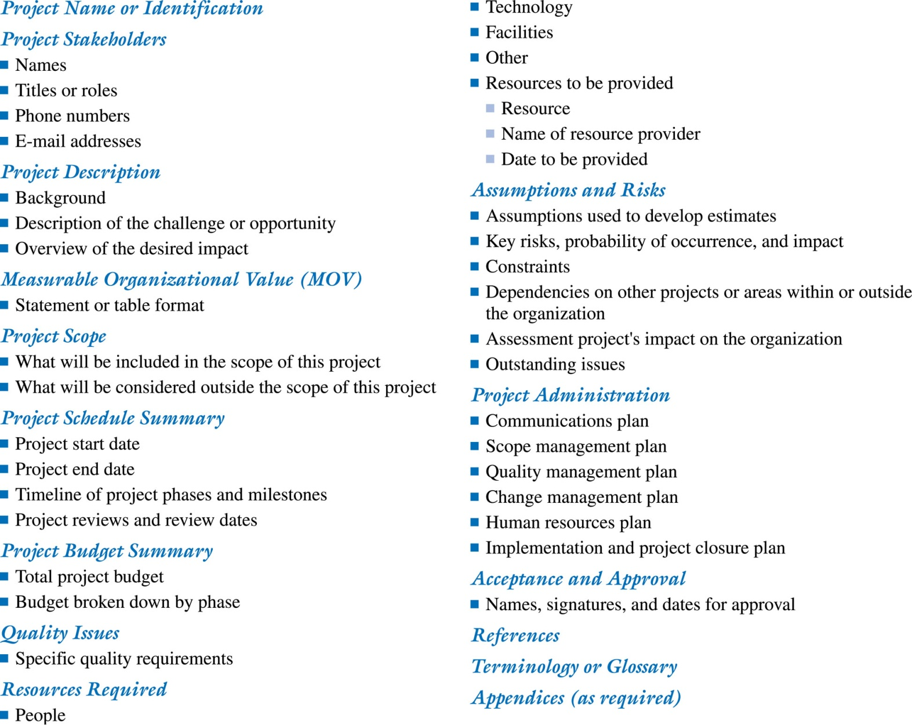
Project Charter Template

Slide 17
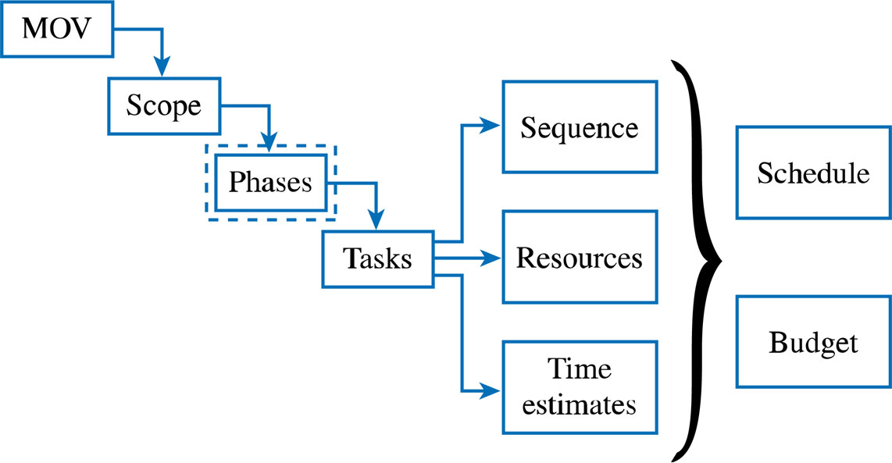
Project Planning Framework
Figure 3.4

Slide 18
Project Planning Framework
The MOV
Define the Project’s Scope
  Initiation
  Planning
  Definition
  Verification
  Change Control

Slide 19
Project Planning
Framework – cont’d.
Subdivide the Project into Phases
Tasks-Sequence, Resources, and Time Estimates
  Sequence
  Resources
  Time
Schedule and Budget-The Baseline Plan

Slide 20
The Kick-Off Meeting
Officially starts the work on the project (secara resmi pekerjaan proyek dimulai)
Brings closure to the planning phase (merupakan penutupan dari fase perencanaan)
Communicates to all what the project is about (mengkomunikasikan segala hal kepada semuanya tentang proyek)
Energizes stakeholders (memberikan energi kepada stakeholder)
Engenders positive attitudes (menimbulkan sikap positif)

Slide 21
THANK YOU

