Slide 1
Information Technology Project Management
by
Denny Ganjar Purnama, MTI
Universitas Pembangunan Jaya
April 2014

Slide 2
Chapter 2
Conceptualizing and Initializing The IT Project
(Business Case)

Slide 3
Learning Objectives
Define what a methodology is and describe the role it serves in IT projects.
Identify the phases and infrastructure that makes up the IT project methodology.
Develop and apply the concept of a project’s measurable organizational value (MOV).
Describe and be able to prepare a business case.
Distinguish between financial models and scoring models.
Describe the project selection process as well as the Balanced Scorecard approach.

Slide 4
Methodology
A strategic level plan for managing and controlling IT projects.
A template for initiating, planning and developing an information system.
Recommends:
  phases
  deliverables
  processes
  tools
  knowledge areas
Must be flexible and include best “practices” learned from experiences over time.

Slide 5
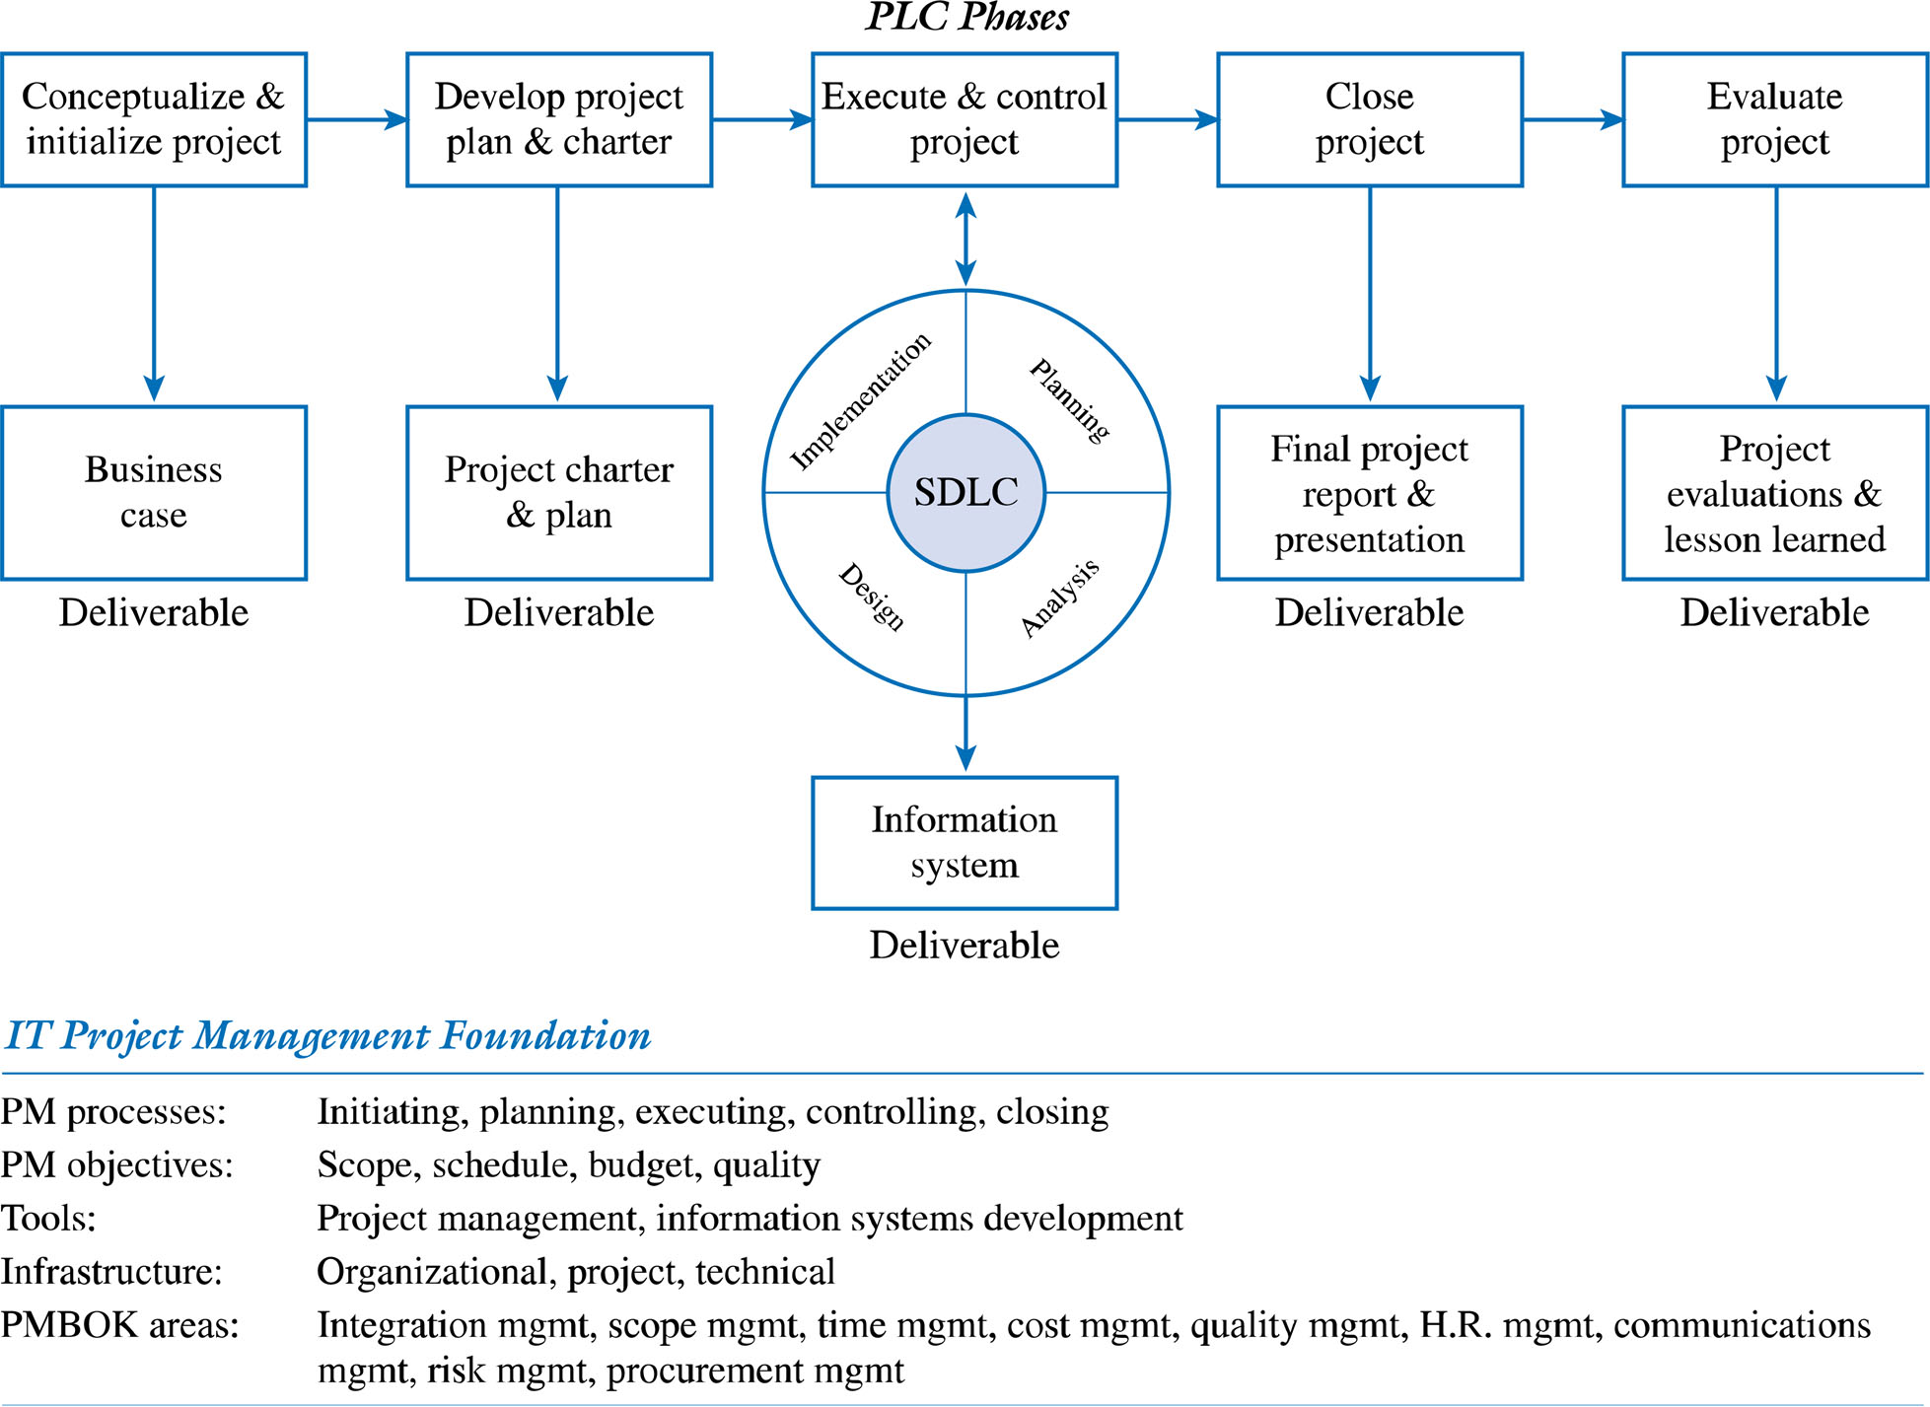
An IT Project Methodology

Slide 6
Phases
Phase 1: Conceptualize and Initialize
Phase 2: Develop the Project Charter and Detailed Project Plan defined in terms of project’s:
  scope
  schedule
  budget
  quality objectives

Slide 7
Phases continued
Phase 3: Execute and Control the Project using approach such as the SDLC
Phase 4: Close Project
Phase 5: Evaluate Project Success
  Post mortem by project manager and team of entire project
  Evaluation of team members by project manager
  Outside evaluation of project, project leader and team members
  Evaluate project’s organizational value

Slide 8
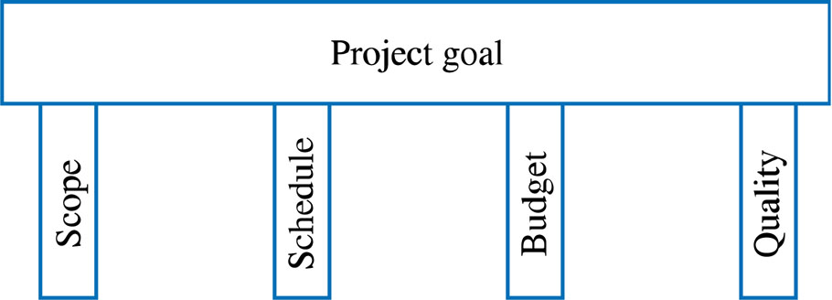
IT Project Management Foundation
Project Management Processes
  Initiating processes
  Planning processes
  Executing processes
  Controlling processes
  Closing processes
Project Objectives

Slide 9
IT Project Management Foundation
Tools - e.g. CASE, Visio, Microsoft Project, etc
Infrastructure
  Organizational Infrastructure
  Project Infrastructure
    Project Environment
    Roles and Responsibilities of team members
    Processes and Controls
  Technical Infrastructure
Project Management Knowledge Areas

Slide 10
The Business Case
Definition of Business Case: an analysis of the organizational value, feasibility, costs, benefits and risks of the project plan.
Attributes of a good Business Case
  Details all possible impacts, costs, benefits
  Clearly compares alternatives
  Objectively includes all pertinent information
  Systematic in terms of summarizing findings

Slide 11
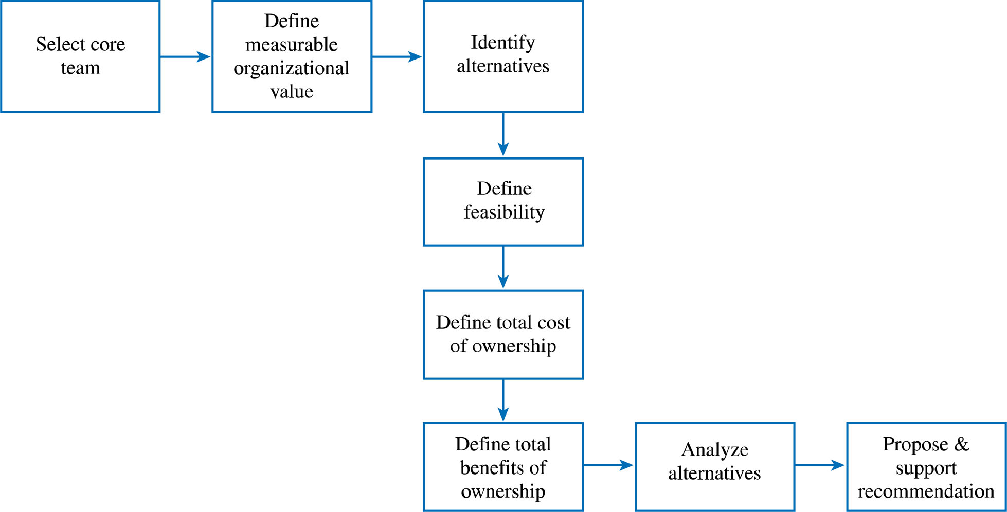
Process for Developing the Business Case

Slide 12
Developing the Business Case
Step 1: Select the Core Team
Advantages:
    Credibility
    Alignment with organizational goals
    Access to the real costs
    Ownership
    Agreement
    Bridge building

Slide 13
Developing the Business Case
Step 2: Define Measurable Organizational Value (MOV) - the project’s overall goal.

Slide 14
Measurable Organizational Value (MOV)
The project’s goal
Measure of success
Must be measurable
Provides value to the organization
Must be agreed upon
Must be verifiable at the end of the project
Guides the project throughout its life cycle
Should align with the organization’s strategy and goals

Slide 15
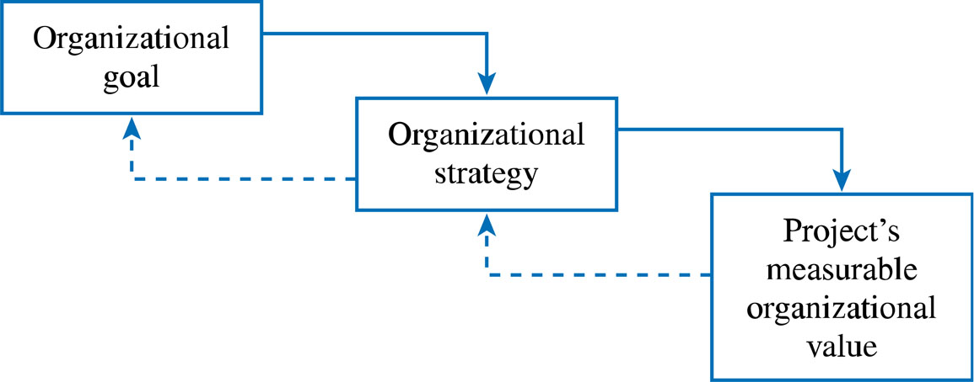
The IT Value Chain

Slide 16
Process for Developing the MOV
Identify the desired area of impact (dampak area yg diinginkan)
Potential Areas:
Strategic
Customer
Financial
Operational
Social

Slide 17
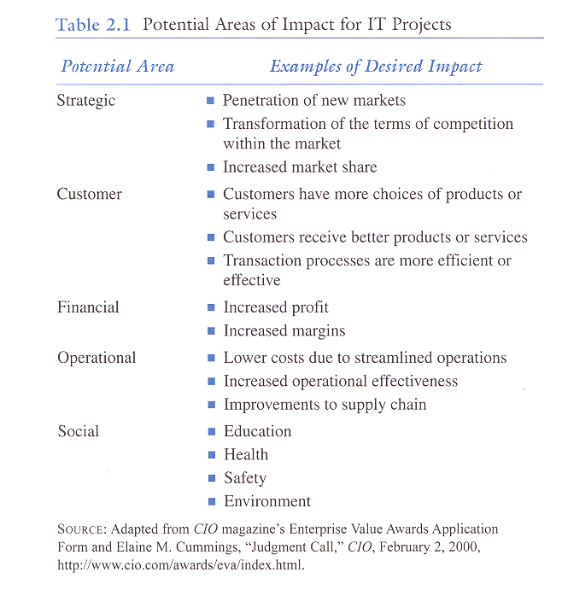

Slide 18
Process for Developing the MOV
Identify the desired value of the IT project (Nilai-nilai yg diinginkan)
Organizational Value:
Better?
Faster?
Cheaper?
Do More? (growth)

Slide 19
Process for Developing the MOV
Develop an Appropriate Metric (metrik yg tepat)
      Should it increase or decrease?
Metrics:
Money ($ £ ¥ )
Percentage (%)
Numeric Values

Slide 20
Process for Developing the MOV
Set a time frame for achieving the MOV
    When will the MOV be achieved?

Slide 21
Process for Developing the MOV
Verify and get agreement from the project stakeholders
  Project manager and team can only guide the process

Slide 22
Process for Developing the MOV
Summarize the MOV in a clear, concise statement or table.
This project will be successful if _________________.
MOV: The B2C project will provide a 20% return on
investment and 500 new customers within the
first year of its operation

Slide 23
Year | MOV
1 | 20% return on investment 500 new customers
2 | 25% return on investment 1,000 new customers
3 | 30% return on investment 1,500 new customers
Example MOV Using Table Format

Slide 24
Project Goal ?
Install new hardware and software to improve our customer service to world class levels.
Respond to 95% of our customers’ inquiries within 90 seconds with less than 5% callbacks about the same problem.
versus

Slide 25
A Really Good Goal
Our goal is to land a man on the moon and return him safely by the end of the decade.
John F. Kennedy

Slide 26
Developing the Business Case
Step 3: Identify Alternatives
  Base Case Alternative
  Possible Alternative Strategies
    Change existing process without investing in IT
    Adopt/Adapt systems from other organizational areas
    Reengineer Existing System
    Purchase off-the-shelf Applications package
    Custom Build New Solution

Slide 27
Developing the Business Case
Step 4: Define Feasibility and Asses Risk
  Economic feasibility
  Technical feasibility
  Organizational feasibility
  Other feasibilities
  Risk focus on :
  Identification
  Assessment
  Response

Slide 28
Developing the Business Case
Step 5: Define Total Cost of Ownership
  Direct or Up-front costs
  Ongoing Costs
  Indirect Costs

Slide 29
Developing the Business Case
Step 6: Define Total Benefits of Ownership
  Increasing high-value work
  Improving accuracy and efficiency
  Improving decision-making
  Improving customer service

Slide 30
Developing the Business Case
Step 7: Analyze Alternatives using financial models and scoring models
  Payback :
Payback Period = Initial Investment
Net Cash Flow
= $100,000
$20,000
= 5 years

Slide 31
Developing the Business Case
  Break Even :
Materials (putter head, shaft, grip, etc.) | $12.00
Labor (0.5 hours at $9.00/hr) | $ 4.50
Overhead (rent, insurance, utilities, taxes, etc.) | $ 8.50
Total | $25.00
If you sell a golf putter for $30.00 and it costs $25.00 to make, you have a profit margin of $5.00:
Breakeven Point = Initial Investment / Net Profit Margin
= $100,000 / $5.00
= 20,000 units

Slide 32
Developing the Business Case
  Return on Investment :
Project ROI =(total expected benefits – total expected costs)
total expected costs
= ($115,000 - $100,000)
$100,000
= 15%

Slide 33
Developing the Business Case
  Net Present Value :
 | Year 0 | Year 1 | Year 2 | Year 3 | Year 4
Total Cash Inflows | $0 | $150,000 | $200,000 | $250,000 | $300,000
Total Cash Outflows | $200,000 | $85,000 | $125,000 | $150,000 | $200,000
Net Cash Flow | ($200,000) | $65,000 | $75,000 | $100,000 | $100,000
NPV = -I₀ + Σ (Net Cash Flow / (1 + r)^{t})
Where:
I = Total Cost or Investment of the Project
r = discount rate
t = time period

Slide 34
Developing the Business Case
  Net Present Value :
Time Period | Calculation | Discounted Cash Flow
Year 0 | ($200,000) | ($200,000)
Year 1 | $65,000/(1 + .08)¹ | $60,185
Year 2 | $75,000/(1 + .08)² | $64,300
Year 3 | $100,000/(1 + .08)³ | $79,383
Year 4 | $100,000/(1 + .08)⁴ | $73,503
Net Present Value (NPV) |  | $77,371

Slide 35
Criterion |  | Weight | Alternative A | Alternative B | Alternative C
Financial | ROI | 15% | 2 | 4 | 10
 | Payback | 10% | 3 | 5 | 10
 | NPV | 15% | 2 | 4 | 10
Organizational | Alignment with strategic objectives | 10% | 3 | 5 | 8
 | Likelihood of achieving project’s MOV | 10% | 2 | 6 | 9
Project | Availability of skilled team members | 5% | 5 | 5 | 4
 | Maintainability | 5% | 4 | 6 | 7
 | Time to develop | 5% | 5 | 7 | 6
 | Risk | 5% | 3 | 5 | 5
External | Customer satisfaction | 10% | 2 | 4 | 9
 | Increased market share | 10% | 2 | 5 | 8
Total Score |  | 100% | 2.65 | 4.85 | 8.50
Notes: Risk scores have a reverse scale – i.e., higher scores for risk imply lower levels of risk

Slide 36
Developing the Business Case
Step 8: Propose and Support the Recommendation

Slide 37
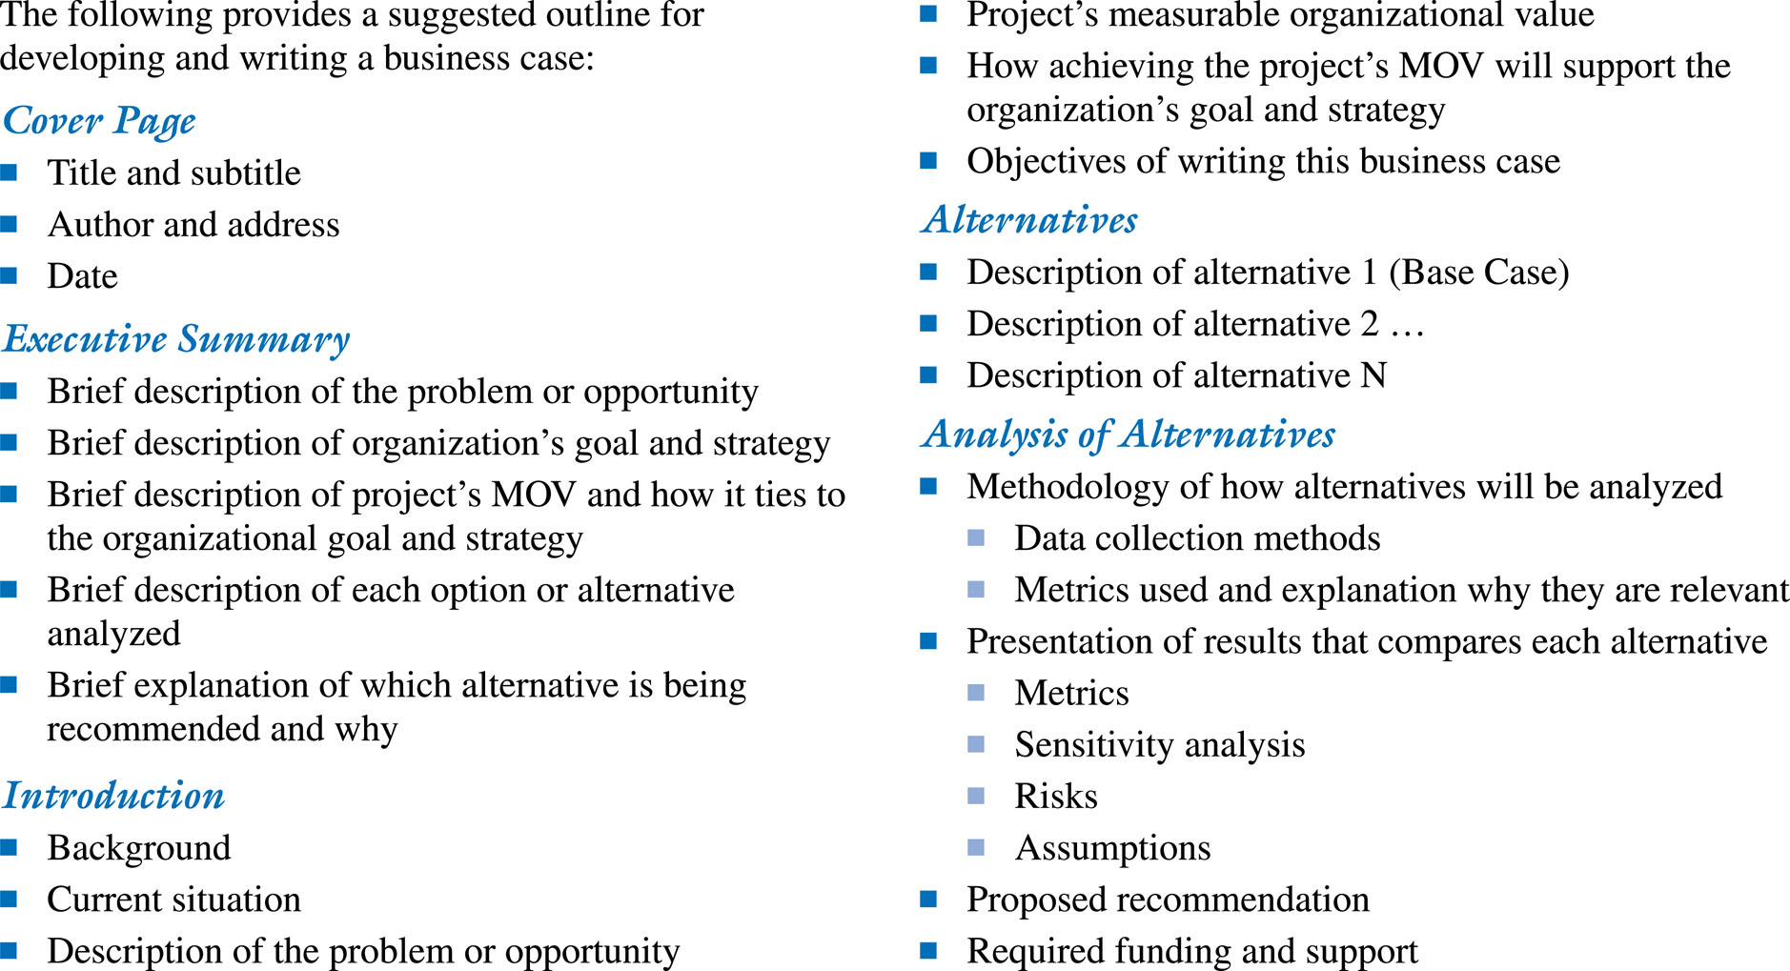
Business Case Template

Slide 38
Project Selection and Approval
The IT Project Selection Process
The Project Selection Decision
  IT project must map to organization goals
  IT project must provide verifiable MOV
  Selection should be based on diverse measures such as
    tangible and intangible costs and benefits
    various levels throughout the organization

Slide 39
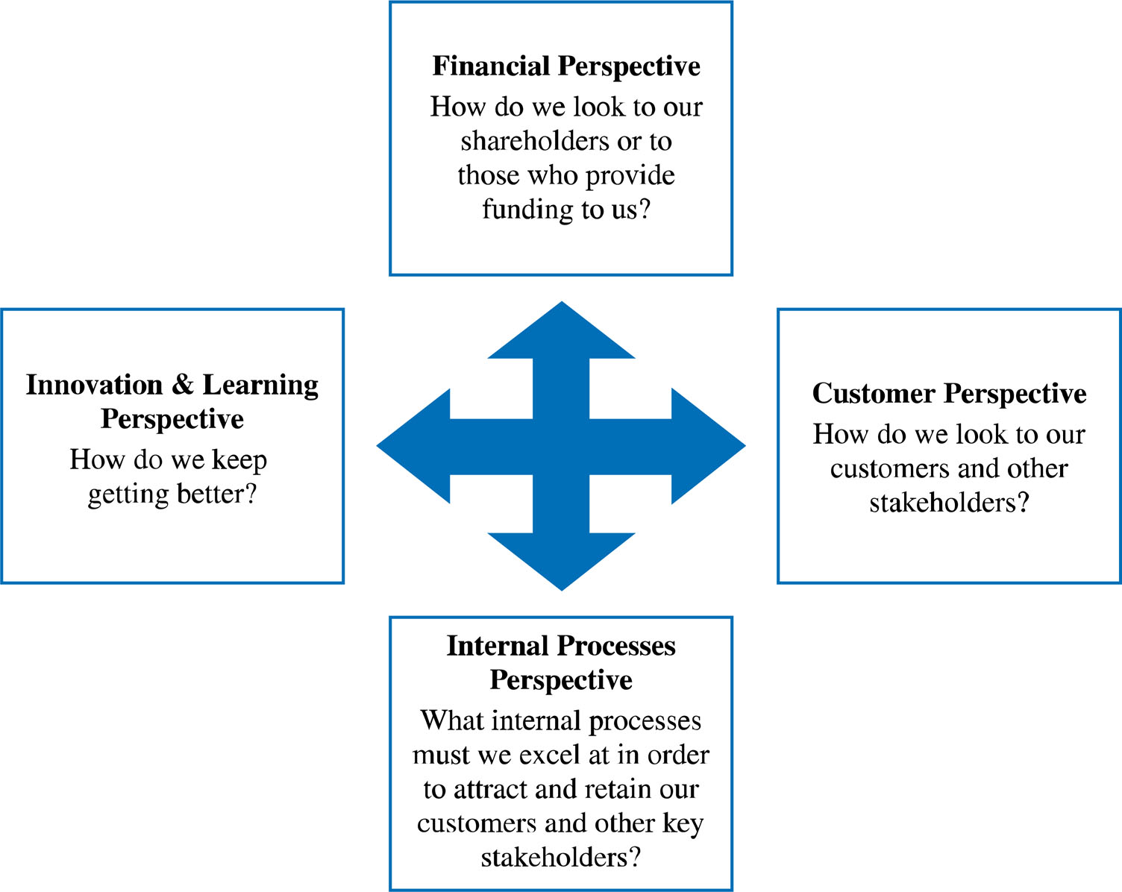
Balanced Scorecard Approach

Slide 40
Reasons Balanced Scorecard Approach Might Fail
Non-financial variables incorrectly identified as primary drivers
Metrics not properly defined
Goals for improvements negotiated not based on requirements
No systematic way to map high-level goals
Reliance on trial and error as a methodology
No quantitative linkage between non-financial and expected financial results

Slide 41
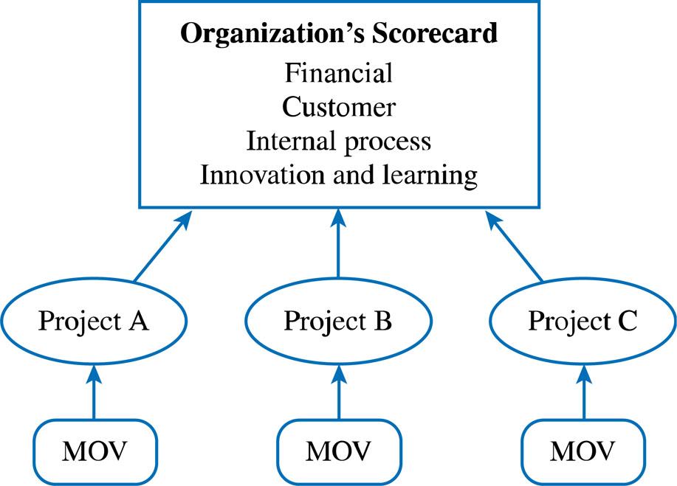
MOV and the Organization’s Scorecard

Slide 42
THANK YOU

