Slide 1
Analisis Proses Bisnis #4
Project Management Methodology

Slide 2

PROJECT MANAGEMENT PHILOSOPHY & MISSION
Notes:
Six Sigma is a philosophy of doing business with a focus on eliminating defects through fundamental process knowledge.
Its methods integrate principles of business, statistics, and engineering to achieve tangible results.
Six Sigma is a rigorous management discipline that systematically eliminates errors and improves the economics of business processes.
It culminates in a transformation to a data-driven, customer-driven, cost-reduction-driven culture.

Slide 3

PROJECT MANAGEMENT
Project management is both an art and a science.
The science consists of a systematic approach using a standard methodology.
The art consists of “soft skills” including leadership, trust, credibility, problem solving, and managing expectations.
The art of project management is developed through experience, practice, and intuition.
Notes:
The processes presented in this document illustrate the science of project management.

Slide 4

WHAT IS PROJECT …?

Slide 5



A Project has Boundaries, So Its Extent is Defined
Projects must have a clear, definitive goal or objective
The objective is; specific, identifiable, and can be accomplished
Many efforts are called “projects” but actually become programs as they extend indefinitely and cover broader, less specific business objectives

Slide 6




A Project is A One-time Effort, Usually Requiring Finite Resources
Finite
Finite

Slide 7
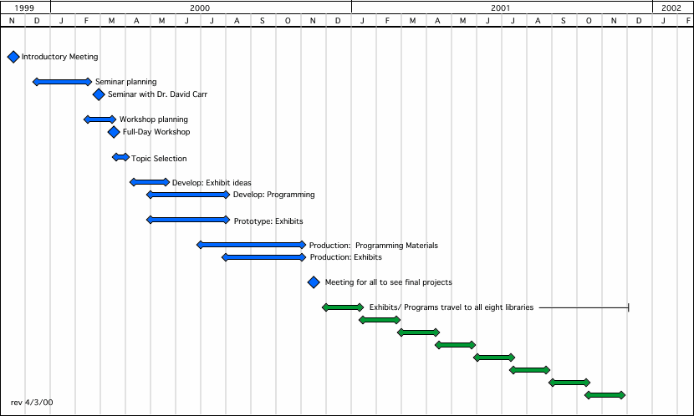
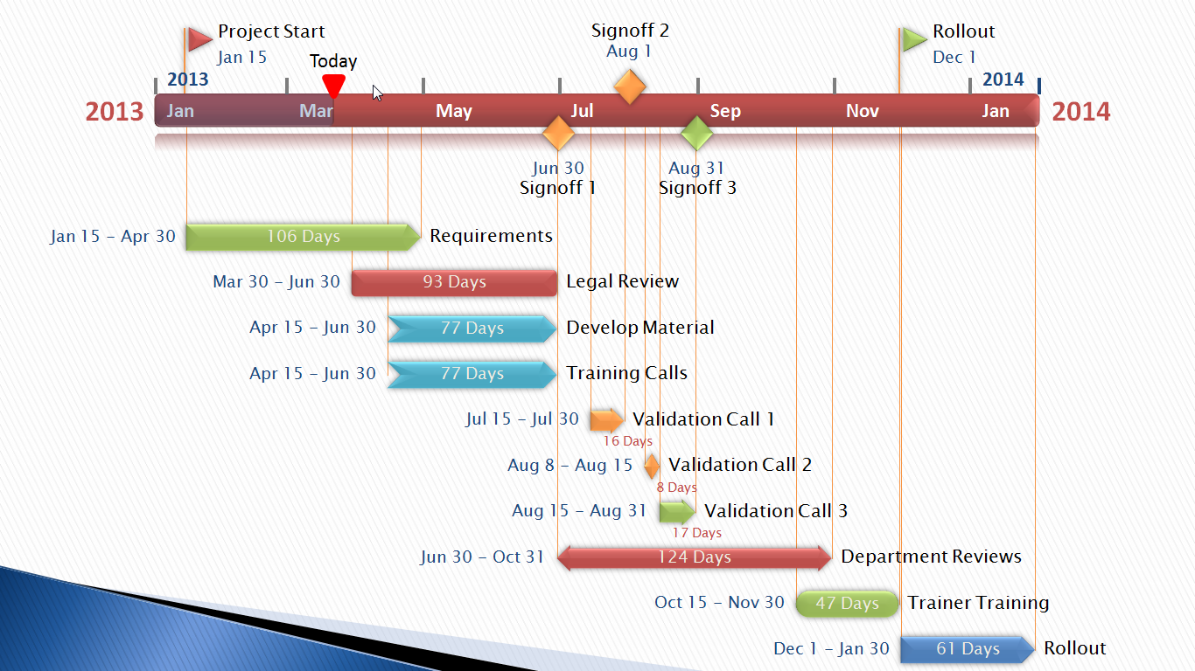
There are Distinct Start and
End Dates for Projects
Specific Time Frame

Slide 8



You know when you have reached the end of the project
OR

Slide 9
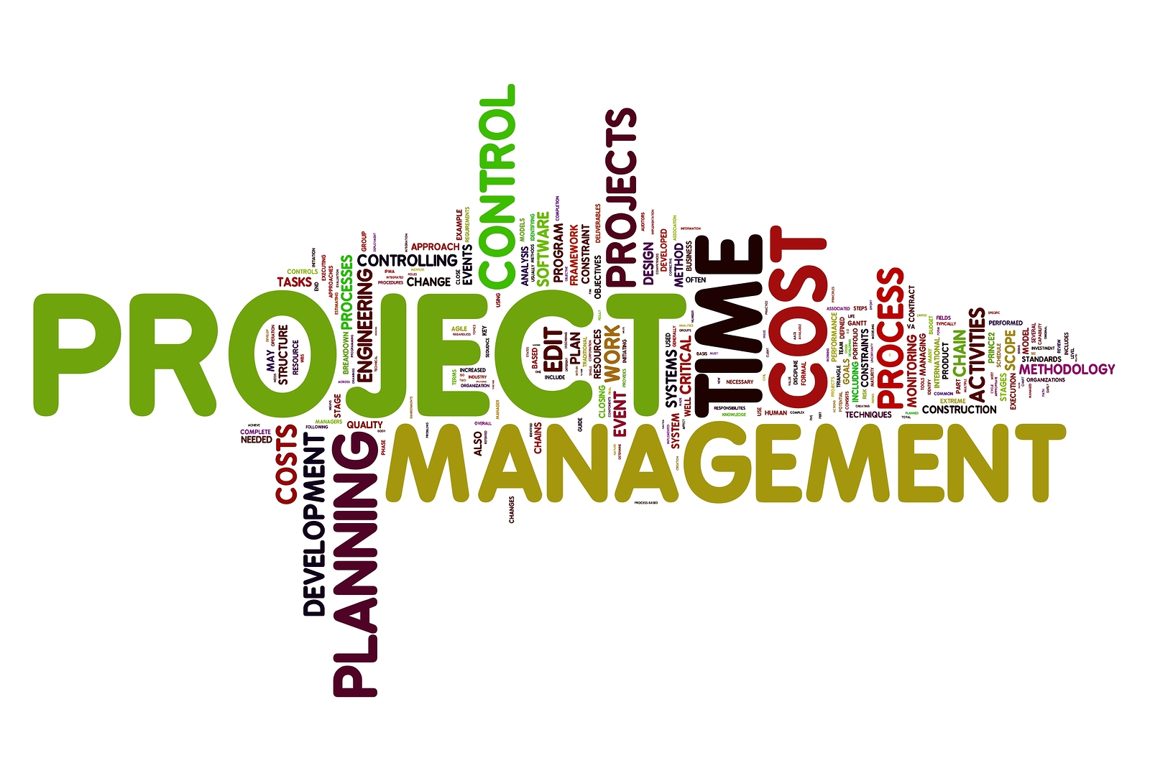
What is Project Management …?

Slide 10

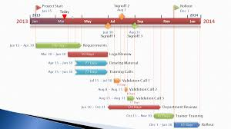

Project Management is the process of achieving project objectives (schedule, budget and performance) through a set of activities that start and end at certain points in time and produce quantifiable and qualifiable deliverables

Slide 11
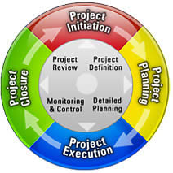
PROJECT LIFE CYCLE
Notes:
Six Sigma is a philosophy of doing business with a focus on eliminating defects through fundamental process knowledge.
Its methods integrate principles of business, statistics, and engineering to achieve tangible results.
Six Sigma is a rigorous management discipline that systematically eliminates errors and improves the economics of business processes.
It culminates in a transformation to a data-driven, customer-driven, cost-reduction-driven culture.

Slide 12





Project Management Body of Knowledge (PMBOK) Phase;
Initiation
Planning
Executing
Controlling

Slide 13

Project Management Body of Knowledge
- Initiation Phase;

Slide 14
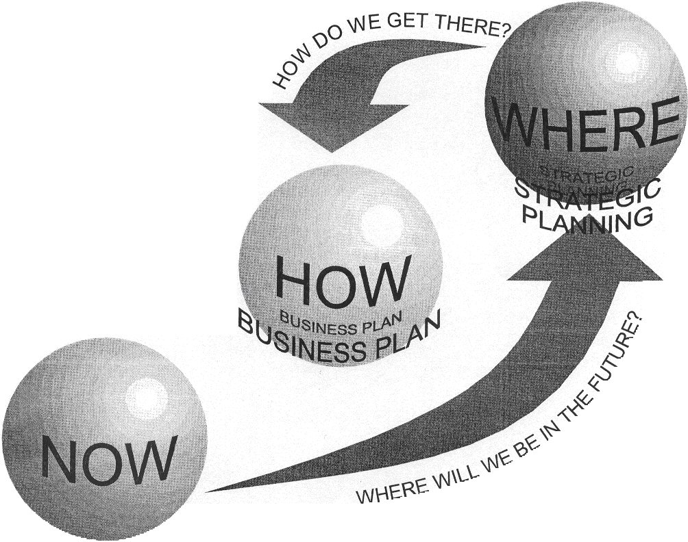
Project Management Body of Knowledge
- Planning Phase;

Slide 15
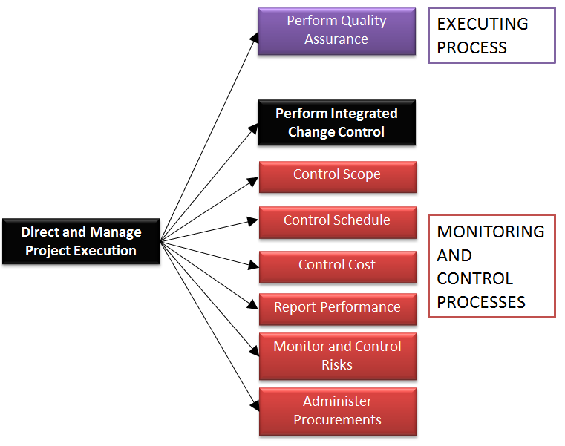
Project Management Body of Knowledge
- Executing & Controlling Phase;

Slide 16
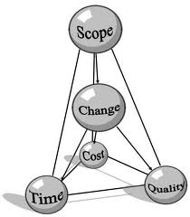

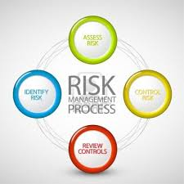



9 Major Knowledge Areas of Project Management Expertise Required;
Scope Management
Communications Management
Risk Management
Human Resources Management
Integration Management
Quality Management
Cost Management
Time Management
Procurement Management

Slide 17
PROJECT MANAGEMENT KNOWLEDGE AREAS

Slide 18
Project Management Lifecycle & Knowledge Areas
LIFECYCLE. KNOWLEDGE . |  | PRELIMINARY |  | INITIATION |  | PLANNIG |  | EXECUTING & CONTROLLING |  | CLOSING
Integration Management
Scope Management
Communications Management
Risk Management
Human Resource Management
Procurement Management
Time Management
Cost Management
Quality Management

Slide 19
COMMUNICATIONS MANAGEMENT PROCESS
“Project Communications Management includes the Processes required to ensure timely and appropriate generation, collection, dissemination, storage,and ultimate disposition of project information.”

Slide 20
A RISK MANAGEMENT PROCESS
“Project Risk Management includes the processes concerned with identifying, analyzing, and responding to project risk.”

Slide 21
HUMAN RESOURCES MANAGEMENT PROCESS
“Project Human Resource Management includes the Processes required to make the most effective use of people involved with the Project.”

Slide 22
PROCUREMENT MANAGEMENT PROCESS
“Project Procurement Management includes the processes requiredto acquire goods and services from outside theperforming organization.”

Slide 23
TIME MANAGEMENT PROCESS
“Project Time Management includes the processes required to ensure timely completion of the project.”

Slide 24
COST MANAGEMENT PROCESS
“Project Cost Management includes the processes required to ensure that the project is completed within the approved budget.”

Slide 25
QUALITY MANAGEMENT PROCESS
“Project Quality Management includes the Processes required to ensure the Project will satisfy the needs for which it was undertaken.”

Slide 26
ISSUES MANAGEMENT PROCESS
“Project Issues Management includes the Processes required to identify, resolve, and control in a timely manner factors which could influence the overall scope, time, cost, risk, and quality of the project.”

Slide 27
CHANGE MANAGEMENT PROCESS
“Project Change Management includes the processes required to control changes to the project scope”

Slide 28
THAT’S ALL
See You Next Session

Slide 29
REFERENSI
Project Management Methodology Guidebook, Chandler - Arizona, 2010

