Slide 1
Analisis Proses Bisnis #3
Pengenalan Six Sigma dan Siklus Manajemen Proses

Slide 2

SIX SIGMA
Notes:
Six Sigma is a philosophy of doing business with a focus on eliminating defects through fundamental process knowledge.
Its methods integrate principles of business, statistics, and engineering to achieve tangible results.
Six Sigma is a rigorous management discipline that systematically eliminates errors and improves the economics of business processes.
It culminates in a transformation to a data-driven, customer-driven, cost-reduction-driven culture.

Slide 3
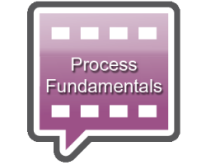


SIX SIGMA
Six Sigma is a philosophy of doing business with a focus on eliminating defects through fundamental process knowledge.
Its methods integrate principles of business, statistics, and engineering to achieve tangible results.
+
+

Slide 4
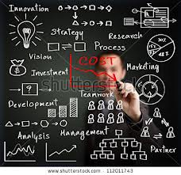




SIX SIGMA
Six Sigma is a rigorous management discipline that systematically eliminates errors
and improves the economics of
business processes.
It culminates in a transformation to a data-driven, customer-driven, cost-reduction-driven culture.
COST

Slide 5
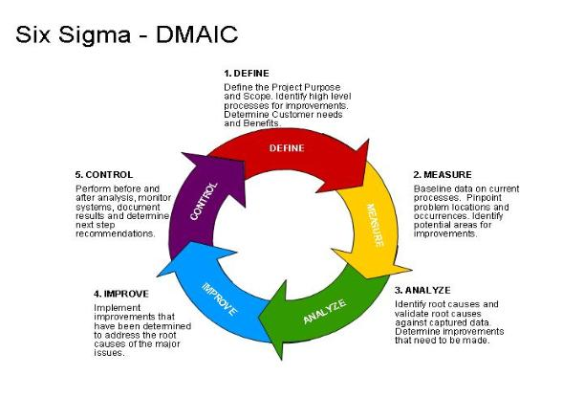
SIX SIGMA – LIFE CYCLE

Slide 6
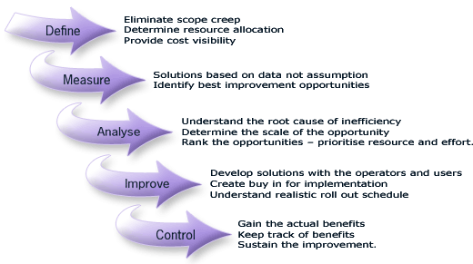
SIX SIGMA – CONTENT & IT’S FUNCTION

Slide 7
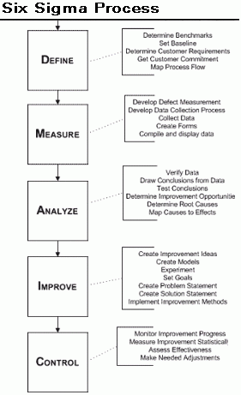

Slide 9
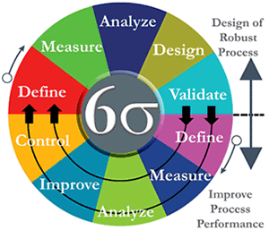
SIX SIGMA – DESIGN OF ROBUST PROCESS and IMPROVE PROCESS PERFORMANCE

Slide 10
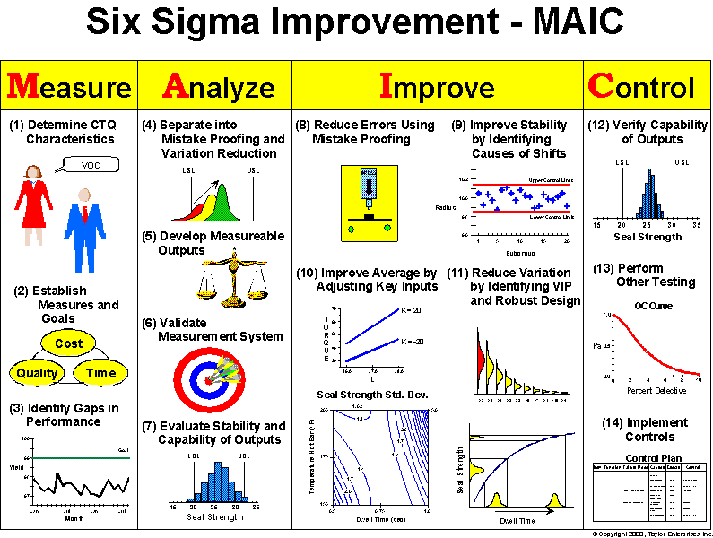
SIX SIGMA - EXAMPLE

Slide 11
PROCESS MANAGEMENT CYCLE

Slide 12
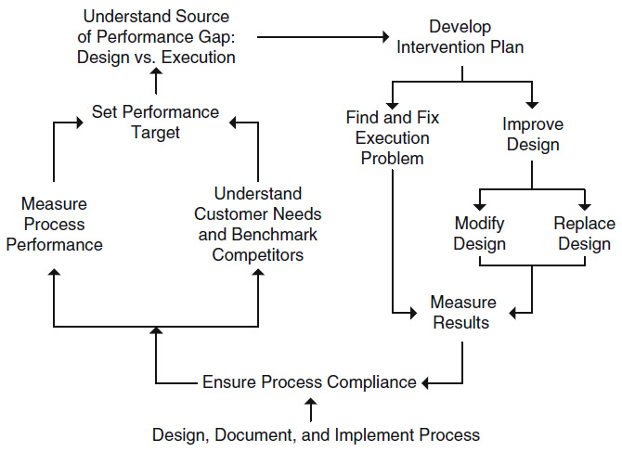
ESSENTIAL PROCESS MANAGEMENT CYCLE
Start from Here
Notes:
Reff: Springer-PeterBernus-Handbook on Business Process Management 1 (page 5-)
What is Business Process Management - Process Management Cycle
1. It begins at the bottom, with the creation of a formal process.
2. Once a process is in place, it needs to be managed on an ongoing basis.
3. Its performance, in terms of critical metrics that relate to;
3.a. customer needs, and
3.b. company requirements,
needs to be compared to the targets for these metrics.
4. Set Performance Target based on:
4.a. customer expectations, competitor benchmarks,
4.b. enterprise needs and other resources.
5. Understand Source of Performance Gap: Design vs. Execution
If performance does not meet targets, the reason for this shortcoming must be determined.
Broadly speaking, processes fail to meet performance requirements either because of faulty design or faulty execution.
6. Develop InterventionPlan;
fault in execution;
then the particular root cause (such as inadequate training, or insufficient resources, or faulty equipment, or any of a host of other possibilities) must be determined.
Doing so is a challenging undertaking, because of the large number of possible root causes; as a rule, however, once the root cause has been found, it is easy to fix.
fault in design;
they are easy to find (being indicated by consistently inadequate performance) but hard to fix (requiring a wholesale rethinking of the structure of the process).
Once the appropriate intervention has been chosen and implemented, the results are assessed, and the entire cycle begins again.
This cycle is derived from Deming’s PDCA cycle (Plan Do Check Act) (Deming 1986), with the addition of the attention to process design.

Slide 13
ESSENTIAL PROCESS MANAGEMENT CYCLE
2
1
It begins at the bottom, with the creation of a formal process.
Once a process is in place, it needs to be managed on an ongoing basis.
1
2

Slide 14
ESSENTIAL PROCESS MANAGEMENT CYCLE
Its performance, in terms of critical metrics that relate to;
customer needs, and company requirements,
needs to be compared to the targets for these metrics.
4
3a
3a
3b
3b
Set Performance Target based on:
4.a. customer expectations, competitor benchmarks,
4.b. enterprise needs and other resources.
4

Slide 15
ESSENTIAL PROCESS MANAGEMENT CYCLE
5
Understand Source of Performance Gap: Design vs. Execution
If performance does not meet targets, the reason for this shortcoming must be determined.
5
Broadly speaking, processes fail to meet performance requirements either because of faulty design or faulty execution.

Slide 16
ESSENTIAL PROCESS MANAGEMENT CYCLE
Develop InterventionPlan;
6a. fault in execution;
then the particular root cause (such as inadequate training, or insufficient resources, or faulty equipment, or any of a host of other possibilities) must be determined.
Find the root causes.
Doing so is a challenging undertaking, because of the large number of possible root causes; as a rule, however, once the root cause has been found, it is easy to fix the executin problem.
6
6
7a
7b
7a
6b. fault in design;
they are easy to find (being indicated by consistently inadequate performance) but hard to fix
(requiring a wholesale rethinking of the structure of the process).
Then it needs to improve design by;
Modify Design, or
Replace Design.
7b

Slide 17
ESSENTIAL PROCESS MANAGEMENT CYCLE
Plan
Action
Do
Check
Check
Do
Action Plan
Plan
Once the appropriate intervention has been chosen and implemented, the results are assessed, and the entire cycle begins again.
This cycle is derived from Deming’s PDCA cycle (Plan Do Check Act) (Deming 1986), with the addition of the attention to process design.

Slide 18
THAT’S ALL
See You Next Session

Slide 19
REFERENSI
PeterBernus, Handbook on Business Process Management 1, Springer, 2010
“What is Business Process Management - Process Management Cycle”

