Slide 1
Week 11
Knowledge Discovery Systems & Data Mining :
Systems That Create Knowledge

Slide 2
Chapter Objectives
• To explain how knowledge is discovered
• To describe knowledge discovery systems, including design considerations, and how they rely on mechanisms and technologies
• To explain data mining (DM) technologies
• To discuss the role of DM in customer relationship management

Slide 3
Knowledge Synthesis through Socialization
To discover tacit knowledge
Socialization enables the discovery of tacit knowledge through joint activities
  between masters and apprentices
  between researchers at an academic conference

Slide 4
Knowledge Discovery from Data – Data Mining
Another name for Knowledge Discovery in Databases is data mining (DM).
Data mining systems have made a significant contribution in scientific fields for years.
The recent proliferation of e-commerce applications, providing reams of hard data ready for analysis, presents us with an excellent opportunity to make profitable use of data mining.
Becerra-Fernandez, et al. -- Knowledge Management 1/e -- © 2004 Prentice Hall

Slide 5
Data Mining Techniques Applications
Marketing – Predictive DM techniques, like artificial neural networks (ANN), have been used for target marketing including market segmentation.
Direct marketing – customers are likely to respond to new products based on their previous consumer behavior.
Retail – DM methods have likewise been used for sales forecasting.
Market basket analysis – uncover which products are likely to be purchased together.
Becerra-Fernandez, et al. -- Knowledge Management 1/e -- © 2004 Prentice Hall

Slide 6
Data Mining Techniques Applications
Banking – Trading and financial forecasting are used to determine derivative securities pricing, futures price forecasting, and stock performance.
Insurance – DM techniques have been used for segmenting customer groups to determine premium pricing and predict claim frequencies.
Telecommunications – Predictive DM techniques have been used to attempt to reduce churn, and to predict when customers will attrition to a competitor.
Operations management – Neural network techniques have been used for planning and scheduling, project management, and quality control.
Becerra-Fernandez, et al. -- Knowledge Management 1/e -- © 2004 Prentice Hall

Slide 7
Designing the Knowledge Discovery System – CRISP DM
Business Understanding – To obtain the highest benefit from data mining, there must be a clear statement of the business objectives.
Data Understanding – Knowing the data well can permit the designer to tailor the algorithm or tools used for data mining to his/her specific problem.
Data Preparation – Data selection, variable construction and transformation, integration, and formatting
Model building and validation – Building an accurate model is a trial and error process. The process often requires the data mining specialist to iteratively try several options, until the best model emerges.
Evaluation and interpretation – Once the model is determined, the validation dataset is fed through the model.
Deployment – Involves implementing the ‘live’ model within an organization to aid the decision making process.
Becerra-Fernandez, et al. -- Knowledge Management 1/e -- © 2004 Prentice Hall

Slide 8
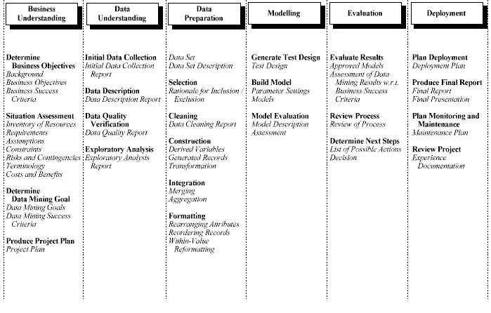
CRISP-DM Data Mining Process Methodology
Becerra-Fernandez, et al. -- Knowledge Management 1/e -- © 2004 Prentice Hall

Slide 9
1. Business Understanding process
Determine Business objectives – To obtain the highest benefit from data mining, there must be a clear statement of the business objectives .
Situation Assessment – The majority of the people in a marketing campaign who receive a target mail, do not purchase the product .
Determine Data Mining Goal – Identifying the most likely prospective buyers from the sample, and targeting the direct mail to those customers, could save the organization significant costs.
Produce Project Plan – This step also includes the specification of a project plan for the DM study .

Slide 10
2. Data Understanding process
Data collection – Defines the data sources for the study, including the use of external public data, and proprietary databases.
Data description – Describes the contents of each file or table. Some of the important items in this report are: number of fields (columns) and percent of records missing.
Data quality and verification – Define if any data can be eliminated because of irrelevance or lack of quality.
Exploratory Analysis of the Data – Use to develop a hypothesis of the problem to be studied, and to identify the fields that are likely to be the best predictors.

Slide 11
3. Data Preparation process
Selection – Requires the selection of the predictor variables and the sample set.
Construction and transformation of variables – Often, new variables must be constructed to build effective models.
Data integration – The dataset for the data mining study may reside on multiple databases, which would need to be consolidated into one database.
Formatting – Involves the reordering and reformatting of the data fields, as required by the DM model.

Slide 12
4. Model building and Validation process
Generate Test Design – Building an accurate model is a trial and error process. The data mining specialist iteratively try several options, until the best model emerges.
Build Model – Different algorithms could be tried with the same dataset. Results are compared to see which model yields the best results.
Model Evaluation – In constructing a model, a subset of the data is usually set-aside for validation purposes. The validation data set is used to calculate the accuracy of predictive qualities of the model.

Slide 13
5. Evaluation and Interpretation process
Evaluate Results – Once the model is determined, the predicted results are compared with the actual results in the validation dataset.
Review Process – Verify the accuracy of the process.
Determine Next Steps – List of possible actions decision.

Slide 14
6. Deployment process
Plan Deployment – This step involves implementing the ‘live’ model within an organization to aid the decision making process..
Produce Final Report – Write a final report.
Plan Monitoring and Maintenance – Monitor how well the model predicts the outcomes, and the benefits that this brings to the organization.
Review Project – Experience, and documentation.

Slide 15
The Iterative Nature of the KDD process

Slide 16
Data Mining Techniques
Predictive Techniques
  Classification: Data mining techniques in this category serve to classify the discrete outcome variable.
  Prediction or Estimation: DM techniques in this category predict a continuous outcome (as opposed to classification techniques that predict discrete outcomes).
Descriptive Techniques
  Affinity or association: Data mining techniques in this category serve to find items closely associated in the data set.
  Clustering: DM techniques in this category aim to create clusters of input objects, rather than an outcome variable.

Slide 17
Web Data Mining - Types
Web structure mining – Examines how the Web documents are structured, and attempts to discover the model underlying the link structures of the Web.
  Intra-page structure mining evaluates the arrangement of the various HTML or XML tags within a page
  Inter-page structure refers to hyper-links connecting one page to another.
Web usage mining (Clickstream Analysis) – Involves the identification of patterns in user navigation through Web pages in a domain.
  Processing, Pattern analysis, and Pattern discovery
Web content mining – Used to discover what a Web page is about and how to uncover new knowledge from it.

Slide 18
Data Mining and Customer Relationship Management
CRM is the mechanisms and technologies used to manage the interactions between a company and its customers.
The data mining prediction model is used to calculate a score: a numeric value assigned to each record in the database to indicate the probability that the customer represented by that record will behave in a specific manner.

Slide 19
Barriers to the use of DM
Two of the most significant barriers that prevented the earlier deployment of knowledge discovery in the business relate to:
  Lack of data to support the analysis
  Limited computing power to perform the mathematical calculations required by the DM algorithms.
Becerra-Fernandez, et al. -- Knowledge Management 1/e -- © 2004 Prentice Hall

Slide 20
Conclusions
In this Chapter we:
Described knowledge discovery systems, including design considerations, and how they rely on mechanisms and technologies
Learned how knowledge is discovered:
  Through through socialization with other knowledgeable persons
  Trough DM by finding interesting patterns in observations, typically embodied in explicit data
Explained data mining (DM) technologies
Discussed the role of DM in customer relationship management
Becerra-Fernandez, et al. -- Knowledge Management 1/e -- © 2004 Prentice Hall

Slide 21
Week 11
Knowledge Discovery Systems:
Systems That Create Knowledge

