Slide 1
The Modern Organization in the
Global, Web-Based Environment
Chapter 1
Introduction to Information System

Slide 2
Learning Objectives
Differentiate among data, information,and knowledge.
Differentiate between information technology architecture and information technology infrastructure.
Describe the global business environment and the new information technology infrastructure.
Discuss the relationships among business pressures, organizational responses, and information systems.
Notes:
Tujuan Pembelajaran:
Memahami perbedaan data, informasi, dan pengetahuan.
Memahami perbedaan arsitektur teknologi informasi dan infrastruktur teknologi informasi.
Mampu mendeskripsikan lingkungan bisnis global dan infrastruktur teknologi informasi yang baru.
Mendiskusikan hubungan antara tekanan bisnis, tanggapan/kesiapan perusahaan, dan sistem informasi.

Slide 3
Topic
Information Systems: Consept and Definitions
The Global, Web – Based Platform
Business Pressures, Organizational Responses, and IT Support
Why Are Information Systems Important to Me?

Slide 4
Fakta
Latar Belakang

Slide 5

Facebook
Jerman (22,119,300)
Prancis (23,545,120)
Filipina (27,033,680)
United Kingdom (30,470,400)
Turki (30,963,100)
Meksiko (30,990,480)
Brazil (35,158,740)
India (41,399,720
Indonesia (41,777,240)
Amerika Serikat (157,418,920)

Slide 6
Penggunaan Facebook
  Indonesia (41,777,240)
  Total penduduk 241.452.952
  41% berusia 18-24 tahun
  21% berusia 25-34 tahun
  60% pengguna pria
  Pengguna internet di Indonesia mencapai 45 juta jiwa, 48% mengakses internet dari ponsel

Slide 7
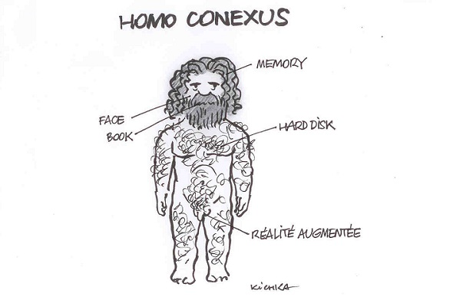
Homo Conexus
You are the most connected generation in history
You practice continuous computing
You are surrounded by a personal, movable information network

Slide 8
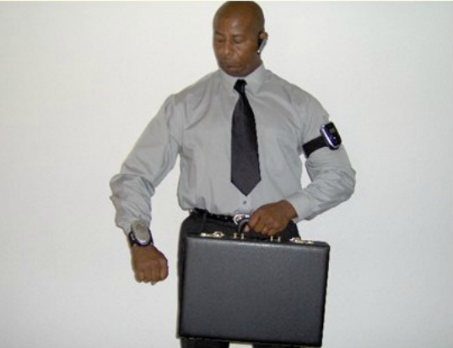
Personal movable information network
And... Laptop in briefcase!

Slide 9
Information Systems:
Concepts & Definitions

Slide 10
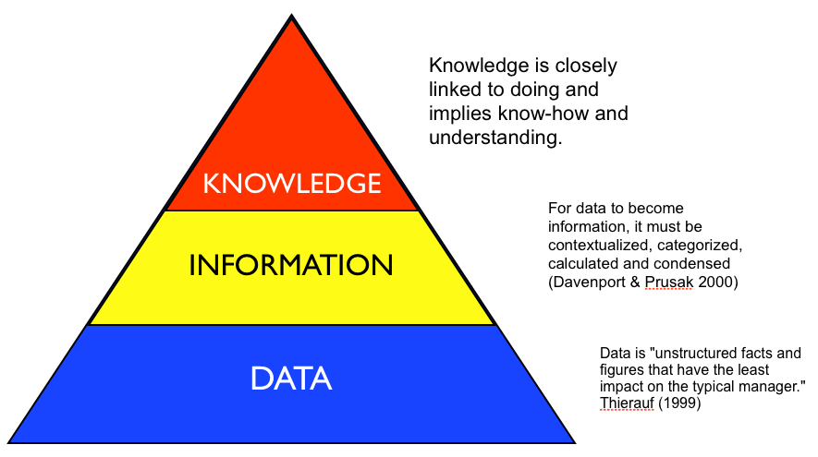
Information Systems:
Concepts & Definitions
Data item
Information
Knowledge
Notes:
Data items refer to an elementary description of things, events, activities, and transactions
that are recorded, classified, and stored but not organized to convey any specific meaning. Data items
can be numbers, letters, figures, sounds, or images. Examples of data items are a student grade in a
class and the number of hours an employee worked in a certain week.
Information refers to data that have been organized so that they have meaning and value to
the recipient. For example, a grade point average (GPA) is data, but a student’s name coupled with
his or her GPA is information. The recipient interprets the meaning and draws conclusions and implications
from the information.
Knowledge consists of data and/or information that have been organized and processed to
convey understanding, experience, accumulated learning, and expertise as they apply to a current
business problem. For example, a company recruiting at your school has found over time that students
with grade point averages over 3.0 have had the most success in its management program. Based
on its experience, that company may decide to interview only those students with GPAs over 3.0.
Organizational knowledge, which reflects the experience and expertise of many people, has great
value to all employees.

Slide 11
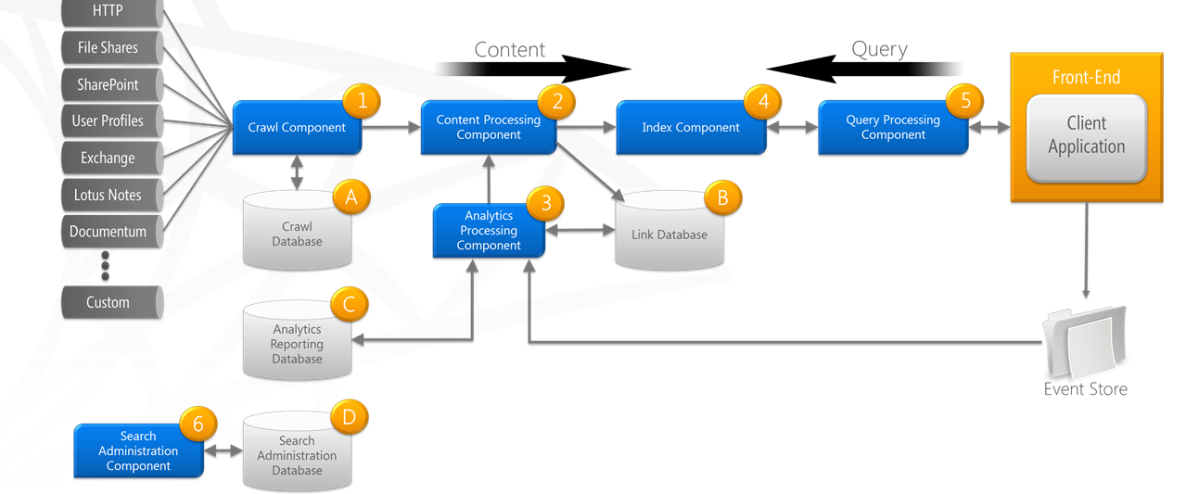
Information Systems:
Concepts & Definitions
Information Technology Architecture
Information Technology Infrastructure
Notes:
An organization’s information technology (IT) architecture is a high-level map or plan of the information
assets in an organization. It is both a guide for current operations and a blueprint for future
directions. The IT architecture integrates the entire organization’s business needs for information,
the IT infrastructure (discussed in the next section), and all applications. The IT architecture is analogous
to the architecture of a house. An architectural plan describes how the house is to be constructed,
including how the various components of the house, such as the plumbing and electrical
systems, are to be integrated. Similarly, the IT architecture shows how all aspects of information technology
in an organization fit together.
An organization’s information technology (IT) infrastructure consists of the physical facilities, IT
components, IT services, and IT personnel that support the entire organization (see Figure 1.3). Starting
from the bottom of Figure 1.3, we see that IT components are the computer hardware, software,
and communications technologies that provide the foundation for all of an organization’s information
systems. As we move up the pyramid, we see that IT personnel use IT components to produce
IT services, which include data management, systems development, and security concerns.

Slide 12
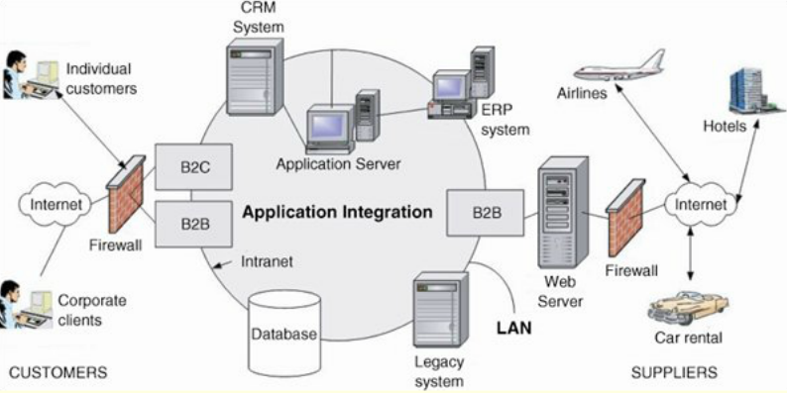
IT Architecture of Online Travel Agency

Slide 13
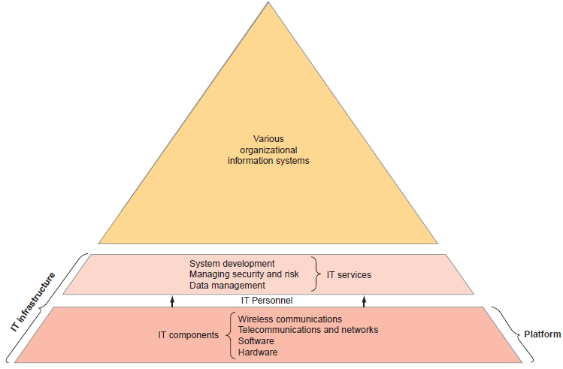
IT Components, IT Platform, IT Services, and IT Infrastructure

Slide 14
The Global, Web–Based Platform
Best represented by the Internet and the World Wide Web
Enables us to connect, compute, communicate, collaborate, and compete everywhere and anytime
Operates without regard to geography, time, distance, and language

Slide 15
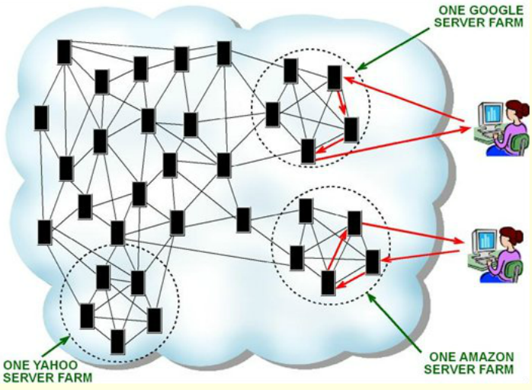
The Global, Web–Based Platform

Slide 16

The Stages of Globalization
(From Thomas Friedman in The World is Flat)
Globalization 1.0 (1492 – 1800)
Globalization 2.0 (1800 – 2000)
Globalization 3.0 (2000 – present)
Notes:
The focus of Globalization 1.0 was on countries, the focus of Globalization 2.0 was on companies,
and the focus of Globalization 3.0 is on groups and individuals.

Slide 17

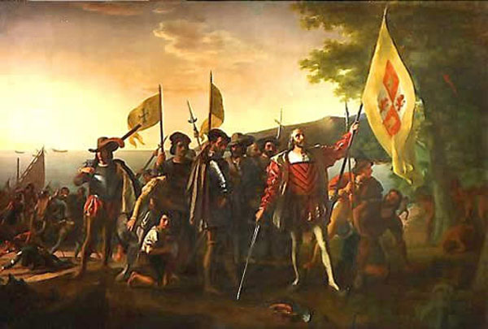
Globalization 1.0
Christopher Columbus

Slide 18
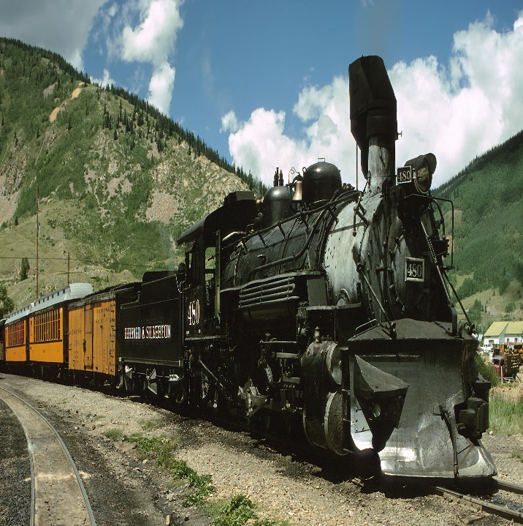
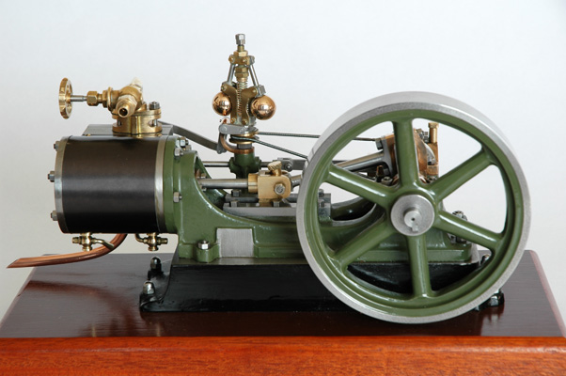
Globalization 2.0 (first half)
Steam Engine
Railroad

Slide 19
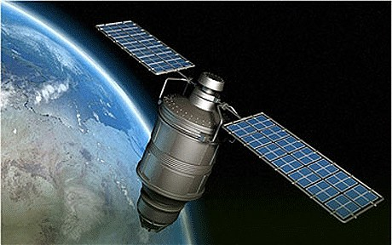
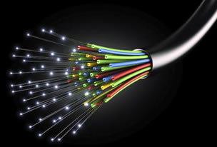
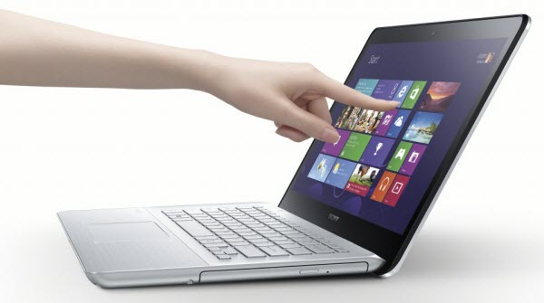

Globalization 2.0 (second half)

Slide 20

Globalization 3.0
3.0
2.0
1.0

Slide 21
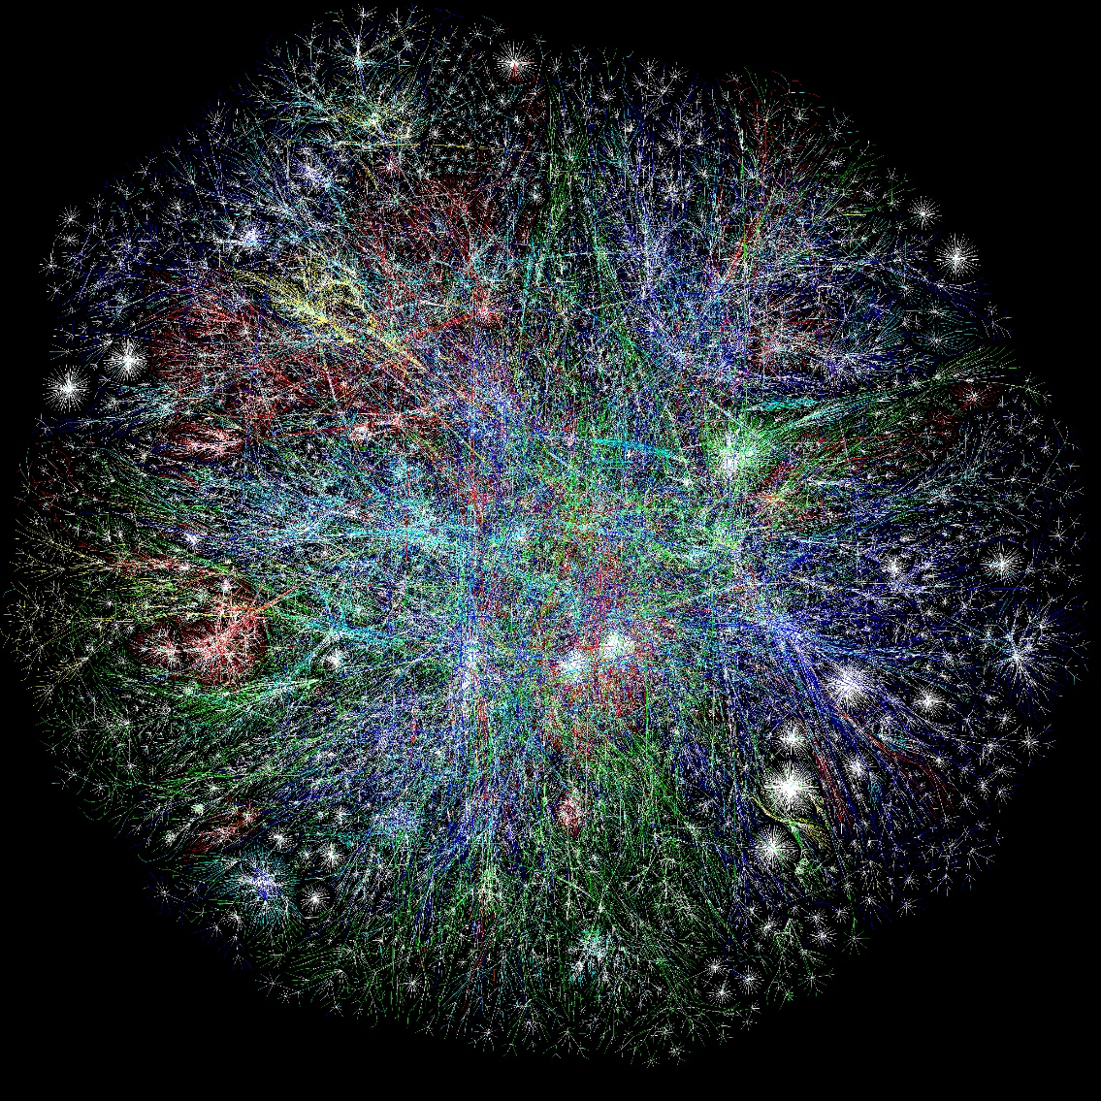
Globalization 3.0
schematic map of the internet
You are here

Slide 22
Friedman’s Ten Flatteners
Fall of the Berlin Wall on November 9, 1989
Netscape goes public on August 9, 1995
Development of work-flow software
Uploading
Outsourcing
Offshoring
Supply chaining
Insourcing
Informing
The steroids
Notes:
Fall of the Berlin Wall on November 9, 1989
• Shifted the world toward free-market economies and away from centrally planned economies.
• Led to eventual rise of the European Union and early thinking about the world as a single, global market.
Netscape goes public on August 9, 1995
• Popularized the Internet and the World Wide Web.
Development of work-flow software
• Enabled computer applications to work with one another without human intervention.
• Enabled faster, closer collaboration and coordination among employees, regardless of their location.
Uploading
• Empowered everybody to create content and put it on the Web.
• Led the transition from a passive approach to content to an active, participatory, collaborative approach.
Outsourcing
• Contracting with an outside company to perform a specific function that your company was doing itself and then integrating their work back into your operation; for example, moving customer call centers to India.
Offshoring
• Relocating an entire operation, or just certain tasks, to another country; for example, moving an entire manufacturing operation to China.
Supply chaining
• Technological revolution led to the creation of networks comprised of companies, their suppliers, and their customers, all of whom could collaborate and share information for increased efficiency.
Insourcing
• Delegating operations or jobs within a business to another company that specializes in those operations; for example, Dell hires FedEx to “take over” Dell’s logistics process.
Informing
• Your ability to search for information, best illustrated by search engines.
The steroids (computing, instant messaging and file sharing, wireless technologies, voice over Internet Protocol, videoconferencing, and computer graphics)
• Technologies that amplify the other flatteners.
• Enable all forms of computing and collaboration to be digital, mobile, and personal.

Slide 23
Business Pressures, Organizational Responses, and IT Support
Business Pressures
  Market Pressures
    Global Economy and Strong Competition
    The Changing Nature of the Workforce
    Powerful Customers
  Technology Pressures
    Technological Innovation and Obsolescence
    Information Overload
  Societal/Political/Legal Pressures
    Social Responsibility
    Compliance with Government Regulations and Deregulation
    Protection Against Terrorist Attacks
    Ethical Issues

Slide 24
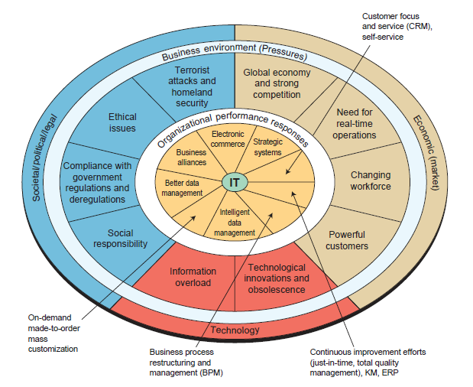
Business Pressures, Organizational Responses, and IT Support

Slide 25
Business Pressures, Organizational Responses, and IT Support
Organizational Responses
  Strategic Systems
  Customer Focus
  Make-to-Order and Mass Customization
    Bodymetrics

Slide 26
Why Are Information Systems Important to Me?
Information Systems and Information Technologies are Integral to Your Lives
Information Systems Offers Career Opportunities
Information Systems are used by all functional areas in an organization
Notes:
There are many examples of the ways in which information systems and technologies are embedded
in your lives. For example, think of all you can do online:
• Register for classes
• Take classes, and not just classes from your university
• Access class syllabi, information, PowerPoints, and lectures
• Research class papers and presentations
• Conduct banking
• Pay your bills
• Research, shop, and buy products from companies or other people
• Sell your “stuff ”
• Search for, and apply for, jobs
• Make your travel reservations (hotel, airline, rental car)

Slide 27
Misinformation about Information Systems Career Opportunities
Myth #1: There are no computing jobs
Myth #2: There will be no IT jobs when I graduate
Myth #3: All IT-related jobs are moving offshore
Myth #4: Computing and IT salaries are low due to cheaper overseas labor
Notes:
Myth #1: There are no computing jobs. Despite the recession, as of March 2009, the IT job
market was quite strong. For example, the technology jobs site Dice (www.dice.com) listed
56,000 technology jobs that month.
Myth #2: There will be no IT jobs when I graduate. In fact, the four fastest-growing U.S. jobs
that require a bachelor’s degree from 2002 through 2012 are IT-related. They are: (1) computer
engineers, (2) management/computer information systems staffers, (3) computer and
information systems managers, and (4) technical support specialists. Note that numbers (2)
and (3) refer to MIS majors in colleges of business.
Myth #3: All IT-related jobs are moving offshore. In fact, some IT jobs are offshored (that is,
sourced to areas with lower-cost labor), but the more highly skilled IT jobs will typically not
be offshored (see IT’s About Business 1.3). In addition, jobs related to a company’s core
competencies or projects will typically not be offshored, and neither will jobs requiring close
business-to-customer contact.
Myth #4: Computing and IT salaries are low due to cheaper overseas labor. In fact, graduates
who major in management information systems typically command among the highest
starting salaries of any business major.

Slide 28


Slide 29
Referensi
Introduction to Information Systems, Third Edition, R. Kelly Rainer Jr, Casey G. Cegielski, Wiley

Slide 30


