Slide 1
Rekayasa Perangkat Lunak (Software Engineering)
Pertemuan 3
Model Proses Rekayasa Perangkat Lunak
Eriya, S.Kom, MT

Slide 2
Kompetensi
Setelah selesai perkuliahan mahasiswa diharapkan mampu :
Menguraikan Proses Software Engineering
Menjelaskan Model-model Proses RPL

Slide 3
Proses Rekayasa Perangkat Lunak
Communication
  Project initiation
  Requirement gathering
Planning
Modeling
  Analysis of requirements
  Design
Construction
  Code generation
  Testing
Deployment
  delivery
  Support
  Feedback

Slide 4
Model –Model Proses RPL
  Model Waterfall
  Model Prototyping
  Model Spiral
  Model RAD (Rapid Application Development)
  Model RUP (Rational Unified Process)

Slide 5
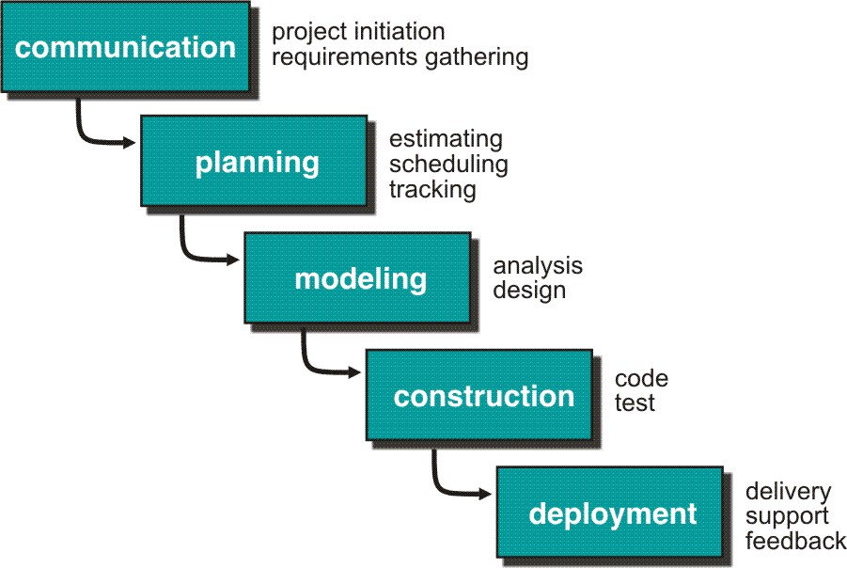
Model Waterfall

Slide 6
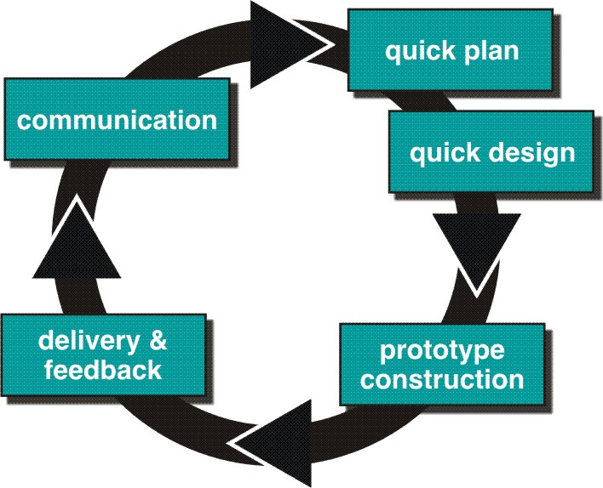
Model Prototyping

Slide 7
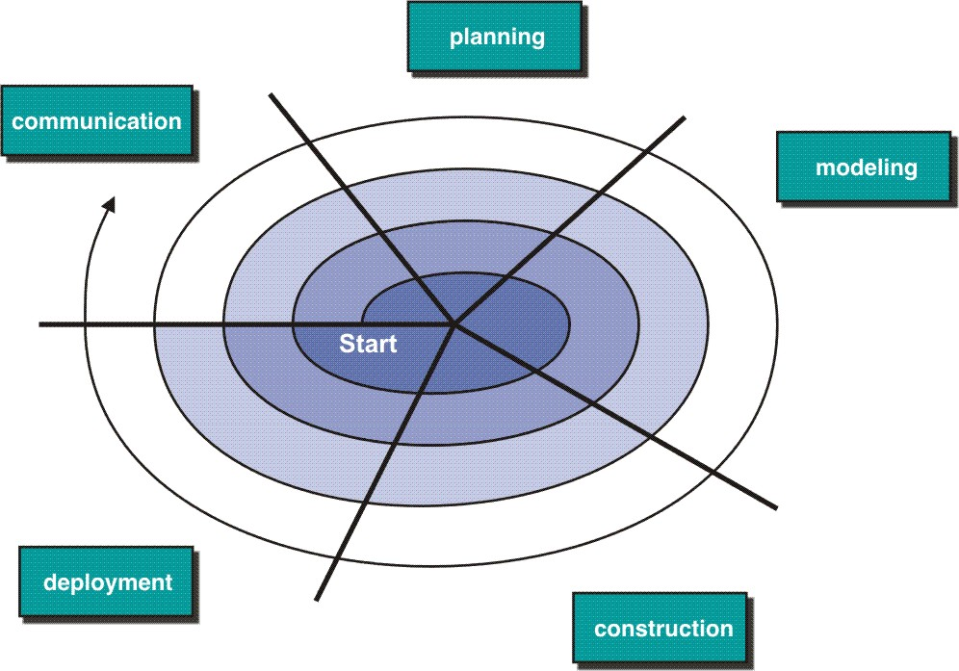
Model Spiral

Slide 8
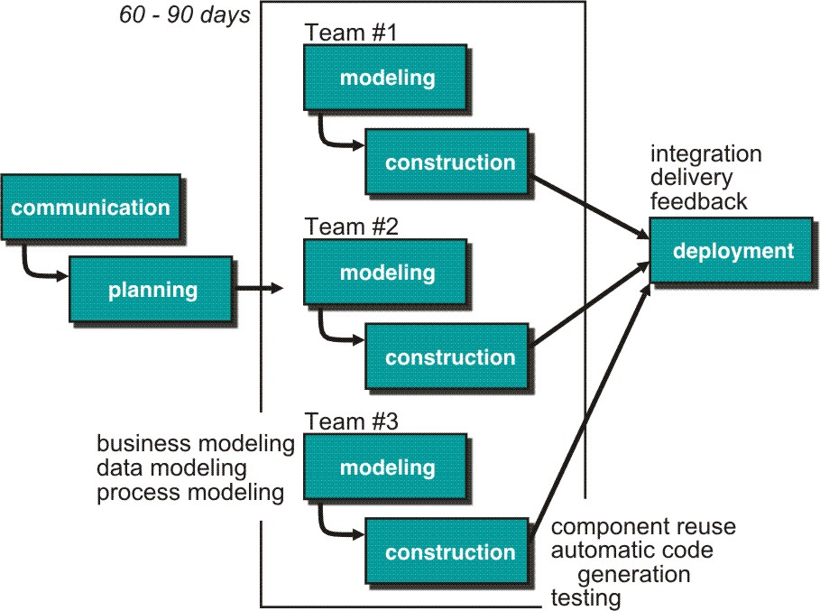
Model RAD

Slide 9
Model RUP

Slide 10
Presentasi Kelompok

Slide 11
See You Next

