Slide 1
Information technology for customer relationship management
Customer Relationship Management

Slide 2
Introduction
Our definition of CRM stresses that CRM is a technology-enabled approach to management of the customer interface.
In this chapter we present an introduction to CRM technologies.
Subsequent chapter take a more detailed look at sales-force automation, marketing automation and service automation.
Notes:
Definisi kita tentang CRM menekankan bahwa CRM adalah teknologi-enabled pendekatan manajemen antarmuka pelanggan.
Dalam bab ini kami menyajikan pengantar teknologi CRM.
Bab berikutnya kita lihat lebih rinci pada otomatisasi penjualan-force, otomatisasi pemasaran dan otomatisasi layanan.

Slide 3
Origins of CRM technology
The building blocks of today’s CRM technology have been in place foe several decades. CRM has evolved from a range of standalone technologies including call centres, sales-force Automation systems and customer information files (CIF), some of which date back to the 1970s and earlier.
In the late 1980s, several organizations attempted to consolidate some of these disparate technologies. For example, the CIF that was central to many insurance companies and banks started to be seen as a source of marketing information, rather than a basic record of a customer’s accounts.
Notes:
Blok bangunan teknologi CRM saat ini telah berada di tempat musuh beberapa dekade. CRM telah berkembang dari berbagai teknologi mandiri termasuk call center, sistem otomatisasi penjualan-force dan file informasi pelanggan (CIF), beberapa di antaranya tanggal kembali ke tahun 1970-an dan sebelumnya.
Pada akhir 1980-an, beberapa organisasi berusaha untuk mengkonsolidasikan beberapa teknologi yang berbeda. Misalnya, CIF yang merupakan perusahaan asuransi yang bank mulai dilihat sebagai sumber informasi pemasaran, daripada catatan dasar rekening pelanggan.

Slide 4
Call centres began being used for outbound calls such as up-
selling customer rather than just responding to inbound service
calls. The customer started to be recognized as a single entity
across all customer-facing departments, leading to the idea of a
‘single view of the customer’ (Figure 13.1), whereby appropriate
customer-related data is made available at all customer touch
points and channels.
Notes:
Call center mulai digunakan untuk panggilan keluar seperti up
menjual pelanggan bukan hanya menanggapi layanan masuk
panggilan. Pelanggan mulai diakui sebagai satu kesatuan
di semua departemen pelanggan-menghadap, yang mengarah ke gagasan
'tampilan tunggal pelanggan' (Gambar 13.1), dimana sesuai
-pelanggan terkait data yang dibuat tersedia di semua sentuhan pelanggan
poin dan saluran.

Slide 5
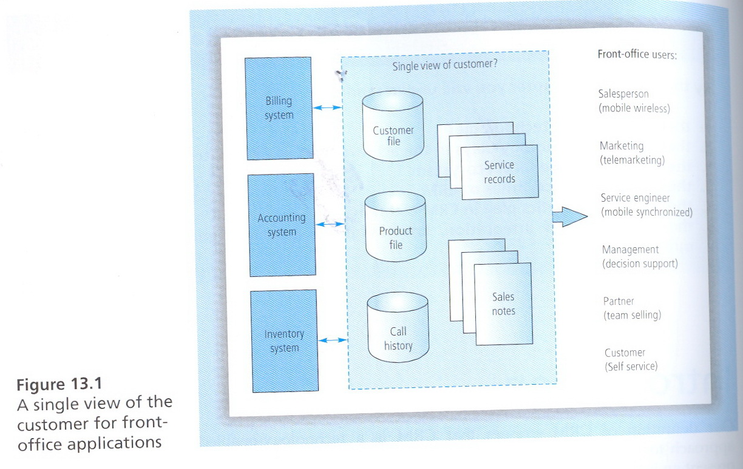

Slide 6
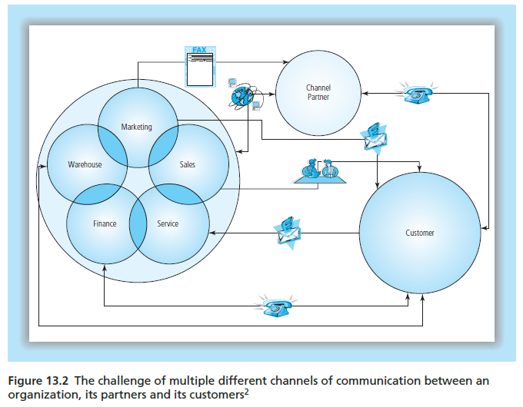

Slide 7
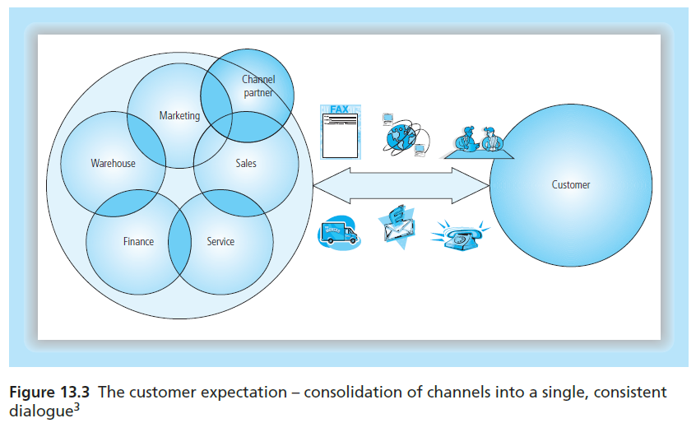

Slide 8
Web technologies also had a significant role to play in the
Emergence of a broader conception of CRM, encompassing user
Other than direct employees (customers, channel partner,
investors). Web browsers (Figure 13.4) allowed these external users to access and share information, without requiring specialist software to be installed on their own computers, leading to extra-enterprise CRM functions such as customer self-service, partner portals and investor portals.

Slide 9
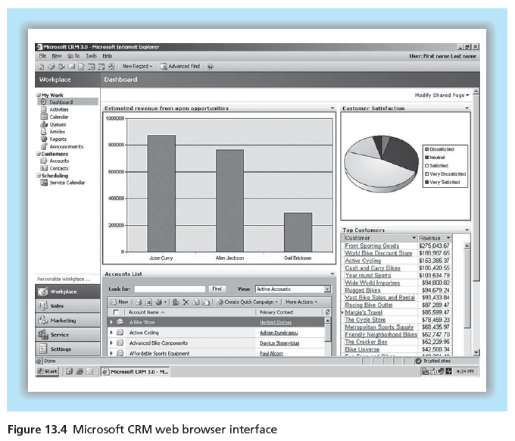

Slide 10
CRM analysis
CRM analysis has grown in importance over the last few year.
Organizations have realized that merely streamlining the
customer-facing operations in sales, marketing and service is not enough. Analytics can provide a deeper insight into the
customer, reflected in key CRM metrics such as customer value,
Satisfaction and propensity to churn. The three levels of analysis
in today’s CRM systems, in increasing order of complexity, are
standard reporting , online analytical processing (OLAP) and data mining.

Slide 11
1. Standard reporting
Reporting is an essential element of an effective CRM system.
The foundation of CRM is an understanding and differentiation
of customer something which depends on good customer-
related information. Reporting can take the form of simple lists
of information, such as key accounts and annual revenues, to
more sophisticated reports on certain performance metrics.
Reporting can be standardized(predefined), or query-based
(adhoc).

Slide 12
Standardized reports are typically integrated into CRM
software applications, but often need customization to suit the
needs of the organization. Some customization of the report can
be done when it is run, for example in selecting options or
filtering criteria, but the end result is limited to what the report
designers envisaged. For some industries, legislation or
regulators require certain report to be produced. Sometime
customized report s can be expensive to design and create.
Query-based reporting, on the other hand, presents the user
with a selection of tools which can then be used to construct a
specific report. This is far more flexible, but it is not suitable for
regular, standard operational level reporting due to the time
required to set up the request for information. This is a powerful
tool in the right hands, as it allows specific reports to be
requested.

Slide 13
2. Online analytical processing(OLAP)
As the requirement for analysis grows, the standard transactional
information in the core CRM database may no be structured to
deliver the best results; for this reason, online analytical processing
(OLAP) has become an essential part of CRM.
OLAP technologies allow warehoused data to be subjected to
analysis and ac hoc inquiry. Warehoused data is stored in one
or more star schema, allowing user to drill down into graphs and
tables to analyses how a certain figure or problem may have arisen.
The format used is known as a star schema because it contains a
central fact table surrounded by several dimension tables, giving it
the appearance of a star, as in Figure 13.13

Slide 14
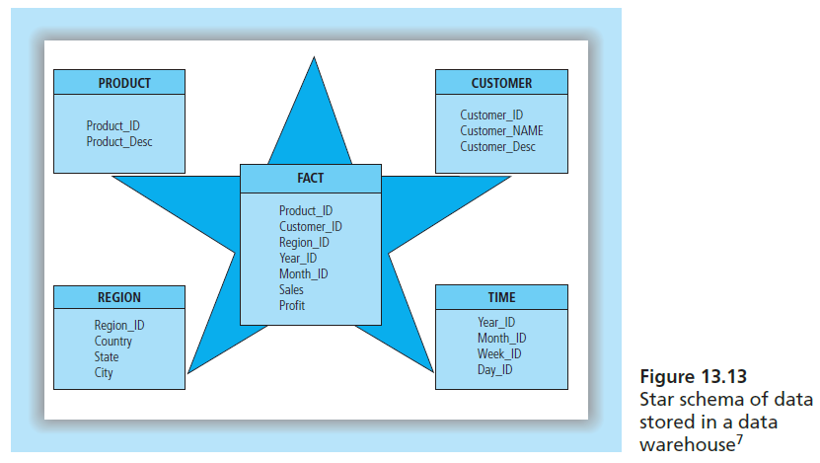

Slide 15
OLAP is valuable to a range of CRM users who have different
types of questions to ask of the warehoused data (Figure 13.14).
Salespeople can analyses their territory to determine revenue
and profitability by customer. Service people can analyses call
response rates and times. Partner managers can analyses the
performance of partner by comparing marketing fund approvals
to partner-generated revenues.

Slide 16
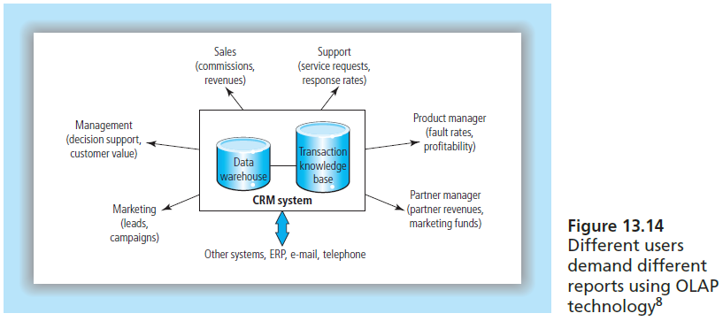

Slide 17
Mobile and wireless solutions
Many businesses operate in the field, with salespeople,
merchandisers, meter readers and service technicians making
calls on customers’ home or business premises. These people
play a significant role in delivering excellent customer
experience.
They can only do this if they are equipped with the latest
customer, product and technical information. The two main
technologies that are available to support such mobile
professionals are mobile (synchronized) and wireless (online)

Slide 18
Mobile synchronized solutions include a handheld or laptop device with a small resident database that is a replica of the particular individual’s information in the main CRM system.
These system are not online or permanently connected, but they rely on sophisticated synchronized technology to filter the Information that flows onto the relatively small handheld device.
The user synchronized the device when convenient.

Slide 19
Wireless online solution also typically involve a handheld
device. However, this device is connected to the main system
using a wireless data connection. Technologies such as 3G, 4G
and Bluetooth have enhanced the wireless online experience.
Modern wireless broadband networks have largely removed the
cost and Performance penalties that were previously associated
with wireless online solutions, especially in metropolitan areas.
The advantage of being continuously online, with all the ensuing
benefits of data currency, may offset the relatively minor
connection and data cost differences.

