Slide 1
Developing, managing and using customer-related databases
Customer Relationship Management

Slide 2
Learning Objectives
By the end of this chapter, you will understand:
the central role of customer-related databases to the successful delivery of CRM outcomes
the importance of high quality data to CRM performance
the issues that need to be considered in developing a customer-related database
what data integration contributes to CRM performance
the purpose of a data warehouse and data mart
how data access can be obtained by CRM users
the data protection and privacy issues that concern public policy makers.

Slide 3
What is a customer-related database?
Why? Companies typically do not have a single customer database; instead, they have a number of customer-related database. Large organizations, such as financial service companies, can have 20 or more customer systems, each with a separate database.
customer-related database might be maintained in a number of functional areas – sales, marketing, service, logistics and account- each serving different operational purposes. Customer-related database can have a current, past or future perspective, focusing upon current opportunities, historic sale or potential opportunities.
Notes:
Mengapa? Perusahaan biasanya tidak memiliki database pelanggan tunggal; sebaliknya, mereka memiliki sejumlah database pelanggan terkait. Organisasi besar, seperti perusahaan jasa keuangan, dapat memiliki 20 atau lebih sistem pelanggan, masing-masing dengan database yang terpisah.
database pelanggan terkait mungkin dipertahankan dalam sejumlah bidang fungsional - penjualan, pemasaran, layanan, logistik dan akuntabilitas masing-masing melayani tujuan operasional yang berbeda. Database pelanggan terkait dapat memiliki perspektif saat ini, masa lalu atau masa, berfokus pada peluang saat ini, penjualan bersejarah atau peluang potensial.

Slide 4
Developing a customer-related database
Most databases share a common structure of files, records and fields (also called table, rows and columns). Files (table) Hold information on a single topic such as customers, products, transactions or service requests. Each file (table) contains a number of records (rows). Each record (row) contains a number of elements of data. These elements are arranged in common sets of fields (columns) across the table. The modern customer-related database therefore resembles a spreadsheet.
There are six major step in building a customer-related database, as shown in Figure 4.1

Slide 5
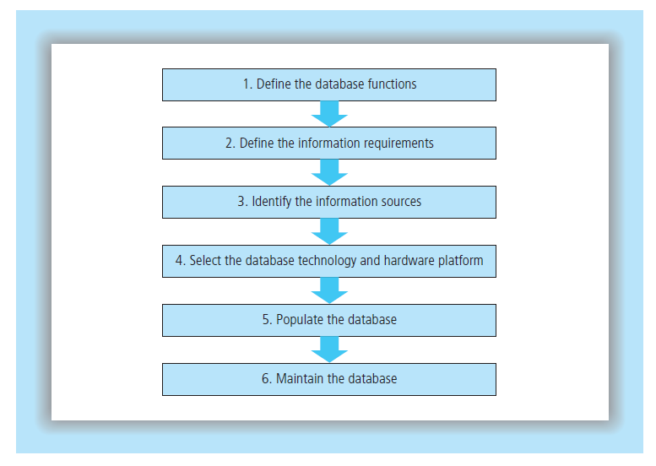

Slide 6
1. Define the database functions
Database support the four form of CRM:
Strategic CRM needs data about markets, market offerings, customers, channels, competitors, performance and potential to be able to identify which customers to target for customer acquisition, retention and development, and what to offer them.
Collaborative CRM implementations generally use the operational and analytical as described below, so that partner in distribution channels can align their efforts to serve end-customers.

Slide 7
1. Define the database functions
Operational CRM users customer-related data to help in the everyday running of the business. For example:
  a telecoms customer service representative needs to access a customer record when she receives a telephone query
  a hotel receptionist needs access to a guest’s history so that she can reserve the preferred type of room – smoking or non-smoking, standard or de-luxe
  a salesperson needs to check a customer’s payment history to find out whether the account has reached the maximum credit limit.

Slide 8
1. Define the database functions
Analytical CRM uses customer-related data to support the marketing, sale and service decision that aim to enhance the value created for and from customer. For example:
  the telecoms company might want to target a retention offer to customer who are signaling an intention to switch to a different supplier
  the hotel company might want to promote a weekend break to customers who have indicated their complete delight in previous customer satisfaction surveys
  a sale manager might want to compute his sales representatives’ customer profitability, given the level of service that is begin provided.

Slide 9
2. Define the information requirements
The people best placed to answer the question ‘what information is needed?’ are those who interact or communicate with customer for sales, marketing and service purposes, and those who have to make strategic CRM decisions.
A direct marketer who is panning an e-mail campaign might want to know open and click-through rates, broken down by target market. She would also want to know e-mail address, e-mail preferences (html or plain text), and preferred solution (first name? Mr.? Ms.?). Operational and analytical needs like these help define the contents of customer-related database.

Slide 10
Customer information fields
Most CRM software has predefined fields in different modules, Whether for sales, marketing or service application. For example, in a sales application, a number of field (columns) of information about customers are common:
Contact data: name ,invoice addresses, phone number, fax number, e-mail addresses, street addresses etc.
Contact history: Who, When, about what, with what outcome
Transactional history: What has the customer bought and when? What has been offered to the customer, but not been purchased?

Slide 11
Customer information fields
Current pipeline: What opportunities are currently in the sales pipeline? What is the value of each opportunity? What is the probability of closing? Some CRM applications enable sales people to allocate red, amber or green signals to opportunities according to the probability of success.
Opportunities: Whereas ‘transactional history’ looks backwards, ‘opportunity’ looks forwards. This is opportunities that have not yet been opened or discussed are recorded.
Products: What product does the customer have? When were these products purchased, and when are they due for renewal? Have there been any service issues related to these products in the past?
Communication preferences: What is the preferred medium of communication – mail, telephone, e-mail, face-to-face, etc.?
Amazon.com, for example, allows customer to opt to receive
e-mail about six different types of content:

Slide 12
3. Identify the information sources
Information for customer-related database can be sourced internally or externally. Prior to building the databaseit is necessary audit to the company to find out what data variable. Internal data are the foundation of most CRM programmes, though the amount of information available about customer depends on the degree of contact that the company has with the customer. Some company sell through partners, agents and distributors and have little knowledge about the demand chain beyond their immediate contact.

Slide 13
4. Select the database technology and hardware platform
Customer-related data can be stored in a database in a number of different ways.
  hierarchical
  network
  Relational

Slide 14
4. Select the database technology and hardware platform
Hierarchical and network database were the most common form between the 1960s and 1980s. The hierarchical database is the oldest form and not well suited to most CRM applications. You can imagine the hierarchical model as an organization chart or family tree, in which a child can have only one parent can have one parent, but a parent can have many children.

Slide 15
4. Select the database technology and hardware platform
Relational database are now the standard architecture for CRM Applications (see Figure 4.3)

Slide 16
4. Select the database technology and hardware platform
The choice of hardware platform is influenced by several conditions:
  The size of the database. Even standard desktop PCs are capable of storing huge amounts of customer data. However, they are not designed for this data to be shared easily between several users.
  Existing technology. Most companies will already have technology that lends itself to database applications.
  The number and location of users. Many CRM applications are Quite simple, but in an increasingly global marketplace the hardware may need very careful specification and periodic review. For example , the hardware might need to enable a geographically dispersed, multilingual, user group to access data foe both analytical and operational purposes

Slide 17
5. Populate the database
Having decided what information is needed and the database and hardware requirements, the next task is to obtain the data and enter it onto the database. CRM applications need data that are appropriately accurate.
One of the biggest issues with customer data is not so much incorrect data as missing data. Many organizations find it difficult to obtain even basic customer data, such as e-mail addresses and preferences. The main steps in ensuring that the database is populated with appropriately accurate data are as follows:
  ource the data
  verify the data
  validate the data
  de-duplicate the data
  merge and purge data from two or more source

Slide 18
6. Maintain the database
User with administrative rights can update records. Database updating and maintenance is also enabled by database query language. Common languages are SQL (Structured Query Language) and QBE (Query By Example). Maintenance queries available in SQL include UPDATE, INSERT and DELETE commands.

Slide 19


Slide 20
Referensi
Customer Relationship Management - Concepts and Technologies, Second edition, Francis Buttle

Slide 21


